Slide 1
Cascading Stylesheets
Information Systems 337
Prof. Harry Plantinga

Slide 2
Styling Web Sites
Web site problems:
How to make all the pages look similar?
How to change the look of all pages at once?
How to minimize time spent styling web pages?
Web architecture over the years:
Plain HTML with embedded styling
HTML with common CSS stylesheet
Server-side includes
Content management system

Slide 3
Separation of Style and Content
Why
Easy management of a large web site
Easier editing of HTML files
Smaller HTML files
How
Inline stylesheets
External stylesheets
HTML formatting considered evil?

Slide 4
Cascading Style Sheets
Put your formatting in one place and standardize
CSS 2 for web page formatting since 1998
CSS 3 in progress
Ways of using CSS:
Inline styles: style attribute
Document level: <style> stylesheet and class attribute
External: external stylesheet with <link>
<link rel="stylesheet" type="text/css" href="styles.css">

Slide 5
CSS in 337
I'm not going to exhaustively cover specific properties and uses. (Study a CSS reference book!)
I will cover some key concepts:
Overview of usage
Selectors
Cascading and inheritance
Box model
Positioning

Slide 6
How do I . . .
On IS 337 schedule page, how to
Give background colors to assignments, readings
Make months appear in different colors
Highlight cells on mouseover
Make the Calvin seal appear
Make the Calvin nameplate appear (and text disappear)

Slide 7
CSS Rules
/* A sample stylesheet */
@import url(base.css)
@media print { body { font-size:12pt; } }
h2 {
color: #666;
font-weight: bold;
}
Notes:
@ rules
media selectors
selector h2
declaration block { declarations }

Slide 8
CSS Selector Examples
h2 { text-align:center; }
h2, p { color: gray; }
h1 em { color:hotpink; }
quotation { color: red; font-size:90% }
.warn { color:maroon; font-weight:bold; }
p.warn { font-size: 110%; }
#first { margin-top: 12pt; }
h1 > strong { color:orchid; }
h1 + p { margin-top:0pt; }
h1 ~ p { margin-top:0pt; }
h1[class] { color:lemonchiffon; }
p[lang=“HE”] { color:fuchsia; }
*[title] { font-weight:bold; }
planet[moons=“1”] { font-weight:bold; } /* xml */
Notes:
contains: one of the class entries is "warning". Note that this doesn't make much sense; .warning would work. But you could do that for any attributed.
Child: >
Adjacent sibling: +
General sibling: ~
Contains: =~

Slide 9
CSS Selectors
Element type
h1, h2, h3
Class
h1.title, .title
ID
h1#title, #title
Attribute
p[lang=“fr”]

Slide 10
Combining Selectors
Descendant: whitespace
Child: >
Adjacent sibling: +
General sibling: ~

Slide 11
CSS Example 1
<style type="text/css">
body { font-size:150% }
p#p1 strong { color:red; }
p > strong { color:blue }
h1 ~ p { color:brown }
h1 + p { color:green }
ralph { text-decoration:underline }
</style>
<h1 class="chaptitle">Chapter 1. The Gargoyle</h1>
<p class="norm" id="p1">It was a <em>dark and <strong>really</strong> stormy</em> night.</p>
<p class="norm1" id="p2">The moon hung in the sky like a <em style="color:#aa0">lead balloon</em>,
just waiting for its <ralph>chance</ralph> to <strong>drop out of sight</strong>.</p>
[css1.html]
Notes:
Bonus question: what effect does <ralph> have on rendering? – Puts us into standards mode because of the XML syntax.

Slide 12
Pseudo-classes
:link (unvisited links)
:visited
a:visited { color:red }
:hover
:focus
:active
:lang
:first-child (any element that is the first child of its parent)
CSS3: many, e.g. :nth-child, :nth-of-type, :first-of-type, :empty, :enabled, :checked

Slide 13
Pseudo-elements
:before
[insert stuff before with content:stuff]
:after
:first-line
:first-letter
e.g. p:first-letter { font-size:200%; float:left }
::selection (CSS3)

Slide 14
CSS Example 2
<style type="text/css">
body { font-size:150% }
#p1:first-letter { font-size:150% }
em:hover, strong:hover { font-size:120% }
p:after {content:"..."}
</style>
<body>
<h1 class="chaptitle">The Gargoyle</h1>
<p class="norm" id="p1">It was a <em>dark and <strong>really</strong> stormy</em> night.</p>
<p class="norm1" id="p2">The moon hung in the sky like a <em style="color:#aa0">lead balloon</em>,
just waiting for its chance to <strong>drop out of sight. </strong></p>
[css2.html]

Slide 15
CSS Question 1
p strong { color:red; }

Slide 16
CSS Question 2
p, strong { color:red; }

Slide 17
CSS Question 3
p.norm { color:red; }

Slide 18
CSS Question 4
.norm { color:red; }

Slide 19
CSS Question 5
#p1 { color:red; }

Slide 20
CSS Question 6
#p1 em { color:red; }

Slide 21
CSS Question 7
h1 #p1 { color:red; }

Slide 22
CSS Question 8
p > em { color:red; }

Slide 23
CSS Question 9
h1 + p { color:red; }

Slide 24
CSS Question 10
h1 ~ p { color:red; }

Slide 25
CSS Question 11
*[id] { color:red; }

Slide 26
CSS Question 12
p {color:red;}
p {color:green; }

Slide 27
CSS Question 13
.norm {color:red;}
p {color:green; }

Slide 28
CSS Question 14
#p2 {color:red;}
.norm, .norm1 {color:green; }

Slide 29
CSS Question 15
p em {color:red;}
em {color:green; }

Slide 30
Cascading
Specificity: four values: 0,0,0,0
For every ID in the selector add 0,1,0,0
For every class, class attribute, or pseudo-class selector add 0,0,1,0
For every element or pseudo-element, add 0,0,0,1
Inline: add 1,0,0,0
Sort by first (left-most) value, then next, then next…
With equal specificity, the latest rule wins

Slide 31
CSS Example 3
<style type="text/css">
body { font-size:150% }
p em { color:purple }
p.norm { color:blue }
h1 + p { color: green }
p#p1 { color:yellow }
p#p1.norm { color:pink }
#p1 { color:red }
</style>
<body>
<h1 class="chaptitle">The Gargoyle</h1>
<p class="norm" id="p1">It was a <em>dark and <strong>really</strong> stormy</em> night.</p>
<p class="norm1" id="p2">The moon hung in the sky like a <em style="color:#aa0">lead balloon</em>,
just waiting for its chance to <strong>drop out of sight</strong>.</p>
[css3.html]

Slide 32
Inheritance
Most styles given to an element also apply to any elements it contains
<h1 style="color:blue">Hello <em>world!</em></h1>
Inherited values have no specificity
Older browsers (e.g. IE 6) do not implement inheritance correctly
Notes:
Examples of properties that don’t inherit: margin, float, width. In most cases common sense will tell you, but you can google it.

Slide 33
Origins and Importance
Importance:
p { font-size: 1em !important; }
Origins (lowest to highest priority)
declarations in user agent style sheets
normal declarations in user style sheets (e.g. Firefox's userChrome.css)
normal declarations in author style sheets
important declarations in user style sheets
important declarations in author style sheet

Slide 34
The Cascade
Step 1: find all declarations for an element
Step 2: sort by importance and origins
Step 3: sort ties by selector specificity
Step 4: Sort ties by declaration order. Last one wins!

Slide 35
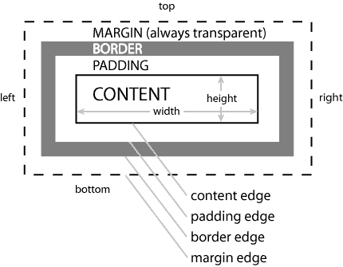
Box Model
Box model
offset
margin
border
padding
element
Try it!
image source: http://lesliefranke.com/files/reference/csscheatsheet.html

Slide 36
Float
Float: left, right, none
Clear: left, right, both, none
(Move below any left-, etc. floating element)
Notes:
go through the w3schools examples

Slide 37
Differences?
<img src="foo.png" style="float:left">
<p>This is some text. This is some more text. This is some more text. This is some more text. This is some more text. This is some more text. This is some more text. This is some more text. This is some more text. </p>
floatleft
<img src="foo.png" style="float:right">
<p>This is some text. This is some more text. This is some more text. This is some more text. This is some more text. This is some more text. This is some more text. This is some more text. This is some more text. </p>
floatright
<img src="foo.png" style="float:none">
<p>This is some text. This is some more text. This is some more text. This is some more text. This is some more text. This is some more text. This is some more text. This is some more text. This is some more text. </p>
floatnone

Slide 38
Float and Box Model
How will this render?
<div style=“width:200pt;”>
<div style=“width:100pt; float:left;”>
<h1>Hello!</h1>
</div>
<div style=“width:100pt; float:left”>
<h1>World!</h1>
</div>
</div>
Notes:
go through the w3schools examples

Slide 39
Float and Box Model
How will this render?
<div style=“width:200pt;”>
<div style=“width:100pt; float:left; margin:5pt;”>
<h1>Hello!</h1>
</div>
<div style=“width:100pt; float:left”>
<h1>World!</h1>
</div>
</div>
Notes:
go through the w3schools examples

Slide 40
Position
Position
static (normal)
relative (offset from normal position)
absolute (removed from flow; positioned with respect to containing block)
fixed (positioned with respect to browser window)
Notes:
go through the w3schools examples

Slide 41
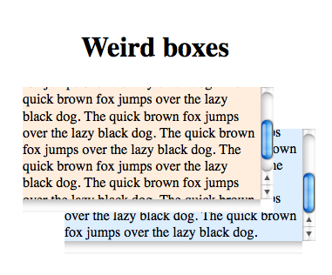
More positioning attributes
z-index: if items overlap, which one is in front?
clip: remove part of an item
cursor: specify the type of cursor to display
overflow: scroll or hidden

Slide 42
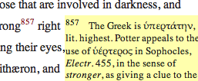
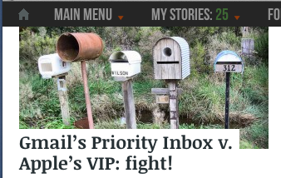
How Would I Make…
Drop-caps?
Marginal notes?
Icon before off-site links?
Stationary navbar?
Columns?
Notes:
Columns:
good design: column width=65x
tables
could float the sidebar.
fixed positioning
- can position the text before or after the main text
- float is highly dependent on source order

Slide 43
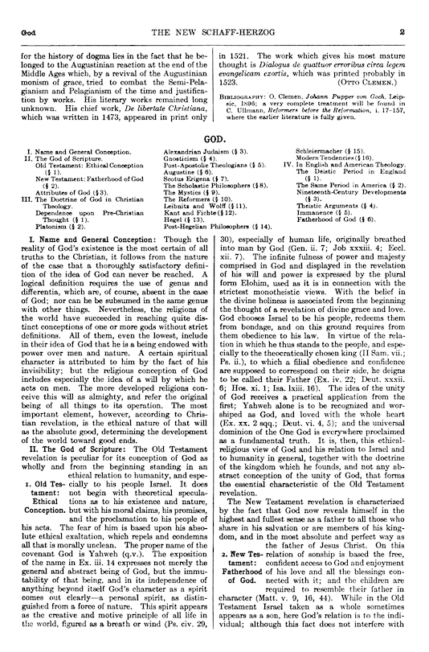

Slide 44
How would I make…

Slide 45
Columns in CSS
Tables
Easy
Works with old browsers
Can make equal-width columns
Drawbacks: harder to optimize for search engines? Rendering quirks on old browsers. Not semantic?
Web designers hate this approach
Floating div
Easy
Particular about order of content in html file
Changing content can cause columns to move around
CSS positioning
More control
Can place content in any order in page
Currently recommended approach
CSS3 columns
Use a nice template…

Slide 46
Creating Layouts
Write them yourself
Copy examples
Content management systems: Use pre-built templates
Dreamweaver: Use pre-built templates
Use a framework like Bootstrap with templates

Slide 47
CRAP Design
Contrast
Repetition
Alignment
Proximity
Notes:
Contrast: avoid elements that are nearly similar; if nearby, make them very different
Repetition: re-use visual elements throughout the page to give it unity (line thicknesses, colors, etc)
Alignment: visual connections with other elements. No random placements
Proximity: relationships shown by grouping.

Slide 48
The Mobile Web
How are mobile devices changing the Web?
Billions of smartphones, tablets (more than PCs)
Most with Webkit browsers
Differences?
Larger variety of screen sizes
No mouseover events
Need larger click targets
Fixed positioning is problematic on small, zoomable screens
Flash not available

Slide 49
Usability on All Devices
To make your Web page available to all
Separate your content from styling info
Responsive Design: resize appropriately from big to small; hide some things for cell phones
Don’t use flash—or offer alternatives
Use bigger click targets, no fixed positioning, don't require hover or mouseover events

Slide 50
Mobile First
Mobile traffic is greater than desktop traffic in some cases
Some design for mobile first, with desktop access as the afterthought

Slide 51
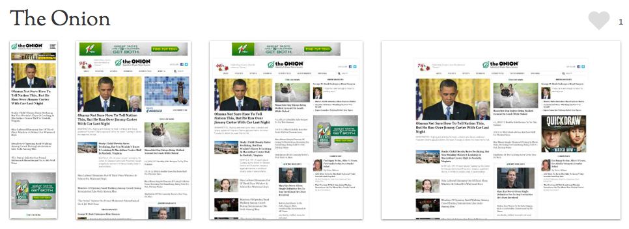
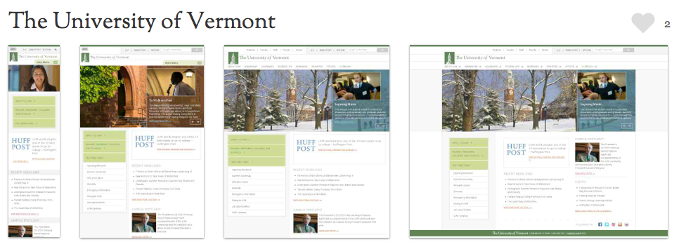

Slide 52
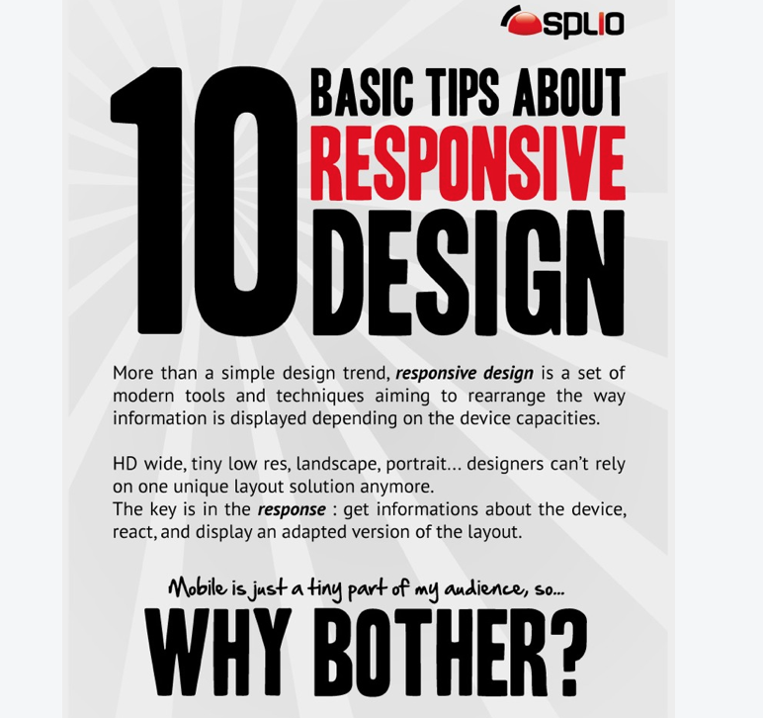
Notes:
https://www.webaholic.co.in/blog/10-basic-tips-to-build-a-responsive-design/

Slide 53
Responsive Design
Don’t use fixed or float positioning
Make your layout fluid, with max and min widths
(min-width: , max-width: )
Define breakpoints for standard screen sizes (fewer columns for smaller screens)
Skip non-essential content for small screens
Media queries:
@import url(tiny.css) (min-width:300px);
@import url(small.css) (min-width:600px);
Or, use a framework such as Bootstrap

