Slide 1
HTML and the Web
Information Systems 337
Prof. Harry Plantinga

Slide 2
What is the World Wide Web?
HTML
URL
HTTP
CSS, RSS, XML, XSLT, XPath, RDF, WSDL, SOAP, …

Slide 3
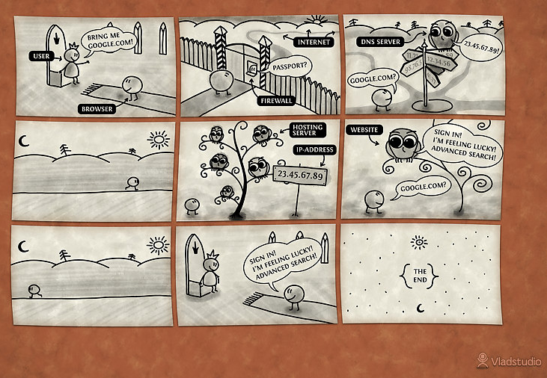

Slide 4
Web Servers and HTTP
What is a Web server?
What does a Web server do?
What does the Web server do with a URL like:
http://153.106.201.117/foo/bar.html
http://students.cs.calvin.edu/
http://elkmelk.org/~hplantin/bar.html
Why do file permissions matter?
Notes:
Wait for connections on port 80
Make connection when requested
Receive request (http or shttp, to its IP address, so those parts are stripped)
Return corresponding file
(optionally keep connection open, wait for another request or client to break connection)
After a certain number of requests, close connection and wait for another.
telnet 153.106.116.190 80
GET / HTTP/1.0
Connection: Keep-Alive

Slide 5
HTML
We assume some familiarity with HTML
Don’t already know HTML? Do the tutorials
HTML Cheat Sheet may come in handy (and we'll use it for quizzes)
HTML handout—fill in during class
And now for a quiz…

Slide 6
Group Question 1
In the following line of HTML, identify the elements, tags, attributes, and entities.
<h1 style=”text-align:center” id=”firstHeading”>Hello World&copy;</h1>

Slide 7
Group Question 2
What does the following line at the top of an HTML file mean?
<!DOCTYPE HTML PUBLIC "-//W3C//DTD HTML 4.01 Transitional//EN"
"http://www.w3.org/TR/html4/loose.dtd">
What does the following line at the top of an HTML file mean?
<!DOCTYPE html>

Slide 8
Group Question 3
Give that these three lines will render exactly the same in a Web browser, which is the best way of marking up a book title? Why?
Plato’s <i>Republic</i>
Plato’s <em>Republic</em>
Plato’s <cite>Republic</cite>

Slide 9
Group Question 4
What does “nesting” mean? How would you correct the error in the following markup?
<p>I’ve never read <b>Plato’s <i>Republic</i></b>, have you?</p>

Slide 10
Group Question 5
The tutorial recommends using alt, height, and width attributes in image elements. Why? When might you not want to use them?
<img src=”pres.jpg” alt=”Barak Obama” height=”320” width=”240” />

Slide 11
Group Question 6
What color would the div have as a background?
<div id=”menu” style=”background-color:#FFFF00”>
<p>Menu...</p></div>

Slide 12
Group Question 7
What difference would there be in the way these two lines display in browser?
<p>Have you read <cite>Cryptnomicon</cite>?</p>
<p> Have you read
<cite>Cryptnomicon</cite>?</p>

Slide 13
Group Question 8
What effect would the title attribute have in the following line?
<h1 title=”G’day!”>Hello World</h1>

Slide 14
Group Question 9
What effect would following line have?
<!-- Hello World -->

Slide 15
Group Question 10
What is the purpose of the <meta> element?
<meta name="description" content="Authoritative information about Amazing grace! (how sweet the sound), with lyrics, ..." />

Slide 16
Is this legal?
<html>
<body>
<h1>Hello World</H1>
<p>Here is some <b>Bold, <i>bold + italic</b>, and italic</i>
<p>This is a new paragraph with &nbsp;<b>bold text.
<br>
<center Height=20>
<P>This paragraph is centered.</p>
Here's another paragraph.
</center>
</body>
</html>
See test1.html, test2.html; http://validator.w3.org/; tidy
Notes:
Valid in HTML4 Transitional? Strict? XHTML?
What are the errors?

Slide 17
Is this legal?
<!DOCTYPE html>
<html>
<head>
<title>Test 3</title>
<meta http-equiv="Content-Type" content="text/html; charset=utf-8" >
</head>
<body>
<h1>Hello World</H1>
<p>Here is some <b>Bold, <i>bold + italic,</i></b><i>, and italic</i>
<p>This is a new paragraph with &nbsp;<b>bold text.</b></p>
<center>
<P>This paragraph is centered.</p>
<p>Here's another paragraph.
</center>
</body>
</html>
Notes:
Valid?
- The only error is the <center> tag – obsolete.

Slide 18
Editing HTML
Options for editing HTML
vi/emacs/nano/notepad and your wits!
DreamWeaver
Simplified online HTML editors
Other markup, e.g. wikipedia, LaTex, etc. with a converter

Slide 19
HTML and Standards
Varieties of HTML
HTML 4 transitional or strict
XHTML
HTML [5]
Standards adherence
Why is it important?
How have companies abused standards?
Embrace, extend, extinguish…
Browsers: quirks mode vs. standards mode
Notes:
Importance: don’t be tied to one vendor, e.g. Microsoft with IE 6
Make sure your Web page works on all browsers.
Microsoft’s embrace, extend, extinguish

Slide 20
Using HTML
How do I specify the version of HTML I'm using?
HTML 4.0 Transitional
<!DOCTYPE html PUBLIC "-//W3C//DTD HTML 4.01 Transitional//EN" "http://www.w3.org/TR/html4/loose.dtd">
HTML 4.0 Strict
<!DOCTYPE html PUBLIC "-//W3C//DTD HTML 4.01 Transitional//EN" "http://www.w3.org/TR/html4/strict.dtd">
XHTML 1.0
<!DOCTYPE html PUBLIC "-//W3C//DTD XHTML 1.0 Strict//EN" "http://www.w3.org/TR/xhtml1/DTD/xhtml1-strict.dtd"> <html xmlns="http://www.w3.org/1999/xhtml" lang="en" xml:lang="en">
HTML 5 ("Standards mode")—<!doctype html>
Quirks mode—no DOCTYPE
Notes:
Nowadays, just use HTML5. Can throw in some XHTML as well.

Slide 21
What about XHTML?
Syntax differences from HTML:
no omitted tags, proper nesting
empty tags must be closed, e.g. <br />
lower-case tag and attribute names
attributes need quotes, values
the only defined entities are &amp; &lt; &gt;
Doctype, xmlns attribute
and more…
Can use XML Tools: XML editors, validation, DOM, XSLT, XPATH
Dying?

Slide 22
HTML 5
New semantic elements: header, footer, nav, section, article, meter, time, aside, etc.
<audio>, <video>
<canvas> -- 2D and 3D
<script async="">
Other Changes:
Tools for making web apps (database, threads)
Drag and drop
Cross-document messaging
Browser history management
2D and 3D transitions and graphics
<font>, <center>, etc dropped
Support for Web apps
Good HTML5 tutorial: http://slides.html5rocks.com/

Slide 23
Semantic Markup
Semantics: “meaning”
Examples of semantic markup:
Examples of non-semantic markup:
<i> and <b> vs. <em> and <strong>
Separating semantics from presentation
Notes:
What if you want to change your output for different screen sizes, desktop vs. mobile, screen vs. print?
Look at Web page for this class. Class names for different functions. Can modify it all by editing stylesheet.

Slide 24
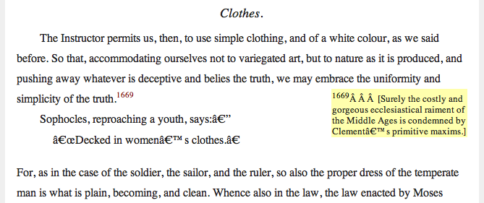
What’s Wrong?
Notes:
Clement of Alexandria, The Instructor, Chapter XI

Slide 25
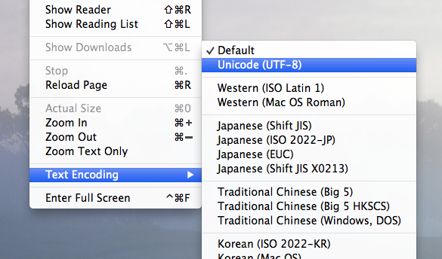
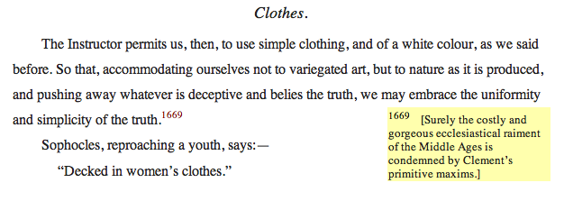

Slide 26
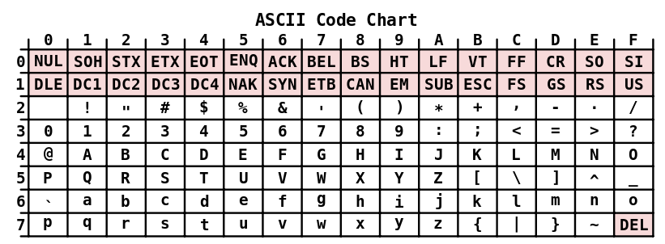
Notes:
ASCII lasted for decades, but it doesn’t have enough characters for world use.

Slide 27
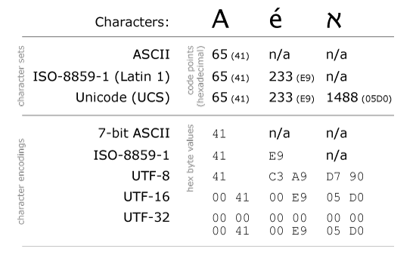
Character Encodings
Do you know your character encodings?

Slide 28
Character Encodings
How to set the encoding on the server?
conf.d: AddDefaultCharset UTF-8
How to set the encoding in your Web page?
<meta http-equiv="Content-Type" content="text/html; charset=UTF-8" />
How to change the encoding in your web browser?
How to enter Unicode?
Editor function, e.g. Word's Insert symbol
Foreign keyboard, keyboard map
Escape sequences (&rdquo; &#8221; &#x201D;)

Slide 29
URLs
What do the parts of this URL mean?
http://www.ccel.org:8080/ccel/calvin/institutes.html#xyz123?notes=margin&print=1

Slide 30
Parts of a URL
Scheme://domain/path#fragment?parameters
Scheme: network protocol (e.g. http, https, ftp, file, mailto)
Domain: server that provides resource
Path: directory path to access resource (relative to server root)
Fragment: location within resource (typically an ID)
Parameters: input for computed resource, e.g. ?node=37&print=true

Slide 31
Relative URLs
Behavioral differences?
http://www.ccel.org/calvin/institutes.iv.html
/ccel/calvin/institutes.iv.html
institutes.iv.html

Slide 32
Video and Audio?
<a href=“video.mp4”>see video</a>
<video> element in HTML 5 – use a library like videojs.com
Flash?
<object width="425" height="344">
<param name="movie" value="http://www.youtube.com/v/w-F_zBnhtHs&amp;hl=en&amp;fs=1&amp;rel=0"></param>
<param name="allowFullScreen" value="true"></param>
<param name="allowscriptaccess" value="always"></param>
<embed src="http://www.youtube.com/v/w-F_zBnhtHs&amp;hl=en&amp;fs=1&amp;rel=0" type="application/x-shockwave-flash" allowscriptaccess="always" allowfullscreen="true" width="425" height="344"></embed>
</object>

Slide 33
How would I…
How would I write HTML to make
A book with chapters, sections
A grid of images
A menu system
A calendar with boxes for numbers
Notes:
Book – use h1 for title, h2 for chapters, h3 for sections? (Why not just styling?)
You try it – take out piece of paper, write HTML for grid of images.
Two-column layout?
Menu system?
Two-column layout – in the Layout section of the tutorial. Do this in Lab 2.

