Slide 1
Website Administration
Information Systems 337
Prof. Harry Plantinga

Slide 2
This Course
Website administration…
Not graphic design
Not heavy-duty Web programming
HTML, CSS coverage, but not complete
Designing, setting up, running, managing a web site
Drupal content management system
Some PHP, SQL
Some linux administration
Legal, social, and ethical issues
My Web projects: CCEL.org, Hymnary.org, PreachingandWorship.org

Slide 3
Service Learning
Semester project: set up a Drupal-based website for a project of interest to you
Ideas: service, team, organization, club, nonprofit
Students will normally work in pairs
You may have a client
Meetings: requirements gathering, handoff
Contact via email, phone
Students should put in 15-30 hours on this project. It counts for 25% of the final grade.

Slide 4
A Good Recommendation
Lots of demand for website creators
This class can be almost as valuable as an internship. Treat it like one!
Act professionally
Be responsive to phone calls, emails
Meet deadlines
Dress well
Do a good job
Get a good recommendation!

Slide 5
LAMP
We'll be using Ubuntu Linux with Apache, Mysql, and PHP
The most common platform for web serving
Good to know a variety of environments
But it may take some getting used to for some…

Slide 6
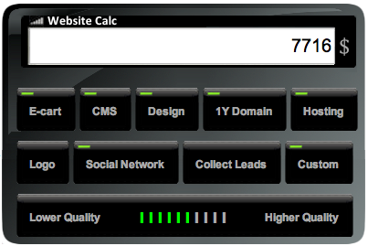
Need for Website Construction
We get many job offers for website designers
It can be a nice self-employment option too!

Slide 7
The World Wide Web
What is the web?
History?
Effects on society?
Is there a Christian perspective?

Slide 8
Web projects
What makes for a successful website project?
Notes:
Does it do good for society? – Love your neighbor?
Measurable criteria for success

Slide 9
Web projects
Suppose someone asked you to create a website offering resources for preachers. Would you do it?
Notes:
What would you need to know?

Slide 10
Web projects
Suppose someone asked you to create a website offering resources for preachers. Would you do it?
What would you want to know about the project?
Notes:
Clarify the mission. A good idea?
Who is going to use it? What for?
What websites should it work/look like?
How will we know if it is working well?
Budget?
Launch date?

Slide 11
Creative Brief
Objectives / Mission statement
Identifiers: title, tag line, domain name
User profile
Use cases
List of model websites
Success metrics
Budget
Launch date
Notes:
Last time I got to this point – developed these points through discussion wrote them on the board as people suggested them, and then got to this summary slide.

Slide 12
Term Project
Work in groups of 2-3 to create a website
Website should be for a client
Website will be deployed at the end of the semester
Ideas:
Create a website for a church, nonprofit, business, team, club, group
Create a website to meet a particular need, e.g. used textbook sales, worship resources
Start thinking about project ideas, partner ideas

Slide 13
What makes for a successful project?
What makes for a successful website project?
Notes:
What makes these projects successful?
Clear, memorable concept
Meeting a need
With good content
And a stress-free implementation

Slide 14
What makes for a successful project?
What makes for a successful website project?
A clear concept
addressing user need
with good content
and a stress-free implementation
Notes:
What makes these projects successful?
Clear, memorable concept
Meeting a need
With good content
And a stress-free implementation
To be really successful and to get people to come back repeatedly you need to tie into the user’s regular cycle – be addictive
User has need
User thinks of your website, visits
User is rewarded with good content, easily found, stress-free
Stimulus—response—reward

Slide 15
Think of a website for
Buying something new
Updates from your friends and family
Search for information on some topic
Buy/sell used stuff
Find an interesting video
Store files in the cloud
Notes:
Why are these memorable?

Slide 16
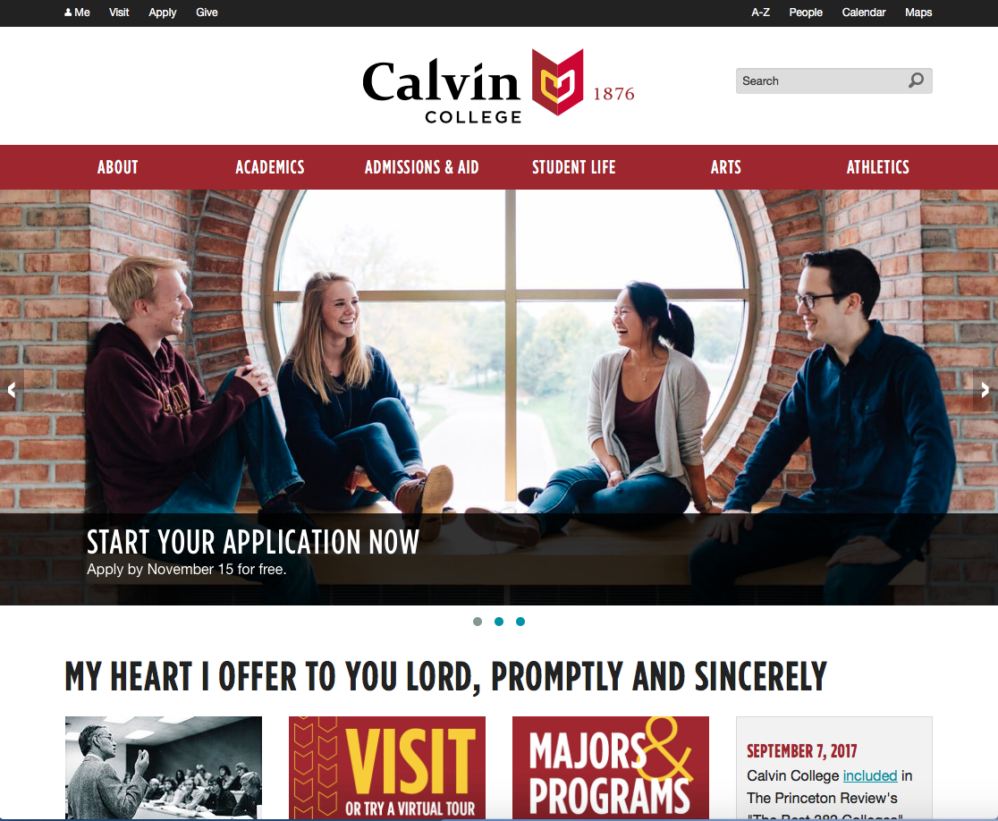
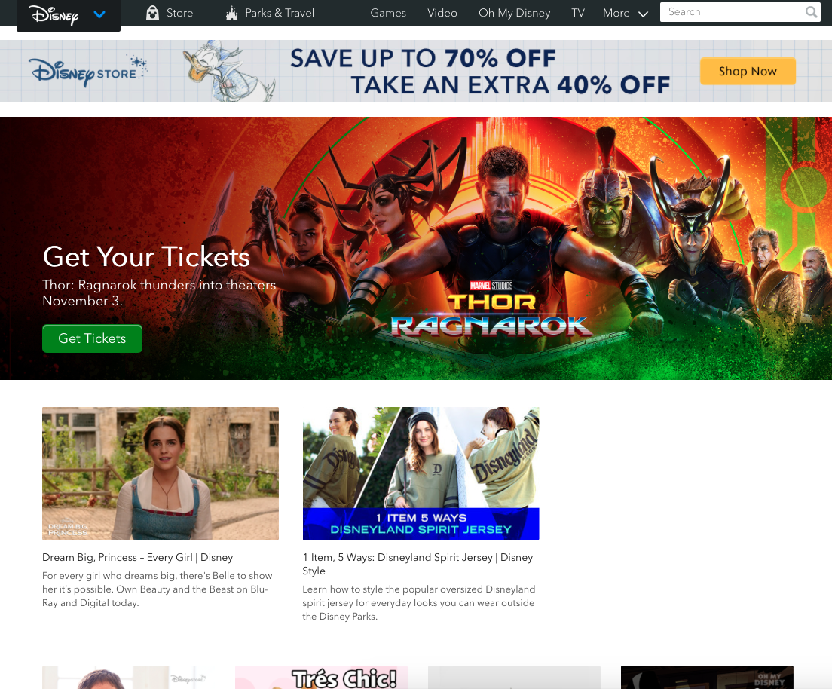
A good concept
Clear and memorable
Addresses a need
Notes:
Are these good concepts?
Calvin: info about calvin. Yes, clear.
Disney: ??
- Different model – get search hits, not direct traffic.

Slide 17
Communicating the concept
It should be immediately obvious what the site is for
A 2-8 word slogan or tagline (action) helps
Avoid distractions
If possible, have one clear ‘next step’
Notes:
Don’t really need to say this yet (at this point in the course), but if it comes up:
With better searching, this is becoming less important.
Now, constellations of good content with less emphasis on keywords?

Slide 18
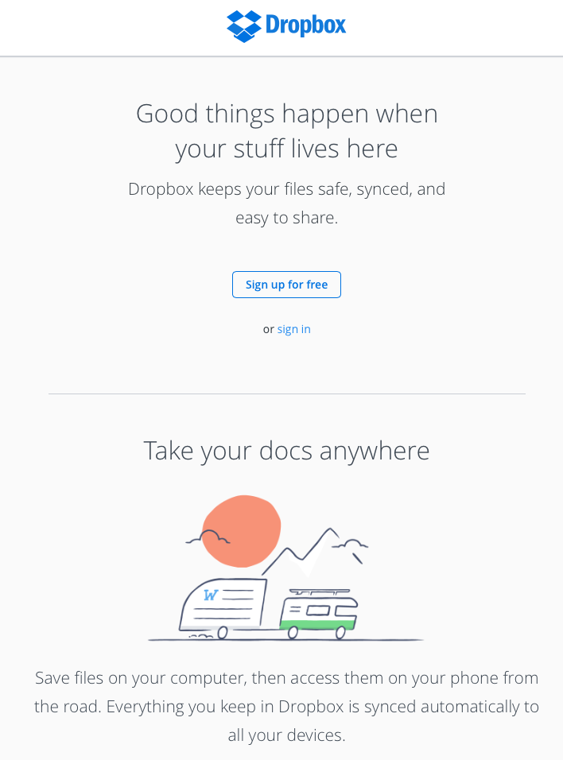

Slide 19
Addressing user need
Notes:
Need to know your user in order to meet their needs in a stress-free way.
Better, know and love your user.
How? – personas, use cases
Surveys, market research

Slide 20
Creative Brief
Objectives / Mission statement
Identifiers: title, tag line, domain name
User profile
Use cases
List of model websites
Success metrics
Budget
Launch date
Notes:
Once you have a project idea, you’ll need to flesh out a creative brief.
Here’s our creative brief description again. Let’s look at some of these things.

Slide 21
Preaching Portal
Objective: a website for helping busy pastors find excellent preaching resources
Notes:
Give handout: creative brief, project definition.
Objective comes down from on high. Or maybe it’s your own idea.

Slide 22
Preaching Portal
Mission
Notes:
OK, work in groups to write a mission for Preaching Portal

Slide 23
Preaching Portal
Mission
The mission of the Preaching and Worship Portal is to provide preachers and worship/liturgical planners efficient access to the best resources on the web, for sermon preparation, worship planning, and related ministry tasks, in multiple cultural and ecumenical contexts. [. . . ] Users will see resources prioritized according to their preferences and history. [. . .] Resources to be indexed include sermon-preparation aids and resources commonly used in worship services, including liturgy, music, and art.
Notes:
It needs to summaries your entire objective.
It needs to answer questions about what features the website should (or shouldn’t) have.
You’ll refer to it later to keep your website creature feep in check.

Slide 24
Identifiers
Title:
Tagline:
Domain name:

Slide 25
Identifiers
Title: Preaching Portal
Tagline: Curated resources for preachers
Domain name: PreachingandWorship.org
Notes:
Is that a good title? How would you test it?

Slide 26
Identifiers
Title: Preaching and Worship Portal
PreachingandWorship.org
Tagline: Curated resources for preachers
Domain name: PreachingandWorship.org

Slide 27
PreachingandWorship.org
Users

Slide 28
PreachingandWorship.org
Users
John is a busy preacher looking for ideas for a sermon tomorrow morning…
Notes:
Should be specific, visualize a typical person
(Is it a problem that we’re visualizing a man here, not a woman?)

Slide 29
PreachingandWorship.org
Use case

Slide 30
PreachingandWorship.org
Use case
Preacher John is preparing for a worship service—sermon and/or liturgy and hymn selection. He has a method of identifying the theme of the sermon, usually scripture passage and/or topic, but also possibly lectionary week, current events, church season, or special days or occasions. He also indicates the type of resource desired. The website responds to such queries with a list of the best-matching resources, ranked by matching John’s profile and preferences as well as resource popularity and rating.

Slide 31
PreachingandWorship.org
List of model websites
Success metrics
Budget
Launch date

Slide 32
Notes:
What do you think?

Slide 33
Project management
What steps would be needed to get this project completed?

Slide 34
Project management
What steps would be needed to get this project completed?
Requirements analysis
Design
Implementation
Testing
Maintenance

Slide 35
Project management
What steps would be needed to get this project completed?
Requirements analysis
Design
Implementation
Testing
Maintenance
Repeat?

Slide 36
Defining the project
Work with higher-ups to flesh out the creative brief
Then, the project manager (you) and your team must define all the technical details of the website, how it will work, how it will be built, etc.
A very laborious (but very necessary) part of project management…
Notes:
If you are a project manager, you’ll have to work out all details before starting. (Else—project creep!)
What details would need to be worked out?

Slide 37
Project Definition
Project charter
Statement of Work
Use-case scenarios
Mockups
Site map
Tech requirements
Application flow diagrams
Risk assessment
Notes:
Project charter: mission, objectives, deliverables, success metrics, resources
Statement of work: describe the deliverables in detail: laundry list of what client will receive
Use-case scenarios: narratives on how site will be used: functional goals from user perspective
Mockups: rough sketches or HTML prototypes (avoid “design” to avoid aesthetic debate)
Site map: tree of content areas; for each, name, purpose, topic, features, tools, etc
Tech requirements: subsystems that will be needed, etc. (e.g. database, authentication, web services, etc)
Application flow diagram: How tech components work together
Risk assessment: dependencies, technical risks, contingency plans

Slide 38
Managing changes
What happens when your client requests additional features?
Notes:
Mission creep. How will you ever be able to say “no”?
How will you know when you are done?

Slide 39
Waterfall project management
Notes:
”Traditional” waterfall project management: each step is completed before the next is started. Much documentation is generated in the design stage.
Realistically, it’s very hard to anticipate everything. Development is usually more iterative. Implement something, test, iterate.

Slide 40
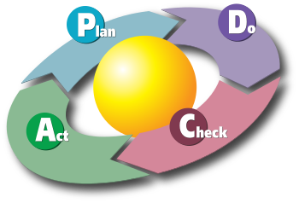
Iterative project management
Notes:
This is an illustration on the Deming cycle (Edward Deming, father of modern quality control techniques popularized by the Japanese in the “Economic miracle” of the 50s and 60s
Plan: establish objectives and processes necessary to deliver desired results
Do: implement the plan.
Check: Study the results:
Act: decide on changes indicated in current process
As you probably know, this kind of thinking has transformed not just quality control in
Industry, but all sorts of fields, including education – SLOs and assessment procedures
Anyone?– and even grant projects.
The idea is to set goals, have a plan for implementing them, and then have a feedback
loop for continuous improvement.
So what is involved in each of these steps for a Web project?
know what users are trying to accomplish
measure how well your website is working for them
Revise your plan
Implement new plan
Realistically, a web project continues, as long as it is living, . . .

