Slide 1
Legal and Ethical Issues
Information Systems 337
Prof. Harry Plantinga

Slide 2
Question
Is it legal and ethical to promote your site with mass emailings?

Slide 3
CAN SPAM act
Requirements of mass emails:
Accurate from line & other headers
Subject line is not deceptive
Accurate physical address
Message may not be sent through open relay
Message may not use harvested email addrs
A way to opt out with single click or web page
Exemptions
Religious messages
Political messages
National security messages
Notes:
Was rushed through congress just before California passed a tougher state law; it supersedes state laws
Less htan 1% of spam complies
Rarely enforced

Slide 4
Privacy policies
Are you required by law to have a privacy policy?

Slide 5
Privacy policies
California requires commercial websites that collect personally identifiable information to post a privacy policy. It must
Identify the categories of personally identifiable information that are collected
Describe how consumers can review and make changes
Describe how consumers can learn of changes in the policy
Identify the effective date of the policy
Notes:
Actually, this law was a cop-out

Slide 6
Privacy policy tips
If you do business in California, make it legal in CA
Make it easy to read
Abide by it! It can be enforced by the FTC (see Wikipedia article on e-commerce)
Notes:
You’ll need a privacy policy for your term project.

Slide 7
Privacy policy tool
Here's an online tool to create a privacy policy
Create one for your term project website

Slide 9
Cookie Consent Law
May, 2011 European Union directive:
Let users know if a website is using cookies
Explain what data is gathered and how used
Gather user consent to the use of cookies
Who does the law apply to?
Any person or organization that is physically in the EU and has a website
Any website that targets EU consumers
Notes:
Does your website use cookies?

Slide 10
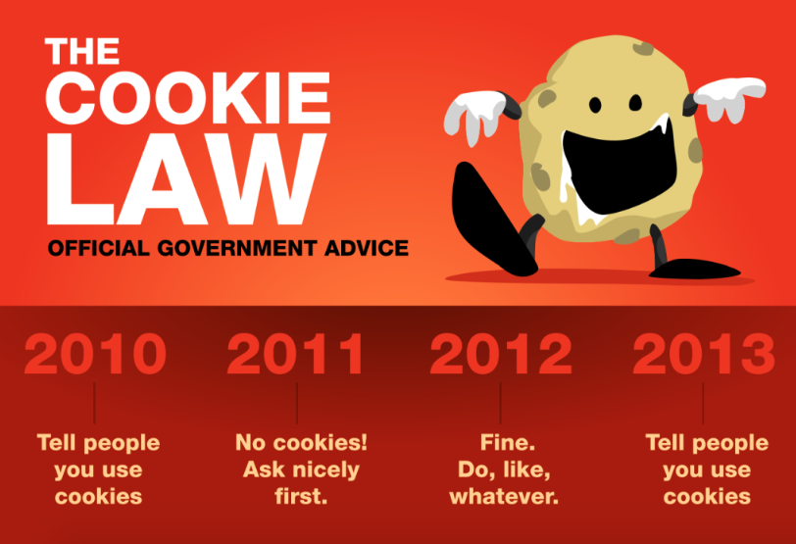

Slide 11
Ethical issues
What ethical and legal issues arise in running a website?
Is there a Christian perspective?

Slide 12
Why do you run your site?
Jesus' fundamental ethical principles: Love God above all, love your neighbor as yourself
You can do that by serving others with your site
You have been entrusted with readers' attention. Do something useful with it!

Slide 13
Ethics of SEO
Is it ethical to buy links in order to get a better SEO ranking?

Slide 14
Ethics of SEO
Is it ethical to buy links in order to get a better SEO ranking?
What will the effect be on effectiveness of search by Google users?
This is a hotly-debated issue.
It's against Google's rules; if you are caught you will be penalized by Google

Slide 15
Ethics of SEO
Is it ethical to target particular keywords and modify your web pages to get better search results?

Slide 16
Ethics of SEO
Is it ethical to target particular keywords and modify your web pages to get better search results?
Are you trying to improve the web?

Slide 17
Advertising
Is it ethical to have advertising on your site?
How does advertising affect your site? Is it a win for users as well as you?
What kinds of advertising should you use?
How about targeted advertising based on user browsing history, etc?

Slide 18
Guestbook
Is it ethical to keep a guestbook at CCEL?
What if people sign from a country where Christianity is illegal?

Slide 19
Ethics of storing data
Is it ethical to keep access logs?
Who might want access?
What harm could be done?
Why are you keeping the log?
Is it ethical to store user names, addresses, credit card numbers, passwords, health problems, etc?
What ethical considerations apply to storing user data?

Slide 20
Ethics of mining data
Is it ethical to use data gathered on a website like Hymnary.org to
Improve website performance?
Give users results they are more likely to want?
Provide more relevant advertising?
Sell to personal information aggregators, to pay for the site?

Slide 21
Ethics of mining data
Case study: Target

Slide 22
Ethics of using data
Suppose a CIT employee happened to see an email you wrote (in the process of normal system administration) that gave evidence you had committed a crime or broken a rule. Should she report it to anyone?
Notes:
So, any overall principles in the ethical use of data?

Slide 23
Code of Fair Info Practices
There must be no personal data record-keeping systems whose very existence is secret.
There must be a way for a person to find out what information about the person is in a record and how it is used.
There must be a way for a person to prevent information about the person that was obtained for one purpose from being used or made available for other purposes without the person's consent.
There must be a way for a person to correct or amend a record of identifiable information about the person.
Any organization creating, maintaining, using, or disseminating records of identifiable personal data must assure the reliability of the data for their intended use and must take precautions to prevent misuses of the data.
Notes:
The Code of Fair Information Practices was the central contribution of the HEW (Health, Education, Welfare) Advisory Committee on Automated Data Systems. The Advisory Committe was established in 1972, and the report released in July. The citation for the report is as follows: U.S. Dep't. of Health, Education and Welfare, Secretary's Advisory Committee on Automated Personal Data Systems, Records, computers, and the Rights of Citizens viii (1973).

Slide 24
Additions to the Code
Three other principles might be added from the ACM Code of Ethics:
Only the necessary information should be collected
Data retention and disposal periods should be implemented
User data observed during normal system maintenance must be treated with confidentiality unless you are required to reveal it by law or organzational rules

Slide 25
Status of the Code
Created by the HEW (Health, Education, Welfare) Advisory Committee on Automated Data Systems in 1972
Not legally binding
Some of its principals were adopted in laws governing data in particular areas:
financial data
medical records

Slide 26
Examples
Is it ethical for a library online catalog to show most popular search results first?
Is it ethical for a store to ask for your rewards card or phone number when you make a purchase?

