Slide 1
Assessment
Information Systems 337
Prof. Harry Plantinga

Slide 2
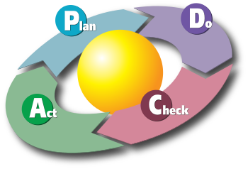
Quality Cycle
Notes:
Knowing and loving your users means understanding what they are trying to accomplish and
serving them in those goals. It means being motivated to make the site ever more useful.
This is a diagram from wikipedia on the Deming cycle (Edwards Deming, father of modern quality control,
which transformed industry in recent decades. Credited with Japan’s post-war “Economic miracle” of 1950-1960
Plan: establish objectives and processes necessary to deliver desired results
Do: implement the plan.
Check: Study the results:
Act: decide on changes indicated in current process
As you probably know, this kind of thinking has transformed not just quality control in
Industry, but all sorts of fields, including education – SLOs and assessment procedures
Anyone?– and even grant projects.

Slide 3
Assessment
Your boss says "Who's visiting our site? Where are they coming from? What do they think about usability? What pages are popular? How many are using mobile devices? What paths are users taking through the site? What are the problem pages where we lose visitors?"
Analysis options:
Read the raw logfile
Set up a logfile analysis program
Sign up for Google Analytics

Slide 4
Empirical testing
User testing
Surveys
Analytics

Slide 5
User Testing
Facts about user testing:
If you want a great site, you’ve got to test
Testing one user is 100% better than testing none
Testing one user early is better than testing 50 year the end

Slide 6
User Testing—method
During active development, one morning a month: morning tests, afternoon debrief
Select tasks from use cases
Three relevant participants each month, one hour each
Get everyone to watch screen and listen to narration during tests
Afternoon debrief: identify 1-3 most serious problems to deal with in the next month
Donuts!

Slide 7
Google Analytics
An amazing tool…
Where do my customers live?
What path do they take through the site?
What links are popular?
Would a certain change improve the site? (A/B testing)
How to add Google Analytics to a web site?
Sign up for GA, install the google_analytics module

Slide 8
Google Analytics
A/B testing
Conversions
Dashboards

Slide 9
Custom analytics
Hymnary.org: how could you evaluate how well searching is working?

Slide 10
Custom analytics
Hymnary.org: how could you evaluate how well searching is working?
We measure the number of clicks in the top 1, 3, 10 results
We added machine learning
Top1: 60% -> 70%
Top10: 89% -> 96%

Slide 11
Speed
Suppose you set up a new web site using Drupal
Performance is mediocre
What was a site in the top 5% (for speed) drops near the bottom…
What to do?
Notes:
200,000 pages per day is about 2.3 per second. If each takes a couple of seconds of CPU time…
First, reduce the number of files served

Slide 12
Minimize download time
Reduce the number of hits per pageview
Use Drupal's CSS and JS optimization
[ Reduced from >30 to about 20 files per pageview (stylesheets, artwork, etc) this way]
Can also minimize Javascript
Notes:
What else?
Add a second server

Slide 13
Caching
Turn on Drupal's page cache
Make sure users' browser cache works as well as possible
Static content should never expire
Change filename for revised files
Static server: add an Expires or Cache-control header: make sure content doesn't expire
Still, 40-60% of visitors come with an empty cache…
Notes:
Check out ccel.org – many files, etc.
Next: optimize artwork

Slide 14
Optimize artwork
Make sure artwork files are small
optimize in Photoshop or another program
Many small files == slow. How to reduce?
combine artwork into one background image
use jQuery to round corners
use CSS Sprites
use inline images in stylesheets with data: urls
Notes:
Next: deflate, CDN

Slide 15
Reduce download times
80-90% of wait time is downloading content
More ideas
Compress components
Accept-Encoding: gzip, deflate? Then deflate!
Apache: use mod_deflate
Use a content delivery network
E.g. Akami
Can improve av. response time 20% or more
Notes:
Next: stylesheets at top, static content at bottom
stylesheets in a separate file to facilitate caching

Slide 16
Make pages appear faster
Eliminate dependencies on the first page, above the fold
Stylesheets at the top, so pages can be rendered right away
Scripts at the bottom
Specify image dimensions

Slide 17
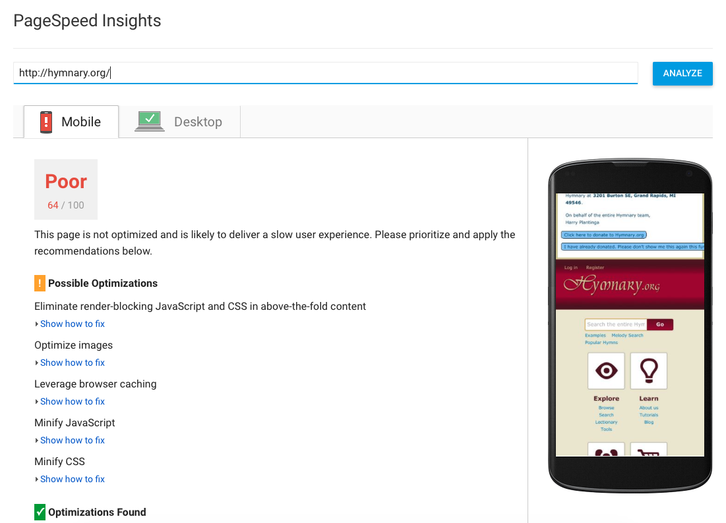
PageSpeed Insights
Google Page Speed Insights tools help identify ways to improve performance

Slide 18
Drupal-specific optimizations
Some improvements you can make in Drupal:
Turn on page caching
Stylesheet optimization
Prune the sessions table/make sessions shorter
Reduce time before garbage collection (cron)
Prune error reporting logs (watchdog table)
Automatic throttling

Slide 19
What next?
I've done all that. What else can I do?
Separate database server
Load balancer and additional servers
Database replication

