Slide 1
Content Types and Views
Information Systems 337
Prof. Harry Plantinga

Slide 2
Drupal’s Most Powerful Features
Content types, Fields, and Fields UI
Build custom content types
Add appropriate fields
Custom forms for input
Views:
Select and display such data
Flexible selection, sorting, and formatting
Output as a block

Slide 3
Content Types and Fields
Add fields to content types
Control how they are entered and validated
Change the way they are displayed
Many plug-ins available for custom types
date, autocomplete, button, RSS, video, audio, calculated values, jQuery Gallery View, Flickr, Google maps, flashcard, …

Slide 4
Examples
Without writing a line of code…
Paged table showing product details that can be sorted by name, price, or manufacturer
A block that lists the albums of a particular artist in a grid with cover thumbnails
Anywhere on your site you need a custom list of content

Slide 5
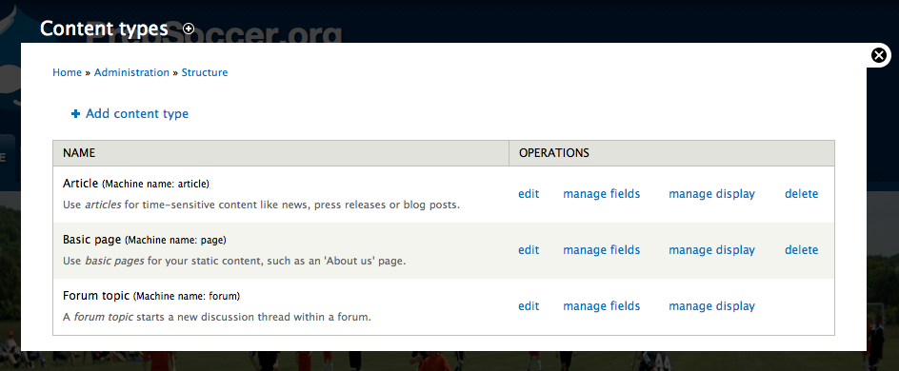
Content Types
Structure -> Content Types

Slide 6
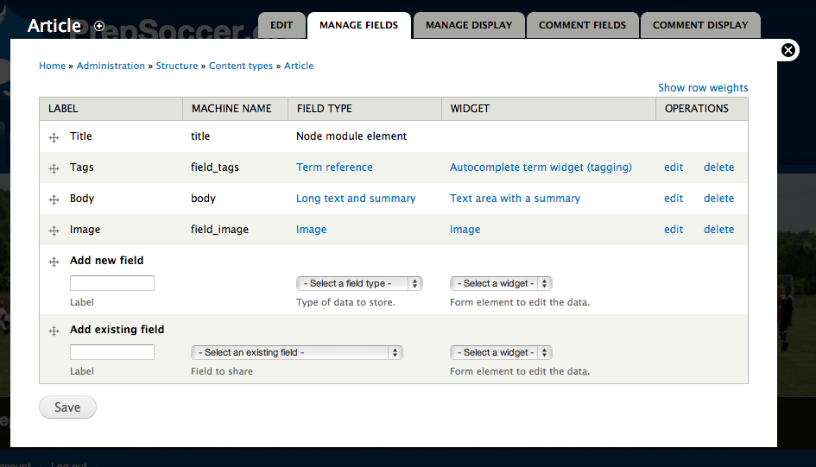
Managing Fields

Slide 7
Adding Fields
With Drupal 7 you can add fields to any entity type in the system
Add a tag field to users
Add a file upload field to contents

Slide 8
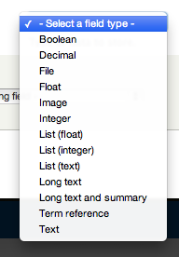
Adding Fields
Field Types
Standard: Integer, Float, List , File, Image, Text, etc.
Modules enable additional field types such as dates
Input widgets
Upload tool for images, jQuery date selector for dates,…

Slide 9
Manage Display
Control how fields are displayed

Slide 10
PrepSoccer.org
What content types might I need?
Team
Game
(Possibly also player, division, league, etc)
How to create?

Slide 11
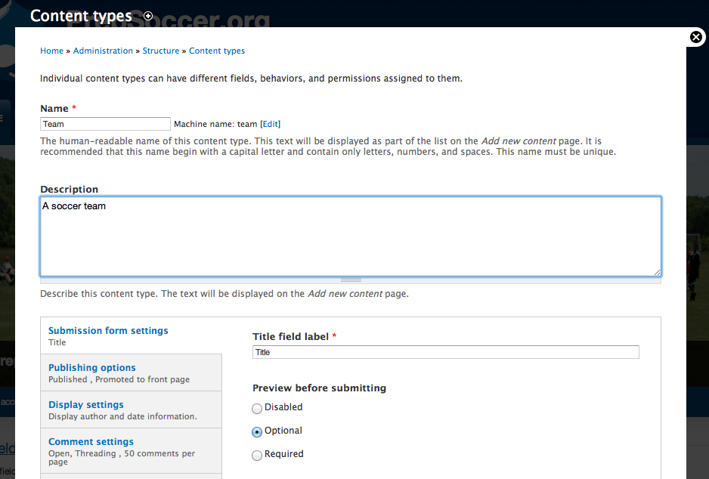
Team Content Type
Notes:
Create team content type

Slide 12
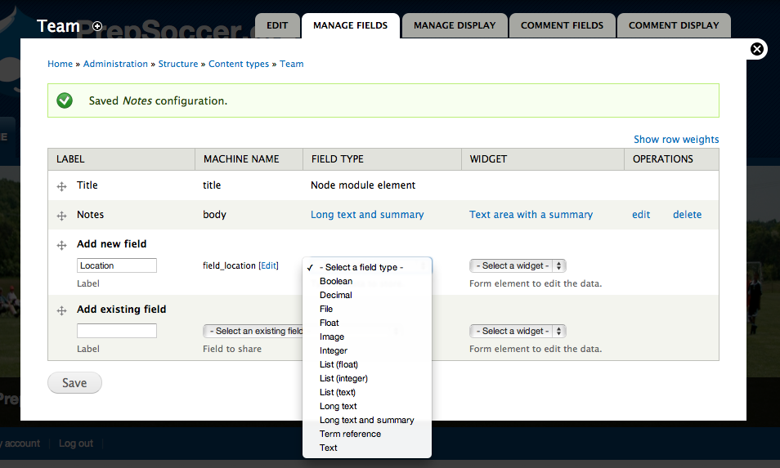
Add fields

Slide 13
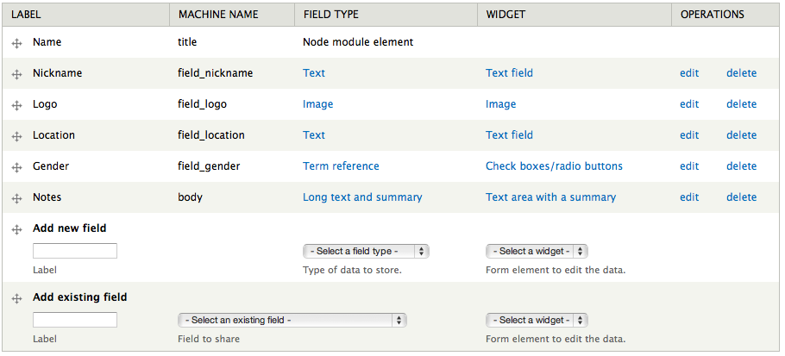
Team content type

Slide 14
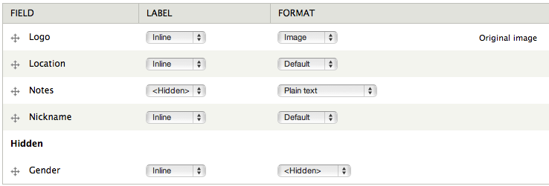
Manage display

Slide 15
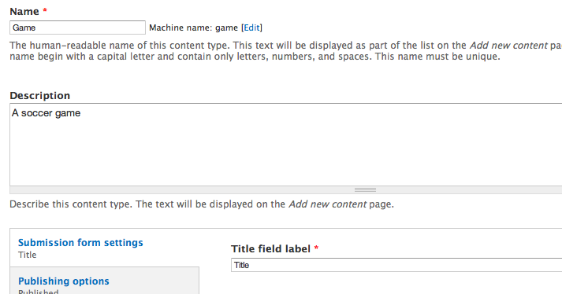
Game Content Type
Notes:
Add Entity, Entity Reference user-contributed module
Game references two teams

Slide 16
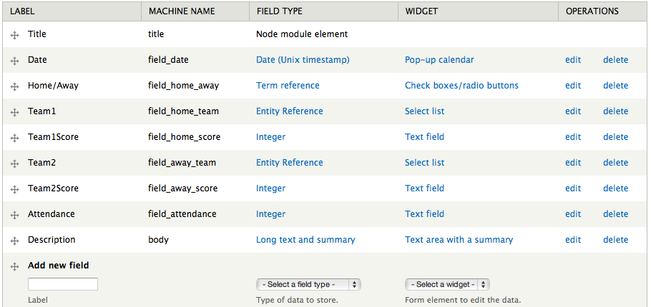
Game Manage Fields

Slide 17
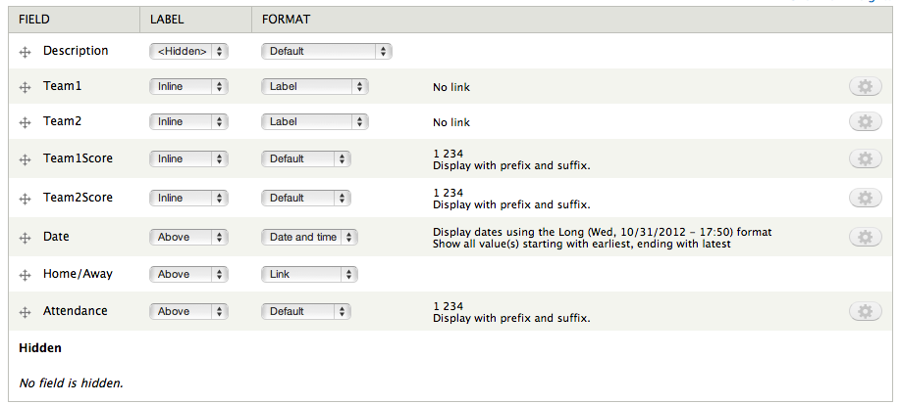
Game Display Fields

Slide 18
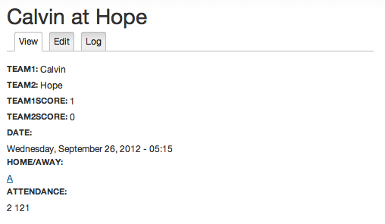
A game
Custom formatting done in theme

Slide 19
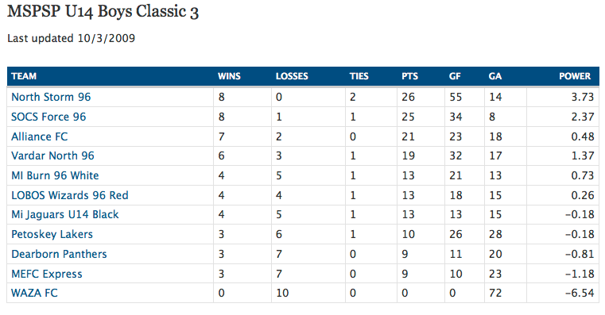
Displaying Teams, Games
How to display a team's results? Conference standings?
Need to understand:
Drupal’s database
Views module

Slide 20
Views
A visual query builder for displaying summaries of node collections
HTML table or list output
A single view may have many displays, e.g.
Page
Block
Feed
Attachment

Slide 21
Views Documentation
Install Advanced Help module to get help
Notes:
Documentation is limited—not up to date for version 3
(Joy of open source!)
Advanced Help module gives some help

Slide 22
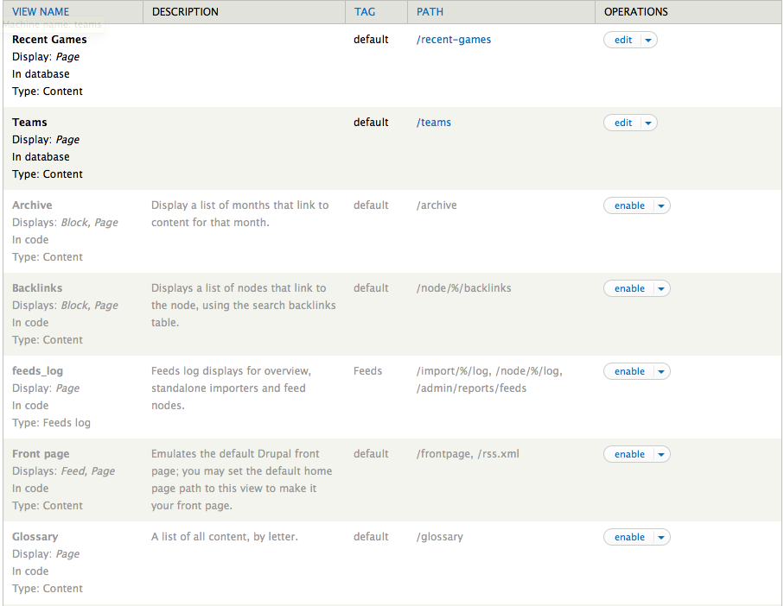
Available Views

Slide 23
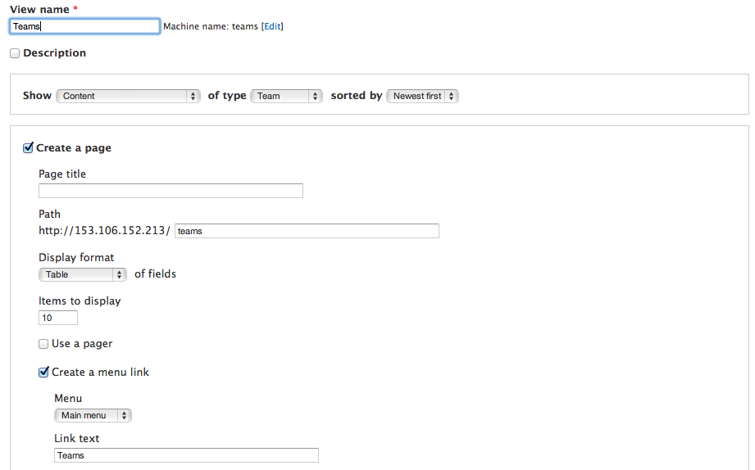
Adding a Basic View
Notes:
Many of you will only need basic views. Those are easy.

Slide 24
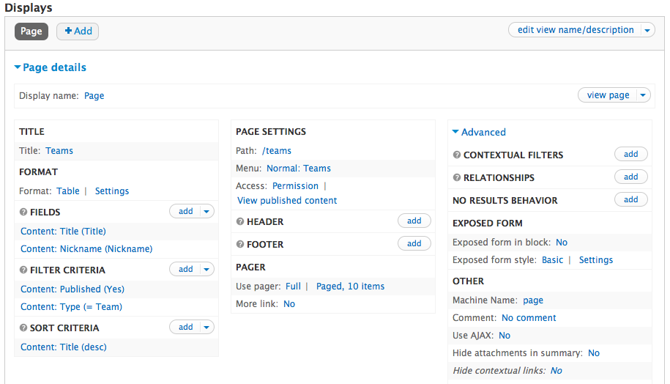
View Details
Notes:
Here’s the details page with the advanced panel exposed.

Slide 25
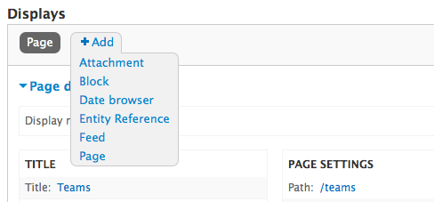
View Displays
Views have multiple displays (page, block, etc)
You can edit the view generally, or override for a particular display

Slide 26
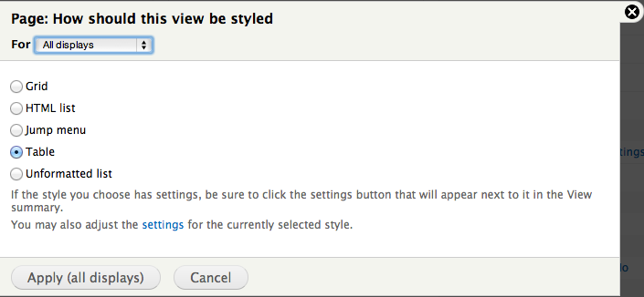
View Output
Output can be table, list, grid, menu, etc.

Slide 27
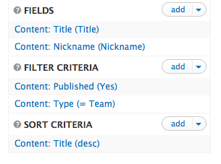
What to Display
Select fields
Filter: which nodes to display?
Sort critera

Slide 28
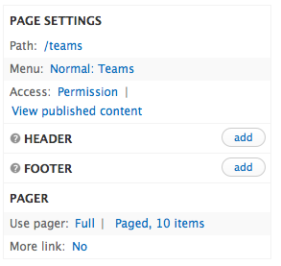
Page Settings
Path to page
Header, footer
Pager

Slide 29
Relationships
Like a database Join
For example, on a Schedule/Results view, you would want to display games but set up a relationship with Teams
Relationship on Team1

Slide 30
Contextual Filters
Arguments
E.g. which team to show results for
We’ll use these in a later lab

Slide 31
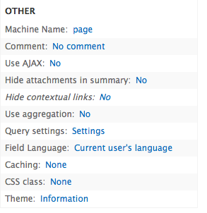
Other Options
AJAX: use AJAX for paging, instead of refreshing page (affects linking to page)
Aggregation: count, sum fields
How many games?
Total goals scored?

Slide 32
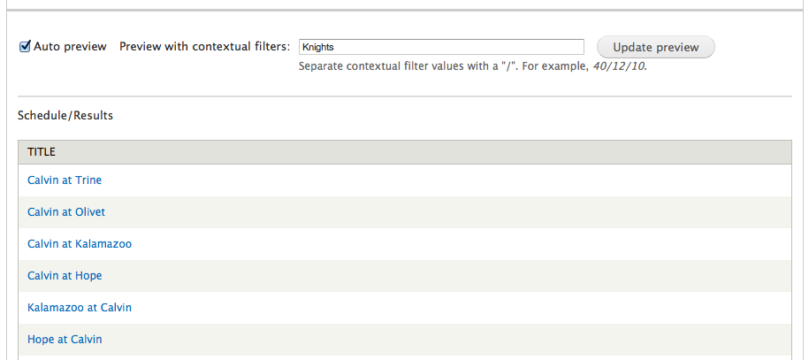
Live Preview

Slide 33
Views and SQL

Slide 34
Problems…
How do I show all a team's games?
How can I display conference standings?
What if it Views can't do what I want?

Slide 35
Rolling Your Own "View"
<h2>MSPSP U14 Boys Classic 3</h2>
<table style='width:100%' id="standings">
<?php
$result = db_query("select name, abbrev, wins, losses, ties, points, goalsFor, goalsAgainst, power from stats.team order by points desc, power desc");
while ($row = db_fetch_array($result)) {
echo("<tr><td><a href=\”schedule?team=$row[abbrev]\”>$row[name]</a></td>");
echo("<td>$row[wins]</td>");
echo("<td>$row[losses]</td>");
echo("<td>$row[ties]</td>");
echo("<td>$row[points]</td>");
echo("<td>$row[goalsFor]</td>");
echo("<td>$row[goalsAgainst]</td>");
$power=round($row[power],2);
echo("<td style='text-align:right'>$power</td></tr>");
}
?>
</table>

Slide 36
Pros and Cons of Custom "Views"
Drawbacks
Benefits
Can't use built-in support (CCK, views, ratings, comments, etc)
Need to write your own PHP code
May need a separate database
Must upgrade your code with new Drupal versions
Can handle more complex problems
Can optimize queries and performance
Give back by releasing your own Drupal module?

Slide 37
SQL & MySQL
Database concepts:
Server
Client
Table
Row
Attribute (or column)
Query
SQL

Slide 38
Drupal Databases
mysql> show databases;
+----------------------+
| Database |
+----------------------+
| information_schema |
| drupal_elkmelk |
| drupal_openpsalter |
| drupal_prepsoccer |
| drupal_v1_prepsoccer |
| drupal_v2_prepsoccer |
| mysql |
| stats |
+----------------------+
8 rows in set (0.00 sec)
mysql> use drupal_v2_prepsoccer;
Database changed
mysql> show tables;
+--------------------------------+
| Tables_in_drupal_v2_prepsoccer |
+--------------------------------+
| blocks |
| blocks_roles |
| comments |
| filter_formats |
| filters |
| menu_custom |
| menu_links |
| menu_router |
| node |
| node_access |
| node_revisions |
| node_type |
| permission |
| role |
| sessions |

Slide 39
Tables
mysql> describe node;
+-----------+------------------+-----+
| Field | Type | Key |
+-----------+------------------+-----+
| nid | int(10) unsigned | PRI |
| vid | int(10) unsigned | UNI |
| type | varchar(32) | MUL |
| language | varchar(12) | |
| title | varchar(255) | MUL |
| uid | int(11) | MUL |
| status | int(11) | MUL |
| created | int(11) | MUL |
| changed | int(11) | MUL |
| comment | int(11) | |
| promote | int(11) | MUL |
| moderate | int(11) | MUL |
| sticky | int(11) | |
| tnid | int(10) unsigned | MUL |
| translate | int(11) | MUL |
+-----------+------------------+-----+
15 rows in set (0.00 sec)
mysql> select nid, type, title from node
order by created limit 9;
+-----+----------+-------------------------
| nid | type | title
+-----+----------+-------------------------
| 1 | story | Welcome to PrepSoccer.or
| 2 | forum | Fall 2009 Season Discuss
| 7 | league | Michigan State Premiere
| 8 | page | Division Standings
| 9 | page | Team Results
| 10 | forum | Power ranking
| 11 | page | About Us
| 13 | division | Premiere 1
| 14 | division | Premiere 1
+-----+----------+-------------------------
9 rows in set (0.00 sec)

Slide 40
Queries
Select: 90% of typical queries. Typical form:
SELECT [fields] FROM [tables] WHERE [conditions] ORDER BY [fields]
Examples
SELECT name, abbrev, wins, losses, ties, points, goalsFor, goalsAgainst, power FROM stats.team WHERE wins >= losses ORDER BY points DESC, power DESC;

Slide 41
SELECT count(distinct sequence), SUM(LENGTH(texttext) > 200 AND NOTdoNotDisplay) as hasText, SUM(textinfo != '') as hastextInfo,SUM(tuneinfo != '') as hastuneInfo FROM ((SELECT text.firstLine, tune.title, text.hymnalID, text.number, text.sequence, text.info AS textinfo, tune.info AS tuneinfo, text.text AS texttext, text.doNotDisplay FROM hymnary.hymnText text LEFT JOIN hymnary.hymnTune tune USING(sequence, hymnalID) WHERE text.pub = 'p' AND text.hymnalID = 'WOV' GROUP BY text.hymnalID, text.number ORDER BY NULL) UNION (SELECT text.firstLine, tune.title, tune.hymnalID, tune.number, tune.sequence, text.info AS textinfo, tune.info AS tuneinfo, text.text AS texttext, text.doNotDisplay FROM hymnary.hymnTune tune LEFT JOIN hymnary.hymnText text USING(sequence, hymnalID) WHERE tune.pub='p' AND tune.hymnalID='WOV' GROUP BY tune.hymnalID, tune.number ORDER BY NULL)) AS subquery
WHERE TRUE AND subquery.title LIKE '%we come to the hungry feast%' AND (EXISTS( (SELECT type FROM hymnary.entryMedia entryMediaAny WHERE subquery.hymnalID = entryMediaAny.hymnalID AND subquery.number =entryMediaAny.number)) OR (LENGTH(texttext) > 200 AND doNotDisplay IS FALSE) OR textinfo != '' OR tuneinfo != '' ) GROUP BY sequence;

Slide 42
Joins
mysql> select nid, type, title from node where type='division' and nid >= 26 and nid <= 31;
+-----+----------+-----------+
| nid | type | title |
+-----+----------+-----------+
| 26 | division | Classic 3 |
| 27 | division | Rg Red |
| 28 | division | St Blue |
| 29 | division | St Orange |
| 30 | division | St Silver |
| 31 | division | St White |
+-----+----------+-----------+
mysql> select nid, … from content_type_division limit 6;
+-----+--------+------+------+--------+
| nid | season | year | age | gender |
+-----+--------+------+------+--------+
| 26 | Fall | 2009 | U14 | Boys |
| 27 | Fall | 2009 | U13 | Boys |
| 28 | Fall | 2009 | U13 | Boys |
| 29 | Fall | 2009 | U13 | Boys |
| 30 | Fall | 2009 | U13 | Boys |
| 31 | Fall | 2009 | U13 | Boys |
+-----+--------+------+------+--------+
6 rows in set (0.00 sec)
mysql> select node.nid, type, title, field_season_value as season … from node, content_type_division where node.nid=content_type_division.nid limit 2;
+-----+----------+-----------+--------+------+------+--------+
| nid | type | title | season | year | age | gender |
+-----+----------+-----------+--------+------+------+--------+
| 26 | division | Classic 3 | Fall | 2009 | U14 | Boys |
| 27 | division | Rg Red | Fall | 2009 | U13 | Boys |
+-----+----------+-----------+--------+------+------+--------+
2 rows in set (0.00 sec)

Slide 43
Other SQL queries
insert (5%)
insert into [table] values (v1, v2, v3, …)
delete from [table] where [condition]
The other 5%:
update
call
load data
replace
show tables
show databases, use, alter table, drop table, drop database, truncate, flush privileges, describe, explain, use, help, set, show, etc.

Slide 44
MySQL utilities
mysqladmin
mysqldump
mysql
How would I find other utilities?
/usr/bin/mysql*
Where would I find documentation?

