Slide 1
How did you ever do without it?
- from the first VisiCalc ad, 1979
Notes:
Spreadsheets were a killer app for personal computers (perhaps the killer business app).
It’s a mind-set, not a skill-set. Brilliance helps, but is not required. Instead, adopt these mantras: be stubborn, bossy, lazy, obssesive, cynical, plodding, and importunate. Why? So you can use IT as a tool to do cool stuff…
This week, resist the urge to build a technological solution before you understand what its for. There’s no sense attending to details until you know what you’re talking about (cf. the old von Neumann quote).

Slide 2
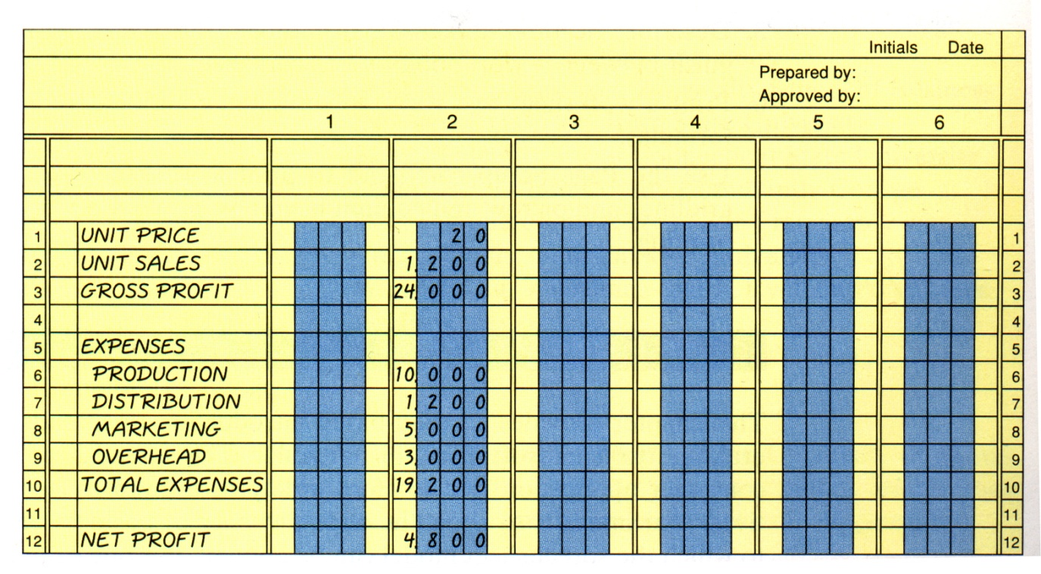
Accountant’s Paper Ledger
2-Dimensional representation of accounting data
image from Grauer&Barber, Excel 2003, Prentice Hall, Oct., 2004
Notes:
The accountant’s ledger is pure paper and hard work! If you found a mistake anywhere in the ledger, you’d have to painstakingly go back through changing all the sums, etc.

Slide 3
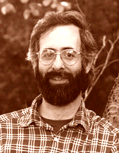
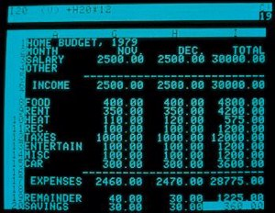
Dan Bricklin (1951-) VisiCalc
1979
Visible, interactive accountants ledger
Developed for the Apple II
A “killer” business application for the personal computer
images from www.bricklin.com, Oct., 2004
Notes:
In 1978 Daniel Bricklin, while a student at the Harvard Business School, came up with the idea. Actually went to market in May 1979.
Bob Frankston whom Bricklin recruited to improve on his idea came up with the term “visible calculator”.
A spreadsheet is a computerized, interactive ledger, which turned out to be a profoundly durable conceptual model. Why?
it was interactive
it supported forecasting (“what if” analysis)
it saved time because it automatically performed arithmetic updates.
They programmed it to fit into 20K of machine memory allowing it to run on the Apple II and it was very successful.
In fact, it can be argued that VisiCalc on the Apple led to the surge of personal computer purchases.
During its lifetime, about 1 million copies of VisiCalc were sold.
VisiCalc was slow in responding to the introduction of the IBM PC (Intel). Then came Lotus...
Can still get VisiCalc executable (for DOS) at http://www.bricklin.com/history/vcexecutable.htm
Jeremy’s ideas:
The biggest advantage a spreadsheet has is the ability to ask the “what if?” questions (and get a quick answer).
Be very, very lazy (in the long run):
Use equations to compute answers as much as possible.
“What if” questions answered by tweaking the data.

Slide 4
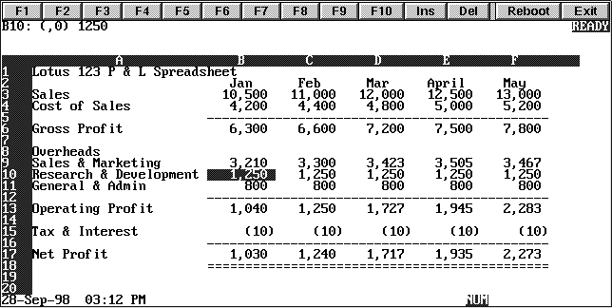
Mitch Kapor (1950- ) Lotus 1-2-3
1982
Included charting and plotting
Wildly successful
images from www.kapor.com and www.nb-info.co.uk, Oct., 2004
Notes:
Kapor was product manager for VisiCalc for about 6 months in 1980.
In 1982 he started Lotus Development corporation with Jonathan Sachs. Before he did this, he offered Personal Software Corporation (VisiCalc’s owner company) his Lotus program. He was declined on the grounds that its functionality was “too limited”
Lotus 1-2-3 made it easier to use spreadsheets and it included charting, plotting and database capabilities. It introduced the idea of naming cells, cell ranges, and allowing macros.
With the addition of VisiPlot,
Lotus went on to be one of the all-time best selling application software packages in the world.
In 1985 Lotus bought out VisiCalc and discontinued it.

Slide 5
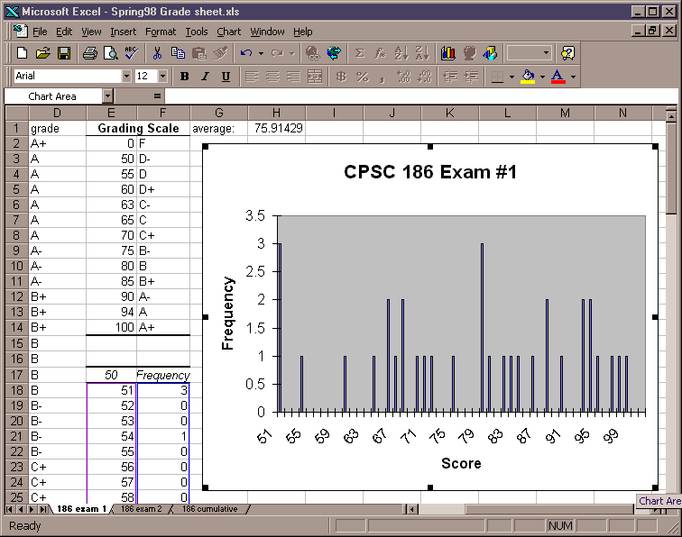
Bill Gates & Microsoft Excel
1985: Originally written for the Mac
1987: Shipped with introduction of Windows
Graphical interface
images from www.microsoft.com, Oct., 2004
Notes:
September 30, 1985--Microsoft announces the shipment to retail stores of Microsoft Excel for the Apple Macintosh, a powerful, full-featured microcomputer spreadsheet that combines business graphics with an on-sheet database.
The Apple version was graphical (even before windows).
It had no Windows competitors until 1992
In 1995 IBM acquired Lotus Development. Excel is the spreadsheet market leader at present.

Slide 6
Spreadsheet Cells
Worksheets are 2-dimensional arrays of cells.
Each cell is referred to by its cell reference.
Examples: A1, E10, AZ1024
Cells can be grouped as a range.
Examples: A1:E10, C5:Q8

Slide 7
Spreadsheet Values
Constants/literals
numbers, text labels, etc.
Formulas (always begins with an =) and can contain: cells, numbers, arithmetic, functions.
=A7 + AVERAGE(E4:E10)
Worksheet contents are updated in real time.
i.e., when you change a cell, all other cells that depend on it are updated.
Select the cell where you want the results to be.
Notes:
Constants (aka “literals”, text of numeric) – e.g., “cell text label”, “3.14159”
Formulas – e.g., =A5+A6
Functions – e.g., =SUM(A5,A20)
Build the budget table as a class example (with them following along), and review the following spreadsheet features:
Constants/formulas/functions
Columns/rows and cell addresses
relative/absolute addresses
cell ranges
copying cells using the “fill handle” with auto-updates of relative addresses
sorting columns
charting

Slide 8
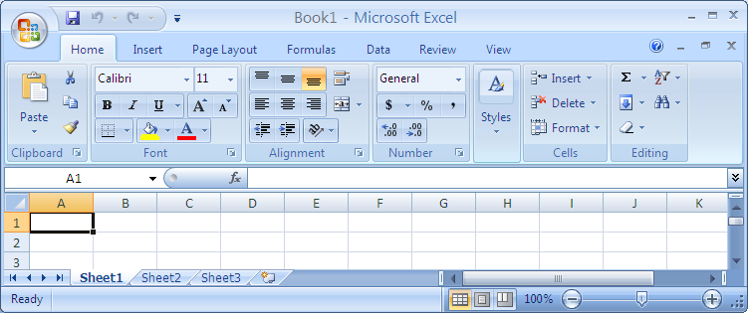
Let’s Make a Simple Budget
Worksheets are saved together in a single file called a workbook.

Slide 9
Rename your worksheet
Right click on the worksheet tab and select Rename. Then key in the new name “Budget”

Slide 10
Add a header
Go to cell A1, hold down your left mouse button and “drag” it four cells across. Then, click on the merge and center tool.

Slide 11
Some more formatting….
With the new “single” cell, key in the header. Type in “Budget for Pat” (use your name instead of Pat) Use the standard MS Office tools for background colors.
*Note: as you type, the “value” for the cell shows in the edit bar, too.

Slide 12
Stretch out the width
Move your mouse to the position between column A and B until it turns into a double arrow. Press your left mouse button and drag it to the right to widen column A. Do this for the remaining three columns.

Slide 13
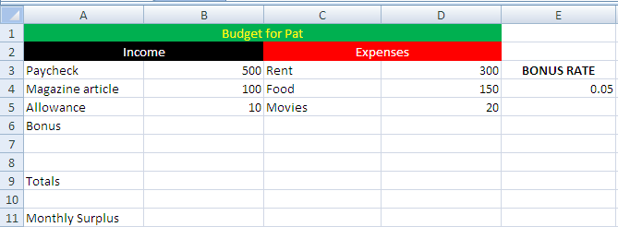
More setup
You know enough to add more. Modify the spreadsheet to look similar to the following (don’t forget to use the merge and center tool when needed)

Slide 14
Formatting
We want to make sure that the numbers look appropriate. We want dollar signs and percent signs. So, click on column B. After it highlights, right click and choose Format Cells
You will see a dialog box show up. Click on the Number tab. Then click on the option to format the numbers as currency. Then click on Okay.

Slide 15
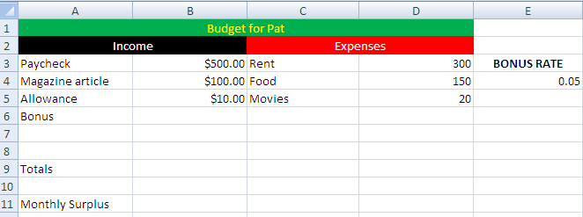
Formatting, gives you
this result.

Slide 16
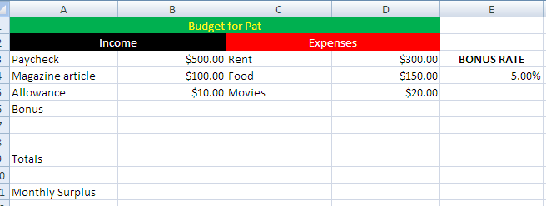
More formatting
Do the same thing for column D.
Then right click on cell with the Bonus rate (it has .05 in it), and choose Format cells. This time, select Percent in the number tab.

Slide 17
Create totals
Click on the cell next to “Totals”. In the far right hand corner, you will see an Sigma sign. Click on that, and you will see that cell filled in with a formula.

Slide 18
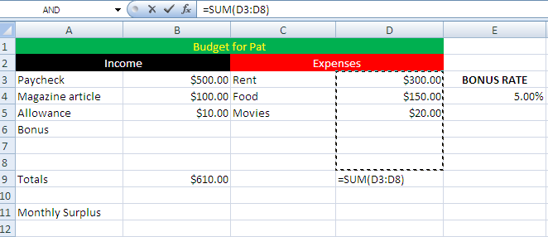
Try it yourself
Hit the enter key -- a total should appear.
Now do the same thing for the Expenses column.

Slide 19
Set the bonus
Enter the following in the cell next to Bonus:
=B3 * $E$4
You will see this is the Paycheck times the percentage bonus.
The dollar signs ensure that we always refer to just cell E4.
See the next slide for the example.

Slide 20
After hitting enter, you should see….
and notice the Totals for Income!

Slide 21
Now set up the bottom line
Click on the cell next to Monthly Surplus and enter the following: =B9-D9 (or whatever is appropriate for the totals for income and expenses)

Slide 22
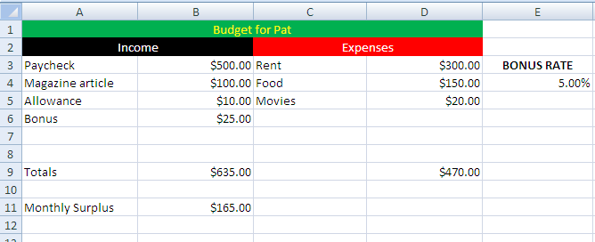
After you hit enter….

Slide 23
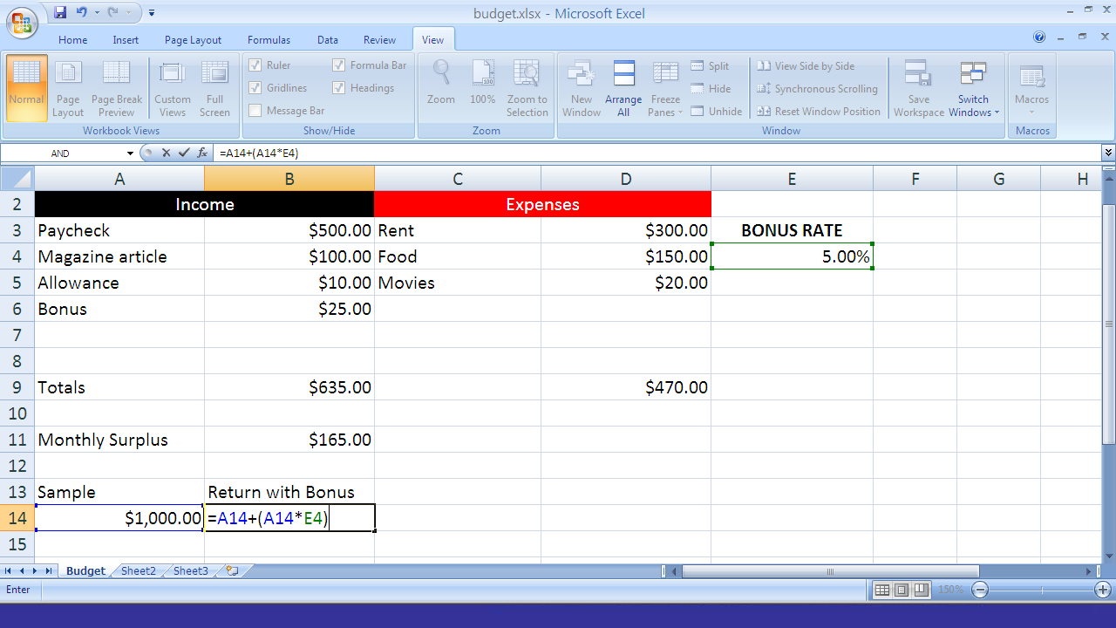

Slide 24
Copying a formula…
Add three more lines under “Sample” for 2000, 3000 and 4000
Copy the formula in the cells next those new entries under the “Return with Bonus”
You will notice something doesn’t look right.

Slide 25
The formula here is =A14+(A14*E4)
The formula here is : =A17+(A17*E7)

Slide 26
Go back and …
Change the original formula to
=A14+(A14 * $E$4)
Then copy and watch the difference.
Note: The $ sign on the reference to the BONUS figure forces each copy not to change the cell address reference (this is an absolute reference)

Slide 27
Formula Gotchas
The location of a formula is not in the formula.
select cell H17 and put a formula in it: you will not (and must not) have H17 in the formula.
A formula starts with =
a space before it means it isn’t a formula, just the characters “ =“.
no other =s in the formula
after the =, you can have spaces, functions, cell references, parentheses, etc.

Slide 28
Formula Gotchas (continued)
You should rarely have numbers in a formula
if you need to multiply by a number, put the value in a cell and reference it.
A cell reference in a formula is relative and will change if you move/copy the formula.
Suppose you have a formula in C7 that references D4: D4 really means one column to the right and 3 rows up.
If you always want D4, write $D$4.

Slide 29
Relative/Absolute Addressing
Syntax:
Relative address: A1
Absolute address: $A$1
When a formula is copied:
relative addresses are modified automatically
absolute addresses are not modified: they always refer to the same cell
Use the F4 key to convert an address

Slide 30
Spreadsheet Issues
Powerful tools can create powerful problems.
How to find bugs?
“Garbage in, garbage out.”
And, “Good stuff in, garbage processing, garbage out.”
Notes:
Tell a failure story:
James A. Cummings Inc of Florida developed a bid on a multi-million dollar project using a spreadsheet. The spreadsheet programming had an error - they added $254,000 overhead at the last minute, but the number was not added to total bid value. They underbid, got the contract, and lost a lot of money. To recover it, they sued the spreadsheet company and lost - the spreadsheet was not the cause of the “operator error”.
Moral - Know your tools; be careful; double-check your work; the organization should have checks and balances
Grab the 03Erroneous Financial Forecast.xls to illustrate this. Talk through it with them:
The administration expenses are not subtracted out of the estimated earnings (because they didn’t use SUM() to add the expenses and then added a new expense line)
The production facility costs are not increasing because they didn’t use an absolute reference for the facility cost increases)
Garbage-in-garbage out!!! Treasure in - garbage processing - garbage out!!!
How do you solve this sort of problem?
estimate results and see if they match
change some constants and see if results change
have others look over your work.

Slide 31
Technology and Humanity
What’s the
Big Idea
Working with technology can be dehumanizing.
Use it, but don’t be used by it.
“Have dominion over it.”
Notes:
Technology is a second-order part of creation. We can mold it, nurture it, be amazed by it, but it shouldn’t control or dehumanize us. In fact, it should help us be more human!
This is pretty easy to forget when we’re battling with Excel.

