Slide 1
I wish that we could calculate by steam.
- attributed to Charles Babbage
Notes:
The computer is a universal machine.
It’s a mind-set, not a skill-set. Brilliance helps, but is not required. Instead, adopt these mantras: be stubborn, bossy, lazy, obsessive, cynical, plodding, and importunate. Why? So you can use IT as a tool to do cool stuff…

Slide 2
Computer History
Computers were developed to mechanize mathematical computations.
Two definitions:
A computer is “one [a human] who computes; a reckoner; a calculator.” - Webster’s Dictionary, 1828
A computer is “a programmable electronic device that can store, retrieve, and process data.” - Merriam-Webster Dictionary, 2000
Notes:
Manual computing was very important in the 1800’s (industrial revolution) and into the 1900’s (the world wars) because of the use of mathematical tables in navigation, engineering, etc. The tables were also very hard to produce and filled with errors.
A British mathematician named William Shanks spent 28 years of his life calculating Pi to 707 places, finishing in 1873. Soon after his calculations, another mathematician called De Morgan found that Shanks had made an error in the 528th place, after which all his digits were wrong!
The 2 definitions show how the view of computing changed around 1940.

Slide 3
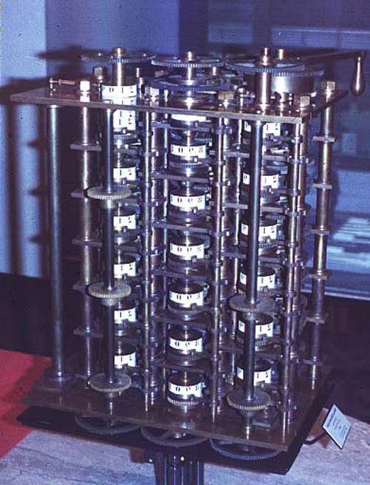
Charles Babbage (1791-1871) “Analytical Engine”
1833
Primary innovation:
The difference engine was single-purpose
The analytical engine was general-purpose
Only the difference engine was built, recently.
a recreation of the difference engine
images from http://www.computer.org/history/ Oct., 2004
Notes:
Babbage died an embittered man, having never convinced anyone of the value of his ideas (apart from Ada and a few others - see the next slide)
“recently” links to excellent 4 minute video of Difference Engine No. 2 built after 2000
http://www.youtube.com/watch?v=0anIyVGeWOI

Slide 4
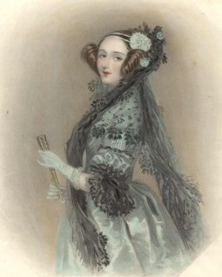
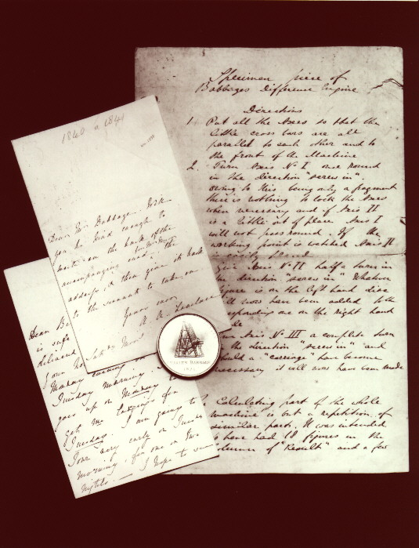
Ada Lovelace (1816-1852) “the first programmer”
Developed a set of “notes” on how to instruct the analytical engine
Suggested the use of punched cards
Known as the “first programmer”
images from http://www.computer.org/history/ Oct., 2004
Notes:
She was Countess of Lovelace and Lord Byron’s daughter. She was a supporter and mentor of Babbage.

Slide 5
The Universal Machine
A computer is known as a universal machine.
It can compute anything that can be computed.
Key ingredients in our universal machines:
Hardware: framework for “any computation”.
Software: describes a specific computation.
a communication with the computer.
Notes:
Computers are universal devices, unlike hammers and other artifacts that are designed to do one thing.

Slide 6
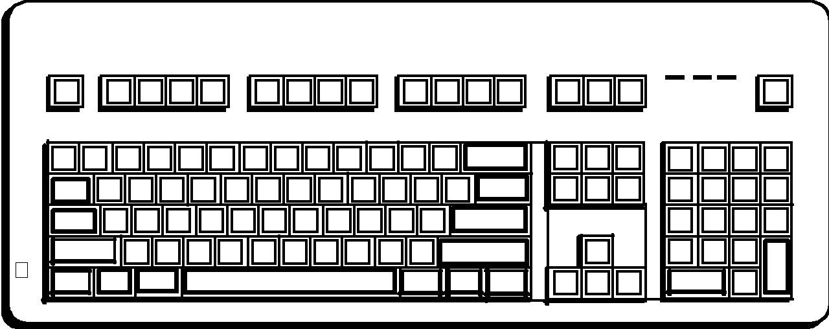
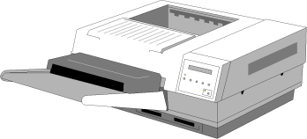
Computer Architecture
Network
Mother board
CPU
RAM
Hard disk
CD
DVD
Thumb drive
Notes:
CPU/Main Memory
System State
Secondary Storage
Peripheral devices
Network
Software

Slide 7
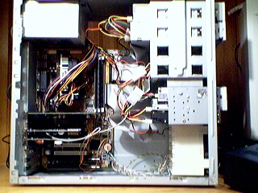
Computer Architecture
Notes:
Tear a computer open and show them all the parts, then talk about each part using the schematic diagram on the next slide as an outline.

Slide 8
Processors (CPU)
Manipulate data/instructions from memory
Three primary characteristics:
word size: the number of bits handled as a unit (32 or 64 bits)
speed: the number of machine cycles per second (2 - 4 GHz)
cores: numbers of processors in computer (2, 4, or more)
a single core can only do 1 thing at a time
Notes:
The computer’s speed/efficiency is based on these characteristics. To speed things up, increase the number of cores or the clock speed.
Least control over word size.
The Central Processing Unit (CPU) - You can find information on your MS Windows system processor in the system properties browser
AMD commercial http://www.youtube.com/embed/ocxDVl9lccE

Slide 9
Main Memory
The processor manipulates data/instructions in Random Access Memory (RAM).
Properties of main memory:
Random access
Relatively fast
Volatile: needs electricity to work
Technology:
current computers have 1 - 4GB of RAM

Slide 10
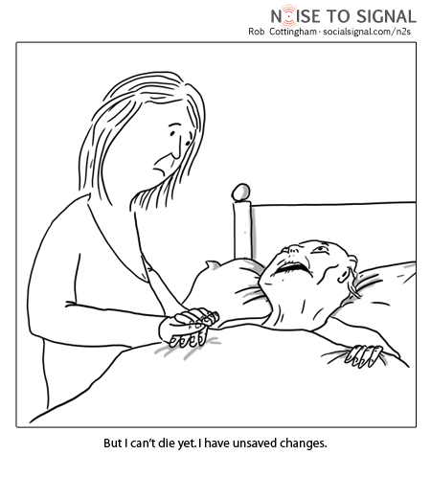
Save early, save often!
Notes:
“But I can’t die yet, I have unsaved changes”

Slide 11
Secondary Storage
Mass, long-term storage
Properties of secondary storage:
Slow
Non-volatile: no power required
Less expensive
Technologies:
Magnetic: hard disk, tape
Optical: CD, DVD
Solid state: USB stick

Slide 12
Back ups!
Both primary and secondary memory technologies are susceptible to faults.
Back up RAM to hard disk with Ctrl-S (on Microsoft products)
Back up hard disk periodically:
Use external drives.
Use on-line backup.
Notes:
Impress upon them the importance of (psychotically) backing things up.
Your H: drive in the windows lab is a network drive that is backed up by CIT. So is the Knightvision/Moodle server.

Slide 13
Memory Sizes
Bit
Byte
Kilobyte (KB)
Megabyte (MB)
Gigabyte (GB)
Terabyte (TB)
Petabyte (PB)
Notes:
Bit - A single 0 or 1
Byte - 8 bits: enough to store one character
Kilobyte (KB) – 1024 (2^10) characters: a paragraph of text
Megabyte (MB) - ~1 million (2^20) bytes: a book or a minute of mp3 audio
Gigabyte (GB) - ~1 billion (2^30) bytes: 16 hours mp3 audio, 20 minutes of DVD video
Terabyte (TB) - ~1 trillion (2^40) bytes: all the text in Calvin’s library, or 150 DVD movies

Slide 14
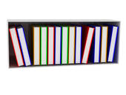
Memory Sizes, CPU Speeds
RAM: You can use information quickly on books open on your table.
CPU: gets books (applications) and files from the bookshelves
Hard disk: holds files and applications.
Bigger table = more RAM = more apps/files open at once
Faster CPU = getting apps/files is faster
Bigger hard disk = more apps/files can be stored

Slide 15
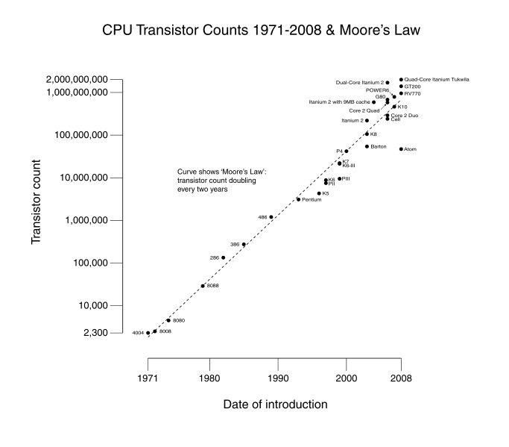
Moore’s “Law”
Processing capacity for the price doubles every 18 months
image from wikipedia, January 2009
Notes:
There is some question as to whether this trend will continue and if it will ever hit a “wall”. See Kurzweil.
Moving to multi-core changes speed-up claim.
Note the log scale on the left!!!!! Exponential growth!!
Nova segment on making things smaller: http://www.pbs.org/wgbh/nova/tech/making-stuff-smaller.html 9:10-18:26

Slide 16
Input/Output Devices
To be useful, the computer must usually be expanded by additional devices:
e.g., monitor, keyboard, mouse, camera, printer, scanner, microphone, touchpad, etc., etc., etc.

Slide 17
Computer Software
Software is composed of sets of computer instructions that:
prescribe algorithms to be performed by the hardware
are encoded and stored in computer memory using programming languages
Basic types of software:
Operating Systems
Applications
Notes:
Just summarize the basic types of software, without visiting the slides:
OS - manages the hardware/software of the computer, e.g., MacOS, Windows, Linux
Applications - support basic user tasks, e.g., Word, Excel, Dreamweaver, Powerpoint

Slide 18
Algorithms
An algorithm is a set of abstract instructions for performing a task.
Use three basic types of instructions:
Sequence: execute instructions in a particular order
Selection: execute some instructions and not others, depending on conditions
Iteration: execute instructions over and over and over
Notes:
Algorithms are like recipes.
We’ll see them used in a programming language in this week’s lab.

Slide 19
Programming Languages
Programming languages are used to encode algorithms in a computer’s language.
Types of programming languages:
machine language
(directly executed by the CPU)
high-level languages
(translated to ML with compilers)
001110110100011100101011...
Code for moving data
Code for data source
and so forth…
Speech = txtSpeak.Text
If Speech = “count to 10" Then
For i = 1 to 10
Peedy.Speak Speech
Next i
End If
Notes:
e.g., C++, Java, VB.net

Slide 20
Operating Systems
Set of programs/utilities/libraries that manages the hardware and basic operations of the computer
Common operating systems:
Microsoft Windows (e.g., XP, pocketPC)
Mac OS
Unix variants (e.g., Linux, Solaris)
PalmOS
images from www.microsoft/apple/linux/palm.com/org Oct., 2004

Slide 21
OS Functions
Loaded into memory when the computer is booted. It manages:
Programs
Memory
Files on secondary store
Peripherals I/O devices
Network connections
images from www.microsoft/apple/linux/palm.com/org Oct., 2004
Notes:
Programs
multi-tasking (show the processes and the applications in the task manager)
Memory
Loads files from disk when needed (show memory use in task manager)
Files on secondary store
keeps track of files on disk (discuss the A:, C: and H: drives in windows explorer)
Peripherals I/O devices
“talks” to all the external devices
Network connections
maintains the network connection (if any) (show network connection in task manager)

Slide 22
Software Applications
Programs built on top of the OS that support basic user tasks
Common Applications:
Word Processing
Spreadsheets
Databases
Electronic Mail
Presentation Software
Web Browsing / Development

Slide 23
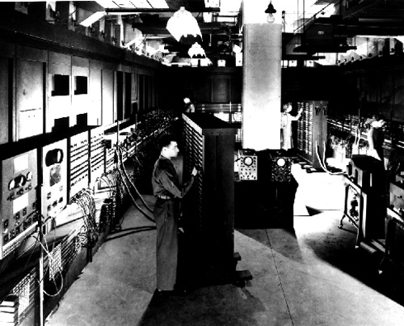
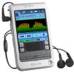
Historical Perspective
ENIAC
200 bytes memory
5,000 additions per second
Allegedly dimmed the Philadelphia lights when started
30 tons
Sony Clie PEG-T665C
144M memory (144 million bytes)
~132,000,000 additions per second
runs on a 5.2v, rechargable, lithium polymer battery
4.9 ounces
images from www.computer.org/history/ & www.sony.com Oct., 2004
Notes:
Palm VIIx has a 20MHz Motorola MC68EZ328 Dragonball processor, 8MB
of RAM, 2MB of Flash memory, and can display 16 gray scales
The Clie T665C has a new DragonBall Super VZ Processor (66 MHz CPU)/16 MB (DRAM) Memory
The original DOS OS was limited to 640K - way too small!
Ipod touch: 64GB flash drive, Built-in rechargeable lithium-ion battery, 3.56 ounces
includes display, built-in speakers, light sensor, accelerometer, three-axis gyro

Slide 24
The Digital Divide
What’s the
Big Idea
Not everyone has equal access to information technology.
“I now realize how true it is that God does not show favoritism, but accepts men from every nation who hear him and do what is right.” - Acts 10:34-35
Notes:
Key problems:
Computer technology costs money that people don’t have.
Computer literacy costs money.
IT is decidedly western in structure and support (e.g., the world-wide-web is not really world-wide).

