Slide 1
The network is the computer.
- Sun Microsystems Motto
Notes:
It’s a mind-set, not a skill-set. Brilliance helps, but is not required. Instead, adopt these mantras: be stubborn, bossy, lazy, obsessive, cynical, plodding, and importunate. Why? So you can use IT as a tool to do cool stuff…

Slide 2
Computer Networks
History
Technology
Issues
Notes:
Computer networks present:
Opportunities
users can share files
you only need 1 printer for a group of people
you can communicate via email and ftp
computing loads could be balanced between machines
Difficulties
hackers can get shared files
when the 1 printer goes down, everyone is toast
you can send spam

Slide 3
Early Computer Networks
Early machines were stand-alone machines.
But people wanted to…
share data
share resources
Growth
1960s: some mainframes
1980s: personal computers at home
2000s: everything? mandatory?
Notes:
We’ll pretty much skip directly to the internet.
Computer networks present:
Opportunities
users can share files
you only need 1 printer for a group of people
you can communicate via email and ftp
computing loads could be balanced between machines
Difficulties
hackers can get shared files
when the 1 printer goes down, everyone is toast
you can send spam
Security is a huge issue!

Slide 4
ARPANET
1969
The DOD wanted a network that could handle computers that crashed regularly.
Notes:
Packet switching is different from the explicit direct circuits used by the telephone system - if you are cut off there, you are cut off and need to re-establish a connection. In packet-switching, the packets just get re-routed. TCP/IP is one of the many packet switching protocols out there.
Note that this is very different from a centralized, switched telephone network. The DOD did not want a computer network in which communication lines could so easily be “disconnected”.

Slide 5
Internet
1983
ARPANET, CSNET & other networks combined to form the Internet.
Network of independent, heterogeneous networks.
Within your network, use whatever protocol you want.
On the Internet, use TCP/IP
Notes:
The internet is a network of networks, all using TCP/IP.
The instructor’s station has the address: pcnh180-1.calvin.edu. This is completely unique in the world.

Slide 6
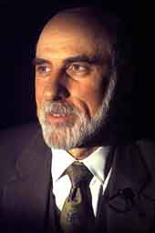
Vinton Cerf (1943- ) TCP/IP
1973
Co-invented with Robert Kahn
TCP/IP – a suite of protocols, including:
Transmission Control Protocol
Internet Protocol
Together, they form the basis of the internet.
Image from www.elseviar.com
Notes:
Transmission Control Protocol - rules for building and managing packets
Internet Protocol - rules for routing the packets
The basis of the internet for 2 reasons really:
packet switching
it was an open-network architecture, not a proprietary one.

Slide 7
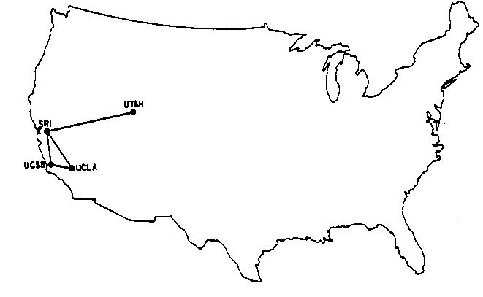
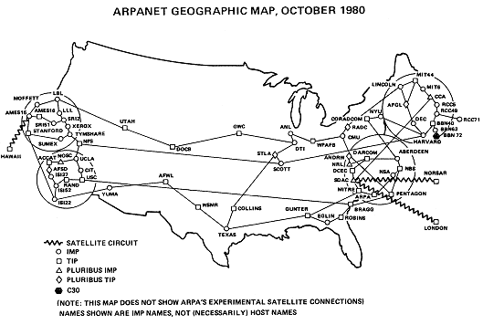
Growth of the ARPANET
ARPANET GEOGRAPHIC MAP, 1969
Images from www.cybergeography.org
Notes:
No, I won’t try to get a map of the whole internet today!

Slide 8
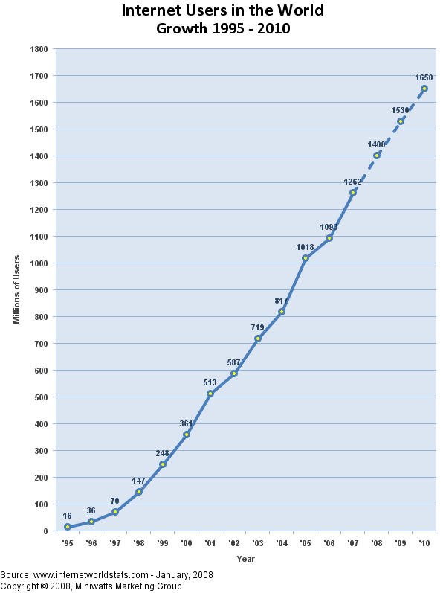
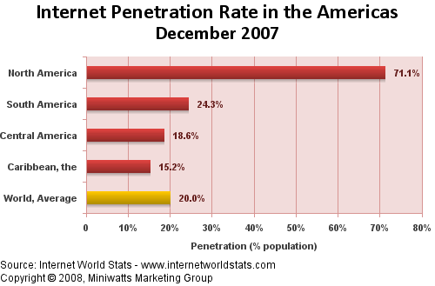
Growth of the Internet

Slide 9
Distributed Network
No one computer is in charge of the Internet.
All computers are in charge!
Some take on more responsibilities.
Computers are connected to each other in multiple ways.
Each computer routes data closer to its destination.
Routers: extra routing responsibilities.

Slide 10
Packet Switching
Data is split up into small packets.
Each packet is sent on its own to a nearby computer.
Not all packets take the same route!
The packets are reassembled into the original data.
If a packet goes missing, it’s resent.

Slide 11
Network Size
Networks can be characterized by how large they are:
Local-Area Network (LAN)
Wide-Area Network (WAN)
Notes:
Local Area Networks (LAN):
reach up to 1 mile – say for a single building or a campus
are relatively fast
Wide Area Networks (WAN):
can be global
e.g., the internet is a WAN (but not the only one)
are relatively slower

Slide 12
Network Architectures
Networks can be characterized by how they manage their resources.
Common network architectures:
Client-Server
Peer-to-Peer
Server₁
Server₂
Network
User Client₁
User Client₂
User Client₃
peer
peer
Network
peer
peer
Notes:
Common network architectures:
Client-server – Separates front-end interfaces (clients) from centralized service providers (servers) – This is by far the most common architecture today.
Peer-to-peer – used direct network connections between egalitarian client/servers (clervers!?)
Show them this commercial:
http://www-03.ibm.com/systems/tv/spacedout_flat.html
http://www-03.ibm.com/servers/uk/eserver/tv/campaigns/takebackcontrol/?ca=2005q4_SystemLead_UK

Slide 13
Network Technologies
Copper wire
coaxial or twisted pair (telephone wire, cat5/ethernet cable)
Fiber-optics
Wireless technology
Radio Frequency (RF)
Infrared radiation
Microwave
Notes:
Fiber is cheaper to fabricate, but slower to connect. Thus, copper is still common.
RF is nice, but there are limited radio frequencies to use
infrared is restricted to a single room, and is still slower than the others
microwave can’t penetrate metal either, and are potentially dangerous to humans

Slide 14
Network Connections
Computers on a Network, connect via a NIC.
Other computers connect to a POP using:
Modem (modulator/demodulator)
ISDN - digital telephone service (up to 128 Kb/s)
DSL - similar to ISDN (up to 1.5 Mb/s upload)
Cable modem - standard cable lines (up to 1 Mb/s)
Notes:
Computers on a Network, connect via a Network Interface Card (NIC)
high-speed connection to a LAN
Connecting to a Network point of presence (POP):
Modem (modulator/demodulator)
digital to analog telephone signals (up to 56 Kb/s)
connects to an Internet Service Provider (ISP)
Other technologies:
ISDN - digital telephone service (up to 128 Kb/s)
DSL - similar to ISDN (up to 1.5 Mb/s upload)
Cable modem - standard cable lines (up to 1 Mb/s)
ISDN/DSL are used because we’re stuck presently with twisted pair technology.
“broadband” refers to high-speed (> 1Mbps) internet connections
Talk about the “last mile” problem here.

Slide 15
Network Architecture
The rest of the Internet
Calvin
100 Mbps each
SB 372
ResNet
US Signal
(ISP)
Notes:
The internet is a network of heterogeneous networks, as can be seen in this myopic, SB372-centric view of the internet.
Talk through all of this, including a discussion of:
LANS (circles at Calvin)
routers link one (potentially incompatible) network to another (little box between calvin and michnet)
backbones
modems (little circles) /ISPs vs. direct internet connections (MichNet/Merit)
reiterate the “last mile” problem here
MichNet architecture is at: http://www.merit.edu/mn/resources/network/backbone.pdf
Find an architecture diagram for CIT as well.

Slide 16
Calvin’s Network
Dual 100 Mbps fiber connections to/from US Signal
400 switches
Distribution closets in all buildings – with big one in Bolt-Heyns-Timmer
All data through a “packet shaper”, “intrusion prevention device”, and “external firewall”.

Slide 17
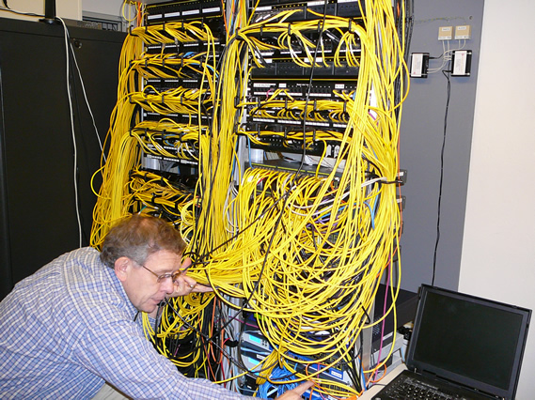
Calvin’s Network

Slide 18
Internet Services
The Internet supports a variety of information services.
These services use the Internet.
Examples:
World Wide Web (http)
Email
Telnet/SSH
FTP/SFTP
Notes:
The internet now supports a vast array of programs/systems, called services.
The Web is an Internet service that supports the sharing of hypermedia. Internet != WWW
Email is a service for exchanging mail messages.
don’t push on the other two (i.e., on telnet/ssh and ftp/sftp).

Slide 19
Website Development
Building a website is much more than hacking up a few pages in Dreamweaver.
Development processes tend to involve a number of cyclic activities:
Analysis
Design
Implementation
Testing
Maintenance
Notes:
This is known as the “waterfall” model in software development, and applies here as well. The text is too limited on this point.
Analysis – Determine what the website will do
Design – Determine how the website will do it
Implementation – build the website
Testing – try it out
Maintenance – keep it up to date and functioning properly

Slide 20
Website Examples
Websites come in all shapes and sizes:
Home Pages*
http://www.calvin.edu/~kvlinden/
Electronic portfolios
Informational references*
http://cs.calvin.edu/curriculum/idis/110/kvlinden/private/lab6/
Corporate websites
On-line communities
Notes:
*We’ll be doing one of these in this class.
Types of websites:
Home Pages*
Electronic portfolios
Informational references* - your final project
Corporate websites – Calvin’s homesite
On-line communities – Facebook, blog sites

Slide 21
Lou Montulli Cookies
A small file stored on your computer by websites
Introduced in Netscape 1.1 in 1995
Named after UNIX magic cookies
Common uses:
Sharing information among different web pages
Data collection
image from www.epinions.com
Notes:
Runner up for People Magazine’s sexiest man alive in 1999.
Here’s the preliminary spec:
http://home.netscape.com/newsref/std/cookie_spec.html
You can turn them off in your browser, but then some websites will no longer work properly.

Slide 22
Inclusiveness of the Web
What’s the
Big Idea
How “world-wide” is the web?
How could we make it more international?
How inclusive or intrusive should it be?
Notes:
Given the English-centric nature of the web, one might more accurately call it the Western-wide web.
Digital divide – the WWW is hard to access in:
the developing world
the non-western world
underpriviledged social classes
the disabled community
What could we do to help bridge this divide?
Unicode
internationalized domain name resolution
better translation tools
better international/disabled design and testing

Slide 23
Malware
malicious software: “software to infiltrate a computer system without the owner’s informed consent” [wikipedia]
definition based on the user’s intent or motive
Note: God judges us based on our motives.
includes computer viruses, worms, trojan horses, rootkits, spyware, dishonest adware, crimeware, etc.
Notes:
What kinds of data:
internet usage patterns
credit cards (even with encryption)
informational databases
proprietary systems or information
passwords
how can they be compromised:
copying
hacking into protected sites
sniffed in various ways
packet-sniffers
carnivore
companies monitoring stuff
cookies
identity theft
Privacy is somewhat of a fallacy on the internet.
What to do:
privacy legislation
proper security
ethical behavior.

Slide 24
Malware (cont)
virus: attached to an existing program, does damage to files, and copies itself.
worm: unattached, damages the network, and copies itself.
trojan horse: opens up a “backdoor” to the system for future unauthorized access; non-replicating.
spyware: collects info about users.
crimeware: for identity theft.

Slide 25
Privacy and the Internet
What’s the
Big Idea
The internet never sleeps, it never forgets and it doesn’t always tell the truth.
phishing schemes
The internet makes information more vulnerable to improper use.
What can be done about this?
“…be shrewd as snakes and as innocent as doves.” - Matthew 10:16
Notes:
What kinds of data:
internet usage patterns
credit cards (even with encryption)
informational databases
proprietary systems or information
passwords
how can they be compromised:
copying
hacking into protected sites
sniffed in various ways
packet-sniffers
carnivore
companies monitoring stuff
cookies
identity theft
Privacy is somewhat of a fallacy on the internet.
What to do:
privacy legislation
proper security
ethical behavior.

