Slide 1
Graphs and Charts
Quantitative data can frequently be illustrated in a compelling way using charts and graphs.
see www.gapminder.org for fascinating, interactive charts
Spreadsheet systems usually provide graphing and charting capabilities.
Here are some examples.
Notes:
Lotus added charting to the spreadsheet concept.
Sometimes a picture is worth 1000 words.

Slide 2
© Keith Vander Linden, 2005
Notes:
This simple bar chart is much more clear than the raw numbers in the upper left.
Show them how to build this chart.
People are visually oriented, making the chart much easier to understand (provided it is illustrating the right thing the right way).

Slide 3
Bar chart of same data

Slide 4
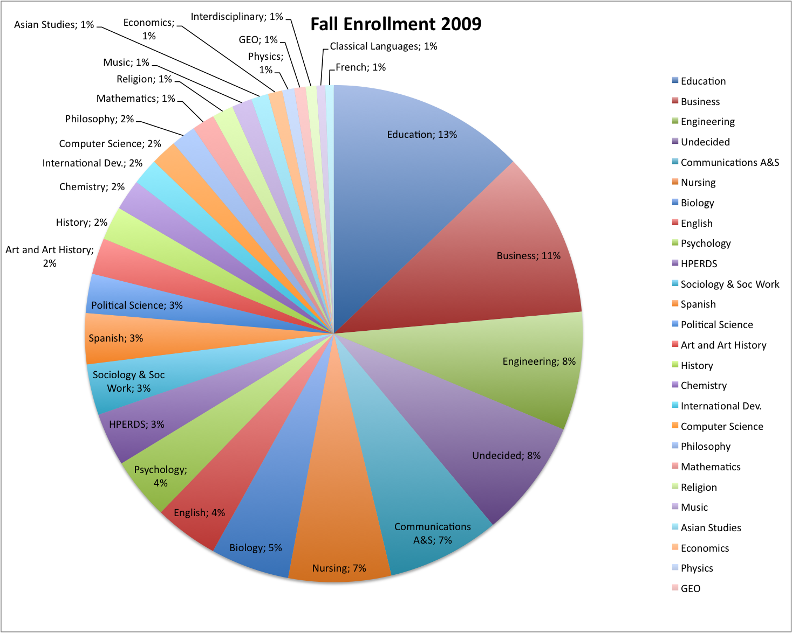
Pie chart of same data

Slide 5
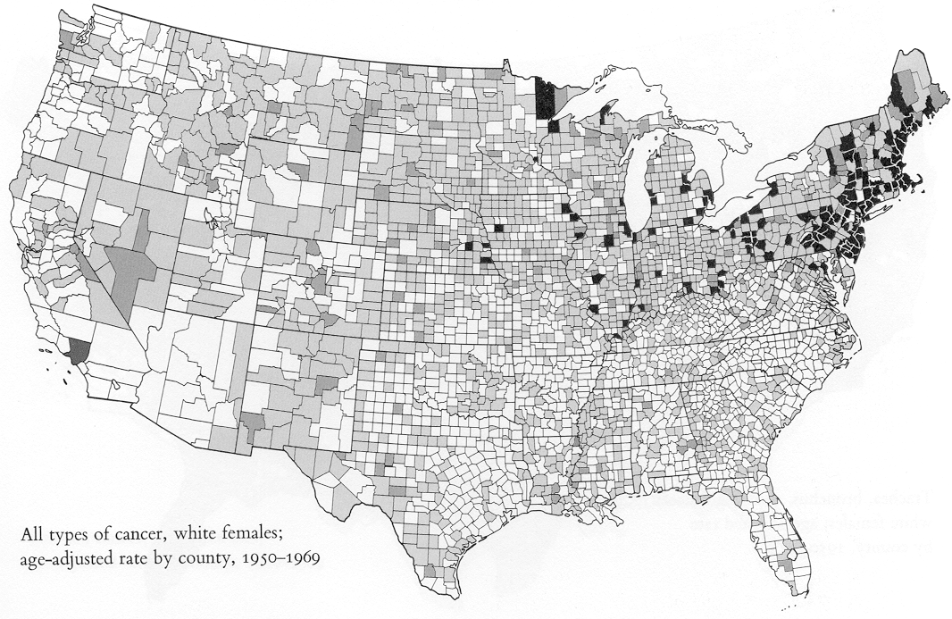
image from VDQI, 1983
Notes:
Tufte, page17 top here
This chart displays 21,000 data points very very well.

Slide 6
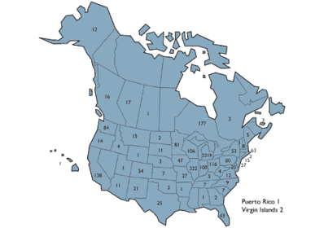
Chart Types
Pie charts
proportional relationships
Column/bar charts
relative numeric information
(rather than percentages)
Line charts
change in values over time
Maps
geographical information
spatial relationships
Notes:
Pie charts - proportional relationships
Column/bar charts - relative numeric information (rather than just percentages)
Line charts – change in values over time
Maps - geographical information (obviously), people are very good at noting
spatial relationships.

Slide 7
Graph/Chart Issues
Data values can, however, be obscured or misrepresented using charts.
Here are some examples.
Notes:
Sometimes a picture is worth 1000 lies.

Slide 8
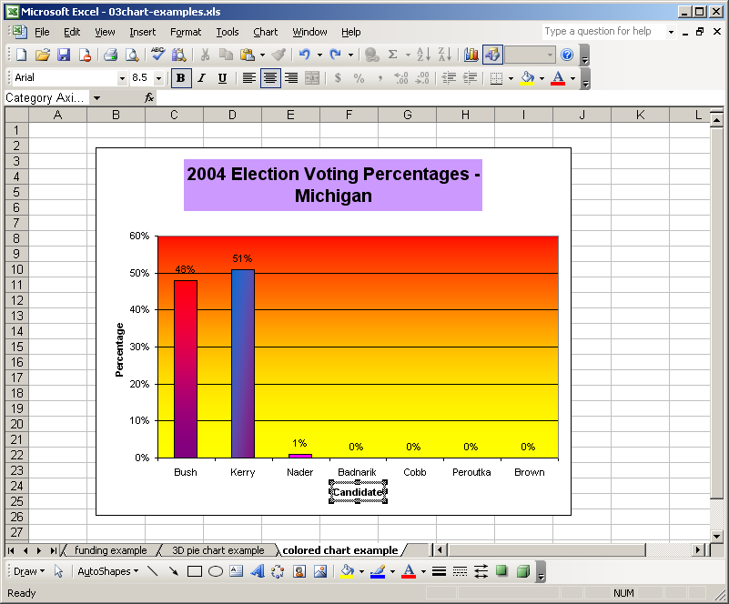
© Keith Vander Linden, 2005
Notes:
These colors obscure the real message of the chart, and would basically make it hard to photocopy a legible version.
Don’t be cute with your slides – KISS!
KISS is an acronym for the design principle "Keep it simple, Stupid!”. Other variations include "keep it short and simple”, "keep it simple AND stupid" or "keep it simple and straightforward”. The KISS principle states that simplicity should be a key goal in design, and that unnecessary complexity should be avoided.

Slide 9
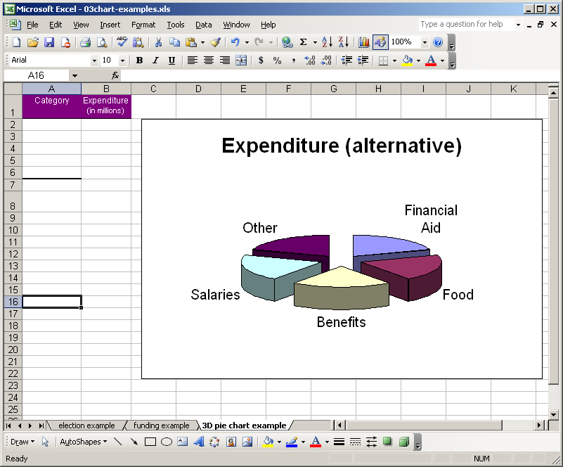
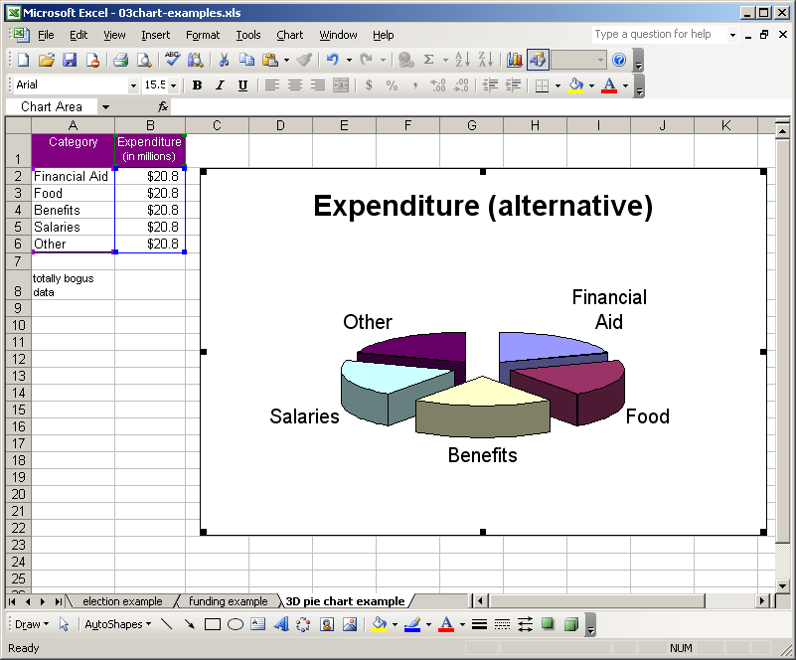
© Keith Vander Linden, 2005
Notes:
This chart misrepresents the data values in a subtle way - 3D pie charts are evil. See if they can guess what the real proportion is here.
Don’t be cute with your slides – KISS!

Slide 10
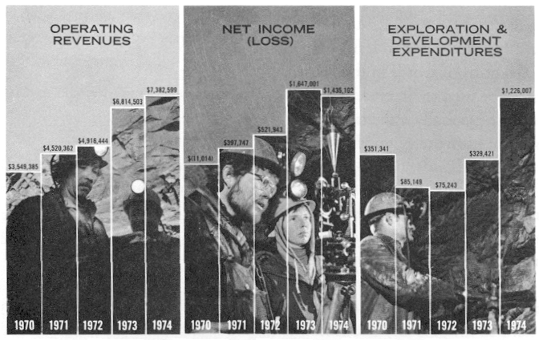
image from VDQI, 1983
Notes:
Tufte, page 54 top here
This chart masks the net loss in 1970. You’re looking at the pictures and not at the y-axis manipulations.

Slide 11
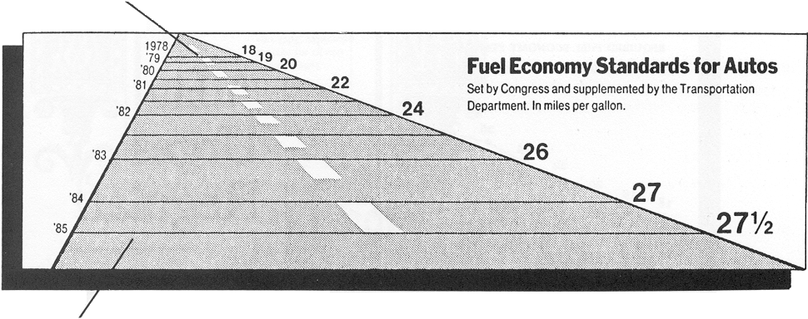
image from VDQI, 1983
Notes:
Tufte page 57 bottom
This chart is terrible
high lie factor (ratio of spatial change with data change) distance between lines not consisten
time goes from top to bottom (not standard in the west)
text is all the same size, so perspective is lost
bigger numbers on right appear smaller because of perspective

Slide 12
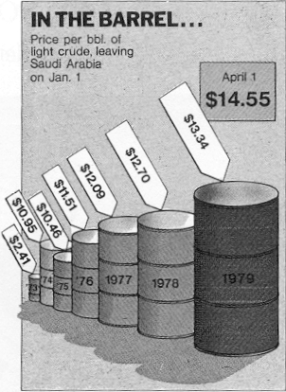
image from VDQI, 1983
Notes:
Tufte, page 62
this has a high lie factor with a political intent.
The data variation of 454% is depicted with a surface area variation of 4280% and a volume variation of 27000%

Slide 13
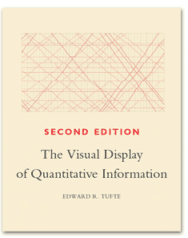
Edward Tufte (1940-) VDQI, 1983
Lying graphics cheapen the graphical art everywhere … When a chart on television lies, it lies millions of times over; when a New York Times chart lies, it lies 900,000 times over to a great many important and influential readers. VDQI, p. 53-79
images from www.edwardtufte.com, Oct., 2004
Notes:
See http://www.edwardtufte.com/tufte/

Slide 14
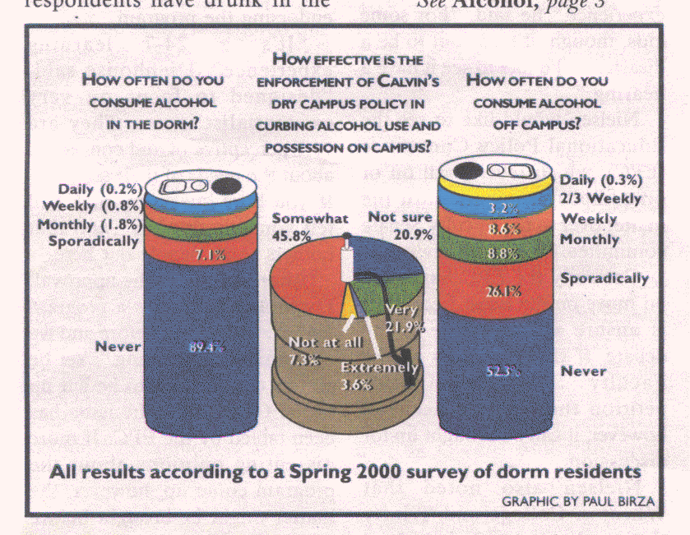
from Calvin College Chimes, Oct. 6, 2000
Notes:
Note the differing scales on the can at left from can at right.
L can - approx 25% of can is taken up in about 10% of data, making it seem that there’s more consumption on campus than there really is.
R can - blue 3.2% is same size as orange 8.6%
It seems that they’ve modified the data size in order to get the words on the page properly…
What chart would you really use to display this sort of data?
(These notes from Brenda Vander Linden)

Slide 15
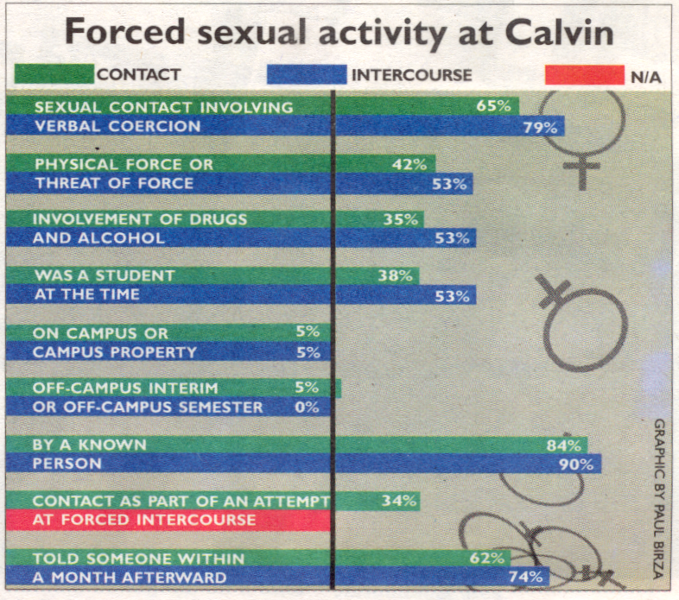
from Calvin College Chimes, Sept. 29, 2000
Notes:
PREFACE: I don’t mean to diminish the severity or horror of rape by showing this graphic. It’s an awful crime and that should never be made light of.
However, the graphic the Chimes used to present the material is seriously flawed:
Here, the vertical black line is intended to be ZERO, thus all the lines look much longer than they really should be.
Unclear whether text on left refers to both bars together, or each individually. In fact, the whole green/blue thing doesn’t make any sense to me (e.g., what is the “intercourse” blue line mean on the first pair of bars discussion “contact”?)
Notice the 5th and 6th sets of bars. Three 5% indicators but not same length.
(Incidentally, there is no indication that the rape statistics covered the women from age 14 to the present, which would include activity off campus and even before college. In actuality, only 3% of the 301 women responding had been raped since coming to Calvin, and of those, only one had actually been raped on campus.)
(These notes from Brenda Vander Linden)

Slide 16
image from Exploring Microsoft Excel 97, Grauer & Barber, 1998
Notes:
Based on Grauer, figure 14.4, page 176
Didn’t label the units! Is this percentage of dumb instructors or what?

Slide 17
image from Exploring Microsoft Excel 97, Grauer & Barber, 1998
Notes:
Based on Grauer, figure 4.15B, page 177
Added dissimilar quantities

Slide 18
Using Charts/Graphs Properly
Decide what you want to present.
Present it accurately and unambiguously.
Let the graphic values/change accurately depict the data values/change.
Clearly label all relevant details.
Don’t graphically mix dissimilar elements.
Use the right type of graph.
Don’t add “chartjunk”.
Notes:
Be honest. If necessary, have other people look at your work to catch any slant you may have.

Slide 19
Technology and Lying
What’s the
Big Idea
It is as easy to lie or mislead with technology.
“When he lies, he speaks his native language, for he is a liar and the father of lies.” - John 8:44
Notes:
The

