Slide 1
IPv6
Victor T. Norman

Slide 2
IPv4
Strengths: IPv4 has accommodated:
Extreme growth in networks.
Large variety of and changes in hardware characteristics
Changes in frame sizes.
Weaknesses:
32 bit addresses → we have run out!
Can not guarantee service – consistent jitter, e.g.
Required for real-time audio and video.

Slide 3
IPv4 / IPv6 Similarities
Connectionless protocol
Contains destination address and uses packet switching.
Contains a counter to ensure packets take a maximum number of hops.

Slide 4
IPv4 / IPv6 Differences
All fields are different – nothing carried over from IPv4.
128 bit addresses (4 times larger than IPv4).
Uses base header + extension headers.
Base header has only required fields; extension headers have fields needed in some situations.
IPv4 has fields in the header that are rarely used.
Fragmentation very different.

Slide 5
IPv4 / IPv6 Differences
Has support for real-time traffic.
Sender/receiver can establish a path with known characteristics – not possible in base IPv4.
IPv6 allows future extensions to be added.

Slide 6
Packet format
Base header, followed by N optional extension headers, followed by payload.
Base header 2x larger than IPv4, but fewer fields.

Slide 7
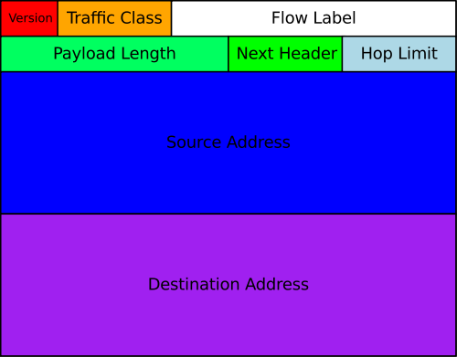

Slide 8
Fields
Version = 6 (note: in same position in IPv4 header)
Traffic class uses “Differentiated services” definitions – low latency, low jitter, etc.
Payload length: just for payload.
Hop limit (like ttl but named better).
Flow label: identify a network path – unlikely to be used nowadays.
Next header: type of the next header – or type of data in payload if no next header.

Slide 9
Fragmentation
Sending host is responsible for fragmenting and sending fragments small enough to reach destination.
Routers do not fragment – they send ICMPv6 error message and drop packet.
Sending hosts may use path MTU discovery.
Or, easier: use minimum MTU of 1280 octets.

Slide 10
Addressing
Like IPv4:
One address per interface
Address split into network part and host part – each fixed at 64 bits.
Unlike IPv4:
Can have multi-level hierarchy within the address.
ISP part, company part, site part, building part, etc…

Slide 11
Addressing
3 kinds of address:
Unicast, multicast, anycast.
Anycast: can assign same address to a cluster of computers and IPv6 will route to one of them.
Colon hexadecimal notation (colon hex)
8 sets of 4 hex characters (2 bytes) separated by colons: 69DC:8864:FFFF:FFFF:0:1280:8C0A:FFFF
Zero-compression: multiple 0-bytes skipped:
69DC:8864::F1

Slide 12
IPv4-mapped IPv6 Addresses
First 80 bits are 0.
Next 16 bits are 1.
Last 32 bit are IPv4 address.
Often written with last bytes in dotted-decimal notation:
::FFFF:192.0.2.128

Slide 13
Stateless Address Autoconfiguration (SLAAC)
Like DHCP – but a host can self-configure.
Host sends ICMPv6 router discovery message.
Router responds with network-layer info.
Host uses network part and uses its (unique) MAC address as part of the host part of the address.
Whole networks can be renumbered with router prefix advertisements (theoretically).

Slide 14
Using IPv6 with sockets
Using an OS with dual-stack implementation, a socket can handle both IPv6 and IPv4.
Using IPv4-mapped IPv6 addresses.
Otherwise, have to open 2 sockets – one for IPv4 and one for IPv6.

Slide 15
DNS and IPv6
DNS has supported IPv6 addresses for a long time – using AAAA records.
Reverse lookups work too, via ip6.arpa domain.

Slide 16
Transition Strategies
Backbone Internet uses IPv4 now, but ISP can’t issue any more IPv4 addresses…
New customers get IPv6 addresses.

