Slide 1
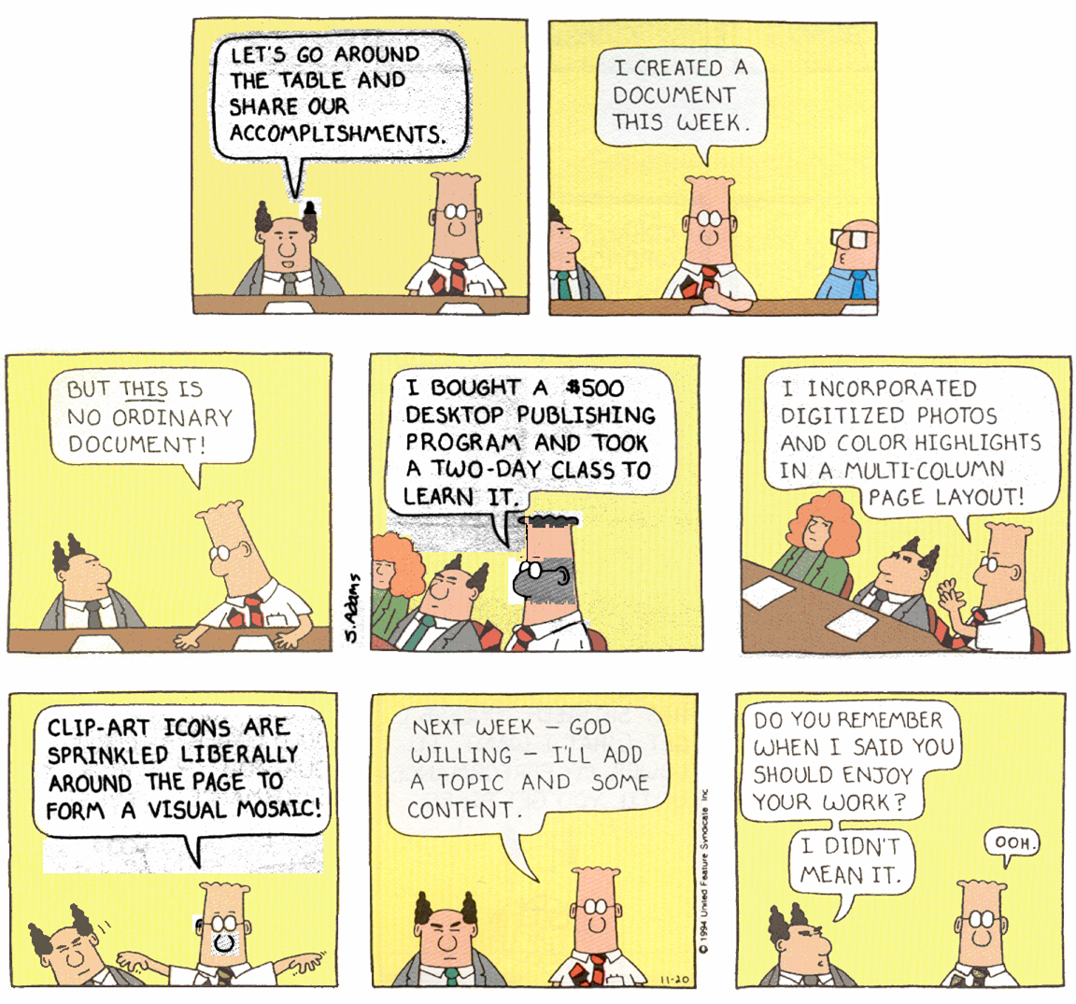
Dilbert © United Feature Syndicate, Inc.

Slide 2
Technical Writing
Types
Modes
Content
Writing
  Nobody reads documentation. – Mark Rettig, CACM, 1991
Notes:
Oh yes they do…

Slide 3
Internal Documentation
  code prologues
  internal comments
  self-documenting stuff :
    variable names
    structured programming
    good OO design
Notes:
You’re doing all of these in your project.
This stuff you already know about.
I crabbed about these a lot during the code review because they are critical
in a group programming environment - you may quit and be replaced by some
poor soul that will have to take over your code.
Tim Collins’ Laws of Software Maintenance:
First Law: Other people’s code tends to look like undecipherable junk.
Second Law: Your own code will look like someone else’s code after 6 months.

Slide 4
External Documentation
  Management documents:
    risk management plan
    project plan
    SQA plan
  Conventional SE documents:
    system specification
    requirements document*
    design document (various levels)*
    test plan (various levels)
  Users documentation:
    installation guides*
    tutorials
    user's guides
    reference guides
    super index
    on-line help*
Notes:
This is the unpleasant surprise.
* You’ll do all of the marked types for your project.

Slide 5
External Documentation
  Management documents:
    risk management plan
    project plan
    SQA plan
  Conventional SE documents:
    system specification
    requirements document*
    design document (various levels)*
    test plan (various levels)
  Users documentation:
    installation guides*
    tutorials
    user's guides
    reference guides
    super index
    on-line help*
Notes:
This is the unpleasant surprise.

Slide 6
sanity check...
Projects produce loads of documentation.
Is this a waste of paper and of time?
Notes:
Big projects produce lots of documents
so will yours!
The B52 bomber cannot carry all its documentation.
The CV documentation sinks the boat 15 ft into the water.
Expensive/time-consuming/frustrating
Is this a waste of time? NO!
How many of you have used some form of documentation
so far in your project?
You sometimes need the documentation…
Writing it is a good exercise in understanding.
It helps communication during the design process, particularly
for new project members getting up to speed.
Nobody Reads Documentation - Mark Rettig, CACM, 1991

Slide 7
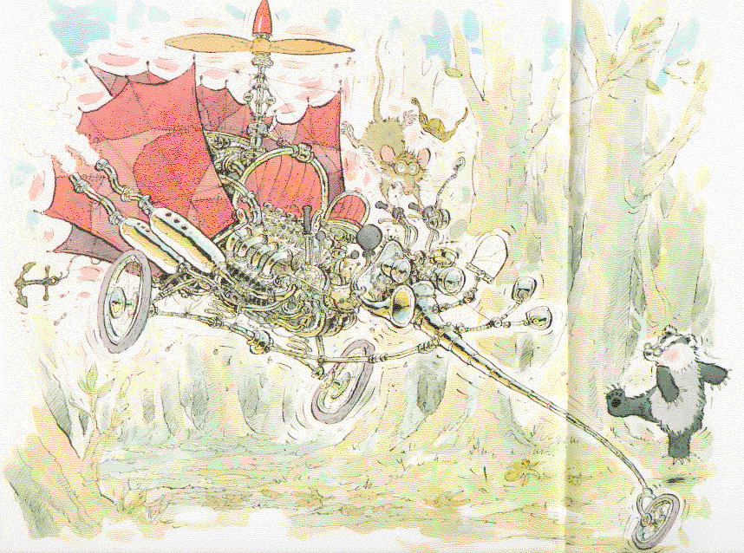
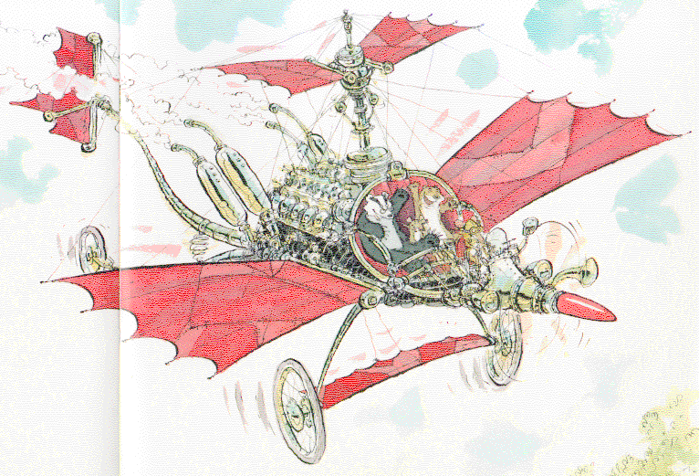
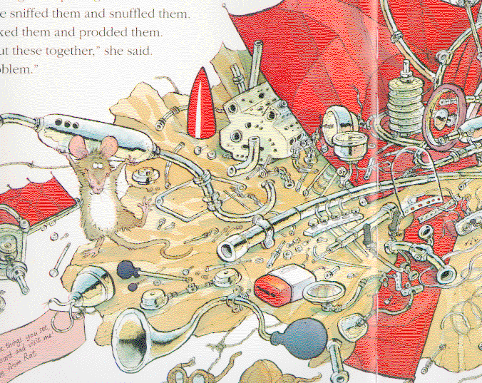
No Problem!
Images from Browne/Parkins, Candlewick Press, 1993
Notes:
No Problem
by Eileen Browne, David Parkins (Illustrator)
Paperback: ; Dimensions (in inches): 0.25 x 10.25 x 9.25
Publisher: Candlewick Press; Reprint edition (January 1996)
When all else fails, read the directions

Slide 8
Date: Tue, 20 Apr 1999 16:54:15 -0400
From: <deleted>
To: SIGCSE.MEMBERS@ACM.ORG
Subject: Re: impact of college
On 4/19/99 @ 3:48 PM, rsc@CASTOR.CSUSTAN.EDU (Steve Cunningham) wrote:
> Years later, several of us were working on a career handbook for computer
> graphics and a member of the group surveyed graphics professionals about
> the skills required for the profession. The skill that was reported as
> the most critical -- and that 98% of respondents listed as required -- was
> communication ability. And interestingly enough, both verbal and written
> communication skills had the same score. Jack hit it on the head.
I was once hired by a company and offer $10,000 more than I was making on the
other company simply because, as my new boss at the time put it: "You are the
only person I know that can write C code and speak English"... and English is
my second language :-)
I often tell my students this story because they often beleive that if they can
"code" they have got it made.

Slide 9
Modes of Documentation
In-line code comments
Paper documents
Hypertext manuals
On-line help systems
Video demonstrations
Reference cards
Help desks

Slide 10
Modes of Documentation
In-line code comments*
Paper documents*
Hypertext manuals*
On-line help systems*
Video demonstrations
Reference cards
Help desks
Notes:
* You’ll do all of the marked modes for your project.

Slide 11
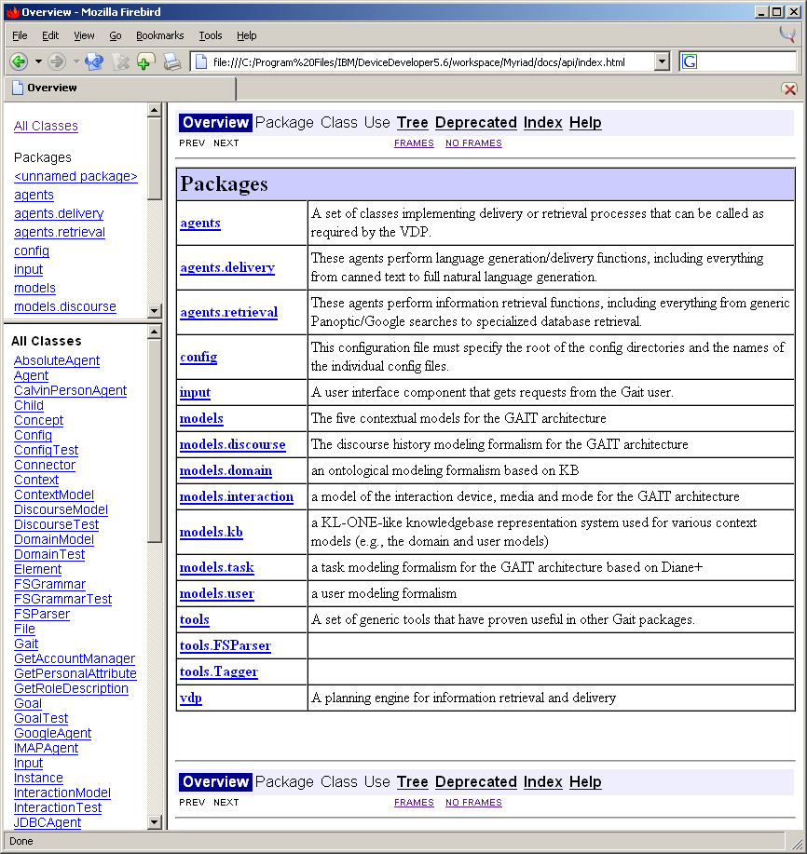
JavaDoc
Javadoc generates API documentation in HTML format from doc comments in Java source code.

Slide 12
User’s Documentation
A class of documentation aimed at the user of the software.
Users judge the quality of your system in part on it.
Unfortunately, it has a bad reputation.
Notes:
We’ll focus on those aspects of the documentation that you will be doing for your projects, ignoring the others for the most part.

Slide 13
Bad User’s Documentation
Depress knob and hold for 60 seconds after pilot has been lighted. Release knob and turn to On position. - a furnace manual
Do you have to light the pilot manually?
How would you rewrite this?
Notes:
Tell Susanna’s story.

Slide 14
Better User’s Documentation
Depress knob and hold for 60 seconds after pilot has been lighted. Release knob and turn to On position. - a furnace manual
Press and hold the knob. Light the pilot and wait for sixty seconds. Release the knob, and turn it to the ON position. -Imagene
Notes:
Use an explicit “light” command.
Imagene is an automated system that I wrote in graduate school.

Slide 15
Better User’s Documentation
Depress knob and hold for 60 seconds after pilot has been lighted. Release knob and turn to On position. - a furnace manual
Press and hold the knob. Light the pilot and wait for sixty seconds. Release the knob, and turn it to the ON position. -Imagene

Slide 16
Better User’s Documentation
Depress knob and hold for 60 seconds after pilot has been lighted. Release knob and turn to On position. - a furnace manual
Press and hold the knob. Light the pilot and wait for sixty seconds. Release the knob, and turn it to the ON position. -Imagene
Notes:
Imagene uses articles and pronouns.

Slide 17
Potential Problems
The info the user wants isn't in the manual.
It's there, but the user can't find it.
The user can find it, but can't understand it.
The user can find it and understand it, but it's wrong, out of date, or inaccurate.
Notes:
Don’t allow these things to happen; write good documentation.

Slide 18
User’s Guide
Task-centered documentation
Should contain:
  explicit examples
  expected feedback
  concise overviews with hyperlinks to details
“Minimal” manuals:
  intentionally incomplete
  force users to explore on their own
Notes:
More common than minimal manuals is to produce levels of documentation verbosity:
quick reference card
quick tutorial
full user’s manual

Slide 19
Reference Guide
Lists all the commands:
  alphabetically (good for command-line interfaces)
  hierarchically (better for shallow GUIs)
Optional, but good for advanced users/administrators

Slide 20
Super Index
Indexes basic terms for the system
Vocabulary problem:
  Choosing names is hard
  Multilingually, it's even harder
  Use an index with multiple terms
Notes:
Vocabulary problem
choosing names is hard
e.g., What should you call "start" ADT?
multilingually it's even harder
e.g., Amanda's Spanish name problem
Bellcore study:
1/10 chance for "armchair" name to match chosen name.
The most common name had only 1/5 the votes.
Solution => use an index with multiple terms
key word search for on-line systems.
How would you build one?
We won't do this one either.

Slide 21
On-Line Help
Is on-line help better or worse than paper documentation?
The good news:
  It's there all the time
  It can be context sensitive
  It’s great for brief reminders
The bad news:
  It isn't better than paper and may well be worse.
It is fundamentally different from paper.

Slide 22
On-Line Help (cont.)
What’s wrong with on-line help?
  Computer text is harder to read
  There's less of it on the screen
  Sometimes it's nice to have a manual separate from the screen
  Hypertext navigation can be confusing
  You can't mark it up or book mark it
  People aren't used to it

Slide 23
Constraints for On-Line Text
Use dark test on a light background.
Be consistent with the application.
Give navigation facilities:
  forward/back
  TOC
Lines should be no longer than 60 characters.
Capital letters should be >= 3mm tall.
Notes:
These are all from the British standard for on-line technical documentation.

Slide 24
Installation Guide
Explains how to install the software system on various platforms
Notes:
Obviously

Slide 25

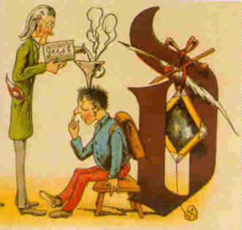
John M. Carroll
The minimal manual
The Nurnberg Funnel, 1990
Minimalist Instruction:
  Allow learners to start using the system immediately.
  Reduce the amount of reading.
  Make errors less traumatic and more instructive.
Der Nurnberger Trichter
Images from www.cs.vt.edu, Apr, 2004
Notes:
The legendary Funnel of Nurnberg was said to make people wise very quickly when the right knowledge was poured in; it is an approach that designers continue to apply in trying to make instruction more efficient. This book describes a quite different instructional paradigm that uses what learners do spontaneously to find meaning in the activities of learning. It presents the "minimalist" approach to instructional design - its origins in the study of people's learning problems with computer systems, its foundations in the psychology of learning and problem solving, and its application in a variety of case studies. Carroll demonstrates that the minimalist approach outperforms the standard "systems approach" in every relevant way - the learner, not the system determines the model and the methods of instruction. It supports the rapid achievement of realistic projects right from the start of training, instead of relying on drill and practice techniques, and designing for error recognition and recovery as basic instructional events, instead of seeing error as failure. The book's many examples - including a brief discussion of recent commercial applications - will help researchers and practitioners apply and develop this new instructional technology. John M. Carroll has participated for a number of years as a leader in the interdisciplinary field of human-computer interactions. He is Manager of User Interface Theory and Design at IBM's Watson Research Center. The Nurnberg Funnel inaugurates the Technical Communications series, edited by Ed Barrett.

Slide 26
The Writing Proper
Writing for the technical industry
Topics:
  Audience analysis
  Basic Grammar
  Basic Style
Hints:
  Revise, revise, revise
  Get someone to proofread it for you

Slide 27
Audience Analysis
Audience types for technical writing:
  Experts
  Technicians
  Executives/managers
  Non-specialists (of various grades)
This may seem obvious, but it is critical.
Notes:
Speaking the reader's language requires knowing who the reader is.
Audience types: (make them guess the manual types)
Experts
design documents are targeted here
technicians
maintenance manuals are targeted here
Executives/managers
sections of the requirements document
risk analysis
hardware/software support requirements
non-specialists (of various grades)
users manuals/tutorials
Military manuals write to the 6th grade level.
examples tend to be critical here
I hate man pages without examples?
This will be your audience.
This may seem obvious, but we forget.
e.g., in 121, I can't just say "copy the mdb file first",

Slide 28
Grammar for Technical Writing
agreement
anaphora
attachment problems
articles
split infinitives
Notes:
Anaphora is “backward reference”

Slide 29
Agreement
When the set of windows {is/are} closed, ...
The flavor of youth - its trials, its joys, its challenges - {is/are} not soon forgotten. - Strunk & White, Elements of Style
Notes:
Set and flavor are both singular, so “is”. Draw this on the slides manually.

Slide 30
Pronouns
The harder the teachers tried to explain the material to the students, the quieter they got. - E231, U. Washington
Tom told James that he had won the lottery. - ibid
Notes:
What about the “they” in the first sentence and the “he” in the second? What do they refer to? In this case, it’s unclear.

Slide 31
Pronouns: Example 1
"The Last Supper" is painted on the dilapidated wall of what was a little chapel attached to the main church in ancient times, I suppose. It is battered and scarred in every direction, and stained and discolored by time, and Napoleon's horses kicked the legs off most the disciples when they (the horses, not the disciples) were stabled there more than half a century ago. - The Innocents Abroad, Mark Twain
Notes:
Note the “they (the horses not the disciples)” joke related to anaphora.

Slide 32
Pronouns: Example 2
You know him better than {I/me}.
Notes:
What does this one mean?
You know him better than I know him.
You know him better than you know me.
See Greenbaum/Quirk, Student’s Grammar, section 6.7.
Either form is acceptable. Being after the verb puts the pronoun in object “territory”.
The “me” is more informal; in writing, the problem is often avoided by saying something like “the I do”.

Slide 33
Attachment
???
I saw the Grand Canyon flying to New York.
I saw the dog on a hill with a telescope.
???

Slide 34

Attachment
I saw the Grand Canyon flying to New York.
I saw the dog on a hill with a telescope.

Slide 35
Attachment
I saw the Grand Canyon flying to New York.
I saw the dog on a hill with a telescope.

Slide 36
Articles
open dialog box
open the dialog box
Notes:
Telegraph speak - very common in instructions
parents tend to talk to kids this way
people tend to talk to computers this way also!

Slide 37
Split Infinitives
to boldly go where no one has gone before
to go boldly where no one has gone before

Slide 38
Split Infinitives
infinitive
to boldly go where no one has gone before
to go boldly where no one has gone before
adverb
Notes:
“News Flash”: Split infinitives have recently been acknowledged as legitimate.
The split infinitive construction goes back to the 13th century, but was relatively rare until the 19th. No split infinitives are to be found in the works of Shakespeare, Spenser, Pope, or Dryden, or in the King James Version of the Bible.– alt.usage.english FAQ
I can think of two very good reasons for not splitting an infinitive.
Because you feel that the rules of English ought to conform to the grammatical precepts of a language that died a thousand years ago.
Because you wish to cling to a pointless affectation of usage that is without the support of any recognized authority of the last 200 years, even at the cost of composing sentences that are ambiguous, inelegant, and patently contorted.
It is exceedingly difficult to find any authority who condemns the split infinitive - Theodore Bernstein, H. W. Fowler, Ernest Gowers, Eric Partridge, Rudolph Flesch, Wilson Follett, Roy H. Copperud, and others too tedious to enumerate here all agree that there is no logical reason not to split an infinitive. -- Bill Bryson, Mother Tongue, 1990

Slide 39
Style for Technical Writing
active/passive
wordiness
stilted language
negatives
context
lists
consistency

Slide 40
Active/Passive
Depress knob and hold for 60 seconds after pilot has been lighted. Release knob and turn to On position. - the furnace example
Chapter IV, in which it is shown that Tiggers don't climb trees - The house at Pooh Corner A. Milne
Parents - Socks must be worn while in Ronald’s Play Place. Thank You - McDonalds Co.

Slide 41
Active/Passive
Depress knob and hold for 60 seconds after pilot has been lighted. Release knob and turn to On position. - the furnace from before
Chapter IV, in which it is shown that Tiggers don't climb trees - The house at Pooh Corner A. Milne
Parents - Socks must be worn while in Ronald’s Play Place. Thank You - McDonalds Co.

Slide 42
Wordiness
Owing to the fact that the notion of Artificial Intelligence is poorly defined, there is no doubt but that it is a loosely knit field.
Better: AI is poorly defined, so the field is disjoint.

Slide 43
Wordiness
Vigorous writing is concise. A sentence should contain no unnecessary words, a paragraph no unnecessary sentences, for the same reason that a drawing should have no unnecessary lines and a machine no unnecessary parts. This requires not that the writer make all his sentences short, or that he avoid all detail and treat his subjects only in outline, but that every word tell. - see Strunk's text on omitting needless words.

Slide 44
Stilted language
We utilized said methodology.
Better: We applied this method.

Slide 45
Negatives
Don't use negative imperatives.
Notes:
This command is self-contradictory

Slide 46
Context
When you have chosen a filename, click on the save button.
Click on the OK button. The system indicates that it is finished by printing "File Saved...".

Slide 47
Context
When you have chosen a filename, click on the save button.
Click on the OK button. The system indicates that it is finished by printing "File Saved...".
Notes:
Be sure to state the precondition.

Slide 48
Context
When you have chosen a filename, click on the save button.
Click on the OK button. The system indicates that it is finished by printing "File Saved...".
Notes:
You should also state the expected/correct system feedback.

Slide 49
Lists
Use lists to make the structure clear.
Enumerate ordered sequences of actions.

Slide 50
Consistency
Parallel lists should have parallel grammar.
Documents should have a standard style and format throughout.

