Slide 1
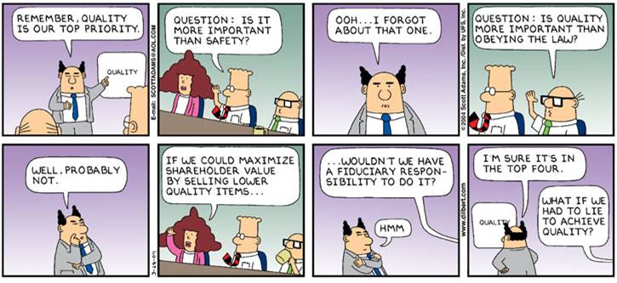
Dilbert © United Feature Syndicate, Inc.
Notes:
Schedule:
Monday – Quality introduction/Software testing overview
Wednesday – Software testing/Configuration management
Monday – Process maturity/Quiz
Wednesday – user testing “lab” They aren’t required to hold their user tests then, but they could. They do need to find a time to run me as a test subject in preparation for the CS 108 students.
Monday (after Thanksgiving) – Metrics plus Start of writing material

Slide 2
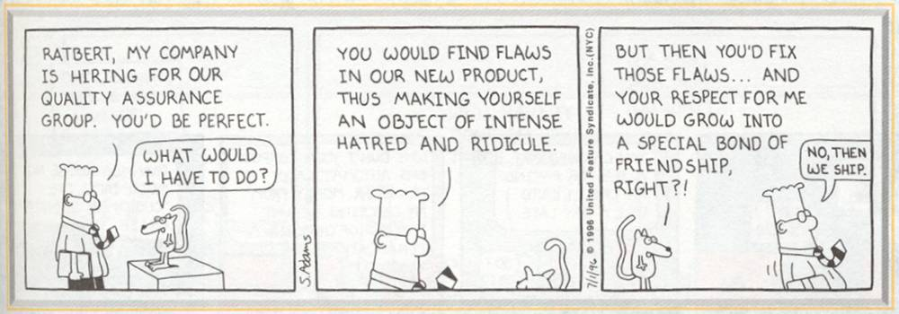
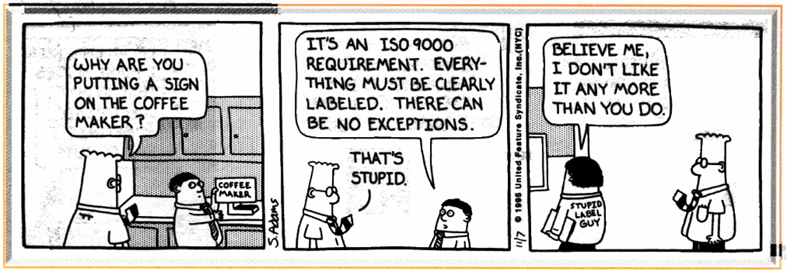
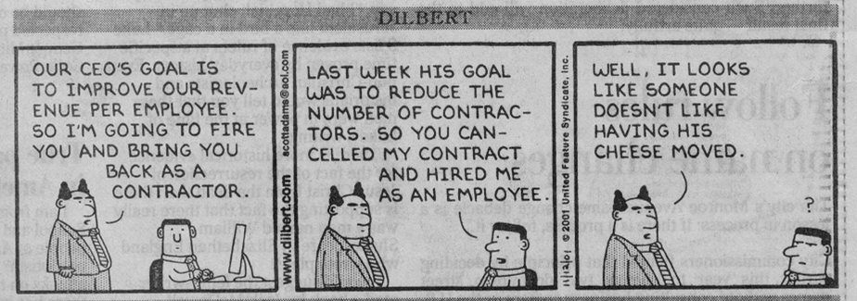
Dilbert © United Feature Syndicate, Inc.

Slide 3
Software Quality
Introduction
Testing
  Traditional software testing
  Test-Driven software development
Configuration Management
Process Improvement
Metrics
  Be not ashamed of mistakes and thus make them crimes. -Shūjīng, #17
Notes:
Quality, process and metrics apply to the whole SE process, not just to “software testing”. However, we’ll focus here mostly on testing approaches for software implementations.
“Testing is an integral component of the software process and an activity the must be carried out throughout the life-cycle.” - Stephen Schach, Software Engineering
“Consider it pure joy, my brothers, whenever you face trials of many kinds, because you know that the testing of your faith develops perseverance.” James 1:2-3

Slide 4
Introduction
What is quality?
  adherence to specifications
  high degree of excellence
Ensuring quality:
  Validation
  Verification
Notes:
Quality definition – “excellence” is what we’d like, “adherence” is mostly what we get. The difference between the two is considerable.
V&V:
Validation – Ensure that the software satisfies the requirements (building the right product – Boehm)
Verification – Ensure that the software is well-built (building the product right - Boehm)

Slide 5
Elements of Quality
Utility
Reliability
Robustness
Performance
Correctness
Notes:
Utility – a measure of how well the system meets the user’s needs (usability/functionality)
Reliability – a measure of the frequency/severity of system failures
Robustness – a measure of the stability of the system in the face of change (including portability, maintainability)
Performance – a measure of the system’s speed and space requirements
Correctness – a measure of the accuracy of the system output/results

Slide 6
Some Definitions
Fault
  a software problem that causes failures
Mistake
  a human error that causes a fault
Failure
  incorrect software behavior caused by a fault
Incident
  an observed, potential failure that must be investigated
Error
  the amount of the incorrectness of a result caused by a fault
Defect
  a generic term for all of the above
Notes:
Based on IEEE Standard 729.

Slide 7
Traditional Software Testing
Software testing is the process of investigating and establishing the quality of a software system.
Overview of Traditional Software Testing
Traditional Approaches:
  Non-execution-based testing
  Execution-based testing
Notes:
It investigates but can generally never “prove” correctness or any of the other quality attributes.
Use the approaches in combination:

Slide 8
Testing: Principles
Testing is not a proof of correctness.
Exhaustive testing is not possible.
Testing is context-dependent.
Defects tend to cluster.
Link tests to their test basis.
Build testability into the product.
Notes:
Correctness proof – Testing can reduce the probability of finding defects, but it can never prove that there are no defects.
Exhaustive testing - not possible for non-trivial systems (e.g., 10 input fields with 5 values each leads to 5^10, 9.7 million, exhaustive test cases) => You simply don’t have time to waste by testing haphazardly.
Context-dependent – Testing is based on context, e.g., safety-critical systems require more testing.
Clustering – Frequently, a small set of modules contain a large set of the faults. Debugging can create new faults “near” the old ones. And the clusters can move around with time, so good testers keep looking (and looking and looking).
Test Basis – Basing tests on requirements (usually, but can be use-cases for business process testing or the code itself for structural tests) helps you test the things that matter to your user. Just be sure to include all the requirements (e.g., usability) to remind yourself to test them later.
Product testability – Well-designed code is easier to test. Use self-testing modules (-d statements, data logging).

Slide 9
Testing: Management
Testing doesn’t just happen; it should be managed.
Testing should be:
  Continuous
  Pervasive
  Meticulous
  Independent
Notes:
Test management – plan for testing, design it, implement it, use tools, automate it.
Test continuously – Test early, test often; don’t treat testing as an afterthought. Testing is really more of a way of life than a phase. Testing is an integral component of the software process and an activity the must be carried out throughout the life-cycle. - Stephen Schach, OO & Classical Software Engineering
Test pervasively – Test everything (I mean everything – code, documents, presentations). Begin with small modules and move out.
Testing meticulously – Testing is challenging; don’t underestimate it.
Test independently – Some testing should be done by an independent group (others on same team, other teams, other division, other companies).

Slide 10
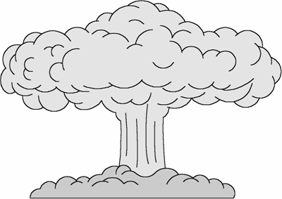



Testing: Psychology
Good coders:
are constructive by nature
they like to build things and solve problems
Good testers:
are skeptical by nature
they like to tinker,
question and explore
images from www.dilbert.com
Notes:
Good coders:
are like artists
are creative in nature
are protective of their creations
like modeling
Good testers:
are like critics
are destructive in nature
are willing to beat on their creations
like hacking
Lou Gossett in "Officer and a Gentleman"
"trip you up and expose your weaknesses
as a potential aviator"
the gorilla in the Samsonite ads
automotive ad with the mild-mannered testing guy
Some are better than others at this
Destructive in nature
Who in your group should do it?
Redo the E V 4 7 card problem – programmers get it right the second time, testers turn over all the cards to check if the assumptions are really true.
Coders testing their own code can create a conflict of interest
Bev Tefer
The non-coders in your groups might be better at some of this.

Slide 11
Revisiting Wason’s Cards
4
E
7
K
Given cards with: a letter on one side a number on the other
Determine: Vowel on one side ⇒ even # on the other side
What cards do you have to turn over to check this?
Notes:
The true tester’s answer here is that your flip them all over (to make sure that the assumption of numeral on one side, letter on the other is really true), mess with them a while to make sure that they really are cards as one would expect), and look around as well (to make sure that there aren’t cards anywhere else), etc, etc.
You see that testers aren’t so much destructive as they are skeptical of assumptions
Wason’s cards
4 e 7 k verify that "vowel => even number"
results: 46% turn over e and 4
4% turn over e and 7 (the correct answer)
envelopes open-closed-addressed-notaddressed
verify that "closed => addressed"
results: 87% got this one right.
We're not good with modus-tollens
P=>Q == ~Q=>~P
=> People are not strict logic engines.
they will infer causation when its not warranted
(see Luke 6:37, we jump to judgement)
Examples of violations
Getting money before your card at an ATM machine
people forget card when they achieve the main goal.

Slide 12
Non-Execution-Based Testing
Non-execution-based testing exposes faults by studying a software system.
Advantages:
Approaches:
  Review
  Inspections
Notes:
This includes reviews of both static and executable artifacts! Systems are built by fallible individuals => Peer reviews are a good sanity check.
Advantages:
Individuals make mistakes that they often cannot see.
Review motivates people - good code avoids embarrassment
Can be done cheap and early
Enhances inter-developer communication (e.g., enforcing coding standards & spreading information) and quality awareness
Approaches:
Walkthrough – a semi-formal meeting at which a peer-team reads through an artifact. (We’ll do a walkthrough in this week’s lab exercise.)
Inspection – a more formal walkthrough with checklists and more steps to go through. Proposed by Fagan in 1976.
Discuss how XP pair-programming creates a sort of continuous review process.

Slide 13
Technical Review
Roles:
  Facilitator
  Recorder
  Producer(s)
  Reviewers
Process
  Before:
  During:
  After:
Notes:
Roles
Facilitator – shouldn’t be the coder; frequently is a QA official
Recorder – takes written notes of problems found
Producer(s) – wears beige and keeps their mouth shut
Reviewers – seriously study the artifact
Process
Before: The producer distributes an artifact and the reviewers study it carefully.
During: The team goes through the code line-by-line, recording issues and estimating their severity.
After: The producer addresses the issues and reports to the facilitator.
Things to keep in mind:
Entry criteria: The artifact should be “good”, it should compile, it should pass automated cleanup utilities, it should be properly formatted, the facilitator shouldn’t be able to find numerous “obvious” faults.
Review the code, not the coder (the egoless programmer, hate the sin not the sinner)
Find something (e.g., Jean Pollari, Brian Cariveau)

Slide 14
Execution-Based Testing
Execution-based testing exposes faults by exercising the software system.
Approach:
  White-box testing
  Black-box testing
Level:
  Unit testing
  Integration testing
  System testing
  Acceptance testing
Notes:
These approaches/levels go by different names – You shall know them by their objectives/process.
We’ll discuss them (and more) in the following slides.

Slide 15
White-Box Testing
aka glass-box, clear-box, structural testing
White-box testing tests to the code.
  It uses knowledge of the code to focus on module design and structure.
  It exercises internal control paths, logical conditions, and data structures.
Target fault types:
Your team project:
Notes:
White-box testing tests to the code. It is more of a verification test that tends to used at lower levels. It cares about statement coverage, which is the amount of the code that the test actually tests.
Target Fault Types:
Problems with unexercised (or little-executed) code
Integration problems between architectural tiers
Your Team Project:
JUnit tests
Testing inter-tier interfaces

Slide 16
Black-Box Testing
aka specification-based, data-driven testing
Black-box testing tests to the requirements.
  It can focus on functional or non-functional requirements.
  It can be based on boundary value analysis, decision tables, state diagrams or use cases.
Target fault types:
Your team project:
Notes:
Black-box testing tests to the specification.
It can focus on functional (correctness, interoperability w/ other systems, security) or non-functional requirements (performance, usability, accessibility, portability).
It can fruitfully employ:
Boundary value analysis – Tests valid and invalid data values at and around representational or logical boundaries (e.g., distance conditions: invalid-negative, valid-0-20ft, out-of-bounds->20ft would dictate testing -1, 0, 20, 21 and perhaps min_double and max_double).
Decision tables – Tests combinations of input conditions.
State diagrams – Tests state-driven behaviour
Use cases – Tests various scenarios from your use cases.
Target fault types:
missing functionality
Poor usability
Performance bottlenecks
initialization/termination problems
Your Team Project:
Use-case-based tests tend to test business-oriented functionality (see below from documentation standards for this).
Usability test (see previous lecture on usability testing)

Slide 17
Unit Testing
aka level-0, component testing
Unit testing tests individual system units.
  It is closely related to the coding process.
  It generally doesn’t require incident reporting.
  It tends to deploy stubs and drivers.
Target fault types:
Your team project:
Notes:
aka level-0 testing, component testing
Unit testing tests individual system units.
It is closely related to the coding process and is generally implemented by the coder.
It generally doesn’t require incident reporting.
It tends to deploy stubs and drivers.
Target fault types:
Basic correctness and accuracy faults
Your team project:
JUnit tests

Slide 18
Integration Testing
aka level-1 testing
Integration testing tests combinations of system units.
  It can be approached top-down or bottom-up.
  It can test multiple levels of integration.
Target fault types:
Your team project:
Notes:
Never underestimate this part. In the same way that there can be practically infinite combinations of input data values, there can also be practically infinite combinations of unit interactions.
Integration testing tests combinations of system units.
It can be approached either top-down (uses stubs) or bottom-up (uses drivers)
There can be multiple levels of integration.
Target fault types:
Conversion faults
Correctness and accuracy faults with multi-unit sub-systems
Your team project:
Your systems aren’t that large, so they won’t have much integration testing. You’ll largely be going from unit tests to system tests.
You will test inter-tier integration.

Slide 19
System Testing
aka level-2, product testing
System testing tests the whole system.
  It tests the fully integrated system.
  It is based on the system requirements.
  It can be seen as a rehearsal for customer acceptance testing.
Target fault types:
Your team project:
Notes:
Target fault types:
Functional faults (e.g., missing functionality, security holes)
Non-functional faults (e.g., poor usability, poor performance)
Your team project:
Usability tests
System tests

Slide 20
Acceptance Testing
Acceptance testing tests the system in customer’s context:
  It is designed to help a customer determine if the system satisfies the requirements.
  It is generally performed by the customer(s).
  It may require phases: alpha & beta testing
Target fault types:
Your team project:
Notes:
Your team project:
Alpha (w/ me, other teams)
Beta (w/ CS 108 students)

Slide 21
Testing Approaches & Levels

Slide 22
Testing Changes to the System
As the system changes, test suites can be run multiple times, for differing reasons:
  Confirmation testing
  Regression testing
Automated testing is attractive for test suites that are executed frequently.
Notes:
You’ll be doing both of these things in your team project:
Confirmation testing – Tests that a defect found in an earlier test has been fixed.
Regression testing – Tests that the integration of new modules or code fixes have not affected the existing modules.
Automation is easier for system unit testing that for usability and GUI functionality.

Slide 23
Testing Databases
Organizations value information, but they tend not to test their database systems.
Things to test with respect to databases:
  Database structure and integrity
  Data loading & extracting
  Application integrity
Use separate database sandboxes to separate development, release, and production databases.
Notes:
See http://www.agiledata.org/essays/databaseTesting.html.
Less than ½ of the organizations surveyed by Scott Ambler in 2006 actually had database regression tests in place. Why is that?
Databases are harder to test because they are harder to run in isolation.
Database software is developed by different sub-organizations who tend not to test as completely.
We’re more into software quality and than we are into data quality.
What to test:
Database structure and integrity – whitebox test your stored procedures/triggers, referential integrity, cascading, etc.
Data loading & extracting – blackbox test your application’s data entry and retrieval.
Application integrity – blackbox test your transactions, test for correctness and load (i.e., create a “big” testing database – one of the classic testing errors is to do all your system testing on a toy database, and then discover in production that your queries are too inefficient for databases with more than 100 records!).
For their team projects, I’d guess that they don’t have stored procedures to test and that they’ve done an ok job of blackbox testing based on use cases. The thing they probably haven’t don’t yet is to create a large test database to test data load. See http://www.generatedata.com/ for a tool to create random table data.

Slide 24
Test Documentation
Can range from formal to informal, depending on the context.
Each test case in a test suite contains:
  Test basis
  Test data
  Test script
Your team project:
Notes:
Range:
Formal – e.g., JUnit test suite, fully documented system test plan (e.g., for safety-critical avionics applications)
Informal – e.g., scribbled notes on what to try, ad hoc CS 108 “testing”, Web interface tests
Each test case in a test suite contains:
Test basis – the documents/artifacts on which the test is based (e.g., a requirements document, use case scenario or even code segment)
Test data – the data that exists before the test is run (e.g., the contents of the database, which you may have to invent data for the test).
Test script – the procedure for executing the test, including input values, user/system actions, and expected results. These tend to be written much like a movie script.
Your team project:
You’ve been doing test documentation for the usability test and the scenario-based system tests.
Show them an example from a pervious semester project
These tests can be written before or in parallel with system development.

Slide 25
Debugging
Testing ≠ debugging.
Document all incidents.
Techniques:
  Brute force
  Backtracking
  Cause elimination
Your team project:
Notes:
Testing finds errors; debugging fixes them. Document all incidents (i.e., potential failures caused by system faults).
Document all incidents so they can be investigated – actual failures should be debugged and re-tested; non-failures should be explained. Include information on when/where/how the incident arose, what exactly happened, who found it. Document real incidents (the system crashed, it didn’t work as advertised, it gave poor output); don’t document non-incident problems (I can’t remember the password, I didn’t follow the test script)
Debugging techniques:
brute force
- adding trace and info dumping stuff
- looking for clues
- doing something radical
backtracking
- searching back from an error
- uses an execution stack;
cause elimination
- systematically removing potential causes
Debugging is more like experimentation in natural science than it is like designing or implementing in mathematics or engineering.
For your team project, document incidents by creating Trac tickets and dealing with them as a team.

Slide 26
Test-Driven Development
In test-driven development, the tests are written before the code.
Advantages of doing this:
Notes:
Advantages of doing this (from Larman, chapter 21):
The tests actually get written.
It forces us to think carefully about the problem, not the coding.
Promotes automated testing.
Provides confidence to refactor.

Slide 27
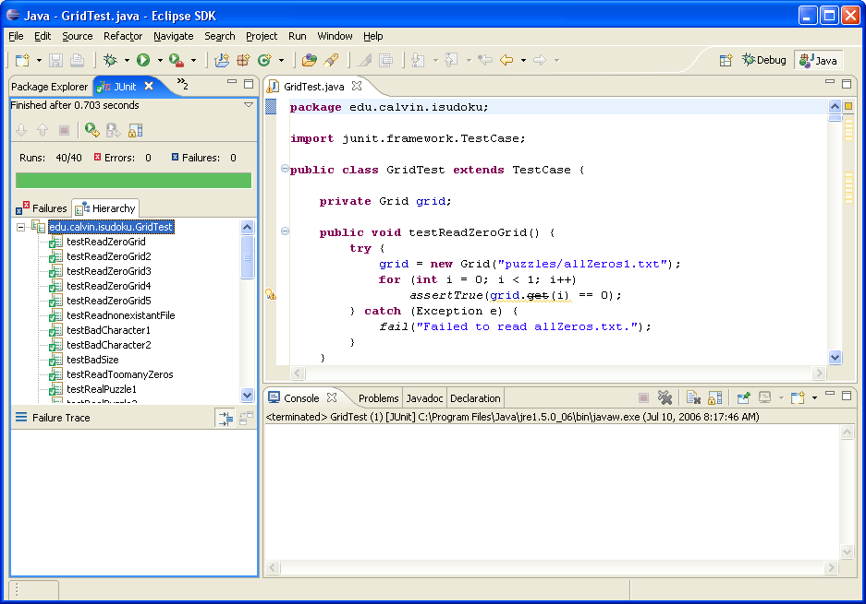
Notes:
What a wonderful feeling – the Eclipse/Java/JUnit green bar on my iSudoku tests after refactoring the grid implementation.

Slide 28
Refactoring
Refactoring is disciplined approach to behavior-preserving modification.
Issues:
  What to refactor
  When to refactor
  How to refactor
Notes:
What to refactor – everything
When to refactor – anytime throughout the software lifecycle that you detect “stench”
Hard to understand code
Long methods
Too many instance variables
Duplicated code
How to refactor – in small steps, rerunning unit tests after each step

Slide 29
Refactoring Patterns
There are many well-known refactorings.
Examples:
  Rename
  Extract method
  Extract constant
  Replace constructor with factory

Slide 30




Eric Gamma & Kent Beck
What’s the
Big Idea
JUnit is a regression testing framework that automates the construction/execution of test cases for Java applications.
"Never in the field of software development was so much owed by so many to so few lines of code" – Martin Fowler
images from www.junit.org, June., 2006
Notes:
This tool revolutionized my approach to programming.
This is an example of the power of intelligent abstractions.

Slide 31
Configuration Management
Software configuration management (SCM) is the process of managing the integrity of a software system throughout its evolution.
It controls all system artifacts:
It involves a range of activities:
Notes:
Change is inevitable.
Artifacts:
documents
code/data modules
object files
executables
link or make files
the CASE tools themselves
It involves a range of activities
Version/Release control
Change management
Build support
Systems and processes are usually complicated enough to require:
specially designated software librarians
automated tool support for all of these tasks

Slide 32
Version/Release Control
Code
Module 1
Code
Module 2
...
Design
Document
...
System
1.0
v. 1.0
v. 1.0
v. 1.0
v. 1.0
v. 1.0
...
v. 1.1
...
v. 1.1
System
2.0
...
1.8.1
1.8.1
...
...
v. 2.0
...
v. 1.7
v. 2.1
v. 2.1
v.2.0.1.1
...
...
v. 3.0
Notes:
Versions (aka revisions):
New versions replace old ones, but the old versions must be kept to support older versions of the product.
Versions usually replace earlier versions, but multiple variants could be kept (e.g., for different OSs or hardware).
Versions are usually numbered linearly.
Generally, you work with the most recent version of everything in the trunk.
Releases (aka configurations, tags):
Releases are aggregates of multiple versioned artifacts representing complete systems.
They don’t create copies of the code, they just mark existing versions as in the release.
Branches (aka forks):
You copy over individual artifacts or whole systems to separate development
You can merge a branch’s changed back into the main trunk when/if appropriate.
Example support tools: RCS, CVS, SVN, SourceSafe, ClearCase

Slide 33
Change Management
Change must be managed.
The process:
  1. A stakeholder submits a change request
  2. If the change is valid, then assign someone to:
    a. Engineer the change.
    b. Submit change plan request.
    c. If change plan is approved, then:
    i. Commit changes to system.
    ii. Document their link to the change request.
Notes:
Change is inevitable and must be managed. Changes must be made for documented reasons.
The change request is usually a formal form that is submitted to quality assurance. Typical contents for this form are discussed in lab #11 (i.e., originator, detailed description of the problem, the resolver, the solution, the approval, the results).
Engineering the change requires that the full software engineering process (i.e., analysis, design, documentation, test, etc) be carried out on the change itself in the context of the rest of the system.
Iteration is required if approvals are not gained on the first try.
Example support tools: Trac tickets, ClearQuest

Slide 34
Build Support
System building is the process of compiling, linking and configuring a complete system.
Build tools can be configured to:
  Recompile modules only when necessary
  Automatically run tests
  Run periodically (or continuously)
Notes:
It’s almost impossible to image living without some form of build support.
Example support tools: make, ant

Slide 35
Process Improvement
Process matters.
Software engineering is a young discipline with weak (but improving) process.
Process improvement iteratively assesses and modifies software processes, e.g.:
  Capability-Maturity Model Integrated (CMMI)
  ISO 9000
  Personal/Team Software Processes (PSP/TSP)
Notes:
Students prefer to focus on people and technology, ignoring process. Process matters. The larger the software system/organization, the more the process matters. Examples of life-changing process ideas: winner picks it up; misplaces shoes go down the clothes chute.
SE has made and continues to make mistakes. Civil engineering has a 3 millennia head start. And process assessment and improvement are even younger than software engineering.

Slide 36
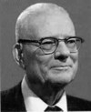

W.E. Deming (1900-1993) System of Profound Knowledge
Promoted the use of statistical quality control in Japanese manufacturing.
“In God we trust, all others bring data.”
Watts Humphrey applied Deming’s approach to software development.
images from www.deming.org
Notes:
Dr. W. Edwards Deming developed his System of Profound Knowledge as a comprehensive theory for management, providing the rationale by which every aspect of life may be improved. Dr. Deming’s teachings of his management philosophy in Japan from 1950 on, created a total transformation in Japanese business resulting in what is known today as the "Japanese Industrial Miracle.”
The late Dr. W. E. Deming (1900 - 1993), one of the foremost experts of quality control in the United States, was invited to Japan by the Union of Japanese Scientists and Engineers (JUSE) in July 1950. Upon his visit, Dr. Deming lectured day after day his, "Eight-Day Course on Quality Control," at the Auditorium of the Japan Medical Association in Kanda-Surugadai, Tokyo. This was followed by Dr. Deming's "One-Day Course on Quality Control for Top Management," held in Hakone. Through these seminars, Dr. Deming taught the basics of statistical quality control plainly and thoroughly to executives, managers, engineers, and researchers of the Japanese industries. His teachings made a deep impression on the participants' mind and provided great impetus to quality control in Japan, which was in its infancy.
W.E. Deming, in his work with the Japanese industry after World War II, applied the concepts of statistical process control to industry. While there are important differences, these concepts are just as applicable to software as they are to automobiles, cameras, wristwatches and steel.
- Watts Humphrey
IEEE Software, 1988
Some relevant features of the Deming philosophy are:
the customer is the most important part of the production line
customer satisfaction is not enough; you must exceed the customer's expectations to improve your reputation and secure future business
improved quality (reliability, consistency, predictability, dependability) is analogous to reduced variation. This is why statistical thinking and statistical methods are all-important: the study of statistics is the study of variation an organisation must operate as a genuine team focussed on the customer, without the internal competition and conflict which typify Western management style
teamwork should extend to customer-supplier relationships
the vast majority of problems and difficulties are caused by poor management good operations, best efforts, hard work, and experience are not enough: everyone in the organisation must understand what changes are needed and the reasons for them
there is no substitute for knowledge

Slide 37

Capability Maturity Model Integrated
CMMI is a process improvement framework developed by CMU’s SEI.
It integrates earlier approaches, including SEI’s own CMM.
It provides two models of process appraisal:
  Continuous
  Staged
image from www.sei.cmu.edu
Notes:
http://www.sei.cmu.edu/cmmi/
This is a very complex system, but is commonly used as a reference in the industry.

Slide 38
CMMI Continuous Model
The continuous model rates an organization in each of 24 process areas, e.g.:
  Project planning - Requirements management
  Technical solution - Configuration Management
  Risk management - …
on a 6-point capability scale:
1. Not performed 4. Defined
2. Performed 5. Quantitatively managed
3. Managed 6. Optimized
Notes:
24 process areas:
See http://en.wikipedia.org/wiki/CMMI#Process_Areas
6-point scale:
1. Not performed – not up to scratch in some particular area
2. Performed – all areas covered/communicated
3. Managed – all areas documented/managed
4. Defined – data collected
5. Quantitatively managed – data used in area process management
6. Optimized – trends analyzed & processes modified

Slide 39
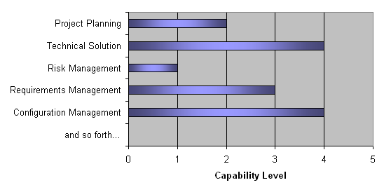
Continuous Capability Example
Notes:
This is a fabricated example.

Slide 40
CMMI Staged Model
The staged model is based on the CMM.
It rates an organization at one of five discrete maturity levels:
  1. Initial
  2. Managed
  3. Defined
  4. Quantitatively Managed
  5. Optimizing
Notes:
Each maturity level dictates a set of target process areas and goals and is roughly similar in nature to the more fine-grained assessment of each area in the continuous model (note that the levels are about the same). As a summary:
1. Initial – The lowest level, characterized by chaos and heroics
2. Managed - Uses basic project management (e.g., planning, configuration management)
3. Defined – Adds organizational support
4. Quantitatively Managed – Adds metrics collection
5. Optimizing – Uses metrics to tweak processes

Slide 41
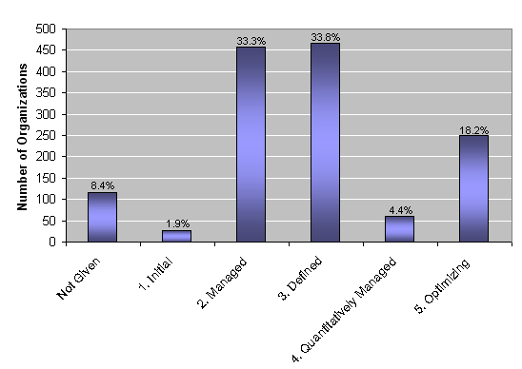
Aggregate Staged Maturity Profiles
Data based on SEI 2002-2006 report
Notes:
Based on staged appraisal data from 2002-2006 provided by SEI:
This is based on self-reported data from 1377 CMMI-staged appraised organizations.
There were 1581 total appraisals, so we can only guess where they fall on the scale (though I have a pretty good idea!).

Slide 42
CMMI Cost/Benefit Analysis
Costs
Benefits
Data based on SEI 2002-2006 report
Notes:
Costs:
This is hard to say. In 1995 the old CMM took organizations some time to tool up: ~2 years to go from CMM level 1 to 2; ~2 years to go from CMM level 2 to 3; ~ It cost from $500-$2000 per engineer.
Benefits:
These data are from an SEI report of 30 companies that achieved a change. I wonder what happened to the other 1347 companies they know about.
CMMIFAQ (http://www.cmmifaq.info/#10) says that there are “There are far more bad implementation stories than success stories.”
Category Median improvement
Cost 34%
Schedule 50%
Productivity 61%
Quality 48%
Customer Sat 14%
ROI 4:1
More data from an ASQ presentation:
• 5:1 ROI for quality activities (Accenture)
• 13:1 ROI calculated as defects avoided per hour spent in training and defect prevention (Northrop Grumman Defense Enterprise Systems)
• Avoided $3.72M in costs due to better cost performance (Raytheon North Texas Software Engineering)
- As the organization improved from SW-CMM level 4 to CMMI level 5
• 2:1 ROI over 3 years (Siemens Information Systems Ltd, India)
• 2.5:1 ROI over 1st year, with benefits amortized over less than 6 months (reported under non disclosure)

Slide 43
Implementing Process Improvement
To implement CMMI process improvement:
  Treat improvement as a technical project.
  Understand your current process.
  Get support from all levels.
  Create and sustain a culture of improvement.
Things to keep in mind:
  Improvement takes time/discipline.
  Improvement is done by a project not to it.
from www.cmmifaq.info/#10
Notes:
This advice is based on independent observations by CMMIFAQ (see http://www.cmmifaq.info/#10).
Regardless of whether you support CMMI per se, you should adopt the “spirit” of the methodology. Take process and process improvement seriously.

Slide 44

ISO 9000
ISO 9000 is a series of related standards.
  It was produced by the International Standards Organization (starting in 1987).
  It is applicable to quality control in many industries.
It is similar but distinct from CMMI:
  Both seek process improvement.
  They have different emphases on documentation and metrics.
  You can comply with one but not the other.
image from www.iso.org
Notes:
From www.iso.org:
The ISO 9000 and ISO 14000 families are among ISO's most widely known standards ever. ISO 9000 and ISO 14000 standards are implemented by some 610 000 organizations in 160 countries. ISO 9000 has become an international reference for quality management requirements in business-to-business dealings, and ISO 14000 is well on the way to achieving as much, if not more, in enabling organizations to meet their environmental challenges.
The ISO 9000 family is primarily concerned with "quality management". This means what the organization does to fulfil:
- the customer's quality requirements, and
- applicable regulatory requirements, while aiming to
- enhance customer satisfaction, and
- achieve continual improvement of its performance in pursuit of these objectives.
The ISO 14000 family is primarily concerned with "environmental management". This means what the organization does to:
- minimize harmful effects on the environment caused by its activities, and to
- achieve continual improvement of its environmental performance.

Slide 45

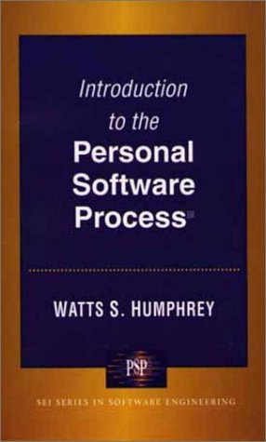

Watts Humphrey (1927-)
Father of software quality
Founded the SEI software process program
Developed CMM subsets that focused on:
  Individuals – PSP
  Teams – TSP
images from www.sei.cmu.edu

Slide 46

Baseball and Statistics
batting average
homeruns
RBIs
ERA
stolen bases
on-base %
runs scored
hits
bases on balls
doubles
triples
total bases
won-lost
games pitched
saves
innings pitched
strike-outs
complete games
shut-outs
image from http://www.whitecaps-baseball.com/
Notes:
What’s your favorite baseball statistic?
E.g., number of times a team has come from behind in the second quarter against a #1 ranked football team in an away game (in late Fall).
Have statistics improved baseball?
European sports casters don't like them.
They allow goals to be set.
Can we better predict and manage the game outcome with them?
Do teams or players perform better with them?

Slide 47

Ice skating and Statistics
Skating is rated on a scale of 10.
It tends to be more subjective.
Image from http://www.icesk8.com
Notes:
On January 29, 1964, the elegant Russian couple of Oleg Protopopov and Lyudmila Belousova earned the gold medal in pairs figure skating. No one knew it at the time, but this victory marked the beginning of the most extraordinary winning streak in the history of the Olympic Winter Games. Russian pairs skaters have won every gold medal awarded since then: 10 in a row.
Protopopov/Belousova defended their medal in the 1968 olympics.
If you need judges, it’s not a sport. - B. Kamery
It’s hard to quantify beauty – and to the extent that programs are beautiful, it’s hard to quantify their quality.

Slide 48
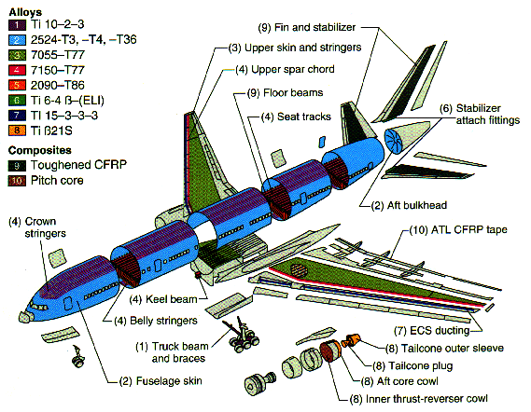
Engineering and Statistics
weight
speed
power consumption
heat
strength
...
image from http://www.boeing.com/
Notes:
Have statistics improved engineering?
Do engineers perform better with them?
The 777 project show on PBS discussed all these and more...
Perhaps the clearest statement about the importance of measurement is Lord Kelvin's: "When you can measure what you are speaking about, and express it in numbers, you know something about it; but when you cannot measure it, when you cannot express it in numbers, your knowledge is of a meager and unsatisfactory kind. It may be the beginning of knowledge, but you have scarcely, in your thoughts, advanced to the stage of science."

Slide 49
Software Metrics
Key points on metrics:
  Measurement is fundamental to engineering and science.
  Measurement in SE is subjective and currently under debate.
What to measure:
  The software process
  The software product
  Software quality
Notes:
Measurement:
allows measurable management and prediction;
allows improvement goals to be set;
In SE it’s hard to objectively measure the “important” bits;
When you can measure what you are speaking about, and express it in numbers, you know something about it; but when you cannot measure it, when you cannot express it in numbers, your knowledge is of a meager and unsatisfactory kind: it may be the beginning of knowledge, but you have scarcely in your thoughts advanced to the stage of science. - Lord Kelvin

Slide 50
Software process metrics
Defect rates (by coder/module)
Faults found in development or total faults
Lines of code written (by coder/group)
Staff turn-over
Notes:
You record who writes the code and what errors are found in level 2 testing (and potentially levels 0 and 1), so you can compute defect rates for coders (or modules).
# of faults - Nick Micris coded the Aamp microcode with no errors.
The amount of code written by good and bad professionals varies by a factor of 10. This isn’t a measure of the size of the program, it’s a measure of the coding process.
Staff turn-over - We’d like to keep this number small.

Slide 51
Software product metrics
Cost
Duration
Effort
Size/complexity
Quality
Notes:
Cost - How much did it cost to produce the software?
Duration - How long did it take to build it?
Effort - How much work was involved?
Size/complexity - How big was the final product?
Quality - What was the level of quality of the final product?
Notes:
The first 3 are pretty easy to compute
the 4th isn’t bad
the last is impossible (and unfortunately, it’s what we really want to know).

Slide 52
Software Size/Complexity Metrics
Lines of Code (LOC):
  The most common measure
  It has problems
Function Points:
  more complicated than LOC
  Better than LOC, but still has problems
For OO systems:
  # of classes
  amount of data or methods per class
Notes:
Lines of code (LOC) - the most common and easiest, but has problems:
different languages are different e.g., exec notepad != MOV A,B
see chart, page 94 lines per function pt: lang LOC/FP
Assembly 320
C 128
VB 32
SQL 12
ignores important work e.g., e=mc^2 is not simple.
Are testing harnesses counted?
do comments count?
If not, who would write them? If so, who would stop?
Function points (FP)
measures functional complexity
complicated, see text for details
See p 86,7 if you are interested.
You may skip this section.
better than LOC, but still inadequate

Slide 53
Software Quality Metrics
Product operation:
  defects/KLOC or defects/time interval
  Mean time between failure (MTBF)
  others?
    security
    usability
Product revision:
  Mean time to change (MTTC)
Product transition:
  Time to port
Notes:
Product operation (using the product)
correctness
defects per KLOC
code-review bugs
DRs
defects per interval (e.g., day, week)
the microsoft video (MTCTW)
mean-time-between-failure (MTBF)
integrity (security)
I've found no hard metrics for this.
# of unknown breaches per interval?!
usability
learning curve time
net increase in productivity
Product revision (maintaining/changing the product)
maintainability - mean-time-to-change (MTTC)
Product Transition (porting the product)
portability - MTTP (I suppose)

Slide 54
Metric Characteristics
Objective vs. Subjective
Direct vs. Indirect
Public vs. Private
Notes:
objective vs. subjective
LOC is objective (mostly)
aesthetics of a GUI
direct vs. indirect metrics
LOC can be measured directly
quality can't
=> Not much of interest can be measured directly.
public vs. private metrics
Some measures are individual and should be kept private.
Most are squeamish about doing performance reviews
based on individual metrics.
Aggregated metrics are more public.

Slide 55
Implementing Metrics
Not many companies use sophisticated metrics analysis.
Things to keep in mind:
  Don’t use metrics to appraise or threaten individuals.
  Clearly define the metrics and set clear goals for their collection and use.
  Don’t focus on only 1 or 2 metrics.

Slide 56
Principles
Metrics should be as direct as possible.
Use automated tools.
Deploy proper statistics.
You can measure anything.
Notes:
Metrics should be as direct as possible.
You need automated tools, or it won't work.
Use proper statistics (e.g., to find truly independent measures)
You can measure anything appropriate:
another "umbrella" activity
Earned bug average
compute a bug finding metric: bugs batted in (BBI)
at code-review, give everyone rating cards (9.7, 10.0)
Only partially in jest. Many of these things are part of departmental lore - e.g.,
Nick Micris programmed the Aamp microcode with no errors
he has a low earned bug average
Bill Kamery was really at finding errors
he has a good bugs batted in average
Rob Schneider is a sweet coder
he gets 10s at his code reviews;
Watch for this area to grow considerably during your career.

