Slide 1
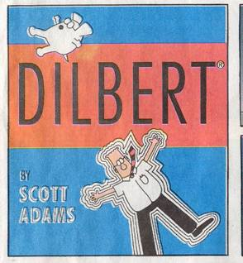
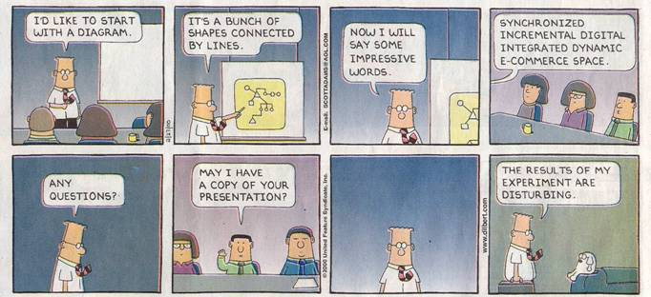
Dilbert © United Feature Syndicate, Inc.
Notes:
Give this lecture on Wednesday. Monday will be overflow from the HCI unit.

Slide 2
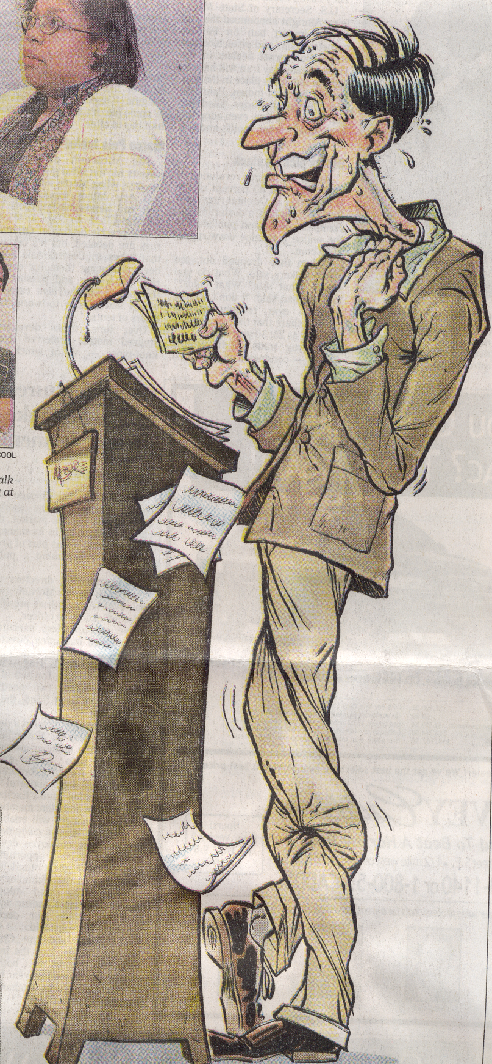
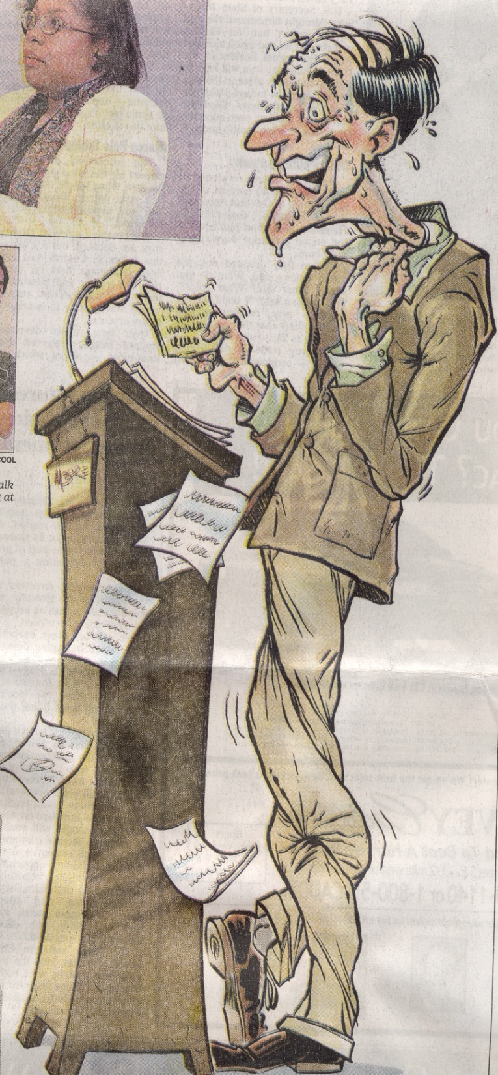
Worst Human Fears
2. Heights 3. Insects and bugs 4. financial problems 5. deep water
1. Speaking before a group
6. Sickness 7. death
8. flying 9. loneliness 10. dogs
- Sony Corporation
GR Press
Michael Moore
March 26, 2000
Notes:
Fears in the US that is - overseas the fears might be much more basic.
Nerves are good. If you’re not nervous, then you’ve got a problem –
“When I’m a bit nervous and I know what I’m talking about, I’m dynamite.” – Herb Dershem

Slide 3
Technical Presentations
Presentations are an important part of the engineering process.
Engineer them like you engineer software:
  Analysis
  Design
  Performance
  Evaluation
Notes:
Software is not exactly like a presentation, but there are strong similarities. See the pseudo waterfall process in the slide.
Never underestimate the value of a good presentation. It may be the only thing some people see of your work. Knowing your stuff is important, but it’s not the only thing. Tell them the story of Nico Cavalotto’s demo at IRST for the GIST project.

Slide 4
Presentation Analysis
Determine the constraints:
  Audience
  Venue
  Time
Establish a goal.
Notes:
Determine the constraints:
Audience
Who are they? What do they know? How do you want them to respond? How formal is it intended to be?
Venue
What equipment is there? How large is the space/audience?
Time
How much time do you have? Should there be time for questions?
Establish a goal
e.g., “my thesis is X – believe it”
e.g., “my system solves this problem in a unique way – buy it!”
e.g., “my proposal is great – fund it”

Slide 5
Presentation Design
Use prepared slides:
  Include a:
    Title slide
    Conclusion slide
  Use explicit structuring.
  Keep your slides simple.
Drive your point home.
Notes:
Build the slides:
Title slide
include title of talk, your name(s) and affiliation(s)
Conclusion slide
summarize the key points of your talk
I don’t normally use this is a class presentation, you should in your team presentation.
Explicit structuring
Start with your thesis and follow an explicit (visible) outline.
A motivating example very early helps too.
Use prepared slides or web pages, this will save you precious time during a formal, timed presentation. Make copies if appropriate.
Don’t assume that people will get your point easily – hit early and often in a variety of ways. Tell them what you’re going to tell them, tell them, then tell them what you told them. This is very much like interface design in a way – a presenter is not a listener and can’t really know if the presentation gets the point across.

Slide 6
Slides
Figure 2-3 minutes per slide.
Use an appropriate font.
Don’t put too much one each slide.
Don’t use distracting slides.
Have a back-up plan in case the technology doesn’t work.
Notes:
Select an appropriate slide layout.
don’t have too many points (<6)
choose a large enough font
Technology can get in the way, so watch what you do. The “experts” are down on powerpoint etc, because it can really screw things up. In CS, it’s almost required for displaying interfaces, code, models, etc.

Slide 7
Bad Fonts
No one can see the brilliance of your points if your font is poorly chosen.
The wrong color
Or too small
Red next to green is a common problem for the colorblind.
People can’t read blue very well
Notes:
Symbol size = 0.06 * feet to last row
Audience size = 50 * (symbol size in inches)^2
Just make sure you can read the slide from the back row.

Slide 8
Too much text
Putting up a slide with too many words of plain text is dangerous. You will be sorely tempted to read it, and even if you don’t, your audience will, ignoring whatever you do no matter how crazy it is. In general, text books are for this sort of thing, not formal presentations (although there are exceptions). Better to stick to bulleted, incisive notes which you explain more fully.
Notes:
Keep your bullet points short – presentations are for general ideas, not details. And you do the talking, keep the slides as a media-oriented backup to what you are saying.
If you have to put up lengthy quotes (and think really hard about whether you REALLY need to), then read quotes out loud so everyone goes together (e.g., my dilbert comics). Don’t expect the audience to read when they should be listening to you.

Slide 9
Too many points
Some people just have too many good ideas:
  Here’s one.
  Here’s another.
  Here’s a third.
  I’m so smart, I can keep coming up with these all day.
  This one is kind of like an earlier one.
  This one is too, but is sort of different.
  This one isn’t related at all, but I thought I’d mention it.
  Now this is starting to get tiring.
  No one will get this far probably.
  You’ll run out of time by now.
  This is for those that start reading from the bottom.
Notes:
Use 6 bullets or less.

Slide 10
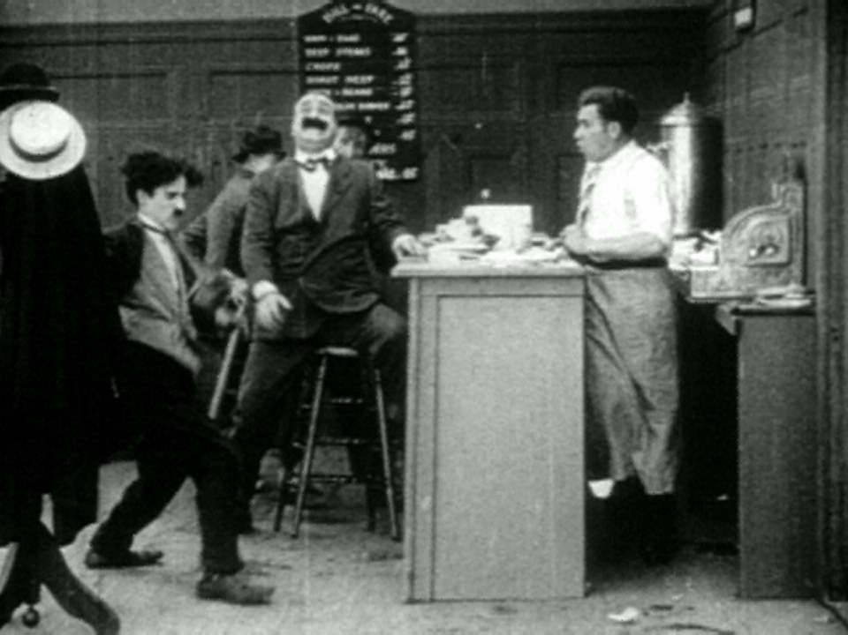
A Distracting Slide
It doesn’t matter what I say here, you won’t see it...
Notes:
You should be the most interesting thing up there.
The material on your slides should be the second most important thing.
Anything else is either a distraction or worse.

Slide 11
Silly Effects
Unrelated nonsense will detract from your fundamental purpose!
Presentation tools make these easy; resist the urge to use them.
effects by Christian Vander Linden, June, 2006

Slide 12
Inconsistent Formatting
Here is an example of using a variety of fonts on a single slide. Ouch! Eye fatigue!
Also notice the color scheme changed

Slide 13
Presentation Performance
Look “presentable”.
Establish a focus of attention:
  Stand close to the slides and refer to them.
  Establish and maintain eye-contact.
  Work from memory, don’t read.
  Keep the audience’s attention.
Presentation roles:
  A team “MC” to channel attention
  A separate demo operator
Notes:
“Presentable” is context dependent. Don’t over or under dress.
Standing isn’t the only way, the British academic frequently sits. Socractes lead his students around. Americans stand, so should you in most cases.
Making contact requires eye-contact (no reading) and using gestures to “bring them in”. Memorization sounds forced, but do learn to work extemporaneously from an outline.
Use cards to get you going if you really need them. I frequently write out the first sentence on the first slide in case I freeze up at the beginning; that’s usually enough to get me going and the rest comes with simple reminders from the slides. Philosophers frequently read their presentations, otherwise reading is a bad idea - it exudes a lack of interest and is quite boring. One might just as well read the paper.
Keep their attention through whatever appropriate means possible (e.g., stories, pictures, nonsense)
Other general ideas:
Nervousness – it’s inevitable. When I’m nervous and I know what I’m talking about, I’m dynamite!
Review each slide, then discuss it
Don’t get side-tracked

Slide 14
Practice, Practice, Practice!
Practice in front of real people.
Rehearse in the real room if possible.
Time your rehearsals closely.
Practice the interaction between the speaker and the demo operator.
Save time for questions at the end.
Notes:
Mark Twain said it usually took him 2 or 3 weeks to work up a good impromptu speech.

Slide 15



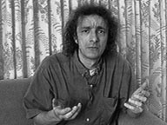
A host of detractors
Microsoft Powerpoint
“Power Corrupts. PowerPoint Corrupts Absolutely.” – E. Tufte
“The 3rd worst invention of the 20th century” – C. Stoll
Gettysburg presentation – P. Norvig (http://www.norvig.com/Gettysburg/)
Images from authors’ web sites, Apr. 2004
Notes:
Mostly, these guys are over-reacting. Powerpoint can be very useful if used properly (and it, or something like it, is required for your team presentations).

