Slide 1
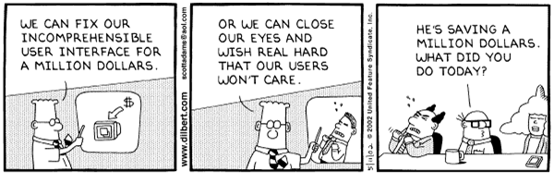
Dilbert © United Feature Syndicate, Inc.
Notes:
In December 1995, American Airlines Flight 965 departed from Miami on a regularly scheduled trip to Cali, Columbia. On the landing approach, the pilot of the 757 needed to select the next radio navigation fix, named "ROZO." He entered an "R" into his navigation computer. The computer returned a list of nearby navigation fixes starting with "R" and the pilot selected the first of these, whose latitude and longitude appeared to be correct. Unfortunately, instead of "ROZO," the pilot selected "ROMEO," 132 miles to the northeast. The jet was southbound, descending into a valley that runs north-south, and any lateral deviation was dangerous. Following indications on the flight computer, the pilots began an easterly turn and slammed into a granite peak at 10,000 feet. One hundred and fifty two passengers and all eight crewmembers aboard perished. Four passengers survived with serious injuries. The National Transportation Safety Board investigated, and-- as usual-- declared the problem human error. The navigational aid the pilots were following was valid but not for the landing procedure at Cali. In the literal definition of the phrase, this was indeed human error, because the pilot selected the wrong fix. However, in the larger picture, it wasn't the pilot's fault at all.
-- The Inmates are Running the Asylum (A. Cooper)

Slide 2
User Interface Design
Introduction
Principles
Design Approaches
  Discount Usability
  Task-Centered Interface Design
Design Patterns
Humanity
  Users are not designers. ... Designers are not users. - Jacob Nielsen, Usability Engineering
Notes:
This lecture series will go as follows:
Monday – (today) Left-over IS slides (?) & HCI Introduction
Wednesday – (advising break)
Monday – (quiz) Principles
Wednesday – Discount Usability
Monday – Interface design and implementation (emphasize plagiarism from TCUI)

Slide 3
Introduction
Human Computer Interaction is a discipline concerned with the design, evaluation and implementation of interactive computing systems for human use and with the study of major phenomena surrounding them. – ACM SIGCHI, 1992
Names:
  Human Computer Interaction (HCI)
  Computer Human Interaction (CHI)
  User Interface Design
Notes:
The SE community has not done a good job of this, but there’s no sense in even building an application if it is unusable.

Slide 4
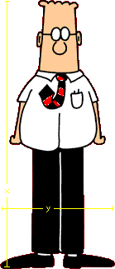
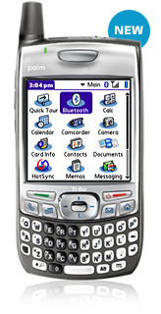
An Interaction Framework
Presentation
Observation
the system’s capability to output information
the user’s ability to understand the output
Output
Performance
Input
Articulation
the system’s ability to accept the input
the user’s ability to do the input
images from www.dilbert.com and www.palm.com
Notes:
I won’t quiz you over these particular names, but all of these things have to work right before the HCI works. Examples:
Articulation – errors tend to be “slips”
KV – clicking on “!”
simple typos
pressing the wrong button because they are too close together
pressing VCR buttons in wrong order because of inconsistency with stereo/TV
Performance
KV – no support for team grades
Using emacs key bindings in eclipse (which isn’t fully emacs compatible)
You can’t program the VCR with the remote, only on the console
Presentation
KV – No assignment score histogram, my inability to see student view
We will miss hidden features (e.g., T option at Colorado library search engine)
the VCR panel doesn’t display that it’s ready to record
Observation
KV padlock (??) and “!” ???
misjudging document size (pine’s % output rather than bar)
Hard to remember key shortcuts unless there is a reminder.
The VCR does present, but the user can’t understand it.

Slide 5
The Range of HCI
Ethnography
GUI Design
Output
Ergonomics
Programming
Input
images from www.dilbert.com
Notes:
Programming/systems engineering - traditional- what you’ve had so far.
GUI design is just the hacking aspects.
Ergonomics
ethnography - social/organizational context
Philosophers question the existence of the page.

Slide 6

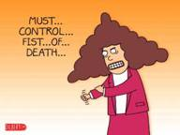
Computers and Humans
Computer traits
Incredibly fast
Error-free
Deterministic
Apathetic
Literal
Sequential
Predictable
Amoral
Stupid
Human traits
Incredibly slow
Error-prone
Irrational
Emotional
Inferential
Random
Unpredictable
Ethical
Intelligent
ideas from from The Inmates are Running the Asylum, A. Cooper, images from www.dilbert.com
Notes:
They know about computers pretty well already.

Slide 7
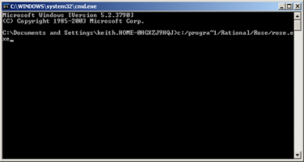
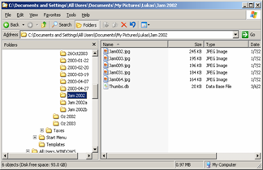
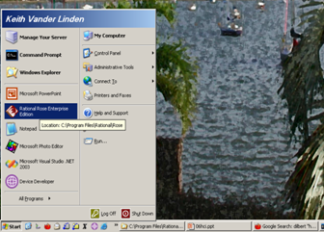
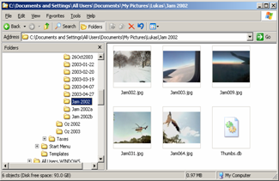
Human Memory
Human memory is limited
Miller's magical number 7 (+-2)
Notes:
DOS/UNIX assumes you’ll remember textual commands (e.g., starting up xemacs) – Mac/Windows provides menus
Filenames are hard to remember, icons are much easier

Slide 8
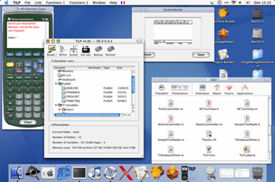
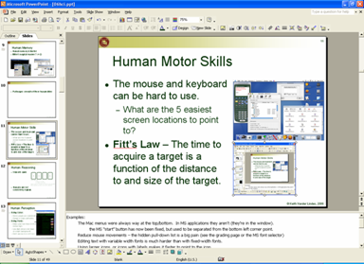
Human Motor Skills
The mouse and keyboard can be hard to use.
  What are the 5 easiest screen locations to point to?
Fitt’s Law – The time to acquire a target is a function of the distance to and size of the target.
Notes:
Examples:
The Mac menus were always way at the top/bottom. In MS applications they weren’t always this way (they were in the window). E.g., the MS “start” button has now been fixed, but used to be separated from the bottom left corner point.
Reduce mouse movements – the hidden pull-down list is a big pain (see the grading page or the MS font selector)
Editing text with variable width fonts is much harder than with fixed-width fonts.
Using larger icons, or icons with labels makes it faster to point to the icon.
The connect project occasionally has people that just can’t use the mouse – We have them do solitaire to practice.

Slide 9
Human Reasoning
Humans are not consistently logical.
Wason's cards
4
E
7
K
Given cards with: a letter on one side a number on the other
Does a vowel on one side ⇒ an even # on the other side?
What cards do you have to turn over to check this?
Notes:
Add Hick’s law here?
Humans aren’t logical. They just aren’t.
If you have any doubt of this, consider the results of Wason’s card experiments:
The results of testing - 4 e 7 k - verify that "vowel => even number“:
46% turn over e and 4
4% turn over e and 7 (the correct answer)
The results of doing the same problem with envelopes – open-closed-addressed-notaddressed/verify that "closed => addressed“:
87% got this one right.
We're just not good with modus-tollens in theory, but we’re not bad in practice. (P=>Q == ~Q=>~P).
UI Implications of the fact that people are not strict logic engines:
We like hand holding – have a process complete and just quit makes us uneasy.
We will infer causation when its not warranted, e.g., we may think that the computer “hates” them.
We will forget stuff they shouldn’t forget, e.g., Getting money before your card at an ATM machine (we tend to forget the card when we achieve the main goal of getting money – the solution is to force ourselves to take the card before giving us the money).

Slide 10
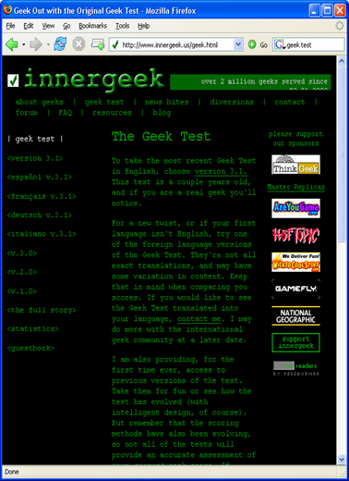
Human Perception
Using Color:
  Some people are colorblind.
  Design in black and white.
Using Fonts:
  Make capital letters 2.3-5.2 mm high, lines ≤ 60 chars wide, & use ragged right.
  Use dark letters (not blue) on a light background.
illustrations from Spoelsky, 2001 and www.innergeek.com
Notes:
Issues:
8% of the population is color blind, and they are colorblind in different ways, so you should design in black and white and use color only as an addition cue.
There are fewer blue receptors in the human eye.
BLOCK CAPITALS are bad except for non-sense words (e.g., United flight UA121, press Q for quit, ctrl-X).
Stupid color tricks:
Generally, excel legends are evil
This innergeek site is so hard to read that you have to select the text in the browser just to read it.

Slide 11
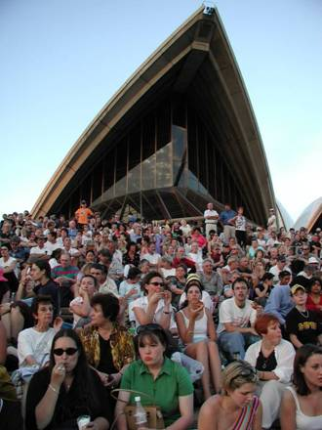
Human Diversity
Humanity is diverse.
People have different:
  languages
  cultural expectations
  color perception
  ergonomic needs
  abilities/disabilities
  ages
Notes:
Disabilities:
Color-blindness
Inability to type
Text to speech systems etc…
The elderly need larger type
The blind need further accessibility accommodation.
Cultural differences:
Localization
Chinese scan top-down/left-right.
ASCII vs UNICODE
Office ergonomics is important too:
Comfort for a variety of shapes and sizes
Distractions

Slide 12
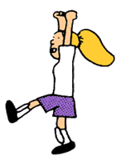

Developers and Users
Developer traits
Logical
Technically trained
Views technology as an end in itself
On the inside
Knows the system
Lives to hack
User traits
Who knows?
Who knows?
Uses technology to achieve goals
On the outside
Doesn’t know the system
Has better things to do
images from www.dilbert.com
Notes:
Techno-bill and Liz (actually, Liz is an engineer too)
Users are not designers. ... Designers are not users. – Jacob Nielsen, Usability Engineering
See the technobill comic here: http://cs.calvin.edu/curriculum/cs/262/kvlinden/private/images/techno-bill.gif

Slide 13
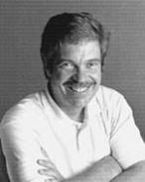

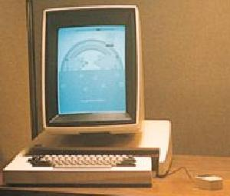
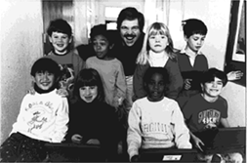
Alan Kay the Alto
What’s the
Big Idea
The Alto incorporated the first GUI interface.
It was developed at Xerox PARC in the early 1980’s based on child-psychology.
Steve Jobs took the idea to Apple for its Macintosh computers.
"Only people born before a technology is invented think of it as a technology"
images from www.parc.xerox.com, quote from MTCTW
Notes:
Remind them that OO really took hold in GUIs (smalltalk) (review encaps/inherit/polym). It was very natural there to thing of objects that were like other objects, but with a few extensions.

Slide 14
Interface Design Principles
Everyone tries to reduce interface design to a set of “rules”.
Here’s a consolidation of them:
  Help the user learn the interface.
  Put the user in control of the interface.
  Make the interface robust.
Doing these things helps ensure a pleasant/productive user experience.
Notes:
We’ll run an example here with the NH253/SB382 lighting systems. It works, but is it well designed?
Making it pleasant promotes customer loyalty.

Slide 15
Learnability
The interface is useless if it is unusable.
Principles:
  Be consistent.
  Plagiarize.
  Establish meaningful defaults.
  Make functions visible or memorable.
  Make the mapping from control to goal clear.
  Encapsulate action sequences.
Notes:
be consistent
e.g., story of the RAF Spitfire eject/fire buttons that were reversed (urban legend).
Cut down on the information that must be learned/remembered
Plagiarize “standard” ideas. Not all copying is plagiarism.
Old ideas are probably better than yours, your users will know them, you won’t have to design them.
When you must invent, ask “Has no one really done this?”, “Is it really important?” have good defaults
e.g. Rational Rose doesn’t
e.g., MS doesn’t always default to the current directory by making it visible
e.g., CD player interface for PC CD players make the mapping clear
e.g., which side of the door do you push/pull?
e.g., MacOS is much better and UNIX, except perhaps for power users
e.g., Put the tool-bar icon on the pull-down menu to help the user learn.
Don’t make the user remember all action sequences - script them or allow the user to make macros for them.
The light switches are consistent (they’re like all other switches in the US), have good defaults (up-on,down-off), there’s not much to remember, the mapping is bad.

Slide 16
Control
Users, particularly experienced users, want to be in control.
Principles:
  Allow the user to be efficient.
  Enable shortcuts and customizations.
  Cluster common features together.
  Give appropriate feedback.
  Reduce short-term memory load.
Notes:
Know your users and conform to them, not the other way around.
Support both novices and experts if appropriate.
customizability (end-user modifiability).
e.g., accelerator keys and macros
Tannenbaum's notion of one way to do things is wrong.
Easy things should be easy, hard things should be possible.
User’s crave feedback.
E.g., the original telephones were very well designed
dial tone, the feedback touch tones, the buttons’ tactile feedback your voice is feedback through the receiver at the right level
e.g., Modern phones are not so well-designed.
reduce short-term memory load
e.g., cut/paste is nice for this
The light switch needs no shortcuts (probably), and it does give good feedback. Not much short-term memory is required either.
SB382 interface has much better shortcuts.

Slide 17
Robustness
The system must deal with error.
Principles:
  Offer error prevention and handling.
  Support undo and redo.
  Provide good help and error messages.
Notes:
Design the GUI to disallow dumb errors if possible
Handle them gracefully when they happen.
Allow undo/reversal of actions
Provide help.
E.g., automatic back-up of files
e.g., context sensitive help
No written messages are really required (except, perhaps, to solve the mapping problem given above).

Slide 18

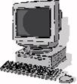
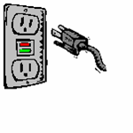




Example: The Electric Plug
Notes:
Review the AC electric plug with respect to our basic principles:
tons of different sorts of devices:
phones, tvs, computers, drills, etc.
PLUG (at least in the US)
tons of different sorts of power:
production methods:
coal, nuclear, hydro-electric, solar
potential delivery types:
120V 60C, 240V
learnability - very consistent and learnable
control- There is the grounding/no-grounding problem
robustness - we do have problems with shocks and blown fuses (not found in England or Germany)

Slide 19
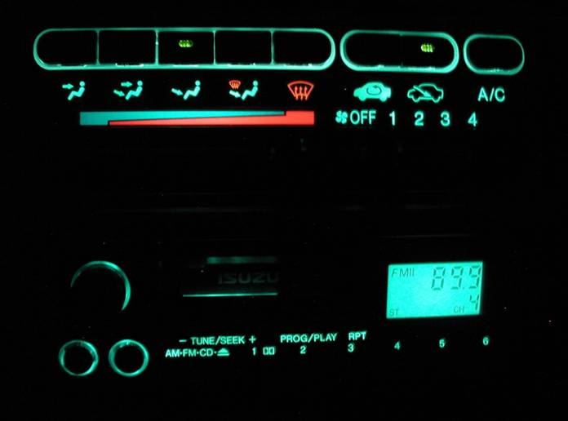
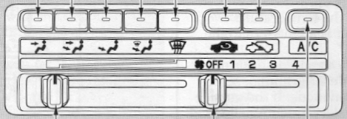
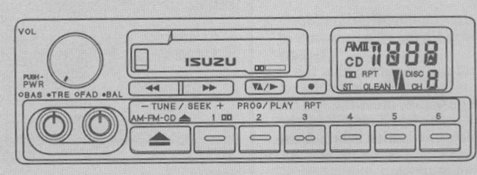
Example: My Car Radio
Photos from Isuzu, USA corporation
Notes:
Use the Oasis climate control and radio as examples. They looks fine during the day, but at night you can see what the temperature is set as, you can’t see the tape/cd controls.
The standard Oasis radio is an example - Note that this is just a drawing on the interface, the Cognitive Walkthrough should be done before very much programming has been wasted.
User task: Keith is driving home after faculty senate and wants to play a cassette tape (very very loud) to work out vocal parts for Sunday’s service- What should he do? Tell a story about each of these that is cognitively believable:
If the radio is not on, turn it on (how to tell it’s on, how to turn it on)
get the tape somehow (this is hard, but not the radio’s fault)
stick it in (can it be turned in backwards?)
press play (you can’t see this button - 2 directions are not clear)
listen (hope this is ok)
eject (how do you do this - by switching mode)
turn off radio.

Slide 20
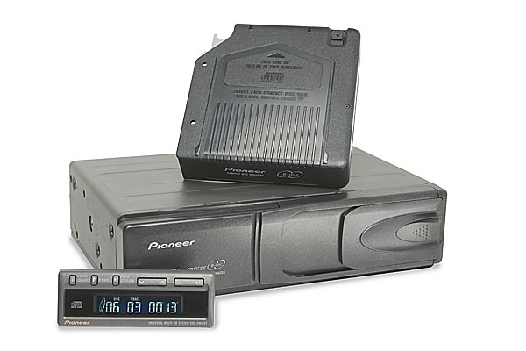
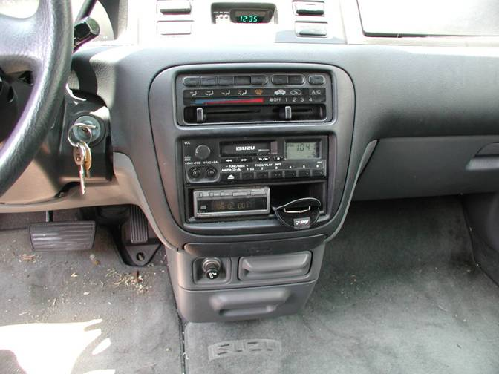
Example: My Car CD Player
image from pioneerelectronics.com
Notes:
Can you read those buttons? Could you figure out how to play random tracks from the current CD? Neither can I, especially when I’m driving. I’ve tried to memorize the buttons, but it never really works. I can’t read the button text, nor can I read the LCD indicators. It’s modal interface, which makes it harder remember.

Slide 21
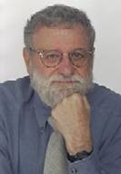
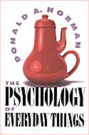
Donald Norman
Design for Human Factors
Published POET in 1988 as a study of design.
It was based on a lifetime of bad experiences with poorly designed objects.
http://www.jnd.org/
images from www.jnd.com
Notes:
We used to hit this heavily in the lab, but don’t have time for it anymore.

Slide 22
Discount Usability
Nielsen’s streamlined usability regimen
  Le mieux est l'ennemi du bien – Voltaire, 1764
Basic elements:
  User/Task Observation
  Scenarios
  Heuristic Evaluation
  Simplified Thinking-Aloud
Notes:
1 & 2 are more for design, 3 & 4 are more for V&V
User/Task Observation – obvious, but not an official part of DU.
Observe real users in context
Example – Global HSI issues like users copying part numbers and going to a separate manual.
Scenarios – what we’ve already been doing for system design – he sees them as a form of prototyping.
Build Mock-ups/Simple Prototypes to throw away
Example – Users probably wouldn’t like the tree view format for new configurations (see SQL Server Enterprise Manager)
Simplified Thinking-Aloud
Watch real users using the system
Example – The SQL Server must be installed first problem with the Install wizard
Example – Manual formatting of steps and images
Note – Studies indicate that running 5 representative users will find 80% of the usability problems (even though it may not be statistically significant)
Heuristic Evaluation
Style guides and general guidelines
Example – Status messages in the splash screens – missed them, restarted install the first time
Example – MD vs. SD interfaces
Note – Style guides aren’t enough.
"le mieux est l'ennemi du bien" (the best is the enemy of the good) [Voltaire 1764]

Slide 23
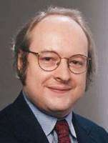
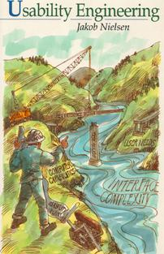
Jakob Nielsen
Discount Usability
Nielsen published UE in 1993 as an attempt to “sell” usability to management.
He has focused much of his recent effort on website usability.
  http://www.useit.com/
images from www.useit.com
Notes:
Show Nielsen video (the first 5 minutes of the video – give them the link for the rest of the video as homework):
Original copy: http://www.devsource.com/article2/0,1895,1937615,00.asp#
Local copy: http://cs.calvin.edu/curriculum/cs/262/kvlinden/private/06 Jacob Nielsen.wmv

Slide 24

User Task Observation
Nielsen doesn’t explicitly list this step; he assumes it.
Customer Anthropology – the study of your customers' people and behaviours in their 'natural habitat'.
“Customer Anthropology is a lot like birdwatching in that you want to try to make yourself invisible to those you're watching
- Dave Pollard, salon.com
image from www.salon.com
Notes:
We’ve talked about this already, but here’s a nice take on it from Dave Pollard, June, 2006.
http://blogs.salon.com/0002007/categories/businessInnovation/2006/06/15.html

Slide 25
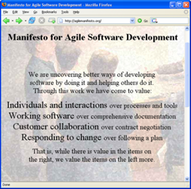
Scenarios
Nielsen sees this as a form of prototyping.
He suggests using either mockups or prototypes, provided that they are small.
“… we have come to value working software over comprehensive documentation.”
- Agile Manifesto
image from www.agilemanifesto.org
Notes:
We’ve covered this already.
User-oriented scenarios tend to be more useful in HCI than requirements lists and other forms of traditional documentation. The Agile folks very much prefer brief, informal statements of the former to the latter.

Slide 26
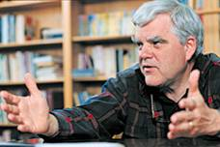
Heuristic Evaluation
Usability experts can review a design with respect to:
  Interface style guides
  General usability guidelines
Base the review on either:
  Mock-ups
  Prototypes
Approaches:
  Cognitive Walkthough
“When users do take time to look at your design, it should be as free as possible of problems.”
- Clayton Lewis, TCUID
image from www.cs.colorado.edu
Notes:
Style Guide are useful, but there are misconceptions (Stephen Gale, Reasons why style guides fail, CHI96):
Once a style guide is in place, no further usability or consistency work is necessary. WRONG
The production of a Style Guide is seen as a substitute for iterative design and user testing. WRONG
General usability guides lines should be learned and, when in doubt, used.
Definitions:
Mock-up - unimplemented, on paper
Prototype - implemented (perhaps with stubs)
A cognitive walkthrough is like a code walkthrough in which we review a procedure, asking at each step whether or not the users will:
want to produce whatever effect the action has?
see the control for the action?
recognize that it produces the effect they want?
understand the feedback they get?

Slide 27
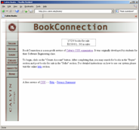
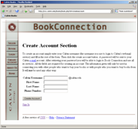
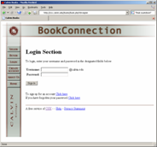
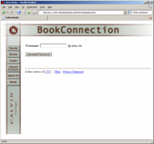
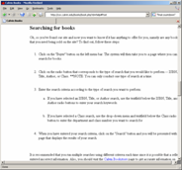
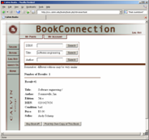
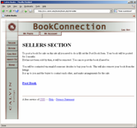
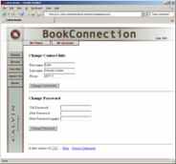
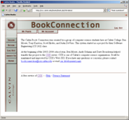
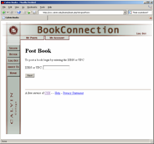
Secure Section
Email sent to seller
Notes:
Heuristic evaluation does a sort of cognitive walkthrough of the design. We won’t probably have time to cover task-centered UI design in detail, but one should definitely use either a full prototype or some sort of mocked up storyboard or screen-flow diagram like this one. (project elab II will require such a diagram – if you can provide screen dumps, then great, otherwise, mock something up).
Go through this with respect to the guidelines:
The content here is the books/items in the bookconnection database (that’s it)
I had some trouble with the interface:
I expected a confirmation dialog box on the “order book” feature, and didn’t get one.
Making the diagram with real screen dumps was a pain, using hand-drawn mockups would make more sense early on I think.
This modeling language/style is not in UML, but it probably should be because it is so useful in designing interactive, menu-based interfaces. It’s based on David Harel’s statecharts.

Slide 28
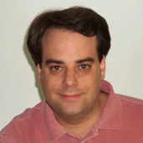
Thinking-Aloud Protocols
Watch real users do real tasks using the system.
Have them talk about what they are doing and why.
“A user interface is well designed when the program behaves exactly how the user thought it would.”
- Joel Spolsky, UIDP
image from joel.spolsky.com
Notes:
Use this as an opportunity to talk about project deliverable #6, the usability study.
Real users:
Get people representative of your real users.
Studies indicate that running 5 representative users will find 80% of the usability problems (even though it may not be statistically significant)
Use the tools yourself if appropriate.
Real tasks:
Base the tasks on representative, real use cases, not on things you as developers think would be interesting.
Let it be a “complete” task.
Make sure that the tasks are “representative”.
Thinking aloud process:
Always be asking them “what are you doing now?” “why are you doing it?”
Do a pilot usability study first.

Slide 29








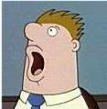

Average Users and Real Users
The Average User
Comes in one generic shape and size
Doesn’t really exist
Real Users
Come in all shapes and sizes
Exist everywhere
images from www.dilbert.com
Notes:
Ted, the generic guy, comes up from time to time when an extra is needed. In Star Trek, such characters are usually killed off.
The “average user” is a myth – what you generally want is a set of representative users. E.g., Target, Kmart and Walmart sell to the “average” customer, with shoe size 8, the opposite of my pants specifications and 2.3 children; though their average customer is happy, it basically does me no good at all.
You’ll always have to balance size and coverage when you build your test subject set. Small numbers from each representative subset should do the job.
For a list of the Dilbert characters, see http://en.wikipedia.org/wiki/List_of_minor_characters_in_Dilbert

Slide 30
The Ethics of User Testing
Important features of user tests:
  They are voluntary.
  Their contents and purpose are clear.
  Subjects can quit at any time (period).
  Individual data is private.
If a subject fails, it's your fault not theirs.
Inform the test subjects of the results of the test.
Notes:
Be careful, people can get upset in tests, even thinking-aloud tests like the ones you’ll be doing,
Never, ever laugh at them! They already feel stupid (even I do when I do tests).
Privacy:
no names, just numbers
no faces in videos (story about Newell, Simon et al in that front-to-back xerox photocopier video)
Make sure that they know that they can’t fail. If them miss something, it’s your fault.

Slide 31
UI Patterns
Patterns are useful in UI design.
  http://www.hcipatterns.org
Interface Implementation perspective:
  Model-View-Controller
User Interaction perspective:
  Undo
  Progress
  Wizard
  Preferences
  Fisheye
Notes:
Distinguish Patterns and Plagiarism.
Implementation perspective
Mvc
User perspective
http://www.cs.helsinki.fi/u/salaakso/patterns/Continuous-Highlight.html
http://www.idi.ntnu.no/~hal/publications/design-patterns/PLoP2k-Welie.pdf
http://www.hcipatterns.org
See, in particular, vanWelie’s MobileUI patterns (see http://www.welie.com/).

Slide 32
Model-View-Controller
MVC is a fundamental user interface design (or architectural) pattern.
Notes:
The previous slide discussed the user interface, this slide discusses the object-design behind the interface.
The Model-View-Controller (MVC) pattern separates the modeling of the domain, the presentation, and the actions based on user input into three separate classes [Burbeck92]:
Model. The model manages the behavior and data of the application domain, responds to requests for information about its state (usually from the view), and responds to instructions to change state (usually from the controller).
View. The view manages the display of information.
Controller. The controller interprets the mouse and keyboard inputs from the user, informing the model and/or the view to change as appropriate.
Only the controller can change the state of the Model. The view can only query the state for display purposes.
Entity-control-boundary objects in UML correspond to MVC.
See: http://msdn.microsoft.com/library/default.asp?url=/library/en-us/dnpatterns/html/DesMVC.asp
We didn’t following this design in a tool that built and really got burned by it (i.e., Tamot2).

Slide 33
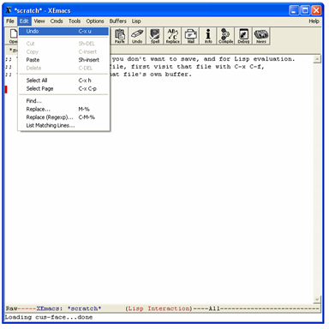
Multi-Level Undo
Problem
  The user makes a mistake in a more involved task and needs to back the changes out.
Solution
  Provide a multi-level undo capability.
Pattern from Tidwell, 2005
Notes:
This is incredibly important in freeing the user to explore the interface, something they won’t do without such a feature.
It’s not always easy to implement this – undo in a database transaction system is a complicated matter. Such features can have large architectural consequences (Nuray Aiken uses an example in which (the late introduction of) undo changed the architecture of a major enterprise system).
OK, so there are better examples that C-x u in emacs, but I’ve probably used that one 10,000 times.

Slide 34
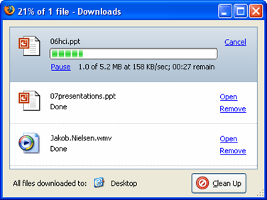
Progress
Problem
  The user is performing a process and would like to know how far they are.
Solution
  Build a progress bar that indicates the percentage completion of the task at 2 second intervals.
Pattern from van Welie, 2000
Notes:
Relate the research on theater and interface design that discussed progress bars in the context of suspenseful drama. You don’t want to keep your user in suspense as movie directors do by limiting the scope of their vision during situations of uncertainty.

Slide 35
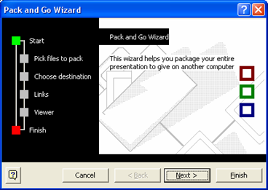
Wizard
Problem
  The user must perform an unfamiliar and involved task.
Solution
  Build a graphical, step-by-step widget that takes the user through the task, indicating progress along the way.
Pattern from van Welie, 2000

Slide 36
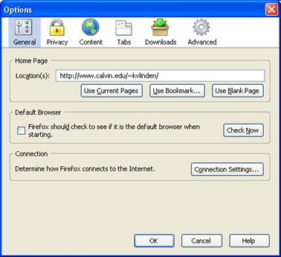
Preferences
Problem
  The user would like to control the general feel of an interface.
Solution
  Provide a parameterized way to tailor the interface in pre-specified ways.
Pattern from van Welie, 2000

Slide 37
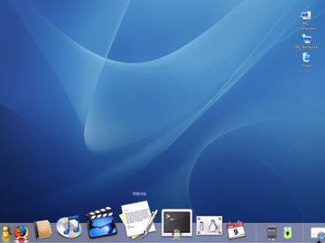
Fisheye
Problem
  The user is working on parts of a large artifact and has trouble “seeing” it all.
Solution
  Provide a graphical view of the artifact that shows all parts, but magnifies specific ones.
Pattern from salaakso, 2003

Slide 38
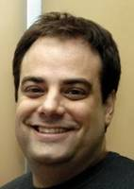
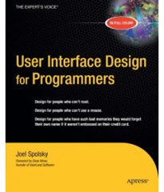
Joel Spolsky
Joel on Software
What’s the
Big Idea
Spolsky published UIDP in 2001.
Usability, fundamentally, is a matter of bringing a bit of human rights into the world of computer-human interaction. … That’s why I care about usability, and you should too.
images from www.joelonsoftware.com
Notes:
Usability, fundamentally, is a matter of bringing a bit of human rights into the world of computer-human interaction. It’s a way to let our ideals shine through in our software, no matter how mundane the software is. You may think that you’re stuck in a boring, drab IT department making mind-numbing inventory software that only five lonely people will ever use. But you have daily opportunities to show respect for humanity even with the most mundane software. Even if you are just working on a code library, an API that is invisible to everyone but other programmers, if you can design the API in a way that is consistent, easily understood, more obvious, and easier to get right, the programmers who use your API will be happier. By focusing on usability, you show your respect for the happiness of the people who run your code.
That’s why I care about usability, and you should too.

