Slide 1
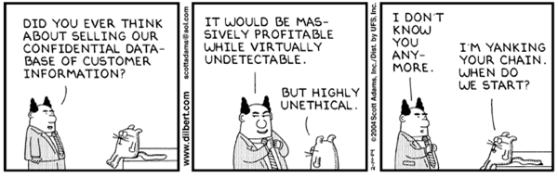
Dilbert © United Feature Syndicate, Inc.
Notes:
I may have to reschedule lab #7 if there is a council session that the students should attend. It could easily be done of-line and the team meeting is not that important this week.
IM1. Information models and systems [core]
Minimum core coverage time: 3 hours
Topics:
History and motivation for information systems
Information storage and retrieval (IS&R)
Information management applications
Information capture and representation
Analysis and indexing
Search, retrieval, linking, navigation
Information privacy, integrity, security, and preservation
Scalability, efficiency, and effectiveness
Learning objectives:
Compare and contrast information with data and knowledge.
Summarize the evolution of information systems from early visions up through modern offerings, distinguishing their respective capabilities and future potential.
Critique/defend a small- to medium-size information application with regard to its satisfying real user information needs.
Describe several technical solutions to the problems related to information privacy, integrity, security, and preservation.
Explain measures of efficiency (throughput, response time) and effectiveness (recall, precision).
Describe approaches to ensure that information systems can scale from the individual to the global.
IM2. Database systems [core] Minimum core coverage time: 3 hours
Topics:
History and motivation for database systems
Components of database systems
DBMS functions
Database architecture and data independence
Use of a database query language
Learning objectives:
Explain the characteristics that distinguish the database approach from the traditional approach of programming with data files.
Cite the basic goals, functions, models, components, applications, and social impact of database systems.
Describe the components of a database system and give examples of their use.
Identify major DBMS functions and describe their role in a database system.
Explain the concept of data independence and its importance in a database system.
Use a query language to elicit information from a database.
IM3. Data modeling [core] Minimum core coverage time: 4 hours
Topics:
Data modeling
Conceptual models (including entity-relationship and UML)
Object-oriented model
Relational data model
Learning objectives:
Categorize data models based on the types of concepts that they provide to describe the database structure -- that is, conceptual data model, physical data model, and representational data model.
Describe the modeling concepts and notation of the entity-relationship model and UML, including their use in data modeling.
Describe the main concepts of the OO model such as object identity, type constructors, encapsulation, inheritance, polymorphism, and versioning.
Define the fundamental terminology used in the relational data model .
Describe the basic principles of the relational data model.
Illustrate the modeling concepts and notation of the relational data model.

Slide 2
Information Systems
Introduction
Database Modeling
Database Management Systems
E.F. Codd
Data is not information, information is not knowledge, knowledge is not understanding, Understanding is not wisdom. - C. Stoll, 1996
Notes:
Monday: Introduction & Modeling through ERDs
Wednesday: Relational Model & DBMS through Architecture
Monday: SQL
Wednesday: JDBC & OO Persistence Frameworks & EF Codd
All our knowledge brings us nearer to our ignorance,
All our ignorance brings us nearer to death,
But nearness to death, no nearer to God.
Where is the Life we have lost in living?
Where is the wisdom we have lost in knowledge?
Where is the knowledge we have lost in information?
The cycles of Heaven in twenty centuries
Bring us farther from God and nearer to the Dust.
- T. S. Eliot, The Rock, 1934

Slide 3
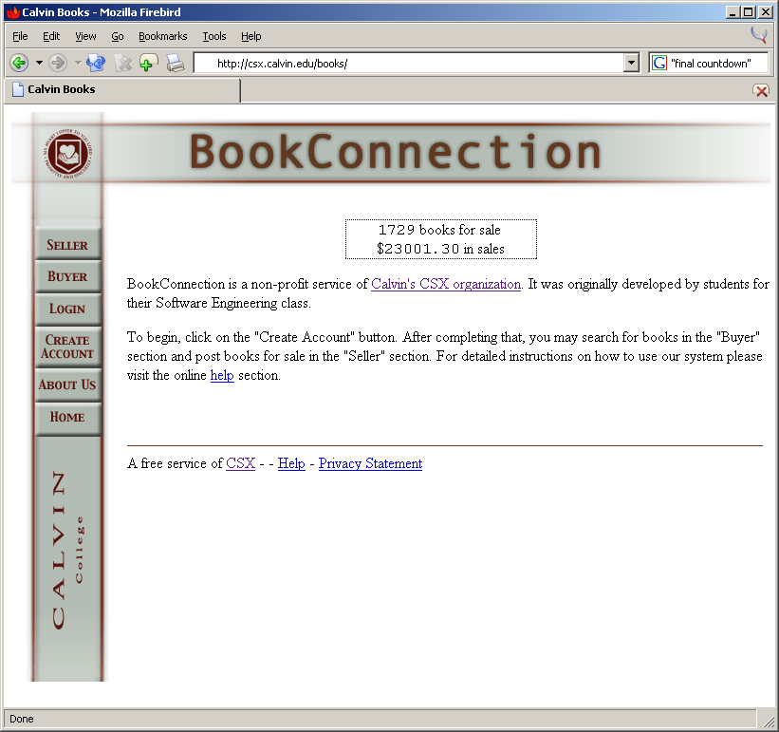
An Example Information System
The CSX book connection system
Find it on-line at:
  http://csx.calvin.edu/books/
Notes:
Login and show them how to use this thing.
CC2001 required topic: Critique/defend a small- to medium-size information application with regard to its satisfying real user information needs.

Slide 4
Definitions
Database - a collection of related data that is persistent and too large to fit into main memory
Database Management System – an automated system that maintains and provides multi-user access to a database, and whose operation is efficient, easy to use, and safe
Information System – A system (i.e., people, machines, and/or methods) to collect, manage, and use the data that represent information to bring value to an organization
Notes:
What databases do they use on a regular basis?
Is there anyone that doesn’t use or depend on databases?
Use one of their examples to illustrate the elements of these definitions,
otherwise use:
Calvin’s registrar’s database
CentrePointe’s church database

Slide 5
Persistence
Most data outlive the programs that operate on them.
The DBMS must be able to store and retrieve this data.
Notes:
Have they built persistent storage systems?
Can you store and retrieve the data structures built during the execution of “normal” C++ or Java program?
e.g., the Calvin registrar keeps your student data even when systems go down or are upgraded.
e.g., A DR database (like the one I wrote) would keep track of DRs for the duration of a 10/20 year project.

Slide 6
Database Size
Massive amounts of data are stored in databases.
How massive?
  A comparison:
    http://www.cacr.caltech.edu/~roy/dataquan/ (a local copy)
Notes:
How large are the databases they have worked with?
a big db story - Meijers, Walmart, Amway,...

Slide 7
Multiple Users
The DBMS must support multi-user access.
There are different types of users:
  Administrators
  Database designers
  End users
Each user should have:
  their own view of the database
  their own means of interacting with it
Notes:
Similar to the concurrent programming problems you see in OS, but with disk data, not memory variables.
Similar to file system access but with finer granularity
The end users come in a variety of types (naïve, savy, etc).

Slide 8
Efficiency
The operations on the data must be efficient.
The data must be stored efficiently.
Notes:
Efficiency of operations:
Chad VandePol’s example of the grep-based Grand rapids public library search program. Replacing it with and Oracle implementation increased the speed tremendously.
Efficiency of storage:
no redundancy

Slide 9
Convenience
The command languages and interfaces must be easy to use.
Database applications must be insulated from changes to:
  the structure of the data - data independence
  the implementation of the commands
  the physical location of the data
Notes:
Have you ever encountered an inconvenient DBMS interface?
You’ve got to provide standard and ad-hoc queries.
“standard things should be easy, hard things should be possible.”
Example of a bad interface - the old Colorado book database - they only had an undocumented method for searching for an exact title.

Slide 10
Safety
The DBMS must protect the integrity of the database from:
Notes:
Cf. the Dilbert comic.
Examples of database failures?
Data Inconsistency
Getting your name/address in the database in various formats and spellings and then getting multiple times the junk mail.
System failures
That COBOL database that Brenda’s old boss worked with. They mangled the whole database with a bad program and also lost the database backups. Thus, the programmers had to go in and “un-mangle” the database with a new program. Yuck!
Malicious users
hackers – examples?
Safety issues - University of Michigan student records were on the web for a short period by accident.

Slide 11
Information Systems
Collecting information
Managing information
Using information
Notes:
The goal is to provide value
Collecting information
old-fashioned data entry
D&W’s value card
on-line solicitations
IE/IR
others?
Managing information
DBMSs (primarily)
others?
Using information
database-driven web sites
OLAP tools
others?

Slide 12
Using Databases
When to use database systems
When not to use them
Notes:
Use them for just about anything.
Don’t bother when the hardware/software cost of a database system is too high for the application, e.g.
the applications are simple
the data structures constant
no multiple user access
significant potential privacy issues

Slide 13
Database Modeling
Databases should be designed.
There are a number of modeling language for doing this:
  UML class diagrams
  Entity-Relationship Diagrams
  Relational models
Notes:
Database schemata may be the one place I don’t take a strong, XP approach to iterative design. A limited or bad data designs are hard to refactor.
see Rational's Tp180.PDF
UML <> ERD
I don’t believe that OMG currently endorses a data modeling profile, although they have been working on one since the early 2000’s at least.

Slide 14
BC: UML
Notes:
This is a UML model for the data in the book connection domain. It is very much like the ThinkGeek domain model from the design lecture. Note:
The basic structure of the domain (class, item, user)
The use of a recursive association on Class
The user of multiple associations between item and user.
The additional utility classes “hanging” off of the assocations.
Those of you that have seen database systems will have noticed that this doesn’t directly map to any obvious database system. The reason for this is that traditional database systems are not object-oriented (they’re relational).

Slide 15

Peter Chen
Entity-Relationship Diagrams
Chen introduced ERDs in the CACM, 1976.
Included features for:
  Data entities
  Data attributes
  Data relationships
Image from www.computer.org July, 2003
Notes:
Chen, Peter. "The Entity-Relationship Model: Toward a Unified View of Data" ACM Transactions on Database Systems I (I). March 1976, pp 8-46.

Slide 16
BC: ERD
ID
name
User
password
1
0..n
Offer
Hold
date
CrossList
price
0..m
0..m
ID
ID
0..n
0..n
creator
ItemCourse
Item
Course
title
description
1..m
0..m
title
professor
price
type
required
semester
Notes:
Talk through the basic elements here:
entities (cf. UML classes)
attributes (cf. UML data members)
relationships (cf. UML aggregation links)
cardinality (we’ll just do it the same way – there are other ways to specify it…)
What about inheritance – where did the inheritance go?
The Item sub-types are represented with the type attribute
sellers are simply buyers with an offer relationship to their name

Slide 17
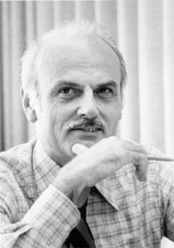
Edgar F. Codd (1923-2003) Relational Data Model
Codd developed the relational model in the early 1970s.
Included features for:
  Data definition
  Data queries
It is the database model.
image from wikipedia, June, 2006
Notes:
Edgar F. (Ted) Codd - won the ACM Turing award in 1981 for his work on the Relational Data model. He cites the example of his fellow pilots and aircrews of Royal Airforce of WWII as the source of his determination to push the relational model even when “government, industry and commerce were strongly opposed to [it]”.
Fields may also be called cells in a spreadsheet
Tuple may be called rows
Relations may be called tables

Slide 18
Relations
2-dimensional tables of data comprising:
  A relation Schema
  Atomic data values
A database schema comprises a set of relation schemata.
Each relation can specify a primary key.
Notes:
Note that the schema is metadata, i.e., data about data.
Use the example on the next slide to explain all this.
A primary key is a value of a single attribute (or set of attributes) that uniquely identifies a record amongst all the records in the relation.

Slide 19
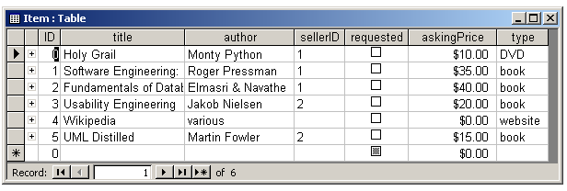
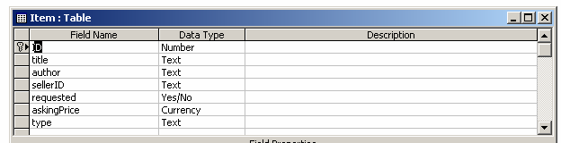
Example
Notes:
We’ve seen this particular information before – Now we’ll put it in relational form (in MS Access, which I’ll use for the lectures because it’s graphical – we’ll use PostgresSQL for the labs – you can use whatever you want to the team project).
Point out:
the schema (on the left)
the data (on the right)
the entities (rows)
the attributes (columns)
The attribute value must be a single value, NOT a repeated or comma-separated list of values that has an unbounded length
talk about this (rectangular data, no arrays as attributes).
The primary key (here it is ID)
That the order of the fields in the tuple and the order of the tuples in the relation is irrelevant.

Slide 20

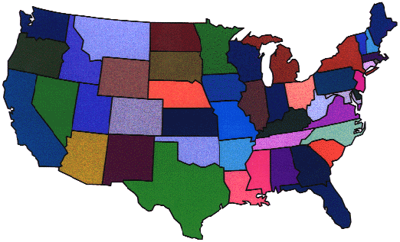
Representing Relationships
Relationships are implemented using foreign keys as attributes.
While in the UK, they kept my:
UK National Insurance #
US Social Security #
...
The USA maintains my:
Social Security #
...
Notes:
This diagram should remind them of the data relationships that we mentioned last week.
The relational model doesn’t have the pointers, variable names or data structures that programming languages have. Everything is value-based.

Slide 21
Representing Relationships
Relationships are implemented using foreign keys as attributes.
Item
ID
UserID
...
User
ID
...
Notes:
Note that HOUSEHOLD is the “rightful owner” or “parent” of the ID# we are using. It is called the “parent” relation. PERSON is called the “child”.

Slide 22
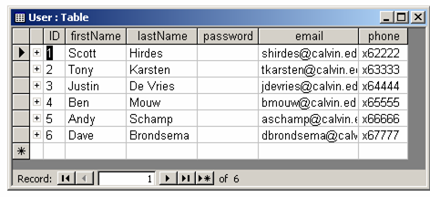
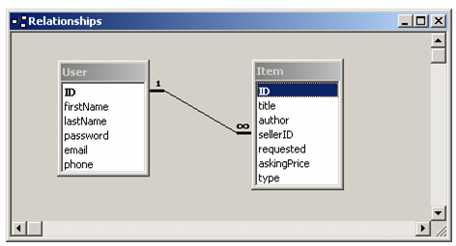
One-to-Many Relationships
Notes:
1-m relationships require a single foreign key.
Notes:
This is value-based rather than pointer-based.
The parent key must be a primary key in the parent relation (why is this?)
The figure shows how MS Access displays this relationship.

Slide 23
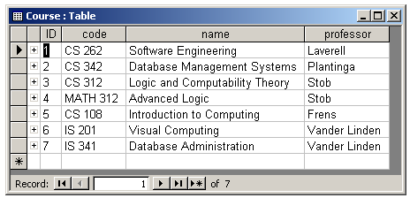
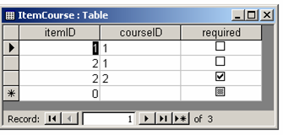
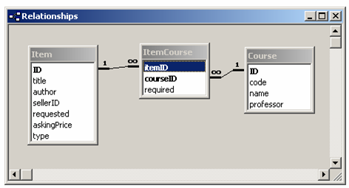
Many-to-Many Relationships
Notes:
m-m relationships require a separate table that contains 2 foreign keys – convince them of this…
Note again that this is value-based rather than pointer-based.
Show them the relationships in the Northwind database; look in particular at the Orders table.

Slide 24
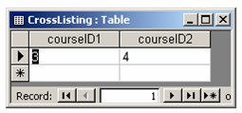
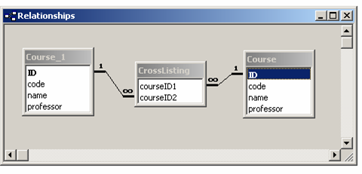
Recursive Relationships
Notes:
The Owner indicates the single supplier that owns this one. It is a 1-m relationship.
The containment relations indicates the container part contains the contained part. It is a m-m relationship.

Slide 25
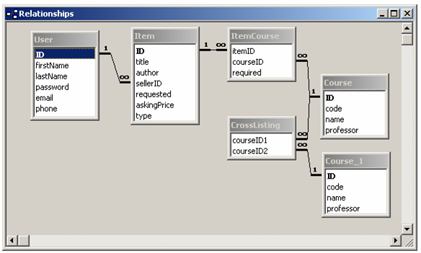
A BC Relational Design
Notes:
Talk here about the foolishness of combining entities with anything put 1-1 relationships into single tables.
Usually, you’ll have one table per relationship, plus some linking tables for m-m relationships.

Slide 26
Integrity Constraints
Integrity constraints allow database systems to maintain the consistency of the database:
  Entity integrity
  Domain integrity
  Referential integrity
Notes:
Entity integrity – the primary key must be unique and may not be NULL
Domain integrity – setting constraints on the values of fields in a table (e.g., int, enumerated types)
Referential integrity – see the next slides

Slide 27
Referential Integrity
The use of foreign keys can lead to inconsistency in the database:
  A foreign key value without a matching primary key value
  Changing a primary key value that is referenced as a foreign key
  Deleting a record whose primary key value is referenced as a foreign key
Notes:
Give an example of each of these potential problems using one of the earlier examples.
All database management systems allow you to enforce these sorts of constraints.

Slide 28
Redundancy
Relational designs can lead to redundancy:
  Repeating foreign key values is fundamental to representing relationships, so it’s unavoidable.
  Other more egregious forms of redundancy should be avoided.
Notes:
An example would be if we were forced to add a lengthy course description to the Book Connection database:
- You could just add a description field to the course table, but this would force you to copy the description every time a different professor teaches that class. Yuck.
- Alternatively, you could separate course from section, but the description in course and the professor, semester, section letter into course.

Slide 29
BC: UML Data Modeling Profile
Notes:
Here is the UML relational profile being used to represent the BC database.
This is the relational database I built to represent the Sales data domain in the first example. Note:
The schema contains all the table/relationship definitions.
The foreign keys are specified and they have 1-M relationships in all cases. There is some over-specification here given that the association links specify the same thing that the <<fk>>s specify.
There are no methods.
The attributes (fields) are all public.
All the relationships are navigable in both directions.
The relational stuff is specified using stereotypes that would, presumably, be understood by a relational code generator and handled appropriately.
The structure isn’t exactly that in the domain model – this isn’t a domain model, it’s an implementation model.
See the Rational whitepaper on this subject: TP180.pdf, http://www3.software.ibm.com/ibmdl/pub/software/rational/web/whitepapers/2003/Tp180.PDF
This spec doesn’t actually model the “connecting” tables, but I’m just going to do that to make the structure of the database clear and so I can avoid using the “association class” in the RDB models. It would be nice if the connecting table had a different stereotyped icon (say a diamond, cf. ERDs).

Slide 30
Database Management Systems
Databases and DBMSs are almost as old as computing itself.
Outline:
  DBMS History
  DBMS Architecture
  Structured Query Language
  JDBC
  Persistence frameworks

Slide 31
Database System History
Time Period | Type
1940’s | Hard-wired
1950’s & 60’s | Flat file
early 1960’s | Hierarchical
late 1960’s | Network
1970’s & 1980’s | Relational
1990’s & 2000’s | Object-Oriented
Notes:
No database systems in number crunching days
this changed, when folks realized that they were good for information retrieval as well
Flat-file database systems
late 50’s and early 60’s
simple 2D, file-based datasets.
Hierarchical and network database systems
late 60’s early 70’s
view databases as interconnected index cards, rather than tables.
IMS, IBM, 1968
CODASYL task group, 1971
Relational database systems
EF Codd, 1970
now a standard - Dbase, Paradox, Access, Oracle, Sybase
Object-oriented database systems
Very new, based on object-oriented programming
relational vendors support extentions
the wave of the future for DBMS’s ?

Slide 32
Flat-File Databases
These are simple file-based programs.
Relationships are not stored explicitly.
01
CS 262
kvlinden
…
02
CS 342
hplantin
…
03
CS 312
stob
…
…
…
…
…

Slide 33
Hierarchical Databases
Work at IBM:
  GUAM, part of the Apollo program (1964)
  IMS system (1968)
Designed to exploit disk structure
Good for 1-m relationships, bad for m-m
Query language:
  getNextWithinParent(), insert(), replace()
Notes:
GUAM, generalized update access method, was subcontracted by NASA.
IMS, information management system, incorporated a generalized version of GUAM in a commercial product.

Slide 34
Example: 1-to-many
User
Vander Linden
tkarsten
Items
SEPA
FDS 3rd ed
FDS 4th ed
…
How it is stored on disk
tkarsten
SEPA
FDBMS3
FDBMS4
…
shirdes
FDBMS3
Notes:
One-to-many relationships work well when storing on the disk. You can use simple pointer arithmetic. Thus, hierarchical models take advantage of the structure of the disk.

Slide 35
Example: many-to-many
Course
Vander Linden
CS 342
Items
SEPA
FDS 3rd ed
FDS 4th ed
…
“Virtual” Courses
CS 342
CS 262
Notes:
Many-to-many relationships don’t work quite so well in the hierarchical model. Unfortunately, the world is filled with relevant m-to-m relationships.

Slide 36
Network Databases
CODASYL-DBTG (1971)
less efficient, but handles many-many
Query language:
  a "navigation" language
  commands:
    get (i.e., follow link),
    connect (i.e. make link)
    In both cases, the queries were written algorithmically.

Slide 37
Example: many-to-many
CS 262
CS 342
MATH 312
1
2
2
SEPA
FDS 3rd ed
Notes:
Can you see why some folks say that OODBs are really just another instantiation of CODASYL? Yes - there are lots of “persistant pointers” - they were a pain then and they still are now.

Slide 38
DBMS Architecture
Relational DBMSs tend to provide three abstractions on a database:
  External view
  Conceptual view
  Internal view
In addition, they support efficient storage and data access.

Slide 39
Users
Queries &
Application Programs
DDL &
system commands
Interactive
queries
Application
programs
DBMS
Query/Program processor
DDL
compiler
Query
compiler
DML
compiler
Run-time
processor
Stored data manager
Concurrency &
Recovery
Systems
File manager
Buffer manager
Operating system
data definition files
data files
Notes:
cf. Text figure 1.1
Users write queries and applications
the query/program processor interprets and compiles them.
the stored data manager runs the queries/programs on the data.
The concurrency and recovery systems deal with concurrent access and backup/recovery for the database system. Concurrency control keeps track of who is working on which records, and if they have read and/or write locks. It does this at a much finer granularity than an OS.
the OS typically provides file access - though many databases modify the operating system (e.g., postgres required UNIX kernel mods) or replace the OS altogether. A DBMS’s needs are very different from those of an OS:
OS files are much more primitive than DBMS files/records/fields
A DBMS has a different process contour
SELECTBASE distinguishes the relational and storage views and the data and data structure files. It just doesn’t support very diverse queries or applications.

Slide 40
Users
Queries &
Application Programs
External View
DBMS
Query/Program processor
Conceptual View
Stored data manager
Concurrency &
Recovery
Systems
Internal View
Operating system
data definition files
data files
Notes:
This is the key slide for this class. Illustrate it via the grading or the book connection database.
cf. Text figure 2.2
the query/program processor translates from each user’s external view into relations/records/fields requests specified in the conceptual view (usually stated in terms of relations). Note that there can be more than on external view (e.g., students don’t see all the registration data, DBA’s do). Both the external and conceptual views deal with relations, records and fields. Implements logical data independence.
the stored data manager translates from the conceptual view to the internal view, thus insulating the rest of the DBMS from the details of the storage structures used by the file system. Implements physical data independence. The internal view deals with:
pages/page sets - fixed-size logical memory hunks
hunk size: 512 bytes - 4K
disk block - hardware memory hunk with physical address
hunk size: same as pages
smallest unit of disk transfer
You may have to explain this in terms of a “view” from the top of the chart. Users cannot see past the External View; the processor cannot see past the conceptual view, and the stored data manager cannot see past the internal view. This enforces layering.

Slide 41
Users
DBA General user Programmer
Queries &
Application Programs
DDL &
system commands
Interactive
queries
Application
programs
Host language
compiler
DBMS
Query/Program processor
DDL
compiler
Query
compiler
DML
compiler
Run-time
processor
Stored data manager
Concurrency &
Recovery
Systems
File manager
Buffer manager
Operating system
data definition files
data files
Notes:
Probably don’t need to cover this much detail…
cf. Text figure 2.3
DDL - data definition language - used by the DBA to structure the data
Queries - interpreted (SQL) queries used by general users
DML - data manipulation language used by application programs
DDL/DML/Query compilers - process their respective inputs and drive the DMBS
Run-time processor - actually does the run-time database operations as required - it doesn’t know where or how the records are stored (nor do any of the modules above)
File manager - Manages stored records, indexes, and files on disk
Knows: - mapping from records to files;
- mapping from files to pages;
- how to request pages from the OS via the buffer manager;
Doesn’t know: - What’s in the records.
Buffer manager - Manages virtual memory
Knows: - what pages are in main memory;
- how to swap them in and out.
OS - manages the disk and file system - it maps from page requests to disk block requests - it doesn’t know anything about relations/records/fields.
SELECTBASE is certainly not this internally complex. Is all this required? YES - in fact, full DBMS architectures can be more complicated that this picture.

Slide 42
SQL
Structured Query Language:
  Supports data definition, queries and updates
  Command-line based
It is the industry standard
Command types that we’ll cover:
  Data-definition commands
  Single-table queries
  Multiple-table queries
  Data manipulation commands
Notes:
It’s hard to imagine a database professional that doesn’t know SQL. Every query interface (including MS Access QBE) is based on some flavor of SQL.
SQL is the “lingua-franca”, the “intergalactic dataspeak” (Michael Stonebraker)

Slide 43
CREATE TABLE Syntax
CREATE TABLE table_name (
column_name data_type [column_constraint],
column_name data_type [column_constraint],
...
)
Notes:
Data types include:
INTEGER, SMALLINT, BIGINT
NUMERIC(precision, scale)
VARCHAR
Column constraints include:
NOT NULL
PRIMARY KEY
REFERENCES reftable
The full reference in here: http://www.postgresql.org/docs/8.1/static/index.html

Slide 44
Creating Tables
Create the BC Users table.
CREATE TABLE rUser (
ID integer PRIMARY KEY,
email varchar(50) NOT NULL,
name varchar(50),
password char(50)
);
CREATE TABLE rItem (
ID integer PRIMARY KEY,
title varchar(50) NOT NULL,
creator varchar(50),
description varchar(50),
offererID integer REFERENCES rUser(ID),
price money
);

Slide 45
SELECT Syntax
SELECT attributes_or_expressions
FROM table(s)
[WHERE attribute_condition(s)]
[ORDER BY attribute_list]
Notes:
This isn’t all of the select command, just the stuff we’ll cover here.
The square brackets indicate optional terms.

Slide 46
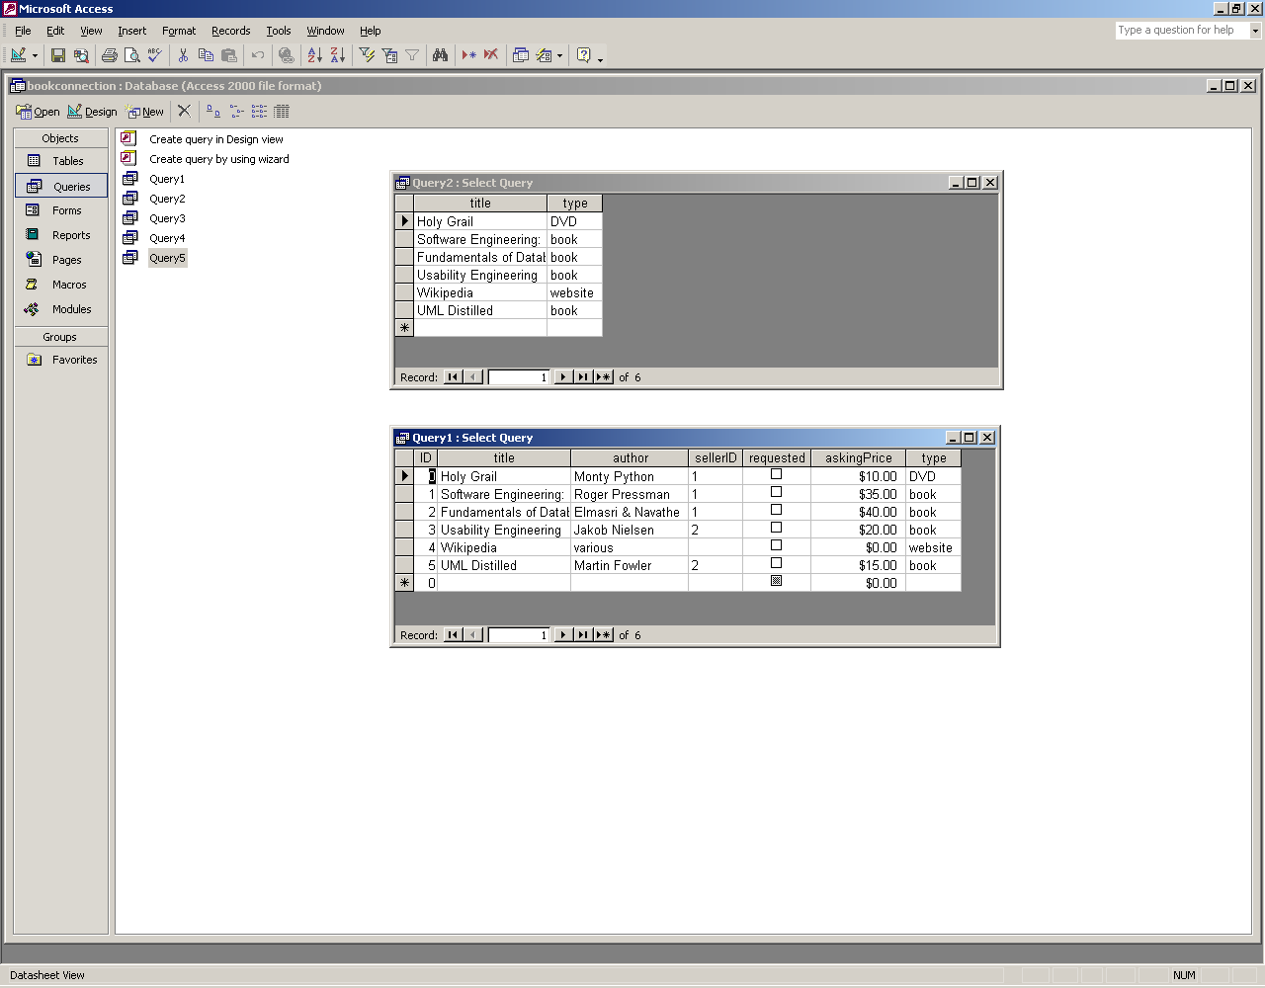
Single-Table Queries
Q: Get a list of all the items.
SELECT * FROM Item;

Slide 47
The Select Clause
Q: Get names and types of all the items.
SELECT title, type
FROM Item;

Slide 48
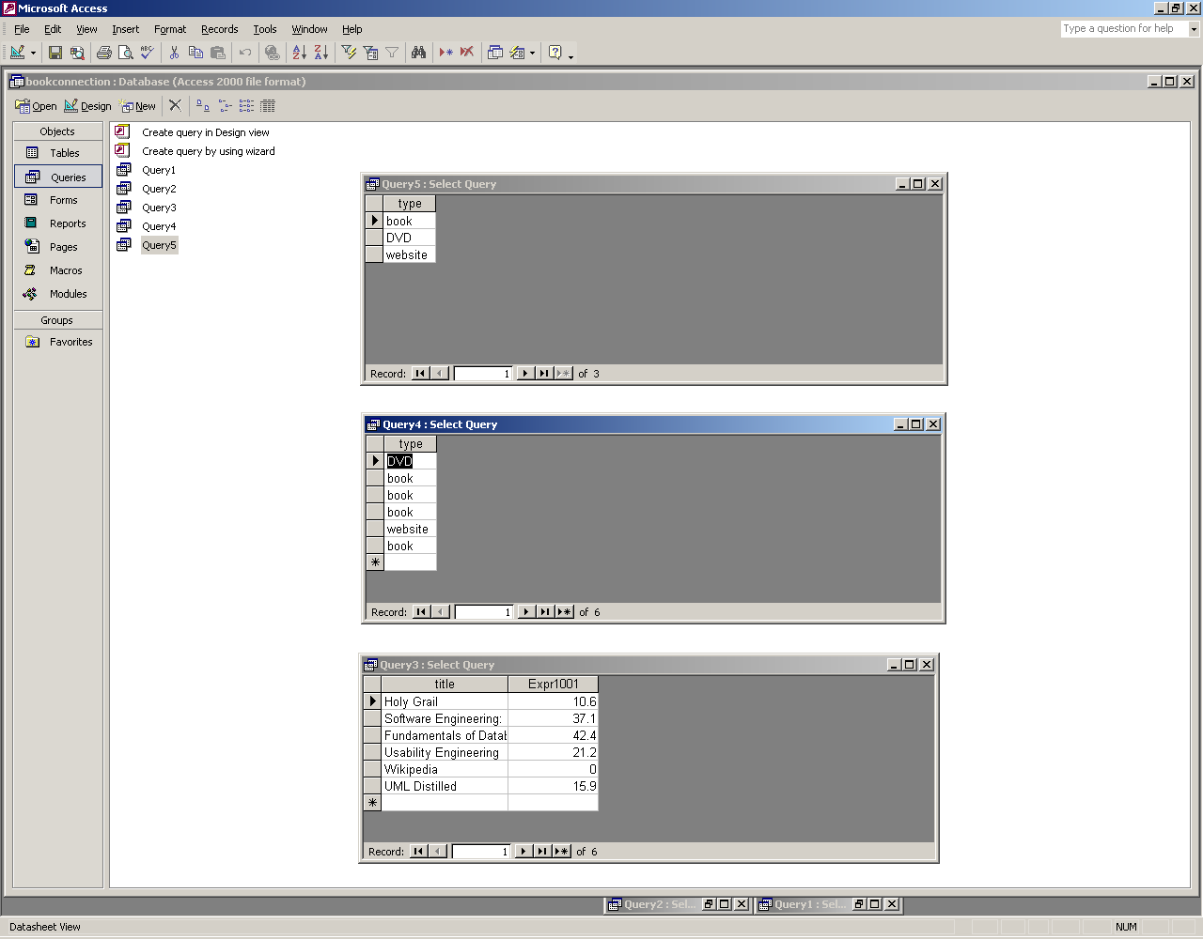
The Select Clause (cont.)
Q: Get the total value of each product in stock.
SELECT title, (askingPrice * 1.06)
FROM Item;
Notes:
Explain precedence order for the expressions (though they should all understand this already).

Slide 49
The Select Clause (cont.)
Q: Can SELECT return duplicates or not?
SELECT type
FROM Item;
Notes:
Sets don’t allow duplicates, bags do. The answer is bags because you can see multiple, identical values in the result set.

Slide 50
The Select Clause (cont.)
Q: Get a list of the category types for items.
SELECT DISTINCT type
FROM Item;
Notes:
Sets don’t allow duplicates, bags do. The answer is bags because you can see multiple, identical values in the result set.

Slide 51
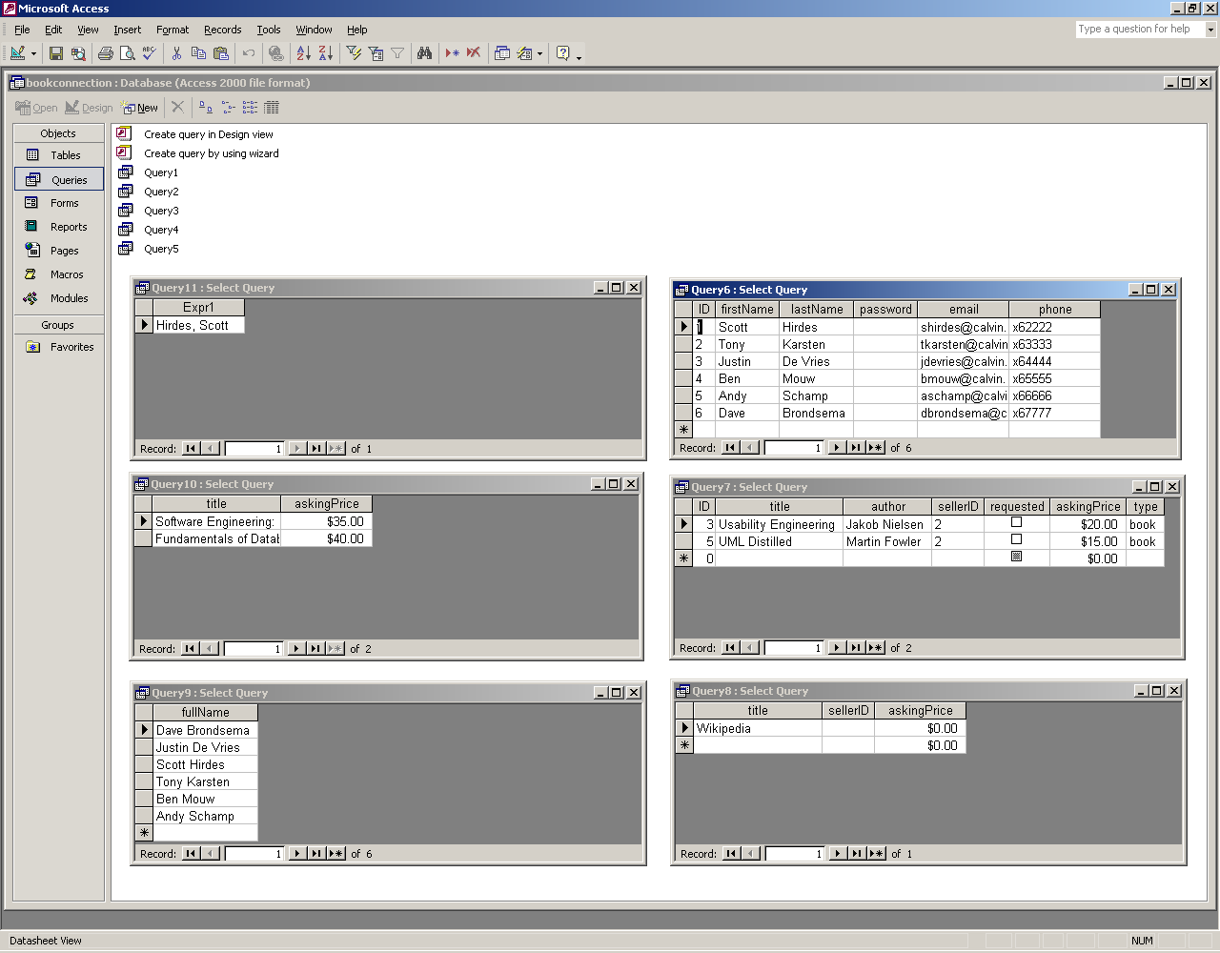
The Where Clause
Q: Get the users with Calvin email addresses.
SELECT *
FROM User
WHERE email LIKE '*@calvin.edu'

Slide 52
The Where Clause (cont.)
Q: Get the cheap books for sale.
SELECT *
FROM Item
WHERE type = 'book'
AND askingPrice < 25.00;

Slide 53
The Where Clause (cont.)
Q: Get the items without sellers.
SELECT title, sellerID, askingPrice
FROM Item
WHERE sellerID IS NULL;
Notes:
Note that image = null doesn’t work, it returns nothing
NULL is not a value, so it can’t be compared – always use IS NULL or IS NOT NULL

Slide 54
The Order By Clause
Q: Get the Users’ names in alphabetical order.
SELECT firstName+' '+lastName AS fullName
FROM User
ORDER BY lastName, firstName;
Notes:
Explain the precedence of the fields in the ORDER BY clause, and explain the use of ASC and DESC in case they ever need it.

Slide 55
Multiple-Table Queries
Q: Get the list of items for sale for CS 262.
SELECT title, askingPrice
FROM Course, ItemCourse, Item
WHERE Course.ID = ItemCourse.courseID
AND Item.ID = ItemCourse.itemID
AND Course.code = 'CS 262';
Notes:
Explain all this, especially:
the join condition (which is handled automatically by QBE)
the mix of join conditions and other conditions in the WHERE clause
the qualified attribute names.
Compare this way of doing the query with Access’s method (using an explicit INNER JOIN) ???

Slide 56
Multiple-Table Queries (cont.)
Q: Get the names of the people with CS 342 items for sale.
SELECT lastName + ', ' + firstName
FROM User, Item, ItemCourse, Course
WHERE User.ID = Item.sellerID
AND Item.ID = ItemCourse.itemID
AND ItemCourse.courseID = Course.ID
AND Course.code='CS 342';

Slide 57
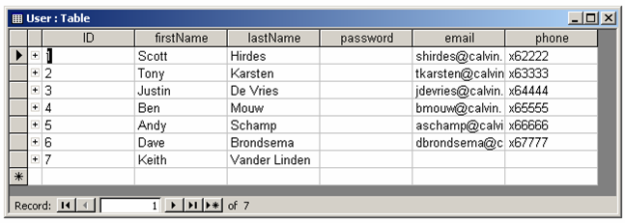
Inserting Data
Q: Add a new user.
INSERT INTO User (ID, firstName, lastName)
VALUES (7, 'Keith', 'Vander Linden');
Notes:
Explain how you can leave the field list off and give all the field values. Here, nulls were added to the missing fields.
Also, note that I had to add a unique ID here (because id is not autonumber) and that I had to “!” execute this query in Access before the values were added.

Slide 58
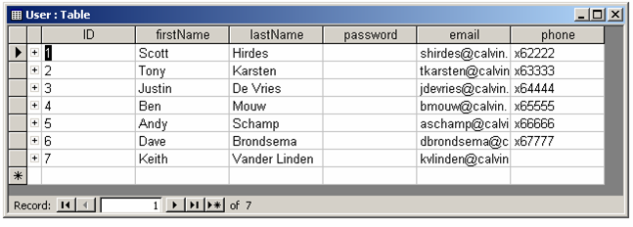
Updating Data
Q: Change an existing email address.
UPDATE User
SET email = 'kvlinden@calvin.edu'
WHERE ID = 7;

Slide 59
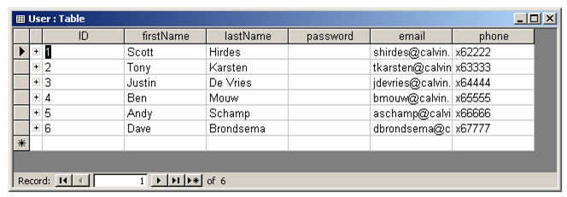
Deleting Data
Q: Remove a user record.
DELETE FROM User
WHERE id = 7;
Notes:
Explain how you can leave the field list off and give all the field values.
Also, note that the system auto-numbered the ProductID in this case.

Slide 60
Importing External Data
Frequently, data from other sources must be imported in bulk.
Approaches:
  an SQL INSERT command file
  a specialized import facility
Notes:
The SQL INSERT command is one way that data can be loaded into a database. Because it’s in SQL, it is a general tool rather than a DBMS-specific loader (e.g., Oracle’s bulk loader, Access’s import wizard).

Slide 61
Edgar F. Codd (1923-2003)
Relational Algebra/Calculus
Codd developed the algebra and calculus from 1971-1974.
Relational Algebra - a procedural language with the following elements:
  Relations
  Relational operators
Relational Calculus - a declarative language with equivalent power.
Image from wikipedia, July, 2006
Notes:
EF Codd comes up again here – he did both the relational model and the relational algebra/calculus.
Algebra
relations: all operations take relation(s) and return a relation
operators: Project/Select/Join/Set
SQL is based, in part, on both the algebra and the calculus.
Edgar F. (Ted) Codd - won the ACM Turing award in 1981 for his work on the Relational Data model. He cites the example of his fellow pilots and aircrews of Royal Airforce of WWII as the source of his determination to push the relational model even when “government, industry and commerce were strongly opposed to [it]”.

Slide 62
Database Programming
Information systems revolve around databases.
Interactive interfaces to DBMSs are useful, but most database work is done though database programs.
Approaches to database programming:
  Embedding commands in a programming language
  Using a database API
  Designing a database programming language
Notes:
Approaches to database programming:
Embedding commands in a programming language – requires a precompiler and tends to be non-dynamic
SQLj
Using a database API – requires a library specifying the API
JDBC
Designing a database programming language – requires a new interpreter/compiler
PL/SQL
This is harder than you might think. DBMS systems are quite diverse, in spite of the fact that all of them support a common purpose and a common query language (SQL).

Slide 63
Impedance Mismatch
Relational databases
fields
records
tables
General-purpose programming languages
standard data types
classes
Notes:
The problem is to bind:
relational fields, records and tables
native 4GL variables, arrays and classes
Binding native relational things (fields, records, tables) to native 4GL programming language things (variables, arrays, classes)

Slide 64
JDBC
Sun Microsystem’s database API for Java.
Supports Sun’s mantra: “Write once, run anywhere”
    JDBC supports portability across DBMS vendors.
    Java supports portability across hardware platforms.
Notes:
cf. ODBC/ADO.net
3rd party jdbc drivers exist for SQL Server.

Slide 65
An Example
import java.sql.*;
class SimpleJDBC {
public static void main (String args[]) throws Exception {
Class.forName("sun.jdbc.odbc.JdbcOdbcDriver");
Connection conn =
DriverManager.getConnection ("jdbc:odbc:Driver={Microsoft Access Driver (*.mdb)};DBQ=bookconnection.mdb", "", "");
Statement stmt = conn.createStatement();
try {
ResultSet rset =
stmt.executeQuery ("SELECT firstName, lastName FROM User");
while (rset.next ())
System.out.println (rset.getString(1) + " " + rset.getString(2));
rset.close();
} catch (SQLException se) {
System.out.println("oops! can't query the User table. Error:");
se.printStackTrace();
}
stmt.close();
conn.close();
}
}
Notes:
Import the JDBC API definition.
Create a “standard” Java application.
Load the JDBC driver for your DBMS and establish a connection to that DBMS.
Create an SQL statement and pass it to the DBMS. Handle any error that might occur.
Process the results of the SQL query.
Close the record set, the statement, and the connection.

Slide 66
The Output
C:\j2sdk1.4.2_03\bin\javac SimpleJDBC.java
Compilation finished at Sat Mar 27 21:57:12
% C:\j2sdk1.4.2_03\bin\java -cp . SimpleJDBC
Scott Hirdes
Tony Karsten
Justin De Vries
Ben Mouw
Andy Schamp
Dave Brondsema
Compilation finished at Sat Mar 27 21:55:40
Notes:
Binding native relational things (fields, records, tables) to native 4GL programming language things (variables, arrays, classes)

Slide 67
JDBC Connections
Connection conn =
DriverManager.getConnection(“the JDBC driver; DBQ=db.mdb",
“login", “pswd");
The Connection class is an interface, so you cannot create Connection objects directly.
All interactions between the java program and the database will be done through this object.
Notes:
The URL string for the connection contains:
the protocol (jdbc)
the vendor (oracle)
the driver (oci8, oci7, thin)
the server (mydb)

Slide 68
JDBC Statements
Three classes for sending SQL statements:
    Statement –
    PreparedStatement –
    CallableStatement –
These “statements” are Java classes, not individual SQL statements.
JDBC Statements are executed with:
    executeQuery() –
    executeUpdate() –
Notes:
There are three classes for sending SQL statements:
Statement – for SQL statements without parameters
recompiled each time
PreparedStatement – for precompiled/parameterized statements
compiled once, when first used/created in the program
CallableStatement – for executing stored procedures
compiled once, when created in the DBMS, then used
JDBC Statements support dynamic SQL statements.

Slide 69
JDBC ResultSets
executeQuery() returns a ResultSet.
ResultSet rset = stmt.executeQuery ("SELECT firstName, lastName FROM User");
while (rset.next())
System.out.println(rset.getString(1) + " " + rset.getString(2));
The ResultSet provides:
    a cursor pointing just before the first result row
    next(), to get the next row, returning true if successful
    getXXX() to retrieve column values of Java type XXX The argument to getXXX() may either be an index number, getInt(1), or a field name, getDouble(“cost”).
ResultSet cursors can be:
    Forward-only or scrollable
    Read-only or read-write
Notes:
3rd party jdbc drivers exist for SQL Server.

Slide 70
Persistent Objects
Persistence frameworks map from object views to Relational databases.
Common persistence patterns:
  Object Identifier
  Persistence façade
  Data Mapper
Hibernate is a well-known, open-source persistence framework.

Slide 71
Object Identifier
The OID is a record/object identifier that is unique in the database and in run-time memory.
The OID is usually alpha-numeric.
Notes:
Aka. Identity Field (Fowler)
Explain object ids and how in-memory addresses won’t cut it globally speaking.

Slide 72
Persistence Façade
A persistence façade acts as a front-end to persistent object services.
It is:
  A fabricated class
  A singleton class
Pattern from Larman, 2005
Notes:
StarUML wouldn’t let me format this as I’d like to:
The getInstanceFacade() function is static, so it should be underlined in UML 2.0.
Get should be get(OID, Class) : Object
Set should be set((OID, Object)
Frequently, a persistence façade is used to represent a DB system class object singleton.

Slide 73
Active Record
We’d frequently like to work with database rows as objects.
An active record is an object that wraps a database row.
Pattern from Fowler, 2003
Notes:
Active record allows object access to database rows and works well so long as the program objects and database rows are isomorphic. More complex relationships will require the database mapper pattern.
Rails provides native support for this pattern.

Slide 74
Database Mapper
Programming persistent objects to map themselves to and from the database doesn’t scale well.
A database mapper is an indirect approach.
Pattern from Fowler, 2003
Notes:
Here, we have a intermediary object that maps the User object to and from the database (called materialization and dematerialization).

Slide 75
Object Materialization
Diagram from Fowler, 2003
Notes:
Here, the UserMapper finds that the object doesn’t exist in memory, so it gets the person 1 data (Tony) from the database and creates an object for Tony.

Slide 76
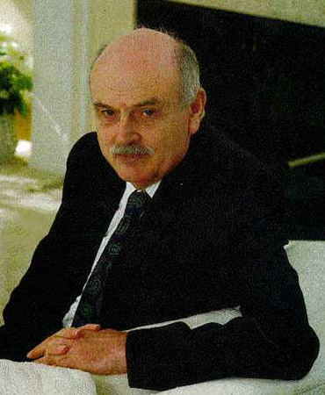
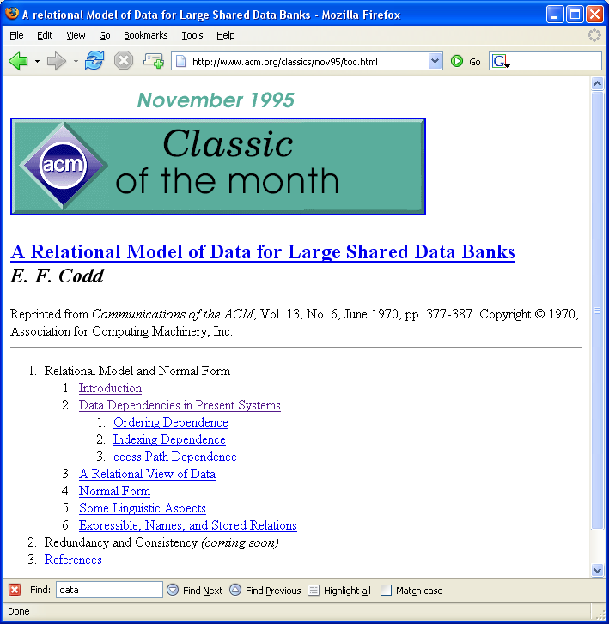
Edgar F. Codd (1923-2003) Turing Award
Codd received the Turing award in 1981.
Regarding the use of the term “normalization”, he is quoted as saying:
  At the time, Nixon was normalizing relations with China. I figured that if he could normalize relations, then so could I.
images from wikipedia and ACM, June, 2006

