Slide 1
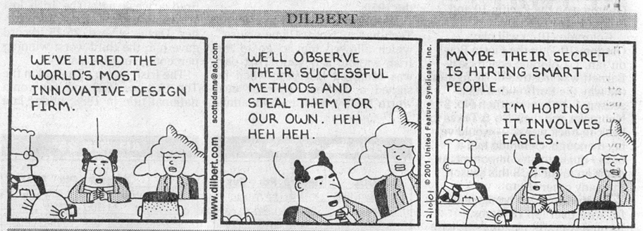
Dilbert © United Feature Syndicate, Inc.
Notes:
Schedule: Do this lecture on design week #1 Wednesday.

Slide 2
Design
Introduction
Patterns
  GRASP Principles
  Gang of Four Patterns
  Architectural Patterns
No Silver Bullet
  Great designs come from great designers. Software construction is a creative process. - Brooks, 1975
Notes:
This covers the UP discipline of design. It is usually done throughout the elaboration phases and into construction.
Here’s how the story goes (as explained by Susan Hendrix): The project is started, the requirements set and the developers write a sort of hand-waving design document (they want to code, you see). They then do what they were born to do, hack. And then, they have a lot of bugs to fix… Moral of the story: Beginnings are more important than endings.

Slide 3
Design: Definition
Design builds a conceptual solution that satisfies the requirements.
It’s not analysis; distinguish between:
  building the right product
  building the product right
It’s not implementation; distinguish between:
  Conceptual solutions
  Actual solutions
Design definition from Larman, 2005
Notes:
Definition from Larman. It’s a conceptual solution, not an implemented solution. We’re asking “how?” questions.

Slide 4
Design: Goals
Effectiveness
Usefulness
Adaptability
Aesthetics
Notes:
Effectiveness – The design had better correctly /efficiently implement the requirements at an affordable price.
Understandability – The design had better be usable for users and understandable for other developers.
Adaptability – The design had better respond well to (inevitable) change.
Aesthetics – The design should be beautiful. You know that getting it to work != getting it RIGHT. If you don’t find beauty in what you do, then you’ll never really be fulfilled in your vocation.

Slide 5
Design: An Analogy to Architecture
Vitruvius, the Roman architectural theorist set three goals of architecture:
  Utilitas
  Venustas
  Firmitas
The architect is responsible for the 1st and 2nd, the builder is responsible for the 3rd.
How would this map into software engineering?
Notes:
Utilitas - commodity - the structure must do what you need - Analysis?
Venustas - delight - it must be aesthetically pleasing – Design?
Firmitas - firmness - it must be structurally sound – Implementation?
Some think this combining of roles in SE is dangerous (e.g., Terry Winograd).
OO approaches tend to blur the lines between analysis/design/implementation, so you must keep the UP disciplines straight. Wear different hats if you must, but keep them separate. Even if you use an iterative approach, ask “what” first, then “how”, then do in each cycle.

Slide 6
Design: Principles
There are countless design approaches.
The fundamental principles required to achieve the goals of design are:
  Modularity
    High cohesion
    Low coupling
  Information Hiding
Notes:
Design approaches:
Structured design
Object-oriented design
Functional design
Etc
My sense is that the fundamental principles these:
Modularity – Divide and conquer, which encourages reuse, and when you do, strive for:
High cohesion – objects should have maximal intra-object relatedness.
Low coupling – objects should have minimal inter-object dependency.
Information hiding (aka protected variation) – Build stable interfaces around areas of expected variation.
All of design (abstraction layers, sub-systems, patterns, etc) boil down to these principles.

Slide 7
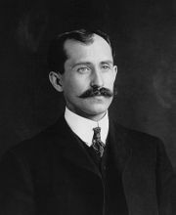
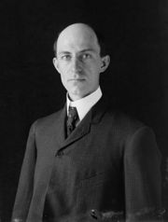
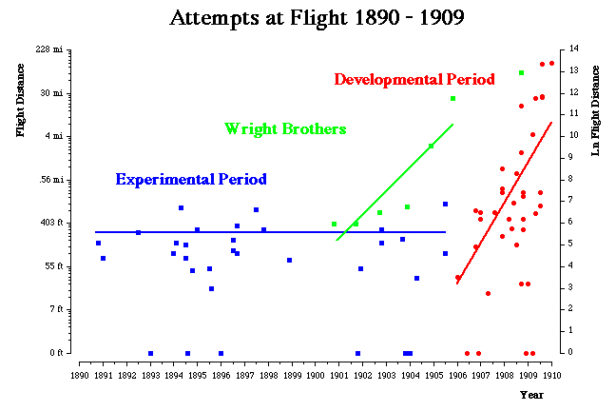
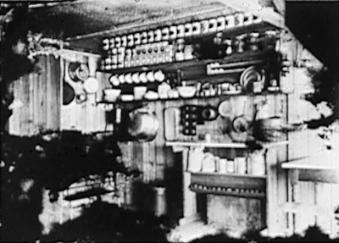
Orville & Wilbur Wright Wright Flier, 1903
The Wright brothers were careful designers.
Their approach as to:
  Study the field
  Decompose the problem
  Work iteratively
  Improve with every step
Basecamp, Kitty Hawk, 1902
images from wikipedia.org, the Library of Congress and Gary Bradshaw, June, 2006
Notes:
The Wright brothers are generally credited with making the first controlled, powered, heavier-than-air flight on December 17, 1903. See http://invention.psychology.msstate.edu/. The Wright brothers were true designer/engineers, which is what makes the following quote reported by Pressman (page 263, 3rd edition only) particularly distressing: We build systems like the Wright brothers built airplanes - build the whole thing, push it off a cliff, let it crash, and start over again. - R.M. Graham
The Wright Brothers - Designers/Prototypers - A case study of Engineering:
Studied the field first - they KNEW the other work
Built gliders first (based on earlier work) - Full tests are expensive and relatively uninformative (e.g., failure because of wings, engine, pilot error, etc.).
- Decomposed the problem into components and then experimented/tested individual components (e.g., lateral control, twisting the wings, wing shapes, wind-tunnel tests of lift, glider tests
- Successful 1902 glider flight [see photo: Doing it Wright]
Powered flight – The built a gasoline engine, did wind-tunnel tests of propeller shapes, and succeeded in the first flight, December 17, 1903 [see photo: Doing it Wright]
Progress was made on each full test [see chart: the puritan fairy tale]
The unhappy ending - others stole the credit.
The moral of the story: Software is engineering. Study, decompose, test/experiment. Identify the absolutely critical thing(s) for the prototype. Strive to improve things with each prototype. Be organized [see photo: base-camp]

Slide 8
Patterns
Patterns are design templates used systematically by good designers.
Pattern include these key elements:
  Name
  Problem description
  Structural solution
  Application advice
Notes:
name
problem - when to use the pattern
solution - elements of the solution
implications - trade-offs of use

Slide 9
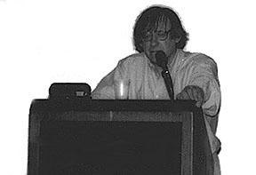


Christopher Alexander (1936-present)
Alexander cataloged useful architectural patterns.
His work inspired the current interest in software patterns.
images from http://www.amazon.com/
Notes:
Kent Beck appears to have first hit on applying named patterns to software. The gang of four got most of the press for their collection of 23 common software patterns.
Christopher Alexander founded the Center for Environmental Structure in Berkeley and, until recently, was a professor of Architecture at the University of California at Berkeley. Dr. Alexander is well known for Notes on the Synthesis of Form (1964), A Pattern Language (1977), and The Timeless Way of Building (1979). His forthcoming book is entitled The Nature of Order. Among the many honors bestowed upon him during his career are receipt of the Gold Medal for Research conferred by the American Institute of Architects, membership in the Swedish Royal Academy, being elected fellow of the American Academy of Arts and Sciences, and his position as Trustee of the Prince of Wales's Institute of Architecture. Dr. Alexander received his B.Arch. and M.A. in Mathematics from Cambridge University, and his Ph.D. in Architecture from Harvard University.
Christopher Alexander was born in Vienna, Austria, and raised in Oxford and Chichester, England. He graduated from Cambridge University, where he studied Mathematics and Architecture. He then obtained a Ph. D. in Architecture at Harvard University. For his Ph. D. Thesis, later published as the book Notes on the Synthesis of Form, he was awarded the first Gold Medal for Research by the American Institute of Architects. Since 1963 he has been Professor of Architecture at the University of California at Berkeley, and Director of the Institute for Environmental Structure. In 1980, Professor Alexander was elected member of the Swedish Royal Academy; and in 1996 he was elected fellow of the American Academy of Arts and Sciences. Christopher Alexander is a Trustee of the Prince of Wales's Institute of Architecture.

Slide 10
GRASP Principles
Craig Larman identifies nine General Responsibility Assignment Software Patterns/Principles (GRASP).
Here are some key examples:
  Information expert
  Controller
  Indirection
from Larman, 2005
Notes:
He also includes:
Low coupling – too low-level, discussed above
High cohesion – too low-level, discussed above
Polymorphism - part of OO
Protected variations (information hiding) – too low-level, discussed above
Creator, a special case of information expert for most applications
Pure fabrication – a general tool for introducing non-domain classes, not targeting a specific problem.

Slide 11
Information Expert
Problem
  What responsibilities should be assigned to what objects?
Solution
  Assign a responsibility to an object if it has the information required to satisfy the responsibility.
models from Larman, 2005
Notes:
This is basically another way of focusing on responsibility.
Examples:
Who should create an ThinkGeek order? In our design it was the controller because it met all 3 of the criteria.
Who should commit an order to the database? In our design it was the order itself.

Slide 12
Controller
Problem
  Given the separation between the UI and domain layers, what domain object should control system operations?
Solution
  Assign control to either of the following fabricated objects:
    Façade controller
    Session controller
models from Larman, 2005
Notes:
This is the C part of the old MVC pattern. UI objects should not handle domain processing, and domain objects should not handle UI processing.
The façade is the single, pure fabricated (i.e., not in the domain model) object that controls things.
The session is a controller specifically designed to handle on use case – they’re good for situations in which a single controller would get too large.
Example: Who handles the commands from the user? In our design it was the controller, which served as a façade for the rest of the system. A session controller would have encapsulated individual use cases or scenarios, so the UI would have to know which session controller to call in which situations.

Slide 13
Indirection
Problem
  How can you decouple objects in order to support reuse or protect against variation?
Solution
  Fabricate an intermediate object that mediates between the other components.
models from Larman, 2005
Notes:
Adding layers of abstraction is a standard approach to design. The intermediate object is not part of the domain, but is fabricated for this system task.
Example: We added the controller to the ThinkGeek design, that wasn’t part of any domain. Another common place to fabricate a object class is with databases, which frequently have a database singleton object that manages database access.

Slide 14
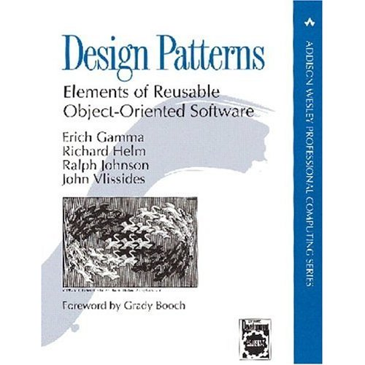
GoF Patterns
Gamma, Helm, Johnson, Vlissides identified a set of 23 commonly used patterns.
Here are some key examples:
  Adapter
  Iterator
  Singleton
image from http://www.amazon.com/, June, 2006
Notes:
GoF – the gang of four.
There are more like patterns that principles.

Slide 15
Adapter
Object Adaptor
Problem
  What do you do when you have an existing class with the wrong sort of interface?
Solution
  Build an interface for an object that makes it look like another more common object.
Class Adaptor
models from Gamma et al, 1995
Notes:
Aka Wrapper
Advantage:
You don’t have to re-implement the Adaptee class.
Potential Consequences:
may slow things down
you may need to use a two-way adapter (Two-way adaptors support both the Target interface and the adaptee interface)

Slide 16
Iterator
Problem
  What do you do when you need to access the elements of a generic aggregate object?
Solution
  Build generic element pointers that can be used polymorphically.
models from Gamma et al, 1995
Notes:
e.g. STL iterators
Introduce the example of two kinds of lists: SimpleList and SkipList. A SkipList is like a list, but it is implemented more like a balanced tree.
We’d like to be able to iterate across both of these structures in a similar manner.
Note that the CreateIterator() function of the ConcreteAggregate does:
return new ConcreteIterator(this);
Thus, there is a additional dependency relationship between these two classes indicating that changes to the constructor of the ConcreteIterator will change the return statement just given in ConcreteAggregate above.

Slide 17
Singleton
Problem
  How can you ensure that exactly one object of a class is created?
Solution
  Define a static method of the class that returns a single point of access.
models from Larman, 2005
Notes:
The underlines mean static attributes/methods (which I couldn’t get done in StarUML).
The getInstance() function does this:
if (instance == null)
return new Singleton();
else
return instance;

Slide 18
Architectural Patterns
Architecture is the large-scale structure of a software system.
Generally a layered architecture is used:
  User Interface
  Application
  Domain
  Business Infrastructure
  Technical services
  Foundation
model from Larman, 2005
Notes:
There are other architectural level patterns, but we’ll stick with this very general one.
See larman, page 199-203
UI – GUI
Application – workflow, session state, window transitions
Domain – business logic
Business Infrastructure – low-level business services (e.g., currency converter)
Technical services – frameworks, persistence, security
Foundation – data structures, threads, math, DB, networking

Slide 19
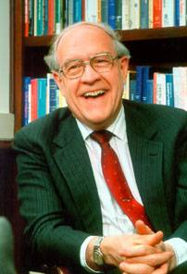

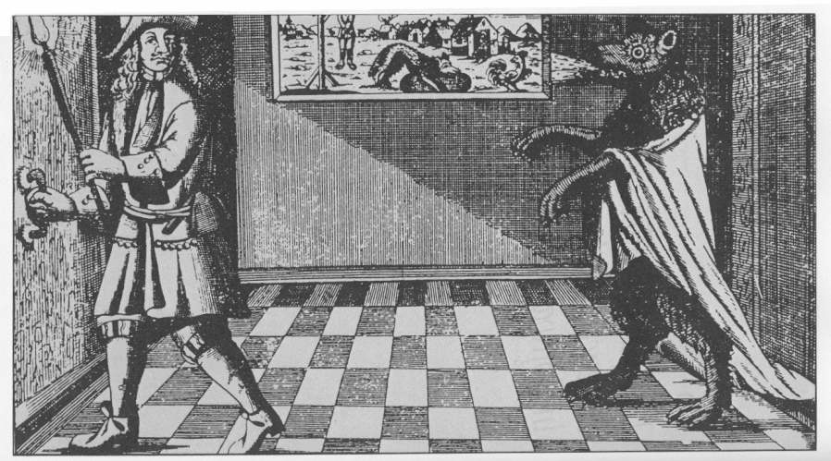
Fredrick P. Brooks, Jr. No Silver Bullet
What’s the
Big Idea
Brooks distinguished:
  Essential difficulties
  Accidental difficulties
He also advocated the importance of good designers.
images from http://www.cs.unc.edu/ and MMM, 1995
Notes:
Even a man who is pure at heart,
and says his prayers by night,
can become a wolf when the wolfsbane blooms,
and the moon is clear and bright.
What is the story of the werewolves? How can software projects be like them?
Consider the history of computer hardware:
1st generation (51-59) vacuum tubes
2nd generation (59-63) transistor/high-level languages
3rd generation (63-75) integrated circuits
4th generation (75-today) microprocessor
!!! 6 orders of magnitude speed increase in 30 years.
Has software technology enjoyed a similar increase? Why or why not?
Brooks distinguishes between essential and accidental issues. What is the difference? What are some examples of each?
He also identifies some potential silver bullets. Name some.
He closes with what he feels are promising attacks on the essential problem. What are these approaches?
Books’ point is essentially that of the Dilbert comic this week.

