Slide 1
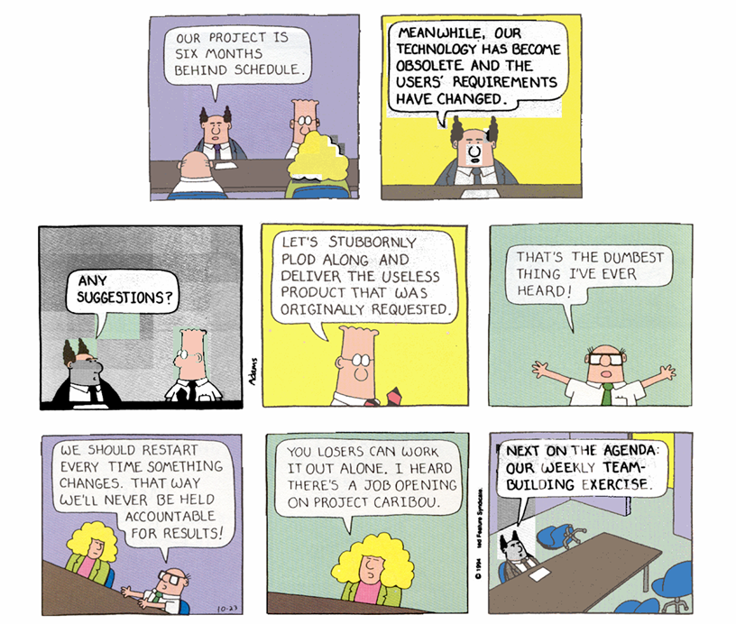
Dilbert © United Feature Syndicate, Inc.
Notes:
Schedule
(analysis week 1) Monday – Analysis intro & quiz
(analysis week 1) Wednesday – Use-case modeling (out of order – Use cases came before UML anyway)
(analysis week 2) Monday – Modeling and UML intro
(analysis week 2) Wednesday – Domain modeling and class diagrams
(design week 1) Monday – Sequence diagrams, 3 amigos video (if there is time) & quiz

Slide 2
Analysis
Principles
Specification
  Unified modeling language
  Requirements analysis with use cases
  Domain modeling with class diagrams
  Dynamic modeling with sequence diagrams
Visual Modeling
  The hardest single part of building a software system is deciding precisely what to build. - Brooks, 1975
Notes:
This covers the UP disciplines of business modeling and requirements, though the specifications will be delivered in reverse order (use cases/stories first, then domain model). This is because building the domain model is pretty detailed and isn’t that useful for requirements analysis; it’s much more useful as a kickoff into design in the first elaboration phase.
Probably, I’ll have to go through use case analysis before getting to the UML overview. This isn’t too bad, Jacobsen worked with use cases independently of class modeling for years before UML was created.
Cover some of Fowler’s analysis patterns (http://www.martinfowler.com/articles.html#ap) ?

Slide 3
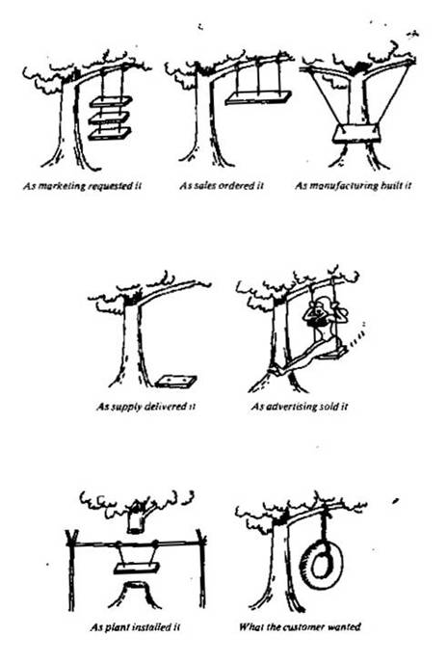
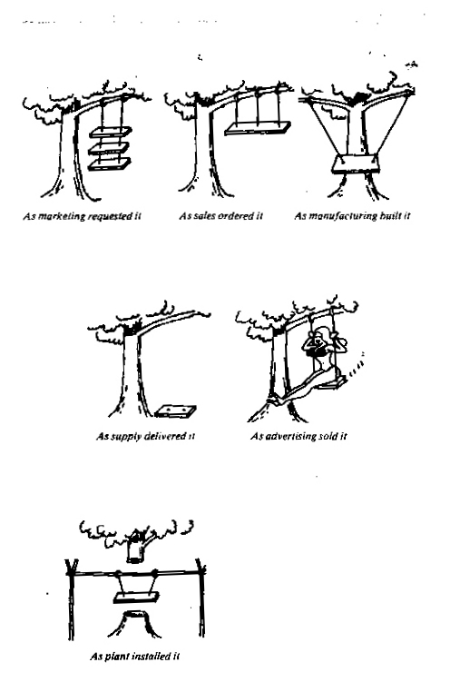
A Similar Story (in pictures)
A Story
Notes:
Brigham Bell’s Story (with embellishments):
When I arrived at graduate school (in the late 80's) I met a graduate student who was known in the department as a major Lisp hacker. Apparently he had been lured to Boulder to work with a small start-up company. He was very good. While this short article recounts some of the basic facts concerning company he worked for (as I recall them), I have added a considerable number of fictional details to compensate for my uncertain memory.
The company started as the brain-child of two computer entrepreneurs who had the idea of building natural-language-based office tools. The idea was that office workers would appreciate being able to use good old-fashioned English to interact with their computer programs rather than the cryptic computer commands that were common then (and now!). They succeeded in attracting two important ingredients for a successful business: (1) talented professional software developers, including the gentleman just mentioned; and (2) a substantial investment from a set of venture capitalists interested in the potential of the project. They held extensive meetings with both the programmers and the investors before embarking on the project. They generated lots of good ideas.
The development of the system went relatively smoothly, but natural language processing (NLP) technology was (and is) relatively new, so there were serious technical problems to deal with. Nevertheless, the team managed to produce significant results. They did so by maintaining around a dozen employees, including developers and managers, and housing them in a state-of-the-art facility in Boulder.
They held frequent team meetings, and gave the programmer/designers considerable freedom in development. The programming team loved this arrangement. As a team, they started by carefully defining the scope of the project, and then moved into the design of the system. They finally moved into the system implementation, within budget (more or less). They used the Lisp programming environment. Within 2 years, they had produced an early version of the software, which by most any technical measure was very well engineered. It operated by allowing the user to type commands in a restricted natural language (speech-recognition systems were not available in those days), and then the system did what the user had requested.
They then started up a serious marketing effort, targeting the potential customers and using the partially functional system as a demonstrater. Unfortunately, the system was not well- received, few if any of the units were ever sold, and the company eventually closed its doors (literally and figuratively). That's when my acquaintance moved over to graduate school.
Although this story is partially fictional, don't believe that it can't really happen; it does.

Slide 4
Reasons Cited for Project Failure
Data from http://www.scs.carleton.ca/~beau/PM/Standish-Report.html
Notes:
http://www.scs.carleton.ca/~beau/PM/Standish-Report.html
This report was a study of 8,380 IT projects which found that more than half were "challenged," with reduced functionality being delivered over-budget and beyond the estimated schedule. The top three contributing factors on challenged projects were lack of user input (12.8% of projects), incomplete requirements and specifications (12.3%), and changing requirements and specifications (11.8%).
31% of the software projects included in the Standish Report (Chaos, Dennis, MA, 1995) were cancelled.
Note how many of the cited reasons involve requirements-related activities/failures.

Slide 5
Principles
Analysis asks “what?” questions not “how?” questions.
It involves two UP disciplines:
  Business modeling
  Requirements
The requirements will change.
Notes:
The definition is from Jacobsen/Booch/Rumbaugh, 1999.
Business models specify the business domain objects and rules.
Requirements are capabilities and conditions to which the system must conform.

Slide 6
Types of Requirements
Functional requirements
Usability
Reliability
Performance
Supportability
Other:
  Implementation
  Interfaces
  Operations
  Packaging
  Legal
Notes:
FURPS+ (from Larman):
Functional requirements – features, capabilities, security
Usability – human factors, documentation
Reliability – MTBF, recoverability, predictability
Performance – response times, throughput, accuracy, availability, resource use
Supportability – adaptability, maintainability, internationalization, configurability
Other:
Implementation – IDEs, hardware, resource limitations
Interfaces – APIs with other systems
Operations – system management in context
Packaging – physical packaging requirements
Legal – licensing, etc.
Domain Model is really more of a glossary specifying the business objects in the domain.

Slide 7
Characteristics of Requirements
Stakeholder-centered
Precise
Consistent
Complete
Realistic
Notes:
Functional
Features the system should provide
How the system should respond in certain circumstances
What the system should not do
Non-functional requirements
Reliability, timing constraints
Software process
Domain Model is really more of a glossary specifying the business objects in the domain.

Slide 8
Stakeholders
Determine the stakeholders in the project.
Stakeholders on the customer side have trouble distinguishing:
  what they want vs. what they need
  what is vs. what could be
Notes:
At Siemens, we spent a couple of weeks determining who to send questionnaires to. Getting the right collection of stakeholders is critical.
Who are the stakeholders in a software project?
end user
customer manager
domain expert
programmer
project manager
executive management
sales managers
customer reps
the customer’s customers
This list goes on and on…
You will find it hard to elicit good quality requirements from customer-type stakeholders.

Slide 9
Precision
Distinguish between:
  Desires
    wishes of the customer/user
    e.g., “it should be fast”
  Requirements
    detailed specs for the designer
    e.g., “it should respond in less than 3 seconds in the typical user's environment.”
Requirements must be precise enough to be testable.
Notes:
Desires
“the system should be fast”
too subjective
UNTESTABLE
Requirements
“the system should respond in less than 3 seconds in the typical user's environment.”
only somewhat subjective
2-4 seconds is a good benchmark for response time, anything longer than that needs a message, progress bar, or popup warning of some sort.
TESTABLE
Your early use cases or stories will probably lean more toward desires that requirements; you’ll have to refine them as you go from inception to elaboration.

Slide 10
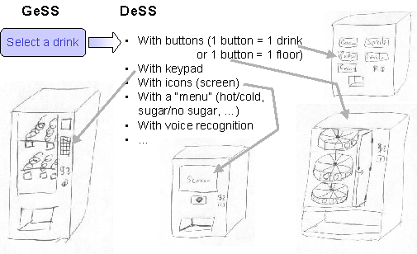
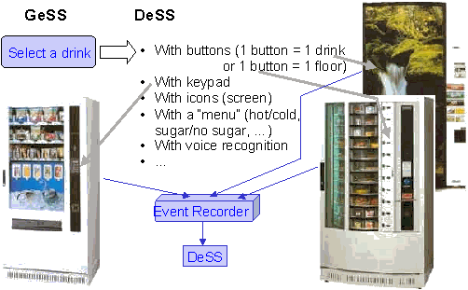
Levels of Detail
Avoid using too much design detail in inception.
Prototypes can overly restrict design choice.
Use a consistent level of detail.
images from J.C. Tarby
Notes:
Let your requirements be precise, but not “overly” precise. If the avionics software has to respond in less that 500ms to keep the jet from crashing, then say so in the requirements. But leave other details to later elaboration phases.
A reasonable example from one of my older papers. Here we have the requirement that the user must be able to select a drink, but we don’t particularly care how. We could list the options, but leave the choice to the design phase.
When we are obliged to build prototypes, we shouldn’t use them as requirements models - they are too specific and limiting.
Don't overly restrict yourself.
e.g., "We shall implement red-black trees using the colors of red and black, orienting the tree horizontally on a pale yellow background.”
Leave room for design!

Slide 11
Consistency
Requirements are usually written in natural language, which can be ambiguous.
Get rid of ambiguity by:
  using precise terms
  having stakeholders review the text
  stating things only once
Notes:
This is one of the things I love about analysis. Tell them about the time I “boiled” the pastor’s 3-page vision statement down to 1 page of requirements.

Slide 12
Completeness
List all the requirements you can.
Prioritize them if necessary:
  Normal requirements
  Expected requirements
  Exciting requirements
Notes:
You won’t get them all up front; we’ve mentioned this before.
Normal requirements
These are the requirements that are absolutely critical.
Expected requirements
These are the requirements that the customer would really like, but doesn’t absolutely need.
Exciting requirements
These are the really cool things that the customer doesn't expect, but would really like

Slide 13
Elicitation Techniques
Holding interviews
Running workshops
Distributing questionnaires
Studying written documents
Writing task narratives
Performing ethnographic observations
Building mockups and prototypes
Notes:
Techniques:
Interviews – require trained interviewers, not easy
Workshops – nice to get designers and customers together
Questionnaires – better for large groups of stakeholders
Document studies – helpful with user artifacts (e.g., forms, existing systems) are available
Task narratives – used in XP (stories) and in many UI development approaches
Ethnographic observation – use video tapes in situ (Lucy Suchman)
Mockups (unimplemented) and prototypes (implemented) – good for iterative approaches
The key thing is to get the user/customer involved and talking.
In this class, we’ll primarily use interviews (perhaps workshops), task narratives and prototypes. We’ll start this process in lab #2.

Slide 14
Specification
Requirements must be recorded.
We will produce artifacts that specify:
  The functional requirements
  The domain model
Notes:
See the list of the required elements in the project specification.

Slide 15
Specification Techniques
Informal approaches
Semiformal approaches
Formal approaches
Notes:
We’ll use:
UML use cases for the functional requirements
UML class diagrams for the domain model
Shall scripts (a simple written document) for the non-functional requirements
Informal approaches, e.g.,
Shall-scripting in written documents (or DOORs databases)
use-cases (and UML)
user stories
Semiformal approaches
Structured Analysis/Design Technique (SADT)
Problem statement language/problem statement analyzer (PSL/PSA)
Entity-relationship diagrams
UML class diagrams
Formal approaches
Z
Finite-State Machines
Petri-nets

Slide 16
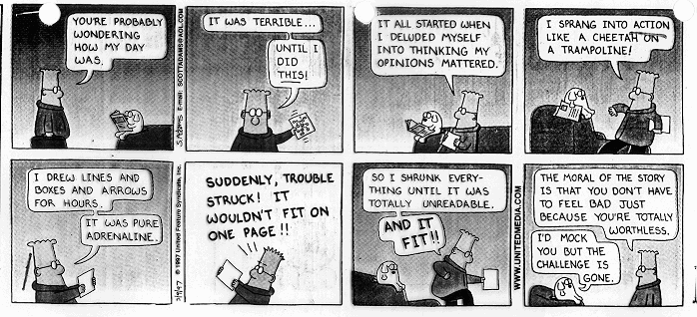
Dilbert © United Feature Syndicate, Inc.
Notes:
UML is not a silver bullet (cf. Fred Brooks, “No Silver Bullet”, 1986).

Slide 17
The Unified Modeling Language
UML is a visual language for specifying, constructing and documenting the artifacts of systems.
Characteristics:
  A collection of diagramming languages
  Non-proprietary
  Semi-formal
  Object-oriented
  Process-neutral
Notes:
Definition from the OMG, infrastructural specification document, 2003

Slide 18
Outline
Modeling
History
Diagrams
Example
Using UML

Slide 19
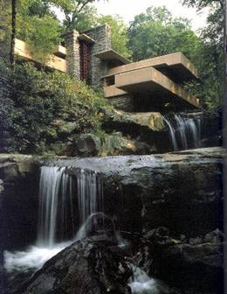
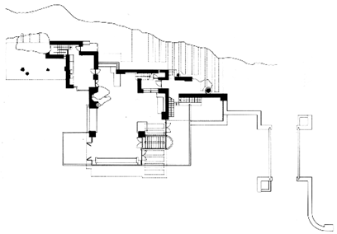
Who cares about models?
A Model is a formal representation of certain aspects of the world.
An architectural blueprint is a model
image from http://ralfshome.virtualave.net/
Notes:
Do you recognize this floorplan. Do you recognize the picture.
The whole world is to hard to represent and work with, and natural language is too ambiguous to be of much use. For example, a floorplan/blueprint is a good formal model for representing a new building. It has 2D relationships, but no 3D and no other realistic clutter to cloud the issues. Just piling up bricks experimentally just won’t do it:
too may irrelevant details (cf. Programming environment details)
too time-consuming (cf. Programming is tedious)
potentially dangerous (cf. You could accidentally destroy data)
Thus, you specify a model and then go on to build the house.
Models can be graphical, but they don’t need to be.

Slide 20
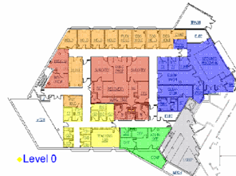
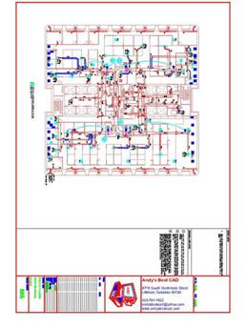

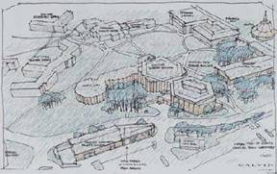
Modeling: Architecture
Models are representations of certain aspects of the world.
Images from Calvin College, August, 2005
Notes:
A building is typically modeled with several models, each focusing on different aspects of the building.
Here we have an HVAC diagram, a floorplan and an early artist’s rendering in 3D.

Slide 21
Modeling: Systems
Models are representations of certain aspects of the world.
System
database
Notes:
Similarly, a system is typically modeled with several models, each focusing on different aspects of the system.
We model the processing and the data.
Here we have a use-case diagram, a class diagram and a scenario diagram as windows into the underlying meta-model.
Replace these Rose models with Rhapsody models from later in the seminar???

Slide 22
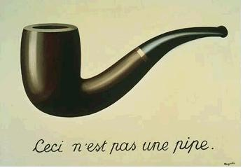
Modeling and Reality
Blueprints aren’t buildings.
Models aren’t systems.
Ceci n’est pas une système
Image from www.wikipedia.org, August, 2005
Notes:
Refer back to the Dilbert comic.
Real houses are not 2 dimensional, walls are not black lines and you can’t see them from above because there’s a roof.
Neither are software systems yellow, 2-dimensional and connected with silly red lines.
Remember that a model is just a model, it isn’t reality. Building real database system requires models, but it requires more than that.
René Magritte, La trahison des images (1928-1929)

Slide 23




The Three Amigos
Unified Modeling Language
Each amigo (and dozens of others) had created their own modeling languages / processes in the 1980’s.
They joined forces at Rational in the mid-90’s to create a “Unified” Modeling Language.
Grady
Booch
Ivar Jacobson
James Rumbaugh
Images from www.rational.com, January, 2003
Notes:
There were at least 50 OO modeling languages/processes by the mid-90’s (e.g., CRC cards, OOSE, OMT, Booch, class-relation, OORam), so it was a nightmare of integration to get people to work together. Note that the languages were all similar, but the processes were not – hence the only unified thing about UML is the language – the processes were left out.
Rational built consensus the “microsoft” way, i.e., by buying out the major players. Actually, Rumbaugh left GE in 94/95 to join Booch at Rational, and then Rational bought out Objectory (Jacobson).
The 3 “egos” – they really didn’t build all of UML as we now know it, but it’s still a good moniker. There were many other major players, particularly once OMG took over the spec.
iLogix folk tend to add David Harel, and perhaps Rational tried to hire him as well…
DON’T show the video clip of them here – save it for the very last analysis “big idea” slide.

Slide 24

OMG
UML Standards
The OMG, a non-profit consortium of companies, produces and maintains standards.
UML Standards:
  UML 2.0 Superstructure, 2004
UML Profiles
  Real-time profile, 2005
Images from www.omg.org, August, 2005
Notes:
CORBA is an OMG spec.
The UML spec was turned over to OMG in 1996.
UML 1.0 came out in 1997.
UML 2.0 is the current standard (almost)

Slide 25
UML Tools
There are many tools that support UML:
  IBM Rational Rose
  iLogix Rhapsody
  Microsoft Visio
  Sparx Enterprise Architect
  …
Notes:
There are dozens of tools, e.g.:
Rose is the flagship tool
Rhapsody is targeted at real-time applications (cf. Harel Statecharts), though there is now a Rational real-time version as well.
Visio is an exemplar of the diagramming tool approach, it doesn’t support the engineering features of the tools like Rose/Rhapsody.
Enterprise Architect (Sparx system, not the MS extension to visio) – cheap, but is access based, and perhaps not ready for prime time.
Eclipse,Dia, etc.

Slide 26
Diagramming Languages
UML Diagramming languages provide various views on a single meta-model.
These views are loosely organized into the following types of diagrams:
  Structural
  Behavioral
UML 2.0 includes 13 languages.

Slide 27
UML 2.0 Diagrams
Notes:
In this class, we’ll focus on the analytical use of use-case, class and sequence diagrams. Mention these in particular here.
Note that one of the information aspects of UML is that the boundaries between these diagrams are pretty fluid, e.g., use case actors can be placed on class diagrams, classes can be placed on object diagrams, etc.
Rhapsody only supports the following diagrams, under these older names:
Use case diagram—Shows typical interactions between the system being designed and external users or actors.
Object model diagram—Shows the static structure of a system, aka UML 2.0 Class and Object diagrams
Sequence diagram—Shows the message flow of objects over time for a particular scenario (emphasizing time)
Collaboration diagram—Provides the same information as a sequence diagram (emphasizing structure). aka UML 2.0 Communication diagrams
Statechart—Defines all the states that an object can occupy and the messages or events that cause transitions (best for even-driven behavior)
Activity diagram—Specifies a workflow or process for classes, use cases, and operations (best for step-by-step processes).
Component diagram—Describes the organization of the software units and the dependencies among these units.
Deployment diagram—Depicts the nodes in the final system architecture and the connections between them.
Structure diagram—Models the structure of a composite class; aka UML 2.0 Object Diagrams

Slide 28
Example: Use-Case Diagram
Example from www.ilogix.com, August, 2005
Notes:
The dishwasher example from the iLogix Ada tutorial (file:///C:/Rhapsody60/Doc/MultiVolume/Output/OtherRefs/tutorialada.pdf).
Walk through this example in Rhapsody if possible, perhaps even building it as you go along. Point out the following:
Metamodel vs. diagrams
Only uses some of the diagrams
Example of UML as programming language

Slide 29
Example: Class Diagram
Example from www.ilogix.com, August, 2005
Notes:
The dishwasher example from the iLogix Ada tutorial (file:///C:/Rhapsody60/Doc/MultiVolume/Output/OtherRefs/tutorialada.pdf).

Slide 30
Example: State Diagram
Example from www.ilogix.com, August, 2005
Notes:
The dishwasher example from the iLogix Ada tutorial (file:///C:/Rhapsody60/Doc/MultiVolume/Output/OtherRefs/tutorialada.pdf).

Slide 31
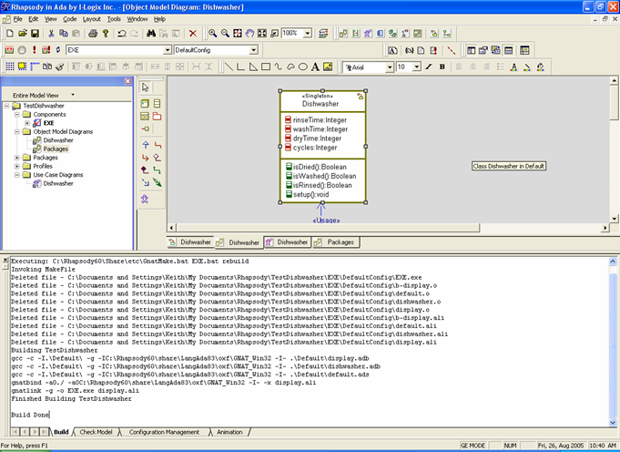
Example: Compilation
Example from www.ilogix.com, August, 2005
Notes:
The dishwasher example from the iLogix Ada tutorial (file:///C:/Rhapsody60/Doc/MultiVolume/Output/OtherRefs/tutorialada.pdf).

Slide 32
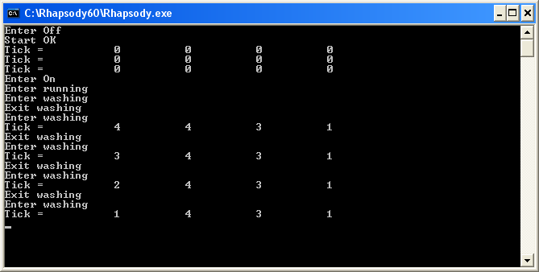
Example: Execution
Example from www.ilogix.com, August, 2005
Notes:
The dishwasher example from the iLogix Ada tutorial (file:///C:/Rhapsody60/Doc/MultiVolume/Output/OtherRefs/tutorialada.pdf).
Remember that ‘s’ (start), ‘o’ (open door), ‘c’ (close door) are single-character commands recognized by the demo system.

Slide 33
Using UML
Language = syntax + semantics + pragmatics
20% of UML is used 80% of the time.
UML can model garbage or gold with equal ease.
Notes:
We’ll focus on the syntax/semantics in the lectures and on pragmatics in the labs. It’s the pragmatics you choose that will make or break this experiment.
“10-20% of the constructs are used 80-90% of the time” - Chris Cobryn, Nov. 1999

Slide 34
Using UML: Why?
Conceptual modeling
Software modeling
Notes:
What to use it for:
Conceptual modeling – describe concepts in the application domain, business modeling
Software modeling – describe aspects of the OO software system
Smiths will have to choose why it wants to use the UML, CS 262 will start with domain modeling (week 4) and then move to system modeling as appropriate throughout the elaboration and construction phases.

Slide 35
Using UML: How?
Sketch
Blueprint
Programming language
Notes:
How to use UML:
Sketch
Partial, high-level views used for preliminary exploration and communication
Do this quickly, informally, collaboratively, say, on a whiteboard.
Blueprint
Complete specification/definition, which could be handed over to an internal or outsourced sub-contractor
Do this with some CASE tool
Programming language
Here, you specify absolutely everything in UML (including the code)
Model-Driven Architecture (MDA) is a set of standards for building platform-independent systems (using UML)
Using round-trip engineering to code the system
I see the sketch as the best approach; it’s hard to improve on text-based languages for implementation. Fowler agrees, and writes his book from that point of view.

Slide 36
Using UML: Directionality
Forward engineering
Reverse engineering
Round-trip
Notes:
Directionality:
Forward engineering
Reverse engineering
Commonly used in the UML as programming language approach.

Slide 37
UML and Software Process
UML fits naturally into traditional software development processes.
UML is also compatible with agile development processes:
Notes:
UML fits with traditional waterfall development methods (probably all too easily) (from Fowler, p.29-32):
Analysis – use cases, class/activity/state diagrams for communication
Design – more detailed class/sequence/state diagrams, package/deployment diagrams
Documentation (of existing or legacy code)
UML fits with the UP as well.
UML is also compatible with agile methods (from Laarman, p. 30-31), which is how we’ll use it:
Model to support discovery/communication
even XP supports some modeling
don’t model for documentation purposes
the developers should do the modeling (the planning in more important than the plan)
Don’t model all of the system
Prefer simple tools

Slide 38
Criticisms of UML
UML is often seen as:
  too informal
  too big
  not big enough
Bell, Alex E., “Death by UML Fever”, ACM Queue, 2(1), March, 2004.
Notes:
Common criticisms (which are largely true but can be good or bad, depending on how you look at things):
The informality of UML leads to ambiguity and can mess things up during implementation/testing.
UML is often seen as oversized and bloated (though you aren’t required to use it all).
UML may be large, but it still doesn’t cover everything you might need (see Fowler, p. 14-15). E.g., there are no screen-flow diagrams such as those used in HCI.
Death by UML Fever:
http://www.acmqueue.com/modules.php?name=Content&pa=showpage&pid=130
Generally not UML’s fault – organizational pathologies
UML is not a silver bullet, it’s a tool (one tool).
Don’t be assimilated by the UML machine - UML is a wonderful servant, but a horrible master.

Slide 39
Use Case Analysis
Use case analysis identifies the intended behavior of the system from the user’s perspective.
Use cases are written scenarios that describe a case of the use of the system.
Use case diagrams are visual representations of the actors, use cases, and their interrelationships.
Notes:
Use cases tend to be easier to understand to users than other requirements specification techniques. The core discipline here is writing the use cases – the use case diagrams are secondary.

Slide 40
Example: Scenario
The customer revisits the Think Geek website, searches for a geeky item they can’t live without, and orders that item. The system maintains a shopping cart with that item. The customer confirms the credit card and shipping information they entered before and then confirms the sale. The system then executes the sale.
Example adapted from Fowler, 2003
Notes:
This is not a use case, it is simple scenario. Use cases are basically scenarios “dressed up” a bit.
http://www.thinkgeek.com/

Slide 41
Example: Use Case
Description
  The customer buys a product from the on-line store.
Primary Actor
  Registered Customer
Preconditions
  The customer can access the website.
Postconditions
  On-line sale is recorded and confirmed.
  The customer's database history is updated.
Notes:
This use case basically “dresses up” the raw scenario given on the previous page.
Compare use cases scenarios and XP stories – An XP story is, roughly speaking, one step in the use case scenario. The teams should be taking on tasks in “step”-sized chunks, based on the estimated duration and risk of the task. E.g., if secure login/logout is easy for you, drop the priority of those tasks, otherwise raise it up.

Slide 42
Example: Use Case (cont.)
Main Scenario:
  The customer browses through the products.
  The customer adds a product to their shopping cart.
  The system displays the shopping cart with the new product.
  The customer logs in and proceeds to check out.
  The customer confirms their credit card and shipping information.
  The customer confirms the order.
  The system validates the credit payment.
  The system makes the sale.
  The system confirms the sale immediately and via email.
Notes:
This use case basically “dresses up” the raw scenario given on the previous page.
Compare use cases scenarios and XP stories – An XP story is, roughly speaking, one step in the use case scenario. The teams should be taking on tasks in “step”-sized chunks, based on the estimated duration and risk of the task. E.g., if secure login/logout is easy for you, drop the priority of those tasks, otherwise raise it up.
To compute an XP velocity, you’ll need to add time estimates to each task you plan to address.

Slide 43
Example: Use Case (cont.)
Extensions
  2a. The database reports that the product is out of stock.
  1. The system marks the shopping cart entry as back order.
  4a. User is a new (unregistered) customer. The system displays the shopping cart with the new product.
  1. The system displays a welcome message.
  2. The customer enters their payment and shipping information.
Notes:
This use case basically “dresses up” the raw scenario given on the previous page.
Compare use cases scenarios and XP stories – An XP story is, roughly speaking, one step in the use case scenario. The teams should be taking on tasks in “step”-sized chunks, based on the estimated duration and risk of the task. E.g., if secure login/logout is easy for you, drop the priority of those tasks, otherwise raise it up.

Slide 44
Example: Use Case Diagram
Notes:
Talk through the diagram, noting:
The main actors are on the left, the supporting actors are on the right.
“actors” can be other (external) systems.
The lines (which include arrows in some systems) do not indicate sequence, they indicate a relationship of some kind (e.g., does, extends, includes, etc).
The use cases are all at the same basic level (though login is a bit smaller, but it’s likely to be factored out of many other use cases).
The text use case(s) (e.g., on the previous page) can be typed into the description fields of these use cases.
I’ve used consistent names for the actors (singular) and use cases (action [object]).
The Store database is involved in most of the use cases, but it’s only associated with the task that it does. You can link the database with the users’ usecases, but use the <<communicates>> stereotype to show that it isn’t the database that initiates this case of use.
The system boundary helps to indicate that the store database is outside the scope of the on-line system.
Questions:
Do we really need both customer and visitor, or could we settle on “user”?
Why not break “update profile” into “change password”, “change name”, etc?
Fowler strongly suggests focusing on the use case description, not the diagram.
Prioritize the use cases in some manner.

Slide 45
Outline
Use Case Diagrams
  Actors
  Use cases
  Relationships
Using Use Case Diagrams

Slide 46
Actors
Use case actors carry out use cases.
They represent roles played by:
  Human users
  Other systems or processes
Notes:
Roles, not people. The roles can be “primary” or “supporting”.

Slide 47
Use Cases
A use case is a set of scenarios all achieving the same high-level goal.
They focus on functionality, not interfaces.
Fully dressed use cases can include fields for:
Notes:
The text of the use case is the most important to work on. Let the diagram just be a notational device.
Note that there are many more possible Use Case fields:
Use Case Name Name of the use case
Unique ID for requirements management
Primary Actor Role/title/description of actor
Supporting Actor Sometimes called stakeholders – define their goal or contribution
Brief Description High level overview of purpose
Pre conditions What must be true before hand.
Main Scenario Typical or “basic” flow
Post Conditions Success condition – “guarantee”
Alternate Scenarios “Exceptions” to the basic flow
Trigger starting event
Other Other considerations of importance
Here is the best discussion of the differences/similarities between user stories and use cases: http://c2.com/xp/UserStory.html

Slide 48
Use Case Relationships
Association
Include
Extend
Generalizes
Notes:
Use these in decreasing order of frequency/fervor.
Association – Communication path between actor and use-case
Include – Additional behavior that is explicitly described. Often a shareable use case
Extend – Insertion of additional behavior into a base use case not explicitly documented
Generalization – Relation to a specific use case that shares featuresAgain, Fowler advises not messing these much, with the exception of includes.

Slide 49
Using Use Case Diagrams
Focus on the written use cases, not on the diagrams.
The written narratives are natural tools for creating understanding.
Use the description field of a use case to:
  Prioritize the use case and the steps within it according to value and risk.
  Add any non-functional requirements relevant to that use case.
Notes:
As a prioritization example, we’d probably start with the critically important/valuable user story found as step 1 in every one of the use cases – “the seller/buyer/user finds the system website.”
It’s probably best to start with a “sea level” use case diagram to lay out the scope of the project, and then to get to work writing the most important use case descriptions.

Slide 50
Classes and Objects
Objects are entities that have attributes, behavior and state.
Classes are sets of objects with common properties and behavior.
Classes and their interrelationships implement the 3 key elements of object-oriented programming:
Notes:
These diagrams model elements that are central to OO systems.
Classes are conceptual types (cookie cutters), existing at design time, objects are instance tokens (cookies) existing at run time.
“This is hard” – reportedly repeated frequently by Booch – Hard? Yes. Important? Definitely!
3 elements:
encapsulation
inheritance
Polymorphism
We won’t focus on OO design/implementation in this seminar.

Slide 51
Class and Object Diagrams
Class diagrams:
  are the most common UML diagram
  model classes and the static relationships between them
Object diagrams:
  are less common
  model a snapshot of the system objects at some time
Notes:
Rhapsody combines these diagrams into one “object model” diagram; Rose doesn’t do this; we don’t care because we won’t mess much with objects diagrams.
name - class - object (aka symbol – intension – extension)
We’ll focus primarily on class diagrams here, with some mention of objects.

Slide 52
Example: Class Diagram
Example adapted from Fowler, 2003
Notes:
Talk through the diagram, largely copied from Fowler, p. 36 and implemented in StarUML.
Class diagrams are the central feature of UML models.
Show the 3 elements of OO programming (attribute encapsulation, inheritance, polymorphic function).
Note that we’ve modeled the “domain” and are largely letting the OO programming language deal with the programming.
The italics indicates “abstract” classes and methods.
The +- indicates public/private.

Slide 53
Outline
Class Diagrams
  Classes
  Relationships
Class Diagrams and Code
Using Class Diagrams

Slide 54
Classes
Classes to model entities in the domain.
One way to discover classes is to identify noun phrases in domain narratives or descriptions.
Classes have two features:
  Attributes
  Operations
Notes:
Classes are design-time entities. We focus this week on design entities (e.g., Person), leaving the system-oriented classes (e.g., PersonGateway) out.
Objects are run-time entities.

Slide 55
Attributes
Attributes describe properties of classes.
Syntax:
visibility name: type multiplicity = default {property-string}
Notes:
Attributes implement data encapsulation.
Early in elaboration, you can leave attributes out, or just list their names. You will come back here later in elaboration to flesh these things out.
Notes:
Visibility: public, private, protected
Name: only required field
Type: reference or value type
Multiplicity: explained later
Default
Property-string: other stuff, e.g., readonly, ordered/unordered, duplicates/nodup, bag/set, …
e.g.,
public address: String [0..5] = “somebody” {read-only}

Slide 56
Classes vs. Attributes
Not all “entities” should be modeled as classes.
Classes tend to have:
  retained or persistent attributes
  multiple attributes
  common attributes
Attributes tend not to have these characteristics.
Notes:
Don’t over-model.
Where “important” objects are those that:
cause events to happen
represent physical devices
visual elements
persistent elements
elements with multiple properties
retained or persistent attributes;
E.g., customer vs name or address
multiple attributes;
E.g., address?
common attributes;
E.g., corporate customer contact info (attribute here, class in Fowler’s example)
Quiz: How would you add:
A sales representative for each customer? (probably with an associated employee class)
Packaging instructions for the order? (probably an attribute, but for MarkMaker, perhaps a set of classes)

Slide 57
Operations
Operations describe services that class objects can perform.
Operation syntax:
visibility name (parameter-list): return-type {property-string}
Parameter syntax
direction name: type = default-value
Notes:
Operations implement behavior encapsulation.
Assign operations to the class that has the clearest sense of “responsibility” for knowing how to do them.
We usually ignore property accessor functions, which can easily be auto-generated from the property specs.
Operation syntax:
Return type: may not be one… (StarUML didn’t let me specify one)
Property string:
Parameter syntax notes:
Direction: in, out, inout
e.g.,
public totalPrice (): Float {???}

Slide 58
Relationships
Relationships link classes together.
UML supports three types of inter-class relationships:
  Association
  Generalization
  Dependency

Slide 59
Association
Associations indicate communication between class objects, with features:
  Multiplicity
  Directionality
  Association Type
Notes:
Classes do not work in isolation.
Features:
multiplicity
directionality
association type (simple, aggregation, composition)

Slide 60
Attributes vs. Associations
Attributes and associations:
  both represent structural properties of classes
  are presented differently in class diagrams
Use association to represent relationships between more significant classes.
Use attributes to represent primitive properties and less significant classes.
Notes:
This issue is related to the class vs attribute distinction above, but is not the same. We may choose to build a class for a certain set of objects, but may represent it only as an attribute in one of the class diagrams in which it doesn’t play a significant role.
Attributes may have multiplicity settings too (see previous slide) – Rhapsody can specify this, but I can’t see that it displays this information in any graphic way.

Slide 61
Multiplicity
Association relationships indicate how many objects may fill the property.
They are specified with min..max on both participants in the relationship.
Notes:
Note that they go on both sides of an association.
Rhapsody allows values:
1 (i.e., 1..1)
* (i.e., 0..*)
0,1
1..*
These values will represent all possible inter-entity relationships (e.g., single/multiple-valued fields, optional/required fields, strong/weak participation constraints, etc).

Slide 62
Directionality
Associations can be:
  Uni-directional
  Bi-directional
Directions can be shown with arrows.
Notes:
Navigability means something in programming languages where pointers are uni-directional. Bi-directional links would require explicitly including reciprocal handles/pointers in both class objects.
For relational database modeling, you can just leave associations as simple lines.
We could have them program the lecture example in Ada/Java/C++, just to see what that would be like.

Slide 63
Types of Associations
Association relationships can have specialized forms:
  Aggregation
  Composition
Notes:
Don’t use aggregation, it was only added to UML because so many modelers used it (but for different reasons). It has no semantics to distinguish it from simple associations and Rumbaugh considered it a “modeling placebo”.
Use composition as a strong form of association indicating:
The sub-element belongs to exactly 1 composite
the composite is responsible for creating/deleting its requisite parts.
Quiz: How would you deal with:
Order – Customer?
ChessBoard – ChessSquare
Point – Line

Slide 64
Generalization
Generalization indicates that all sub-class objects must also be super-class objects.
Don’t overuse it.
Distinguish:
  Generalization
  Classification
Notes:
Generalization implements inheritance and specialization/polymorphism.
Discuss the “<<abstract>>” stereotype in the example.
Don’t overuse generalization. It can be helpful to distinguish:
Sub-typing – inheriting interfaces (classes with “<<interface>>” stereotype)
Sub-classes – inheriting implementations (standard inheritance)
Beware of using “is a”; not all “is a”s are created equal. It’s better to distinguish between:
Generalization: “is a kind of” (AKO)
Classification: “is an instance of” (ISA)
Fowler gives this example of where “is a” is not transitive, and thus shouldn’t be used to indicate generalization.
Shep is a collie (ISA – classification)
Alternatives:
A collie is a breed. (ISA – classification) “shep is a breed” – doesn’t work transitively
A collie is a dog. (AKO – generalization) “shep is a dog” - works transitively

Slide 65
Dependency
A dependency indicates that changes to one class will require changes to another.
There are a number of different types of dependencies.
Notes:
Dependency types (specified with stereotypes):
<<bind>> (or derive) (parameterized classes, here binding T to Event – there is some question in the texts as to whether this is dotted dependency line or a solid inheritance line; I think that it should be a dependency line because this really isn’t inheritance)
<<permit>> (or friend) (allows private access to other class)
Try to minimize these as much as possible.
It might be better to let the system reverse-engineering these from your code.
Quiz: How would you draw the MVC pattern (C associates with M and V, and C and V depend on M)

Slide 66
Code Generation
UML tools help you link UML models with generated code:
  Code generation
  Reverse engineering
  Round-trip engineering
Notes:
Go through an example in Rhapsody of as many of these things as possible.

Slide 67
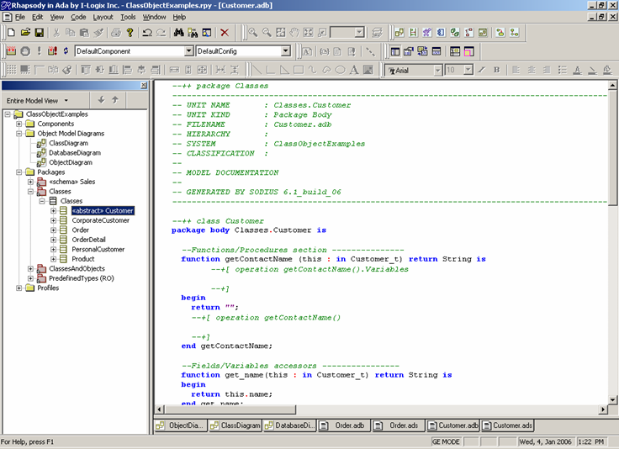
Example
Notes:
Show the class structures built by Rhapsody when code is generated for the lecture example (by choosing “Code”-”Edit”-”Selected Classes” in Rhapsody).
Note:
The code for this example will be static because it comes from classes only.
In lab 1, the system generated dynamic/behavioral code as well (which we’ll discuss in a future session).
The difference between the diagram view and the model (and between “delete” and “delete from model”).
Now, I could show the dishwasher model from the first lecture and how the class/object diagram folds into the full behavioral meta model to create the executable example. I could also extend the model a bit to show some more class diagram features (e.g., sensors, a help system). Probably there won’t be time, and this digs a bit far into Rhapsody at the expense of UML.

Slide 68
Reverse Engineering
Reverse engineering UML class diagrams works pretty well for object-oriented code.
It’s less effective for non-object-oriented code.
Notes:
Note that you’ll get software models rather than concept models.

Slide 69
Using Class Diagrams
Class diagrams are very common, both in early and late elaboration phases.
Class diagrams can be configured using profiles.
Don’t feel that you must:
  Use all of the language features
  Model everything
  Future-proof
Notes:
Be sure to distinguish domain modeling (week 4 – early elaboration) from system modeling (week 5 and beyond – late elaboration and construction).
Class diagram profiles include a real-time profile (see Smiths lectures) and a database profile (see the information lectures in this class).
Don’t feel that you must:
Use all of the language features – use the most useful 20% of the language
Model everything – You’d never be able to do this even if you tried.
Future-proof – Don’t try to anticipate all possible future variation with generalized features. Pick your battles here, some are obviously worth fighting, the others probably aren’t at this point.

Slide 70
Object Interaction
Objects do the following:
  interact with users
  collaborate with other objects
While object-oriented modeling tends to focus on object and class structure, don’t ignore object behavior.
Notes:
Both of the interaction types can be fruitfully modeled. You skip doing these things to the project’s peril.

Slide 71
Interaction Diagrams
Interaction diagrams show the order of events in a particular scenario of a use case.
UML models object interaction with:
  Sequence diagrams
  Communication diagrams
The process of dynamic interaction modeling helps to uncover static object structure.
Notes:
You could have many sequence diagrams for each use case.
Sequence and communication diagrams are largely interchangeable, but we’ll focus on sequence diagrams.
Dynamic and static modeling feed off of one another.

Slide 72
Example: System Sequence Diagram
Example adapted from Fowler, 2003
Notes:
Talk through the diagram, largely copied from Fowler, p. 36 and implemented in StarUML:
Time goes down
Objects are stored in columns
The little blocks indicate processes initiated by method calls.
SSDs tend to be much higher level and are potentially useful analytical tools during early elaboration phases.
The system object here is the “whole” system; it is presumably doing things during its execution, but we’re overlooking them for the moment.
Perhaps you’d find it just as easy to work with a text scenario.

Slide 73
Example adapted from Fowler, 2003
Notes:
Talk through the diagram, preferably on-line, largely added to Fowler’s example and implemented in StarUML:
The controller is a new system class object added for implementation purposes. It’s a pure fabrication, i.e., it’s not really in the domain at all.
The order object is created at the appropriate level and destroyed later.
Having a single controller like this work so long as the application is relatively simple.
The diagram says nothing about the management of the product and order details objects. Mostly this diagram focuses on the operation of the controller.
The database and credit authorities are singleton services or processes.

Slide 74
Outline
Sequence Diagrams:
  Lifeline boxes
  Lifelines
  Messages
  Diagram frames
Using Sequence Diagrams

Slide 75
Participants
Boxes represent participants in the interactions, including class objects, subsystems, services.
Each participant receives a column in the diagram.
Notes:
“participants” is fowler’s term.
They can be singleton objects.

Slide 76
Lifelines
The life of a participant is indicated by the lifeline.
The execution specification bars indicate focus of control.
Message emanating from a single bar are sent by the same process.
Lifelines begin and end at the appropriate “time heights”.

Slide 77
Messages
Horizontal arrows indicate:
  Synchronous messages (solid arrows)
  Returned values (dotted arrows)
Loops indicate messages to “this”.

Slide 78
Asynchronous Messages
Messages between separate threads/processes are asynchronous.
UML indicates this using an open arrow, sometimes drawn on a slant.
Notes:
Note tha StarUML doesn’t support the slant, but it does support the asynchronous stick arrow (by setting the “ActionKind” of the message to “SEND”.

Slide 79
Diagram Frames
Frames support a variety of useful things not naturally supported by other elements:
  Conditional and looping constructs
  Parallel fragments
  Critical sections

Slide 80
Using Interaction Diagrams
Interaction diagrams do not model:
  Intra-object algorithmic behavior
  Inter-use-case behavior
Use system sequence diagrams and traditional sequence diagrams appropriately.
As with the other UML diagrams, don’t feel that you must model everything or use all of the features.
Notes:
Be sure to distinguish domain modeling (week 4 – early elaboration) from system modeling (week 5 and beyond – late elaboration and construction).

Slide 81

Visual Modeling
What’s the
Big Idea
Why model?
Why use visual models?
Why use UML?
Why use a UML tool?
Notes:
The 3 amigos emphasized visual modeling as an important step in analysis and design, very much in the same vein as architects and contractors use architectural models (CAD drawings) for their work.
Optional: SHOW THE VIDEO clip of the three amigos talking about why model (if there is time).
Show: http://cs.calvin.edu/curriculum/cs/262/kvlinden/private/visual_modeling.php

