Slide 1
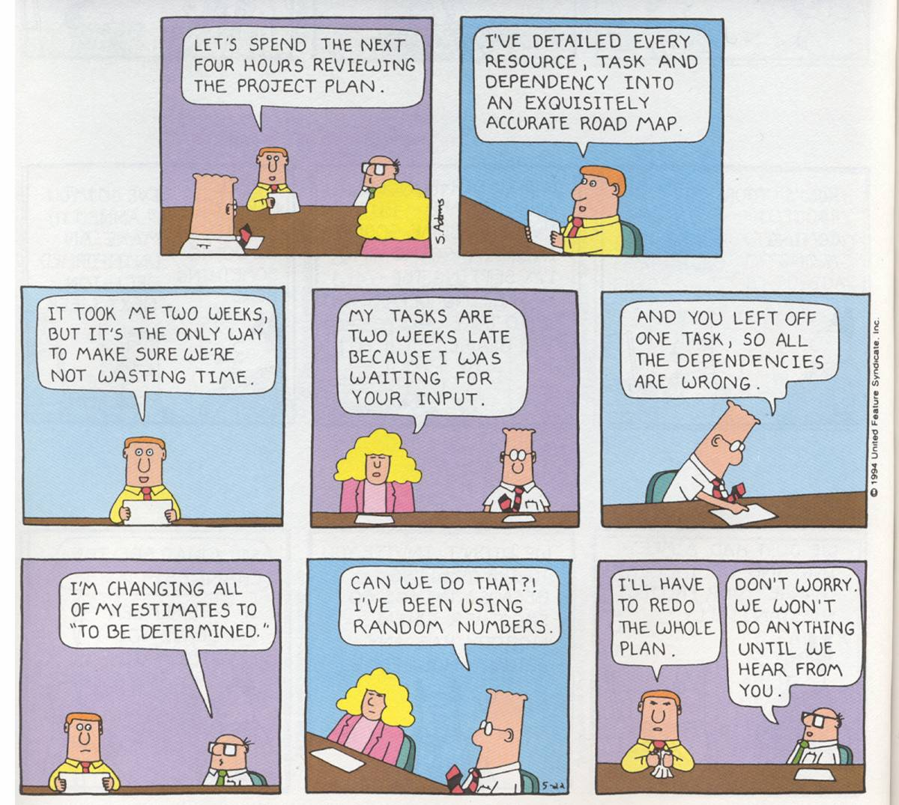
Dilbert © United Feature Syndicate, Inc.
Notes:
Make this material last through Monday and Wednesday.

Slide 2
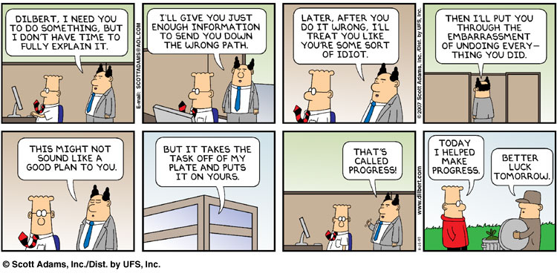
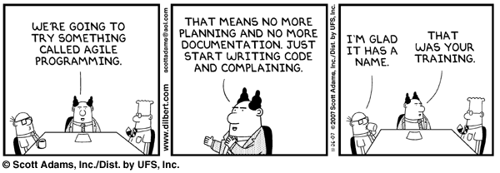
Dilbert © United Feature Syndicate, Inc.

Slide 3
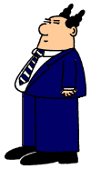
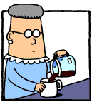
Managing Software Development
Managing People
  People
  Teams
Managing Processes
  Traditional process models
  Modern process models
?
images from: http://www.dilbert.com/

Slide 4
Working with People
Very few projects can be done by one person, thus working effectively with others is a critical professional skill.
Software is developed by people for people. The stakeholders include:
Notes:
The stakeholders include:
Clients
Customers
Users
Users’ managers
Developers
Business/Technical managers
Analysts/Designers/Programmers/Testers
Systems support/Technical writers

Slide 5
Myers-Briggs Type Indicator
Energy source (Introversion/Extroversion)
Information gathering (Sensing/iNtuition)
Decision making (Thinking/Feeling)
Organization (Judging/Perceiving)
Notes:
They took this as part of project #1.
Your primary source of "energy" - Here, you can either be categorized as Introverted or Extroverted. Introverts draw their excitement from the inner world of ideas, thoughts, and emotions. Extroverts draw their excitement from the external world of words and activity. Introverts are quiet and private while extroverts are expressive and social. Can you think of examples of people on both sides? [Our class: (I 7)/(E 10); Programmers: 50-66% I; Population: 25% I; Examples: I - Harry Truman, E- Bill Clinton; Potential: potential collaboration and friction here are obvious]
The way you take in information - Here, you can either be categorized as Sensing or iNtuitive. Sensing types prefer hearing the facts in detail, intuitives prefer hearing patterns and overviews. It is well-known in education theory that some folks prefer to start with examples, while others prefer the overview first. Sensing types tend to be practical and realistic while intuitive types tend to be forward looking and idealistic. Again, can you think of people on both sides of this? [Our class: (S 3)/(N 14); Programmers: evenly split; Population: 25% N; Examples: S - Franklin Roosevelt, N - Albert Einstein; Potential: S's will know details and construct examples. N's will see big pictures and ignore "implementation details“]
The way you make decisions - Here, you can be categorized as either Thinking or Feeling. Thinkers decide based on logic and objective facts, feelers decide based on personal values and intuitions. Thinkers tend to make long range plans based on principle, feelers tend to react in the short term. This one is bit harder - can you think of people on both sides here? [Our class: (T 11)/(F 6); Programmers: 90% T; Population: 50/50; Examples: T - Thomas Edison, F - Mother Teresa; Potential: T's tend to be more logical but can be cold. F's will respond to users better, but may waffle]
The way you organize your life - Here you can be categorized as wanting to direct your life, called Judgment, or to discover life as you go on, called Perception. This differs from the previous category, which considers how you want to make decisions, in that this one considers when you want to make decisions. Judgers create and adhere to master plans, perceivers remain flexible and spontaneous. Again, can you think of people on both sides? [Our class: (J 12)/(P 5); Programmers: ???; Population: 50/50; Examples: J - Margaret Thatcher, P - Elvis Presley; Potential: J's will plan, but may be rigid. P's will go with the flow, but may not get to things.]
Questions to ask:
How accurate do you think this sort of test is? If you took it or some other test like it, would you expect to get the same answer?
Do you think these categorizations could be of any use, or are the just a bunch of nonsense?
What sort of person makes the best programmer? [IS/NTJ -25-40%] the best designer? the best team leader [ENTJ]?
What sort of people would the ideal software development team have? [all kinds – don’t be smug]

Slide 6
Team Organization
Teams can be organized in many ways:
  Democratic teams
  Chief Programmer teams
  Pair Programming Teams
  Hybrid Structures
“Adding manpower to a late software project makes it later.” - F.P. Brooks, The Mythical Man Month, 1975
Notes:
What will you use for your project team?
This is commonly known as Brooks’ Law. Is this true?
Individual contributions are not additive - If a project takes 1 person a year, then 4 people should be able to do it 3 months. Right? Wrong!
Not all projects can be divided easily.
e.g., If 1 person can shovel the driveway in 1 hour, then 2 people can do it in 30 minutes (?).
e.g., However, while 1 woman can have a baby in 9 months, 3 can’t have one in 3 months!
The 4 people may take a year to finish the project as well and it may not be as good.
Multi-person team projects require coordination
jobs must be decomposed
communication lines increase exponentially
the people may argue, which wastes time
APIs must be developed
These are management issues.

Slide 7
Democratic Teams
Described by Weinberg, 1971
No official leader
Egoless programmers
Notes:
Egoless programmers work as team members, not individuals.
Advantages:
Work satisfaction with respect to debugging/testing and egalitarian structure
Probably better for research and hard problems
Problems:
Don’t scale well
Hard to manage
Too many communication lines to work quickly – “too much democracy”
No data to support their effectiveness
Programmers aren’t really equal and resent being treated that way

Slide 8
Chief-Programmer Teams
Suggested by Brooks, 1975
Centralized chief programmer
Specialized team members
tester
Chief
tester
programmer
librarian
programmer
programmer
Notes:
Brooks’ suggestion of the surgical team anology
Advantages:
reduced communication lines
specialization
efficient and produces a unified product (good for, e.g., kernels)
Example: NewYorkTimes project,
83000 LOC in 22 months, most in the last 6 months
21 faults in first 5 weeks of acceptance tests
25 more in first year of operation
explanations - 1 PL/1 project, great people, superb leader (F. Terry Baker)
Problems:
Hard to find the combination of manager/programmer
Only one designer limits the (design) size of the project

Slide 9
Pair Programming Teams
Adopted by extreme programming (XP)
Programming is done in promiscuous, two-person teams.
Programmers don’t specialize.
Notes:
Advantages:
Agile – responsive to change
Problems:
Not clear how it scales
Note that this practice is as old as Echert and Mauchly – Kent Beck didn’t invent it.

Slide 10
Hybrid Structures 1
Split the technical and non-technical management.
Technical
Manager
Financial
Manager
tester
tester
programmer
librarian
programmer
programmer
Notes:
Advantages:
Removes the need for the rare managerial/technical leader.
This is a very common approach.
Problems:
Leads to multiple lines of communication.

Slide 11
Hybrid Structures 2
Use hierarchies of organizational structure.
Can use democratic, hierarchical or paired structures at each level.
Notes:
Advantages:
Removes the need for the rare managerial/technical leader.
Problems:
Leads to multiple lines of communication.

Slide 12
Traditional Process Models
More traditional software process models tend to favor “high ceremony”, planned processes.
Traditional models include:
  Waterfall
  Prototyping
  Spiral
Traditional Project Management
image from: http://www.dilbert.com/
Notes:
We won’t include what might be called the “hack-a-bit/test-a-bit” model, which contains no analysis, design or maintenance. It only works for class assignments and even there it has a questionable record.
There are many life-cycle models, ranging from “high ceremony”/bureaucratic models to “low ceremony”/hacker models, and there is much argument over which is the best. This is yet another ramification of the fact that SE is a young discipline.
Models help control reality, but in the end they only approximate it.
Note: These differences may seem to be hair-splitting, but management uses them very seriously and if a little bit is left out of the model, it doesn't always get done at all!

Slide 13
The Waterfall Model
Analysis
Design
Coding
Testing
Maintenance
Notes:
This is the oldest (first proposed by Royce in 1970) and what people usually do in SE classes.
Analysis - Determine what the software will do. At this point, stakeholders may have little idea what they want/need. => Requirements document
Design - Determine how the software will do it. Design decisions should be specific and linked to requirements. => Design document
Coding - Implement the software. The modules are built and integrated, based on the design spec. => the working system
Testing - Ensure that the software works well and does what the requirements spec said it should do. => Test report
Maintenance - Respond to a lifetime of changes including retirement.
Strengths:
It’s simple so it’s easy to manage.
It has a meaningful order.
The deliverables are clearly defined.
Weaknesses:
It's almost certainly wrong!
In reality, one does have to go back sometimes to add missed requirement or fix misinterpreted requirements (Draw this on the diagram).
“analysis paralysis”
People end up waiting because managers use the phases as a hard-and-fast rule and try to keep everyone on the same phase at once.

Slide 14
Relative Effort of Phases
data from Schach, 2002
Notes:
These numbers were derived by averaging a number of published studies from the late 1970’s/early 1980’s. The percentages were still very similar in the mid 1990’s.

Slide 15
The Prototyping Model
Listen to
customer
Build
prototype
Evaluate
prototype
Notes:
This is iterative but not incremental in its purest form. You prototype the whole thing, then throw out the prototype. Stakeholders are involved in each iteration and you keep cycling until the customer is happy.
Strengths:
Users like it. Why? They get to see early versions.
Developers like it. Why? They get to hack.
Researchers like it. Why? Helps with ill-defined problem and for gathering requirements.
You can build a prototype this way and then proceed with the waterfall model to develop the real product.
Weaknesses:
We may keep bad hacks merely because they are there.
Leads to unrealistic expectations based on unimplemented mock-ups.
Can lead to feature creep.
Seldom used for real development.
Brenda did this sort of stuff. It worked for them because they had a separate prototyping dept that passed the project over to another development division.

Slide 16
The Spiral Model
Risk
Analysis
Risk
Analysis
Risk
Analysis
Verification
Verification
Verification
Prototype
Prototype
Prototype
Analysis
Design
Implementation
Notes:
Defined by Boehm, 1988
It’s another iterative model that is also incremental, i.e., it’s like the prototyping model except:
You don’t prototype the whole system at first.
It adds some new process steps, e.g.:
planning
risk analysis (may include prototypes)
It is designed to last the lifetime of a large product with planning and risks in each cycle.
It's not as simple and therefore harder to control.
Tries to cover all the bases – I’ve never seen it used in practice.

Slide 17
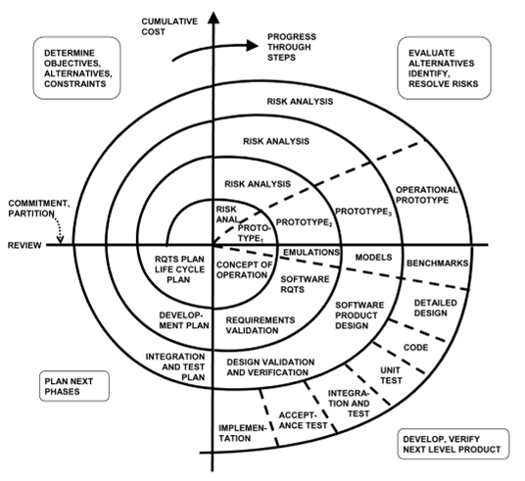
image from: Pressman, SEPA
Notes:
This is the original Boeme diagram for the spiral model, which shows all the details added to the phases.

Slide 18
Project Management
To manage a software project, one must be able to manage future work, risks, schedules.
These are hard management issues.
“All programmers are optimists.” - F.P. Brooks, The Mythical Man Month, 1975
Notes:
These are not easy tasks, and they’re not necessarily technical.
Words of warning:
All programmers are optimists. - Brooks, 1975
How do projects get one year late? … One day at a time. - Brooks, 1975

Slide 19
Project Planning
Traditional project planning must estimate:
  the required human effort
  the duration
  the cost
Common estimation methods include:
  Expert judgment
  Bottom-up estimates
  Algorithmic cost models (e.g., COCOMO)
Notes:
See wikipedia:Project_planning for a reference on this topic.
Words of warning:
All programmers are optimists. - Brooks, 1975
How do projects get one year late? … One day at a time. - Brooks, 1975

Slide 20
Risk Management
Risks must be identified and addressed, using some strategy:
  proactive
  reactive
The best managers:
  know what’s going to go wrong before it does
  take steps to be prepared
Notes:
Hard to identify risks - frequently we use checklists to make sure that we think of everything. See text, section 6.3 for ideas. You’ll have to include this in your requirements spec.
strategies:
Reactive
Harry Potter approach
Indiana Jones - “we’ll think of something”
James Bond
Proactive - think ahead.
Albous Dumbledore approach

Slide 21
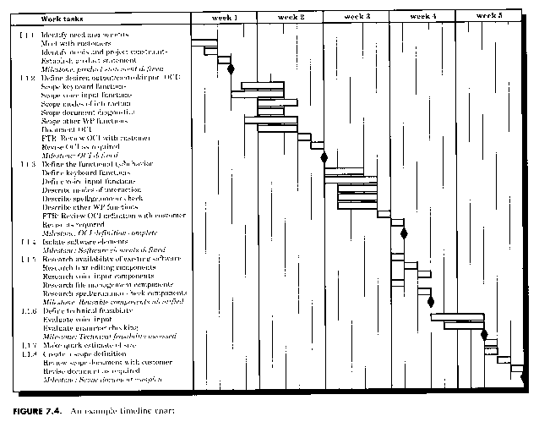
Project Scheduling
A good project schedule sets a realistic agenda for the whole project.
  It will never be perfect.
  Management keys off of it nevertheless.
Gantt Charts are commonly used to specify plans.
image from: Pressman, SEPA
Notes:
Describe (on the chart):
the time line (left to right)
the task bars (representations of the duration of tasks)
may overlap
the task descriptions
the milestones
specify appropriate dates
Importance:
Funding frequently is delivered based on the chart.
Project may or may not follow it, but always references it.
Very useful for larger projects.

Slide 22
The Project Management Plan
A project plan document is frequently written, which would include:
  The chosen process model
  The staffing and team organization
  Risk assessment
  A detailed project schedule
Additional plans can be written for:
  The quality and validation process
  The configuration management process
  The maintenance process

Slide 23
Requirements Change
Data from Larman, 2005
Notes:
Larman took this data from a 1997 study by C. Jones. Some really large projects suffered 35-50% change in their requirements.
It’s just hard to imagine relying solely on waterfall methods on large projects.

Slide 24
Waterfall-Specified Feature Use
Data from Larman, 2005
Notes:
A meta-study by J. Johnson, 2002, indicated this level of use for waterfall-specified requirements. What a waste – 64% of the features we design, implement, test and deploy are rarely if ever used.

Slide 25
Modern Process Models
More modern software process models tend to favor lower ceremony, iterative processes.
Modern models include:
  Synchronize and Stabilize
  Extreme Programming
  (Rational) Unified Process
Agile project management
image from: http://www.dilbert.com/
Notes:
These models are little closer to reality and a little better.
“All models are wrong, but some are useful.” – George Box

Slide 26
Synchronize and Stabilize
Analysis
Architectural
Design
Develop components
Synchronize daily
Stabilize
Build
Notes:
This approach was presented by Cusumano & Selby, 1997 as the approach Microsoft uses. It is a more agile sort of iterative/incremental model, repeating the cycle for each build.
The analysis produces a simple “vision” statement.
The design simply divides the system up into “builds” made up of sub-sets of features in decreasing order of importance.
Development is done by parallel teams that synch up each day so there is always a working system to ship.
Each build cycle ends with stabilization of the build, hence the name (daily)synch/(buildly)stabilize
Strengths:
more free wheeling
works with good engineers
Weaknesses:
real-time applications (which need careful mathematical models)
secure and critical applications (OS’s!, critical monitoring systems)
better for applications than systems

Slide 27
Extreme Programming
Analysis
Build
Design
Develop, Test &
Integrate Tasks
Acceptance
Tests
Notes:
XP was defined by Kent Beck, 1999, and is iterative/incremental.
The official diagram of this approach on the next slide is the more accurate representation.
Similar to the Synch/Stabilize except that:
Analysis is driven by task narratives (called stories).
Design is minimal. It’s mostly just listing features/tasks to implement.
Testing is heavily integrated.
New stories can be added at any time.

Slide 28
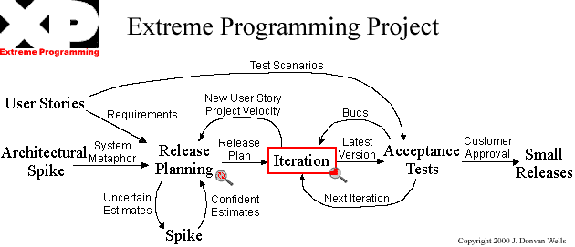
image from: http://www.extremeprogramming.org/
Notes:
XP makes very specific recommendations on what/how to do what/when.

Slide 29
Unified Process
Disciplines:
Analysis
Design
Implementation
Testing
Deployment
…
Inception
Elaboration
Construction
Transition
Phases
Notes:
UP was developed by Jacobsen/Booch/Rumbaugh; RUP was developed by IBM/Rational, articulated by Kruchten, 2000.
This is a generic process formalism, not a specific process model. It can be agile or heavy.
The phases go along the bottom, the disciplines roll along the top – The official diagram on the next page is probably the best illustration of this.
This cycle is repeated over and over again over the following phases (see the next slide):
Inception Phase – analyzing the project
Elaboration Phase – designing the architecture
Construction Phase – implementing the project
Transition Phase – rolling the project out

Slide 30
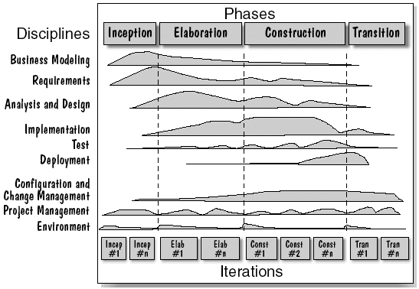
image from: http://www.ibm.com/
Notes:
This is designed to be very, very general.
Each iteration includes all the waterfall phases, but emphasizes them in different ways throughout the development process, as shown in this diagram.
Strengths:
Has supporting tools.
It is very generalized.
Weaknesses:
It is very big (like all Rational ideas).
Given the data you will be collecting, you should be able to build a chart like this for your project.

Slide 31
Unified Process Phases
The UP Phases:
  Inception
  Elaboration
  Construction
  Transition
Each phase generally displays a different relative deployment of the UP disciplines.
Notes:
The unified process will drive the structure of this course. See the UP phases in the course outline and specifically go through the required deliverables for each of the phases:
Inception – initial visioning, scoping, business case (Don’t even start analysis if these things aren’t clear.)
Elaboration – initial architectural development, risk resolution, requirements (Not the design phase)
Construction – lower-risk development, preparing for deployment
Transition – beta testing, deployment
I’ll be presenting the UP disciplines in a waterfall sort of way, just because I have to do it in some order, but the project will proceed in a more UP manner. Talk specifically about the deliverables and their iterations.

Slide 32
Unified Process Disciplines
Business Modeling
Requirements
Design
Implementation
Test
Deployment
Configuration Management
Project Management
Environment
Notes:
There were originally called “workflows”. You’ll use them in your project management.
Engineering workflows:
Business Modeling – Understanding and modeling the business environment (artifacts: domain model)
Requirements – Standard requirements analysis (artifacts: use-case model, supplementary spec)
Design – standard design (artifacts: design class model)
Implementation – standard implementation (artifact: the code)
Test – standard testing (artifacts: unit tests, test plans)
Deployment – installation/packaging of the system (artifact: deployed system)
Supporting disciplines/workflows:
Configuration Management – track & maintain integrity of the evolving system
Project Management – balancing objectives/risk/constraints during development
Environment – setting up tools and processes for development
Documentation is spread across all the disciplines.

Slide 33
Agile Methods
Agile approaches (e.g., XP, Scrum) share a common set of principles. They tend to:
  value people over processes.
  focus on software rather than documents
  prefer collaboration over contracts
  react rather than plan
Agile approaches are always iterative and incremental.
Notes:
http://agilemanifesto.org/
value people over processes – Agile methods tend rely more on people and less on documents and process.
focus on software rather than documents – Agile developers seldom view a document as a deliverable.
prefer collaboration over contracts – Agile methods require trust, a rare commodity in today’s market.
react rather than plan – Agile developers use the YAGNI principle, a sort of Just-in-time approach to programming.

Slide 34
Agile Practices
Time-boxed iterations
Risk and velocity-driven planning
Client stories/scenarios
Test-driven development
Refactoring
Pair programming
Notes:
Time-boxed iterations – Use fixed-increment time periods for planning iterations (e.g., 1 week).
Risk and velocity-driven planning – Plan reactively, choosing tasks based on estimated risk and effort. Project velocity is the ratio between estimated time and real calender time.
Client stories/scenarios – Base everything on client-supplied narratives.
Test-driven development – Integrate unit testing into development, before coding.
Refactoring – Use systematic code modifications to change the system without changing functionality.
Pair programming – Program in teams of two.
Don’t foolishly believe that:
Agile ideas are new ones – They’re not.
Traditional approaches are no longer of any use – They still are.
You’ll work in a company that uses extreme programming – You probably won’t.

Slide 35
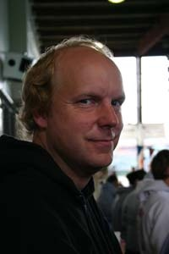


Kent Beck
Extreme Programming
What’s the
Big Idea
Innovative work on CRC cards, patterns and XP
XP values:
  Communication
  Simplicity
  Feedback
  Courage
  Respect
images from www.threeriversinstitute.org and amazon.com
Notes:
We’ll end with Beck’s rather enlightened view of software development. See http://www.extremeprogramming.org/ for more details on XP.
Management practices (usually very nice):
He’s very human - Client representatives are part of the XP teams and no one works overtime for two successive weeks (unless it’s sustainable).
Team members don’t specialize, which is nice, but could be dangerous.
Kent Beck is the founder and director of Three Rivers Institute. He has pioneered patterns for software development, the xUnit family of testing frameworks, the HotDraw drawing editor framework, CRC cards, refactoring, and most recently extreme programming. He is the author of Extreme Programming Explained, Planning Extreme Programming, and Smalltalk Best Practice Patterns. He lives on 20 acres in rural southern Oregon with his wife, five children (one sadly now gone to college), four dogs, two sheep, and a variable number of domestic fowl.
He also was the first to apply Alexander’s architectural patterns to software.

