Slide 1
CS 262
Software Engineering
Keith Vander Linden
Calvin College

Slide 2
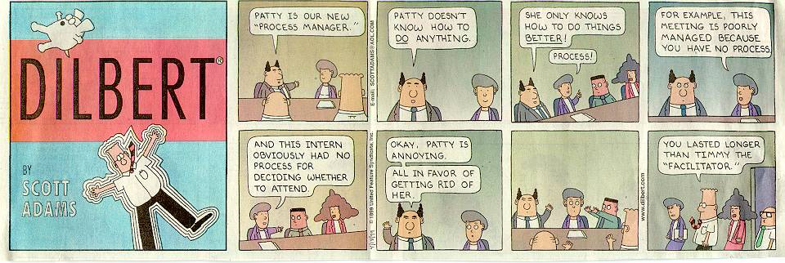
Dilbert © United Feature Syndicate, Inc.

Slide 3
In my software engineering class, I thought the strict methodology was a chore, but I realize that it is important and I’m beginning to see why.
- An intern at Spartan Co.
They’re actually using UML here.
- An intern at Rapistan Co.
Subject: Echoes of your Software Engineering class
…just when I thought I was done with them for good after your class, I'm doing UML activity diagrams on a daily basis now. - A former student now at Boeing
Notes:
This will likely be the most practical course you take, short of the internship/senior project.
Data Structures and algorithms is still the core of the science, but this course will show how it’s applied.
You’ll also learn a notebook full of buzz words.
Vocational notes:
If you aren’t on abstraction-jobs, get on there now.
Start thinking now about the senior project/internship choice.
Thing big vocationally! (see http://money.cnn.com/magazines/moneymag/bestjobs/)

Slide 4
Introduction
Software Engineering
Course Outline (http://cs.calvin.edu/curriculum/cs/262/)
Christian Perspective
Notes:
Logistics:
Tell them to do personality profile shown in lab 1 before coming to the lab period.
Tell them the course materials username/password.
Mention the grading system usernames and passwords (to be seen later in lab).
Explain why we use Wikipedia (rather than a general text).

Slide 5
Software Engineering
Software Engineering is the application of engineering principles to the development of software systems.
Its goal is to produce systems that are:
Notes:
Goal of SE - To produce software systems that are:
Fault-free
Responsive to change
Produced:
on time
within budget
Satisfying to the customer
Note that these goals are achieved not just through programming skills…

Slide 6
Art, Science or Engineering
Is software development an artistic, scientific, or engineering discipline?

Slide 7
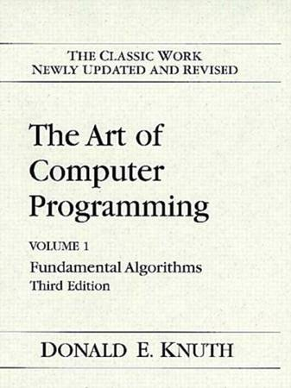
Art, Science or Engineering
Software development requires art.
“Computer Programming is an Art … Programmers who subconsciously view themselves as artists will enjoy what they do and will do it better.”
- Donald Knuth, Turing Award Speech, 1974
image from: http://www.amazon.com/
Notes:
In what ways is software design artistic?
interface design
programming and algorithm design (according to Knuth)
presentation layout

Slide 8

Art, Science or Engineering
Software development requires science.
“Computer Science is no more about computers than astronomy is about telescopes.”
- E.W. Dijkstra
image from: http://www.amazon.com/
Notes:
According to Dijkstra, there is a science that lies behind programming computers that is as important and the astronomical science that lies behind the construction of telescopes.
In what ways is software design scientific?
algorithm development
complexity analysis
logic-based programming with proofs (according to Gries)
We won’t dwell on the science much in this course. It’s been the subject of all your other courses.
Dijkstra was a big supporter of Gries’ book.

Slide 9
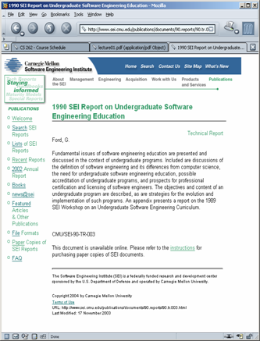
Art, Science or Engineering
Software development requires engineering.
“Software engineering is that form of engineering that applies the principles of computer science and mathematics to achieving cost-effective solutions to software problems.”
- SEI report #90-TR-003, 1990
image from: http://www.sei.cmu.com/
Notes:
In what ways is software design like engineering?
the products have a known life-cycle (analysis, design, implementation, testing, maintenance)
software development must be backed up by art and science just like engineering
In what ways is software design Unlike engineering?
Software engineering is a younger discipline - Bridges don’t crash as often as operating systems
Software has no manufacturing step - This is why file sharing is such a big issue.
Software doesn’t wear out.
Software is often custom-built and must be modifiable - Traditional engineers often repeat projects, we don’t
Computer hardware is changing rapidly
Software has complex states that aren’t well-understood - Software is harder than hardware.
Software has no physical contiguity

Slide 10
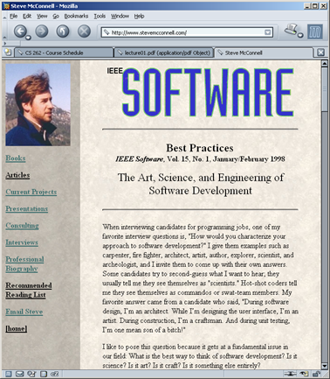
Art, Science and Engineering
Software development requires all three.
“During software design, I’m an architect. While I’m designing the user interface, I’m an artist. During construction, I’m a craftsman. And during unit testing, I’m one mean SOB!”
- S. McConnell, IEEE Software, 1998
image from: http://www.stevemcconnell.com/
Notes:
We will focus largely on the engineering aspects, with some interest invested in the art. We’ll assume the science as covered in other courses.

Slide 11
Software Development
“…developing quality software is hard. In between the nice ideas, the requirements or the “vision,” and a working software product, there is much more than programming.” - P. Kruchten, Forward to Applying UML and Patterns, 2005, p. xix
Notes:
Things other than programming?! What else is there?!
Management
Team work
Mathematical analysis
Anthropological analysis
Documentation
Usability studies
Training
Presentations

Slide 12
The Development Process
Software Development includes the following phases:
  Analysis
  Design
  Implementation
  Testing
  Maintenance
Notes:
Define each:
Analysis – Determine what the software should do.
Design – Determine how the software should do it.
Implementation – Build the software.
Testing – Ensure that the software does it.
Maintenance – Keep the software up to date.
There are many ways to manage this, but you’ll always have to do these things, roughly in this order.

Slide 13
Software Systems
Software systems are becoming pervasive.
Pervasiveness brings risk.
Notes:
What do we mean by pervasity/ubiquity – Give examples:
The portability of ICT devices increases as their size decreases.
The amount of code in consumer products in doubling every year. (e.g., Television - 500K of code, shaver - 2K of code, Apollo - 10 million lines, Space Shuttle - 40 million lines, Modern cars have between 10 and 100 processors that control most everything) - MIT courseware
Compare this ICT/Computing revolution with the industrial revolution and the potential biological revolution.

Slide 14
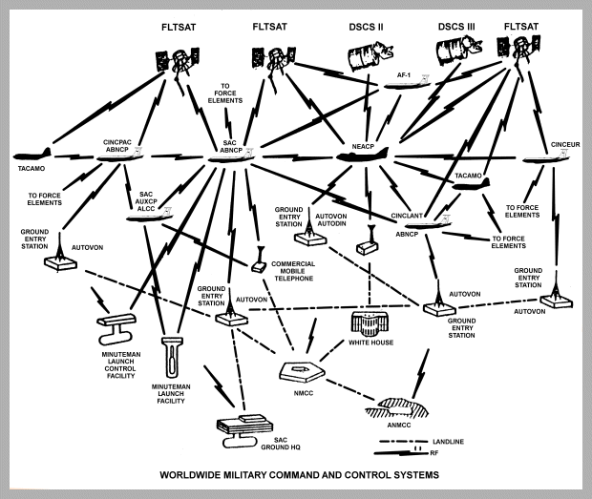
Case Study: WWMCCS
Worldwide Military Command and Control System
The Problem: SAC had a spurious alert scramble on Nov. 9, 1979.
The Reason: a simulation was taken as real
image from www.fas.org, June, 2006

Slide 15
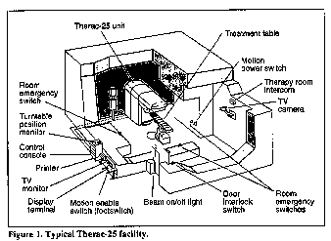
Case Study: Therac-25
Medical linear accelerator (1985-87)
The Problem: Two patients died of radiation overdoses.
The Reason: Faults in the control software.
image from courses.cs.vt.eduom, June, 2006
Notes:
Reprinted with permission, IEEE Computer, Vol. 26, No. 7, July 1993, pp. 18-41.
Computers are increasingly being introduced into safety-critical systems and, as a consequence, have been involved in accidents. Some of the most widely cited software-related accidents in safety-critical systems involved a computerized radiation therapy machine called the Therac-25. Between June 1985 and January 1987, six known accidents involved massive overdoses by the Therac-25 -- with resultant deaths and serious injuries. They have been described as the worst series of radiation accidents in the 35-year history of medical accelerators.[1]

Slide 16
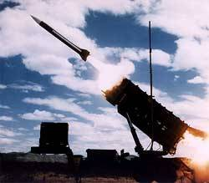
Case Study: Patriot missile
The 1991 Gulf War
The Problem: A SCUD missile killed 28 Americans and wounded 98 others.
The Reason: The software for the Patriot anti-missile missile contained a cumulative timing fault.
image from www.ieee-virtual-museum.org, June, 2006
Notes:
During the 1991 Gulf War, a Scud missile penetrated the Patriot
anti-missile shield and struck a barracks near Dhahran, Saudi
Arabia. In all 28 Americans were killed, and 98 wounded. The software
for the Patriot missile contained a cumulative timing fault. The
Patriot was designed to operate for only a few hours at a time, after
which the clock was reset. As a result, the fault never had a
significant effect and, therefore, was not detected. In the Gulf,
however, the Dhahran Patriot missile battery ran continuously for over
100 hours. This caused the accumulated time discrepancy to become
large enough to render the system inaccurate. Israeli forces detected
the timing problem after only 8 hours and reported the defect to the
company. The new software arrived the day after the tragedy.(Schach,
p. 4)

Slide 17
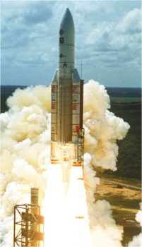
Case Study: Ariane-5 Rocket
A 1996 space launch
The Problem: The rocket exploded 39 seconds after liftoff, destroying the rocket and $.5 billion of cargo.
The Reason: The rocket activated its own self-destruct system upon encountering undocumented conditions.
image from www.ariadne-mtc.de, June, 2006
Notes:
The European space agency spent 10 years and 7 billion dollars to develop the Ariane-5 rocket. On June 4, 1996, the first Ariane-5 was launched. At 39 seconds after liftoff it exploded, destroying the rocket and cargo valued at half a billion dollars. So what happened? It turns out that the explosion was caused by activation of the self-destruct mechanism built into the rocket. The self-destruct was triggered by unusually large aerodynamic forces that were ripping off the boosters. These forces were due to an abrupt course correction made by the on-board steering computer, which was in compensation for a wrong turn off course that in fact never took place. The inertial guidance computer had told the steering computer that the rocket had gone way off course, when in fact it was not off course at all. What caused this turn of events? It seems that what happened was that in the computations done by the inertial guidance computer it was converting a 64-bit floating point number into a 16-bit signed integer number. At about 36 seconds into the flight, a number was encountered that was larger than 32768, which is the largest possible 16-bit signed integer, so the conversation failed. Thus, erroneous numbers were sent to the steering computer, causing it to think the missile was off course and leading to the explosion at 39 seconds into the flight. Again a very costly disaster due to bad computer arithmetic.

Slide 18
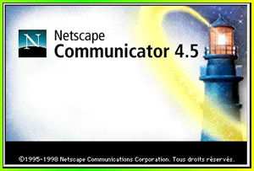
Case Study: Netscape
The Problem: NS lost market share to Microsoft IE in the 1990 browser wars.
The Reason:
  Netscape blames Microsoft’s predatory practices.
  Cusimono/Yaffe blame Netscape’s emphasis on time-to-market at the expense of design.
image from www.netscape.com, June, 2006
Notes:
The original NCSA Mosaic team at the University of Illinois built the first widely used browser, but they did a quick and dirty job. They founded Netscape, and between April and December 1994 built Navigator 1.0. It ran on 3 platforms, and soon became the dominant browser on Windows, Unix and Mac. Microsoft began developing Internet Explorer 1.0 in October 1994, and shipped it with Windows 95 in August 1995. In Netscape’s rapid growth period, from 1995 to 1997, the developers worked hard to ship new products with new features, and gave little time to design. Most companies in the shrink-wrap software business (still) believe that design can be postponed: that once you have market share and a compelling feature set, you can ‘refactor’ the code and obtain the benefits of clean design. Netscape was no exception, and its engineers were probably more talented than many.
Meanwhile, Microsoft had realized the need to build on solid designs. It built NT from scratch, and restructured the Office suite to use shared components. It did hurry to market with IE to catch up with Netscape, but then it took time to restructure IE 3.0. This restructuring of IE is now seen within Microsoft as the key decision that helped them close the gap with Netscape.
Netscape’s development just grew and grew. By Communicator 4.0, there were 120 developers (from 10 initially) and 3 million lines of code (up a factor of 30). Michael Toy, release manager, said: ‘We’re in a really bad situation … We should have stopped shipping this code a year ago. It’s dead… This is like the rude awakening… We’re paying the price for going fast.’ Interestingly, the argument for modular design within Netscape in 1997 came from a desire to go back to developing in small teams. Without clean and simple interfaces, it’s impossible to divide up the work into parts that are independent of one another. Netscape set aside 2 months to re-architect the browser, but it wasn’t long enough. So they decided to start again from scratch, with Communicator 6.0. But 6.0 was never completed, and its developers were reassigned to 4.0. The 5.0 version, Mozilla, was made available as open source, but that didn’t help: nobody wanted to work on spaghetti Code.
In the end, Microsoft won the browser war, and AOL acquired Netscape. Of course this is not the entire story of how Microsoft’s browser came to dominate Netscape’s. Microsoft’s business practices didn’t help Netscape. And platform independence was a big issue right from the start; Navigator ran on Windows, Mac and Unix from version 1.0, and Netscape worked hard to maintain as much platform independence in their code as possible. ey even planned to go to a pure Java version (‘Javagator’), and built a lot of their own Java tools (because Sun’s tools weren’t ready). But in 1998 they gave up. Still, Communicator 4.0 contains about 1.2 million lines of Java.
Michael A. Cusumano and David B. Yoffie. Competing on Internet Time: Lessons from Netscape and its Battle with Microsoft, Free Press, 1998. See especially Chapter 4, Design Strategy.

Slide 19
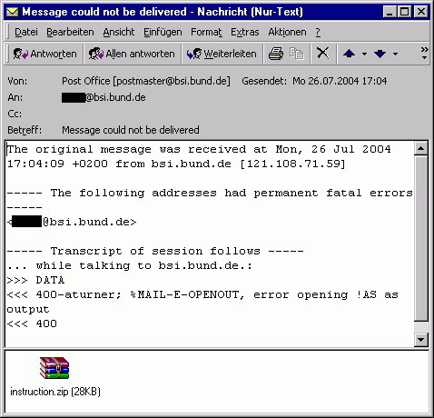
Case Study: MyDoom Worm
Self-contained malware
The Problem: A program, perhaps written for hire, got out of control.
The Reason: People were duped into voluntarily executing the self-replicating program.
image from www.bsi.de, June, 2006
Notes:
http://en.wikipedia.org/wiki/Mydoom
Mydoom, also known as W32.MyDoom@mm, Novarg, Mimail.R and Shimgapi, is a computer worm affecting Microsoft Windows. It was first sighted on January 26, 2004. It became the fastest spreading e-mail worm ever (as of January 2004), exceeding previous records set by the Sobig worm[citation needed]. Mydoom appears to have been commissioned by e-mail spammers so as to send junk e-mail through infected computers.[1] The worm contains the text message "andy; I'm just doing my job, nothing personal, sorry," leading many to believe that the worm's creator was paid to create it. Early on, several security firms published their belief that the worm originated from a professional underground programmer in Russia. [2] The actual author of the worm is unknown.

Slide 20
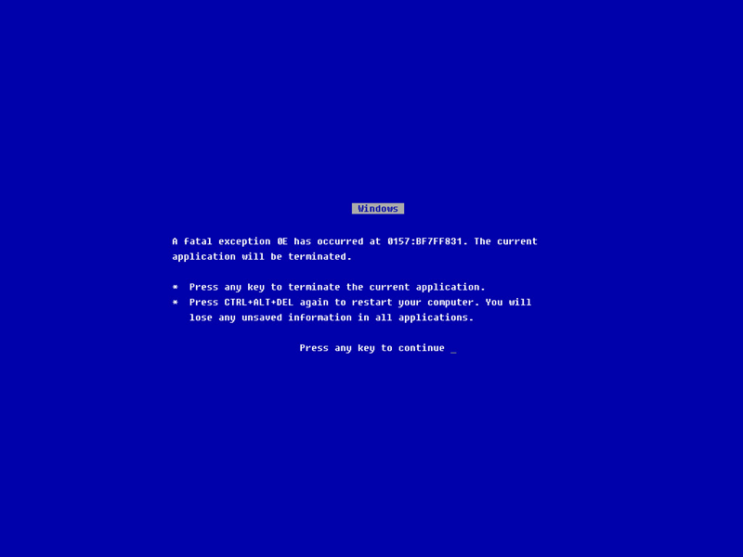
Case Study: Ping of Death
Denial of service attack
The Problem: A malicious network ping brings a machine down.
The Reason: The system software didn’t handle oversized packets.
image fromwww.firestream.net, June, 2006
Notes:
http://en.wikipedia.org/wiki/Ping_of_death
A denial-of-service attack (also, DoS attack) is an attack on a computer system or network that causes a loss of service to users, typically the loss of network connectivity and services by consuming the bandwidth of the victim network or overloading the computational resources of the victim system.
A ping of death (abbreviated "POD") is a type of attack on a computer that involves sending a malformed or otherwise malicious ping to a computer. A ping is normally 64 bytes in size; many computer systems cannot handle a ping larger than the maximum IP packet size which is 65,535 bytes. Sending a ping of this size often crashes the target computer.

Slide 21
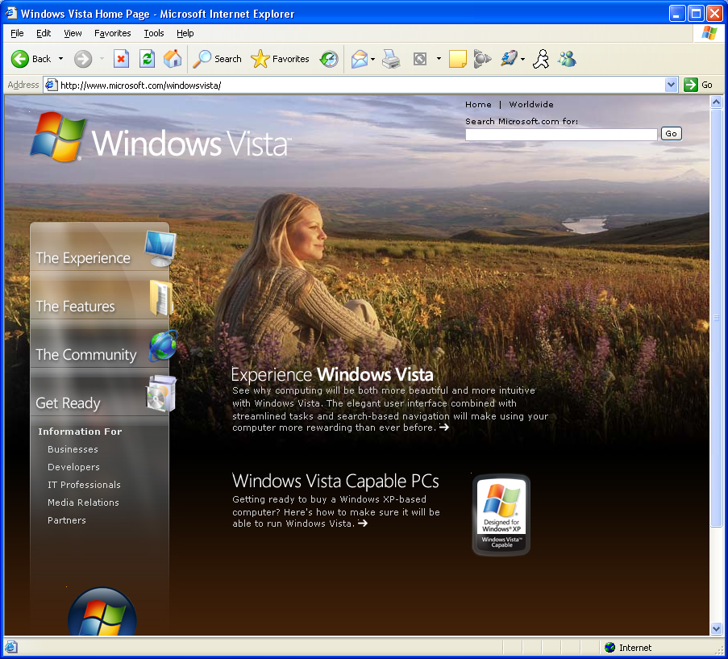
Case Study: Longhorn/Vista
The Problem: Delays in delivery
The Reason: Non-modular software
image from www.microsoft.com, July, 2006
Notes:
See Cusimoto’s paper in the July (?) ACM.

Slide 22
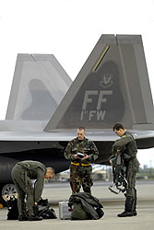
Case Study: Lockheed F-22
The Problem: Crossing the international dateline crashes all avionics computers
The Reason: software error, weak testing
image from www.flightglobal.com, Sept, 2007
Notes:
"The new US stealth fighter, the F-22 Raptor, was deployed for the first time to Asia earlier this month. On Feb. 11, twelve Raptors flying from Hawaii to Japan were forced to turn back when a software glitch crashed all of the F-22s' on-board computers as they crossed the international date line. The delay in arrival in Japan was previously reported, with rumors of problems with the software. CNN television, however, this morning reported that every fighter completely lost all navigation and communications when they crossed the international date line. They reportedly had to turn around and follow their tankers by visual contact back to Hawaii. According to the CNN story, if they had not been with their tankers, or the weather had been bad, this would have been serious. CNN has not put up anything on their website yet.“ - http://it.slashdot.org/article.pl?sid=07/02/25/2038217

Slide 23
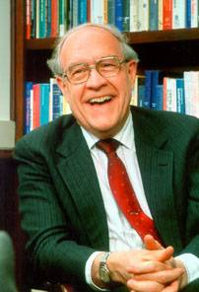

Fredrick P. Brooks (1931- )
The Mythical Man-Month
Joys of programming
We enjoy designing things because we are created in the image of God.
The computer is a powerful and rewarding tool to use.
Woes of programming
The “mindless” details can be excessively tedious.
Products become obsolete too quickly.
As the child delights in his mud pie, so the adult enjoys building things, especially things of his own design. I think this delight must be an image of God's delight in making things, a delight shown in the distinctness and newness of each leaf and each snowflake. - F. P. Brooks, Jr. The Mythical Man-Month, 1975
images from: http://www.amazon.com/
Notes:
The Mythical Man Month (1975) chronicles IBM’s OS/360 project, the largest software project up til 1964. Brooks was the project leader. Note that he explicitly talked about how the waterfall model on the previous page is wrong (he advocated interative design or the “growing” or software).
Joys of the craft (I.e., programming):
1. The joy of building things. “I think this delight must be an image of God’s delight in making things, a delight shown in the distinctness and newness of each leaf and each snowflake.
2. The pleasure of making useful things.
3. The fascination of making complex artifacts.
4. The joy of always learning.
5. The joy of using the computer (flexible, scalable)
Woes of the craft:
1. The smallest errors mess things up.
2. Other people set your agenda
3. Picky details are a pain.
4. Debugging/testing drags on and on.
5. The product becomes obsolete so quickly.

Slide 24

A Christian Perspective?
What’s the
Big Idea
Why do we do all this stuff?
Is any of it uniquely Christian?
Notes:
Why do we do all this stuff?
to exercise our creative nature;
to proliferate or enhance creation;
Is any of it uniquely Christian?
Not really, but both the development and use of software have implications:
Bad software reflects badly on the creator;
Bad Christian SEs are a bad witness;
Bad software demeans/endangers people;
Examples?
Implications:
Bad database systems reflect badly on the creator.
Bad database systems can be demeaning/dangerous.
Examples?
Bad software can demean/injure people.
Cover some relevant, current topic that is information systems based/related (e.g., TIA).

