Slide 1
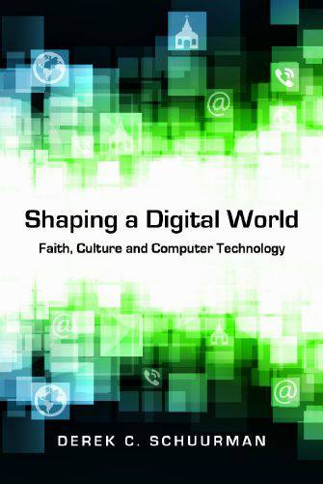
InterVarsity Academic Press, 2013.
by Derek C. Schuurman
Professor of Computer Science
Calvin University

Slide 2
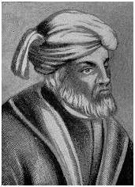
Tertullian and Technology
“Does the ancient Christian faith still have anything to say to a fast-paced modern world shaped by such technology? Tertullian, a father of early Christian literature, once posed the question, "What does Athens have to do with Jerusalem?" When it comes to computer technology, we might well ask, "What does Silicon Valley have to do with Jerusalem?" In a nutshell: what do bytes have to do with Christian beliefs?”
Derek C. Schuurman, Shaping a Digital World, InterVarsity Academic Press, p. 11.
Public domain image from http://en.wikipedia.org/wiki/Tertullian

Slide 3
Approaches to technology
Two different philosophies of technology include:
Technological Determinism
technology is an autonomous force beyond our control
The technological imperative
“Resistance is futile”
Instrumentalism
The assumption that every technical artifact is just a neutral tool

Slide 4
Technology is Value-Laden
Technology is not neutral, it is value-laden
How are the following technologies “not neutral?”
The automobile
The clock
The light bulb
The smartphone
Technology is not “just a tool” - it has both Structure and Direction

Slide 5
Technology is not Neutral
“Embedded in every tool is an ideological bias, a predisposition to construct the world as one thing rather than another, to value one thing over another, to amplify one sense or skill or attitude more loudly than another…”
Neil Postman, Technopoly, p. 13
“The medium is the message”
Marshall McLuhan
“We shape our tools, and thereafter our tools shape us”
John Culkin

Slide 6
Computer Technology is also not neutral
Sherry Turkle, Alone Together: Why We Expect More from Technology and Less from Each Other, Basic Books, 2011.
Nicholas Carr, The Shallows: What the Internet Is Doing to Our Brains, W. W. Norton, 2010.
Gary Small, iBrain: Surviving the Technological Alteration of the Modern Mind, William Morrow, 2008.
Cathy O’Neil, Weapons of Math Destruction: How Big Data Increases Inequality and Threatens Democracy, Crown, 2016.

Slide 7
Some Helpful Questions
What does technology make possible? What do we gain with digital technology?
What does technology make impossible (or more difficult)? What do we lose?
See: Andy Crouch, Culture Making (Downers Grove, IL: InterVarsity Press, 2008), pp. 29-30.

Slide 8
Computer Technology is a distinct cultural activity in which human beings exercise freedom and responsibility in response to God, to unfold the hardware and software possibilities in creation with the aid of tools and procedures, for practical ends or purposes.*
* From Shaping a Digital World, IVP, 2013, pg. 23. Definition derived from the definition of Technology provided by Monsma et al, Responsible Technology, Eerdmans, 1986, p. 19.

Slide 9
Approaches to Technology*
Rejection of technology
Indifference to technology
Embracing technology
Cultivating responsible technology
* Based roughly on the categories sketched by Richard Niebuhr in Christ and Culture, Harper & Row, 1975.

Slide 10
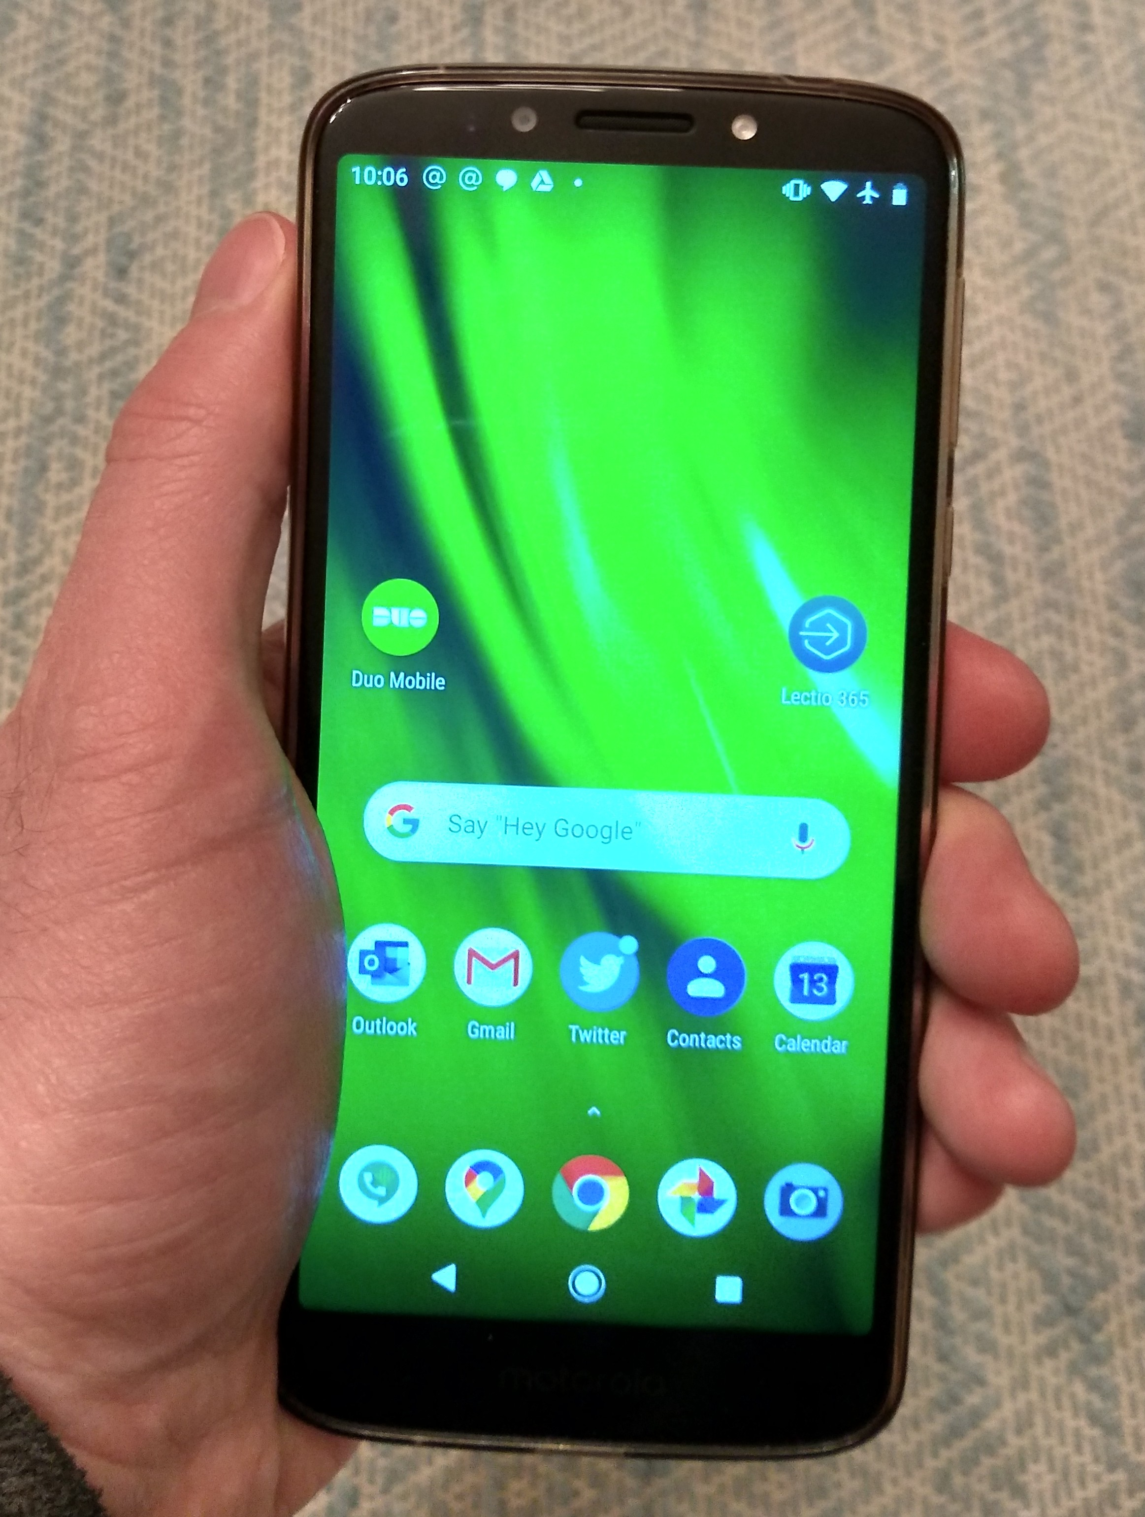
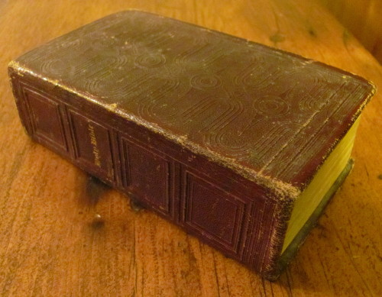
What does the Bible have to say about computer technology?
?
Images by Derek Schuurman

Slide 11
A Biblical Perspective on Technology?
The Scriptures are a guide and teacher that, like “spectacles,” help us to see more clearly (John Calvin)
We can apply Biblical themes to guide us with computer technology
Creation
Fall
Redemption
Restoration

Slide 12
Creation
Computer technology is part of the latent potential in creation
We are given a cultural mandate (Gen. 1:28)
God created humans in His image
Creation is complex and diverse; avoid reductionism
God establishes a pattern of sabbath rest
Creation has limits, laws and norms

Slide 13
Delight in Computing
We can also delight in God’s creation and in computing:
“Why is programming fun? What delights may its practitioner expect as his reward? First is the sheer joy of making things. As the child delights in his mud pie, so the adult enjoys making things, especially things of his own design. I think this delight must be an image of God's delight in making things, a delight shown in the distinctiveness and newness of each leaf and each snowflake.”
Frederick P. Brooks, The Mythical Man-Month: Essays on Software Engineering, Wiley, 1995. p. 7.

Slide 14
Fall
After the fall, creation fell under a curse
“the whole creation has been groaning...” (Rom. 8:22)
How are computers affected by the fall?
Computer technology is a human cultural activity
sinful human beings misdirect technology
structure and direction

Slide 15
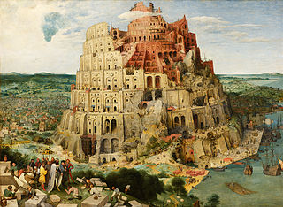
Technicism
Technicism is the secularized faith in technology as savior or rescuer of the human condition
This is a form of idolatry
looking to created things rather than to the creator
Modern day “Tower of Babel”
Pieter Brueghel the Elder (1526/1530–1569) [Public domain] via Wikimedia Commons

Slide 16
Redemption: All things in Christ
For in him all things were created: things in heaven and on earth, visible and invisible, whether thrones or powers or rulers or authorities; all things have been created through him and for him. He is before all things, and in him all things hold together. And he is the head of the body, the church; he is the beginning and the firstborn from among the dead, so that in everything he might have the supremacy. For God was pleased to have all his fullness dwell in him, and through him to reconcile to himself all things, whether things on earth or things in heaven, by making peace through his blood, shed on the cross. (Col. 1:16-20)
“All Things” includes computer technology!
We are called to be agents of Shalom
How do we shape responsible technology?
Discerning Biblical norms and creational norms as guide rails: Cultural, linguistic, social, economic, aesthetic, juridical, moral and faith norms

Slide 17
Design Norms*
Cultural Appropriateness
design ought to fit the culture into which it is introduced
Should alleviate burdens, preserving what is good
Communication
Clear, understandable
Social
Courtesy, politeness, nettiquette
Issues in social networking and sociable robotics
Economic
Stewardship: money, environment, human resources
E-waste, sustainability, green computing
*These norms are discussed in detail in Shaping a Digital World pp. 80-106.

Slide 18
Design Norms* (continued)
Aesthetics
Delightful harmony, tools that work well and pleasing to use
Form and function should be in harmony
Justice
Design ought to respect the rights of all users
Privacy, intellectual property, copyrights
Ethics
Show due care for persons, customers, workers
Assistive technology, reliability and safety, robo-ethics
Trust
Trust, dependability, reliability
Placing our ultimate trust in God rather than technology
All these
norms are
summarized in
love and care.
They are not
exclusive,
they work
together.
They bring
Shalom nearer.
*These norms are discussed in detail in Shaping a Digital World pp. 80-106.

Slide 19
Computer Technology and the Future
Two common viewpoints regarding technology and the future:
Optimists: trust in technology
Pessimists: despair and technology
There will be a new heaven and the new earth - everything will be made new!
Technology in the new heaven and earth
Will there be computers there?
Creation begins in a garden but ends with a “garden city”
“They will beat their swords into plowshares and their spears into pruning hooks. Nation will not take up sword against nation, nor will they train for war anymore” - Micah 4:3

Slide 20
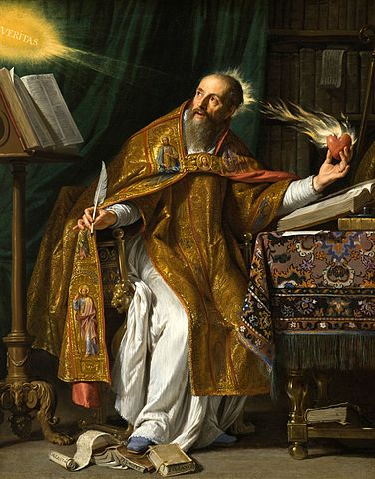
Concluding Thoughts: the Heart
Having a “perspective” is not enough...
“Being a disciple of Jesus is not primarily a matter of getting the right ideas and doctrines into your head... rather, it's a matter of being the kind of person who loves rightly...”
Jamie Smith, Desiring the Kingdom, Baker, 2009, p. 32-33
“If we would have our creation be true, beautiful, and good, we have to attend to our hearts.”
Fred Brooks, “The Computer Scientist as Toolsmith II”, CACM, March 1996.
Above all else, guard your heart, for everything you do flows from it. (Proverbs 4:23)
Saint Augustine, painting by Philippe de Champaigne, 1650

Slide 21
Book website:
https://www.ivpress.com/shaping-a-digital-world
Companion website:
https://cs.calvin.edu/shaping_a_digital_world/

Slide 22
Questions
Can you think of ways in which a smartphone is not neutral?
In what way is computer technology “part of creation”?
In what ways has the Fall effected computing?
Does being a Christian make a difference in how we use and shape computer technology?
How can you be a faithful presence in helping to shape the digital world?
Additional discussion questions can be found on the companion website and at the back of Shaping a Digital World.

