Slide 1
Java
Advanced Control Structures

Slide 2
Objectives
Be able to use a switch statement for selective execution.
Be able to implement repetition using alternative loops:
do-while loops
Be able to write a recursive method.

Slide 3
The switch Statement
Multi-alternative selection can be implemented using:
The multi-branch if statement
The switch statement
The multi-branch if statement can always be used.
The switch statement is a specialized form that operates more efficiently under certain circumstances.
Notes:
They’ve used multi-branch ifs before (e.g., Temperature#setScale(), Calculator#calculate(), computeLetterGrade)
Show them the day ordinal converter program as an example (c05 – textExamples - SwitchConsole#convertIf()) – Use the debugger to show the execution.

Slide 4
switch: Syntax and Behavior
switch (expression) {
case value₁:
statementList₁
case value₂:
statementList₂
…
default:
statementList_{n}
}
Requirements:
expression must be integer compatible;
values must be constants or literals;
Cases check for equality.
expression
StatementList₁
value₁
StatementList₂
value₂
otherwise
StatementList_{n}
Notes:
Illustrate the restrictions in the example:
Strings are not integer compatible types (e.g., int, char, boolean, NOT string, real).
The switch statement can be:
easier to read and write;
more efficient to execute.
Example: show SwitchConsole#convertSwitch()

Slide 5
switch & if: Examples
if (dayCode == 1) {
System.out.println("Sunday");
} else if (dayCode == 2) {
System.out.println("Monday");
} else if (dayCode == 3) {
System.out.println("Tuesday");
} else if (dayCode == 4) {
System.out.println("Wednesday");
} else if (dayCode == 5) {
System.out.println("Thursday");
} else if (dayCode == 6) {
System.out.println("Friday");
} else if (dayCode == 7) {
System.out.println("Saturday");
} else {
System.out.println("invalid code);
}
switch (dayCode) {
case 1:
System.out.println("Sunday");
break;
case 2:
System.out.println("Monday");
break;
case 3:
System.out.println("Tuesday");
break;
case 4:
System.out.println("Wednesday");
break;
case 5:
System.out.println("Thursday");
break;
case 6:
System.out.println("Friday");
break;
case 7:
System.out.println("Saturday");
break;
default:
System.out.println("invalid code");
}
Notes:
These statements have the same behavior. The text includes a pattern for this example that could be helpful.
Draw lines connecting the common code and control.

Slide 6
switch: Fall-Through Behavior
The switch statement implements fall-through behavior.
More than one case can be associated with one statement list.
If only one list is to be executed, then that list must explicitly exit the switch using:
break
return
throw
exit
Notes:
Note the break statements in the example switch statement.
Example: show SwitchConsole#convertSwitchCombine() (to illustrate the combination of cases, a natural result of drop-through behavior)
Example 2: show SwitchConsole#convertSwitchCombineReturn() (to illustrate the use of return rather than break)

Slide 7
switch: Examples
switch (dayCode) {
case 1:
System.out.println("Sunday");
break;
case 2:
System.out.println("Monday");
break;
case 3:
System.out.println("Tuesday");
break;
case 4:
System.out.println("Wednesday");
break;
case 5:
System.out.println("Thursday");
break;
case 6:
System.out.println("Friday");
break;
case 7:
System.out.println("Saturday");
break;
default:
System.out.println("invalid code");
}
switch (dayCode) {
case 1:
case 7:
System.out.println("weekend");
break;
case 2:
case 3:
case 4:
case 5:
case 6:
System.out.println("weekday");
break;
default:
System.out.println("invalid code");
}
Notes:
This switch statement is copied from before.

Slide 8
Execute!
Practice
// value of y?
x = 3;
y = 3;
switch (x + 3){
case 6: y = 1;
default: y += 1;
}
//Rewrite using switch
if (a == 1){
x += 5; }
else if (a == 2) {
x += 10; }
else if (a == 3) {
x += 16; }
else if (a == 4) {
x += 34;
}

Slide 9
The while Loop
A while loop executes a statement based on a boolean condition.
False
while (condition){
statement
}
condition
True
Statement

Slide 10
The do-while Loop
A do-while loop is a post-test version of the while statement.
do {
statement
} while (condition);
statement
condition
True
False
Notes:
We might have done the example using this sort of loop, given that we always want to execute that loop once.

Slide 11
do-while: Example
System.out.print("Guess a number from 1-10: ");
do {
number = keyboard.nextInt();
} while (number != 7);
System.out.println("You guessed it!");
Notes:
This one is a little cleaner because we don’t need to initialize number.
See WhileConsole#guessDoWhile().

Slide 12
Execute!
// What is the output?
int i = 3;
while (i >= 1){
int num = 1;
for (int j = 1; j <= i; j++){
System.out.print(num + "xxx");
num *= 2;
}
System.out.println();
i--;
}

Slide 13
Execute!
// What is the output?
int i = 1;
do {
int num = 1;
for (int j = 1; j <= i; j++){
System.out.print(num + "yyy");
num += 2;
}
System.out.println();
i++;
} while (i <= 3);

Slide 14
Introduction
Recursion is a way of defining functions self-referentially.
Examples:
Droste effect;
(Parenthetical comments (especially comments within comments), etc.);
A chain of phone callers on hold;
Inductive Proofs.
Image from google.com
Notes:
All of these involve self-similarity or self-reference.
Other examples:
Recursive Acronyms: GNU, CCA

Slide 15
Example: Factorial
Write a function that, given n, computes n!
n! == 1 * 2 * ... * (n-1) * n
Example:
5! == 1 * 2 * 3 * 4 * 5 == 120
Assumptions:
Receive n, a non-negative integer.
Return n!, a double (to avoid integer overflow).

Slide 16
Preliminary Analysis
This can be viewed as a counting problem, so we could solve it iteratively:
public static int factorial1(int n){
int result = 1;
for (int i = 2; i <= n; i++){
result *= i;
}
return result;
}

Slide 17
An Alternate Analysis
Consider the following alternate analysis:
n! == 1 * 2 * ... * (n-1) * n
(n-1)! == 1 * 2 * ... * (n-1)
n! == (n-1)! * n
Historically, this is how the factorial function was defined.

Slide 18
The Mechanics of Recursion
Design recursive functions using a three-step process:
Identify a base case - an instance of the problem whose solution is trivial.
E.g., The factorial function has two base cases:
if n == 0: n! == 1
if n == 1: n! == 1

Slide 19
Mechanics (cont.)
2. Identify an induction step - a means of solving the non-trivial instances of the problem using one or more “smaller” instances of the problem.
E.g.,
n! == (n-1)! ∗ n

Slide 20
Mechanics (cont.)
3. Form an algorithm that includes the base case and induction step, and ensures that each inductive step moves toward the base case.
factorial:
Receive n.
If n > 1 then
Return factorial(n-1) * n.
Else
Return 1.

Slide 21
Implementation
public static int factorial(int n){
if (n > 1){
return factorial(n-1) * n;
}
else {
return 1;
}
}
Notes:
Walk through this example, drawing the call stack.
The lab asks them to do summation recursively, so this factorial algorithm/implementation is a good model.

Slide 22
Example: Towers of Hanoi
Move disks from a source pin to a target pin, using the third pin as an auxiliary.
Rules:
move only one disk at a time;
never put a larger disk onto a smaller one.
Notes:
Legend has it that there were three diamond needles set into the floor of the temple of Brahma in Hanoi, with 64 golden disks, each a different size, stacked in concentric order on the left-most needle.
The priests were to transfer the disks from the first needle to the second needle, using the third as necessary. But they could only move one disk at a time, and could never put a larger disk on top of a smaller one.
When they completed this task, the world would end!

Slide 23
Design
Today’s problem is to write a program that generates the instructions for the priests to follow in moving the disks.
While quite difficult to solve iteratively, this problem has a simple and elegant recursive solution.

Slide 24
Driver Program
public static void main (String [] args) {
Scanner keyboard = new Scanner(System.in);
System.out.println("The Hanoi Towers\n");
System.out.print("number of disks: ");
int n = keyboard.nextInt();
move(n, 'A', 'B', 'C');
}
Notes:
For flexibility, let’s allow the user to enter the number of disks for which they wish a set of instructions:

Slide 25
Design (cont.)
Base case:
Inductive case:
Notes:
Demonstrate this with a physical towers of hanoi game.
Show how easy the problem is to solve if you can move n-1 disks together (taking advantage of recursion).

Slide 26
Algorithm
We can combine these steps into the following algorithm:
0. Receive n, src, dest, aux.
1. If n > 1:
a. move(n-1, src, aux, dest);
b. move(1, src, dest, aux);
c. move(n-1, aux, dest, src);
Else
Display “Move the top disk from ” + src + “ to ” + dest.

Slide 27
Implementation
public static void move(int n, char src, char dest, char aux) {
if (n > 1) {
move(n-1, src, aux, dest);
move(1, src, dest, aux);
move(n-1, aux, dest, src);
}
else {
System.out.println("Move the top disk from " +
src + " to " + dest);
}
}
Notes:
Note that this recursive structure defines a set of rather complex behaviors. We’d get lost thinking about all the moves for a 5 disc problem, but the computer does them all easily, mechanically, as defined by a recursive algorithm. Expect to see more and more applications of algorithmic specification (like this one) to natural world problems (in Biology, chemistry, physics, etc).
Run the algorithm for n==1, n==3, n==8 and n==64.

Slide 28
Algorithm Analysis
How many “moves” does it take to solve this problem as a function of n, the number of disks to be moved.
n # of moves required______
1 1
2 3
3 7
4 15
5 31
...
i 2^{i}-1
64 2⁶⁴-1
Notes:
2^64 is “a really big number”.

Slide 29
Analysis (cont.)
Given a “super-printer” that can generate and print 1,048,576 (2²⁰) instructions/second, how long would it take to print 2⁶⁴-1 instructions?
2⁶⁴/2²⁰ = 2⁴⁴ seconds
≅ 2⁴⁴ / 2⁶ = 2³⁸ minutes
≅ 2³⁸ / 2⁶ = 2³² hours
≅ 2³² / 2⁵ = 2²⁷ days
≅ 2²⁷ / 2⁹ = 2¹⁸ years
≅ 2¹⁸ / 2⁷ = 2¹¹ centuries
≅ 2¹¹ / 2⁴ = 2⁷ = 128 millennia
Notes:
64 = 2⁶ is an approximation of 60 (for the minutes and hours calculations)
32 = 2⁵ is an approximation of 24 (for the days calculation)
512 = 2⁹ is an approximation of 365 (for the years calculation)
128 = 2⁷ is an approximation of 100 (for the centuries calculation)
16 = 2⁴ is an approximation of 10 (for the centuries calculation)
And this just prints the priest’s instructions (assuming our computer doesn’t crash, in which case we have to start all over again). How fast can the priests actually move the disks? Calculating the date of the apocalypse is left as an exercise...

Slide 30
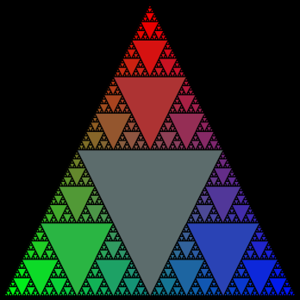
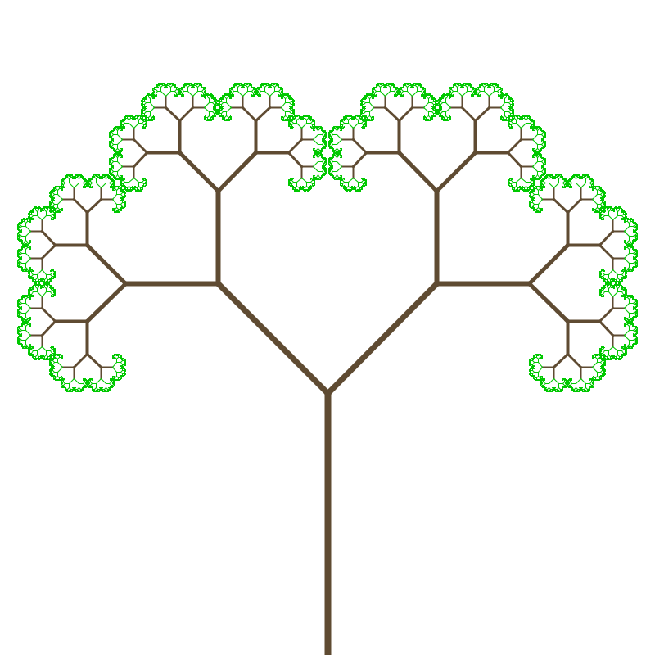
Graphical Examples
Sierpinski triangles
Tree fractals
Koch’s snowflake
Notes:
See Pyramid, Tree and Koch.
The tree is probably the simplest example of self-similarity (because each branch clearly looks like a little tree).
Fibonacci as in class example (routinely defined recursively, but more efficient to use a loop).

