Slide 1
Never in the field of software development was so much owed by so many to so few lines of code.
- Martin Fowler, www.junit.org
Notes:
If you go to junit.org, you'll see a quote from me: "never in the field of software development have so many owed so much to so few lines of code". JUnit has been criticized as a minor thing, something any reasonable programmer could produce in a weekend. This is true, but utterly misses the point. The reason JUnit is important, and deserves the Churchillian knock-off, is that the presence of this tiny tool has been essential to a fundamental shift for many programmers. A shift where testing has moved to a front and central part of programming. People have advocated it before, but JUnit made it happen more than anything else. (from http://martinfowler.com/books.html, 6nov2009)

Slide 2
Software Quality
Introduction
Example
Useful Java features:
Exception Handling
Testing
Debugging
Enumerated Types
Quality – A call to arms
Notes:
Monday – introduction, example, exception handling (It’s hard to get through all of it, but get as far as possible)
Wednesday – testing (try to get through all of unit testing)
Friday – debugging/debugger, quality

Slide 3
Introduction
Our goal is to produce quality software that:
Responds appropriately to anomalous conditions;
Produces correct output behavior.
Java provides tools that can help achieve these goals:
Exception handling helps a program deal with anomalous conditions;
Unit testing helps verify the correctness of a program’s behavior.
Notes:
Validate: the application does what the stakeholders wanted
Verify: the application

Slide 4
Example: Analysis (1)
We’d like to represent and convert temperatures using Celsius, Fahrenheit and Kelvin.
A sketch of a solution achieving this goal is shown here.
Notes:
I can’t remember the correct value for Kelvin in this case!

Slide 5
Example: Design (1)
Elements:
A simple GUI controller;
A temperature class that:
Represents a temperature object;
Performs conversions;
Can be reused.
This system will need to handle bad input.
map from commons.wikimedia.org
Notes:
Can they think of examples of potential bad input? (-1 Kelvin, unsupported scales, e.g., Réaumur, and Rankine)

Slide 6
Iteration 0
Analysis
Design
Implementation
Test
Notes:
Start with a simple Temperature class (Temperature0), a command-line controller (Temperature0ConverterCommandLine) and a GUI (TemperatureConverterController0). Build the temperature and the command line classes by hand. Don’t give much detail on the GUI controller (unless there is time).
Make sure to highlight toString method and explain how Java print calls it.
Explain how the code is built (including a preliminary discussion of the importance of the model-view separation), how it runs, and most importantly how to break it. Test Cases:
0C = 32F = 273.15K
100C = 212F = 373.15K
-273.15C = -459.67F = 0K
Perhaps they won’t think of these anomolous cases – let them get away with it until we have the application running and the proceed to break it easily. Them make them come up with these cases:
Enter a bad scale;
Hit enter on an empty field;
Enter -1 Kelvin;
Enter “zero” into any field.
Show how Java simply dumps the exception message to System.err. Explain how to read these error messages, starting with the most recent level of the call stack. Show also how Eclipse will direct you to the source of such errors (e.g., a null pointer error).

Slide 7
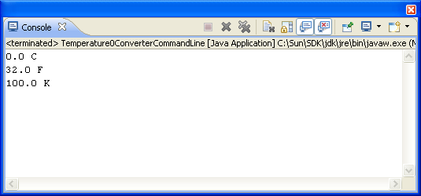
package c09quality.application_temperature;
public class Temperature0ConverterCommandLine {
public static void main(String[] args) throws Exception {
Temperature0 temperature = new Temperature0();
System.out.println(temperature);
temperature.setScale("fahrenheit");
System.out.println(temperature);
temperature = new Temperature0(100.0, "kelvin");
System.out.println(temperature);
}
}
Notes:
This is a simple command line controller to exercise Temperature class objects.
Add a toString() method to the class for printing.

Slide 8
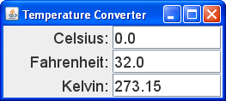
// header commands here...
public class Temperature0ConverterController extends JFrame
implements ActionListener {
private Temperature0 temperature;
private JTextField celsiusField, fahrenheitField, kelvinField;
public Temperature0ConverterController() {
super("Temperature Converter");
setDefaultCloseOperation(EXIT_ON_CLOSE);
setLayout(new GridLayout(3, 1));
Font font = new Font("Ariel", 0, 18);
celsiusField = new JTextField(7);
add(createTemperatureControl("Celsius", celsiusField, font));
fahrenheitField = new JTextField(7);
add(createTemperatureControl("Fahrenheit", fahrenheitField, font));
kelvinField = new JTextField(7);
add(createTemperatureControl("Kelvin", kelvinField, font));
}
private JPanel createTemperatureControl(String name,
JTextField field, Font font) {
JPanel panel = new JPanel();
panel.setLayout(new GridLayout(1, 2));
JLabel label = new JLabel(name + ": ", JLabel.RIGHT);
label.setFont(font);
panel.add(label);
field.setFont(font);
field.setActionCommand(name);
field.addActionListener(this);
panel.add(field);
return panel;
}
@Override
public void actionPerformed(ActionEvent ae) {
String actionEvent = ae.getActionCommand();
double degrees;
if (actionEvent.equalsIgnoreCase("celsius")) {
degrees = Double.parseDouble(celsiusField.getText());
} else if (actionEvent.equalsIgnoreCase("fahrenheit")) {
degrees = Double.parseDouble(fahrenheitField.getText());
} else {
degrees = Double.parseDouble(kelvinField.getText());
}
temperature = new Temperature0(degrees, ae.getActionCommand());
temperature.setScale("celsius");
celsiusField.setText(doubleToString(temperature.getDegrees()));
temperature.setScale("fahrenheit");
fahrenheitField.setText(doubleToString(temperature.getDegrees()));
temperature.setScale("kelvin");
kelvinField.setText(doubleToString(temperature.getDegrees()));
}
private String doubleToString(double value) {
DecimalFormat doubleFormat = new DecimalFormat("#.##");
return doubleFormat.format(value);
}
// Statndard main() method here...
}

Slide 9
public class Temperature0 {
private double myDegrees;
private String myScale;
public Temperature0() {
myDegrees = 0.0;
myScale = "celsius";
}
public Temperature0(double degrees, String scale) {
myDegrees = degrees;
myScale = scale;
}
// accessor methods here...
public void setScale(String scale) {
if (scale.equals("celsius")) {
ConvertToCelsius();
} else if (scale.equals("fahrenheit")) {
convertToFahrenheit();
} else if (scale.equals("kelvin")) {
convertToKelvin();
}
}
private void convertToCelsius() {
if (myScale.equals("fahrenheit")) {
myDegrees = 5.0 / 9.0 * (myDegrees - 32.0);
} else if (myScale.equals("kelvin")) {
myDegrees = myDegrees - 273.15;
}
myScale = "celsius";
}
// two other conversion methods here...
public String toString() {
return getDegrees() + " " +
Character.toUpperCase(getScale().charAt(0));
}
}
Notes:
Mention the overriding of toString() – Java print statements automatically call toString() when asked to print an object.

Slide 10
Exception Handling
Classes may not know how to deal with certain types of problems appropriately.
Java provides exception handling to announce and to deal with such problems:
A class can throw an exception when a problem occurs.
A calling method can catch the exception and deal with the consequences appropriately.
Notes:
In the past we have simply printed an ugly message and stopped the program. This is inappropriately extreme in most cases. The division of labor should be as follows:
Because the class knows its own invariants, it should throw an exception when a problem occurs.
Because the GUI controller (or other calling environment) knows the interface environment, it should deal with the exception appropriately.
The goal is to anticipate all potential problems and deal with them in an explicit way.

Slide 11
Implementing Exceptions
Throwing (or raising) exceptions:
throw new ExceptionType(message);
Catching exceptions:
try {
// method calls that might raise exceptions
} catch (ExceptionType identifier) {
// code to deal with the exceptions
}
Notes:
The catch clause includes an exception type/identifier pair, which is formatted like a parameter.

Slide 12
Exception Hierarchy
Java exceptions are arranged in a class hierarchy.
…
…
…
Notes:
Show how the containment hierarchy is useful for catching either specific or more general exceptions. Note that this is a UML diagram that uses block arrows for inheritance.
You can always catch an Exception, knowing that it will handle all its children.

Slide 13
Multiple Catch Blocks
Using multiple catch blocks:
try {
// method calls that might raise multiple
// types of exceptions...
} catch (ExceptionType1 identifier) {
// code to deal with exceptions of type 1...
} catch (ExceptionType2 identifier) {
// code to deal with exceptions of type 2...
} // and so forth...
Notes:
In this case, it is important to order the catch blocks in order of non-decreasing generality of their exception type (e.g., put IllegalArgument exception after NumberFormatException).

Slide 14
Catch-or-Specify Requirement
Code that might throw an exception must be enclosed in either:
A try-catch block;
A method that specifies a throws clause.
Runtime exceptions are not subject to this requirement.
Notes:
Use the try-catch if your method should deal with the exception; use the throws clause if your code should “pass the buck” on out to the calling program.
Using unchecked exceptions is controversial; we’ll stick with checked exceptions (i.e., non-runtime exceptions) for illustrative purposes.

Slide 15
Iteration 1
Analysis
Design
Implementation
Test
Notes:
Now we start handling the exception conditions (bad numeric input, logically incorrect temperatures).
Start creating iteration 1 by starting with iteration 0 and:
Add a single thrown exception:
a. Add the isValid() method to return true/false based on the scale name (ignore absolute zero).
b. Throw an Exception object in the explicit-value constructor and in the setScale() method.
c. Add the throws clause to the two throwing methods.
d. Add try-catch to the TemperatureConverterController#actionPerformed() method.
e. Add the set field color method to indicate an error condition.
2. Add the absolute zero constraints and modify the thrown exception.
3. Add the second catch block to handle number format exceptions (put it before the general Exception catch block).

Slide 16
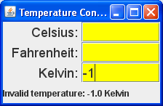
public class Temperature1ConverterController extends and implements clauses {
private JTextField celsiusField, fahrenheitField, kelvinField;
private JLabel messageLabel;
public Temperature1ConverterController() {
super("Temperature Converter");
setDefaultCloseOperation(EXIT_ON_CLOSE);
setLayout(new GridLayout(4, 1));
// previous GUI objects copied here...
messageLabel = new JLabel("Please enter a temperature.");
add(messageLabel);
}
// Utility method copied here...
@Override
public void actionPerformed(ActionEvent ae) {
String actionEvent = ae.getActionCommand();
Temperature1 temperature;
double degrees;
try {
if (actionEvent.equalsIgnoreCase("celsius")) {
degrees = Double.parseDouble(celsiusField.getText());
} else if (actionEvent.equalsIgnoreCase("fahrenheit")) {
degrees = Double.parseDouble(fahrenheitField.getText());
} else {
degrees = Double.parseDouble(kelvinField.getText());
}
temperature = new Temperature1(degrees, ae.getActionCommand());
setFieldColor(Color.WHITE);
setTextFields(temperature);
messageLabel.setText("success...");
} catch (NumberFormatException e) {
setFieldColor(Color.CYAN);
messageLabel.setText("Illegal format: " + e.getMessage());
} catch (Exception e) {
setFieldColor(Color.YELLOW);
messageLabel.setText(e.getMessage());
}
}
private void setFieldColor(Color color) {
celsiusField.setBackground(color);
fahrenheitField.setBackground(color);
kelvinField.setBackground(color);
}
private void setTextFields(Temperature1 temperature) throws Exception {
temperature.setScale("celsius");
celsiusField.setText(doubleToString(temperature.getDegrees()));
temperature.setScale("fahrenheit");
fahrenheitField.setText(doubleToString(temperature.getDegrees()));
temperature.setScale("kelvin");
kelvinField.setText(doubleToString(temperature.getDegrees()));
}
private String doubleToString(double value) {
DecimalFormat doubleFormat = new DecimalFormat("#.##");
return doubleFormat.format(value);
}
// main method copied here...
}
Notes:
Start creating iteration 1 by starting with iteration 0 and:
Add a single thrown exception:
a. Add the isValid() method to return true/false based on the scale name (ignore absolute zero).
b. Throw an Exception object in the explicit-value constructor and in the setScale() method.
c. Add the throws clause to the two throwing methods.
d. Add try-catch to the TemperatureConverterController#actionPerformed() method.
e. Add the set field color method to indicate an error condition.
2. Add the absolute zero constraints and modify the thrown exception.
3. Add the second catch block to handle number format exceptions (put it before the general Exception catch block).

Slide 17
public class Temperature1 {
private final static double ABSOLUTE_ZERO_CELSIUS = -273.15,
ABSOLUTE_ZERO_FAHRENHEIT = -459.67,
ABSOLUTE_ZERO_KELVIN = 0.0;
private double myDegrees;
private String myScale;
public Temperature1() {
myDegrees = 0.0;
myScale = "celsius";
}
public Temperature1(double degrees, String scale) throws Exception {
if (isValid(degrees, scale)) {
myDegrees = degrees;
myScale = scale.toLowerCase();
} else {
throw new Exception("Invalid temperature: " + degrees + " "
+ scale);
}
}
private static boolean isValid(double degrees, String scale) {
if (scale.equalsIgnoreCase("celsius")) {
return degrees >= ABSOLUTE_ZERO_CELSIUS;
} else if (scale.equalsIgnoreCase("fahrenheit")) {
return degrees >= ABSOLUTE_ZERO_FAHRENHEIT;
} else if (scale.equalsIgnoreCase("kelvin")) {
return degrees >= ABSOLUTE_ZERO_KELVIN;
} else {
return false;
}
}
// accessor methods here...
public void setScale(String scale) throws Exception {
if (scale.equalsIgnoreCase("celsius")) {
convertToCelsius();
} else if (scale.equalsIgnoreCase("fahrenheit")) {
convertToFahrenheit();
} else if (scale.equalsIgnoreCase("kelvin")) {
convertToKelvin();
} else {
throw new Exception("Invalid scale: " + scale);
}
}
// three conversion methods copied here...
}

Slide 18
Testing
Testing is a much maligned, but critically important aspect of software development.
Principles:
Test all aspects of the application.
You can’t test every possible case.
Test rigorously.
Test early and test often.

Slide 19
Varieties of Testing
Functional testing
Levels of functional testing:
Unit testing
System testing
Non-functional testing
Types of non-functional testing:
Usability testing
Notes:
Functional testing tests features of the code. Unit testing tests individual units (i.e., classes); system testing tests the system as a whole.
Nonfunctional testing tests other aspects of the application not related to features, e.g., user testing.
There are other levels/types that could be listed – we’ll focus on these in the course.

Slide 20
Unit Testing
Classes are the fundamental program unit.
Manually testing the functions each unit can be both tedious and error-prone.
JUnit provides an automated unit testing framework for Java applications.

Slide 21
Iteration 2
Analysis
Design
Implementation
Test
Notes:
Now we use the command-line harness to test the Temperature class/unit manually.

Slide 22
package c09quality.application_temperature;
import java.util.Scanner;
public class Temperature1ConverterCommandLine {
public static void main(String[] args) throws Exception {
System.out.print(“Temp (e.g. 98.6 fahrenheit): ");
Scanner keyboard = new Scanner(System.in);
Temperature1 temperature = new
Temperature1(keyboard.nextDouble(),
keyboard.next());
System.out.println("\t" + temperature);
System.out.print("Convert to (e.g., celsius): ");
temperature.setScale(keyboard.next());
System.out.println("\t" + temperature + "\n" + "finis");
}
}
Notes:
This code manually tests the Temperature class/unit. It is very much like the TemperatureConsole built in iteration 0, except that now we program it to read the test cases from the user manually – Note that it doesn’t test the user interface (the view), only the computations (the model).
JUnit provides a mechanism to automate model tests like this.

Slide 23
Implementing JUnit Tests
JUnit test class pattern:
import org.junit.Test;
public class ClassTestName {
testMethods
}
Distinguish:
Model
View(s)
Notes:
Models and views:
The model is tool implementation. (no I/O here)
The view is the visible interface to the tool. (no computation here, but interface)
Advantages:
Better modularization.
You can create multiple views on the same model (e.g., a GUI driver and a command-line driver).
You can more easily Unit test the model (GUIs are harder to test).
For us, the V and C in MVC will be melded together.

Slide 24
Implementing JUnit Tests (cont.)
Test method pattern:
@Test
public void methodTestName() {
assertCommands
}
Assert commands signal unit test failures when their assertions are not satisfied.
Assert Command patterns:
assertTrue(booleanExpression)
assertEquals(expr1, expr2, [delta])
fail(messageString)
Notes:
You can find a complete API reference for JUnit assert commands here: http://junit.org/apidocs/org/junit/Assert.html

Slide 25
Iteration 3
Analysis
Design
Implementation
Test
Notes:
Now we build an automated JUnit test for the Temperature class.
It is very important to think about the test cases here. What should we test? E.g.:
default constructor values;
explicit value constructor for 3 scales, small and large values;
explicit value constructor with bad scales and/or bad values;
good temperatures with good setScale() values;
goo temperatures with bad setScale() values.

Slide 26
package c09quality.application_temperature;
import static org.junit.Assert.assertEquals;
import static org.junit.Assert.assertTrue;
import static org.junit.Assert.fail;
import org.junit.Test;
public class Temperature1Test {
private static final double DOUBLE_EPSILON = 1e-3;
@Test
public void doNothingTest() {
assertTrue(true);
assertEquals(1, 1);
}
@Test
public void defaultConstructorTest() {
Temperature1 t = new Temperature1();
assertEquals(0.0, t.getDegrees(), DOUBLE_EPSILON);
assertEquals("celsius", t.getScale());
}}

Slide 27
Testing Thrown Exceptions
Exceptions can (and should) be tested.
Pattern:
try {
someMethod(badArguments);
fail(message);
} catch (ExceptionType e) {
// We should catch an exception so
// do nothing here.
}
Notes:
Note:
The bad arguments here should lead to the raising of an exception.
If we don’t get thrown to the catch expression, we should fail() the test.
We can just leave the catch expression empty because getting there means that everything worked properly.

Slide 28
private void badTemperatureConstructionUtility
(double degrees, String scale) {
try {
new Temperature1(degrees, scale);
fail("inappropriately constructed a "
+ degrees + " degree " + scale
+ " Temperature");
} catch (Exception e) {
// It should throw this exception!
}
}
Notes:
Discuss the alternative where an exception is thrown, and shouldn’t be. Where does the fail expression appear in that case?

Slide 29
package c09quality.application_temperature;
// imports copied here...
public class Temperature1Test {
// previous tests copied here...
@Test
public void explicitConstructorTest() {
try {
Temperature1 t = new Temperature1(0.0, "celsius");
assertEquals(0.0, t.getDegrees(), DOUBLE_EPSILON);
assertEquals("celsius", t.getScale());
t = new Temperature1(273.15, "kelvin");
assertEquals(273.15, t.getDegrees(), DOUBLE_EPSILON);
assertEquals("kelvin", t.getScale());
t = new Temperature1(32.0, "fahrenheit");
assertEquals(32.0, t.getDegrees(), DOUBLE_EPSILON);
assertEquals("fahrenheit", t.getScale());
} catch (Exception e) {
fail("Failed explicit constructors test...");
}
badTemperatureConstructionUtility(-1.0, "kelvin");
badTemperatureConstructionUtility(-274.0, "celsius");
badTemperatureConstructionUtility(-460.0, "fahrenheit");
badTemperatureConstructionUtility(-460.0, "blob");
goodTemperatureConstructionUtility(10000.5, "celsius");
goodTemperatureConstructionUtility(10000.5, "Fahrenheit");
goodTemperatureConstructionUtility(10000.5, "KELVIN");
}
private void goodTemperatureConstructionUtility(double degrees, String scale) {
try {
new Temperature1(degrees, scale);
} catch (Exception e) {
fail("failed good temperature test...");
}
}
private void badTemperatureConstructionUtility(double degrees, String scale) {
try {
new Temperature1(degrees, scale);
fail("inappropriately constructed a " + degrees + " degree "
+ scale + " Temperature");
} catch (Exception e) {
// It should throw this exception!
}
}
// additional tests copied here...
}

Slide 30
package c09quality.application_temperature;
// imports copied here...
public class Temperature1Test {
// previous tests copied here...
@Test
public void mutatorGoodTest() {
try {
Temperature1 t = new Temperature1();
t.setScale("fahrenheit");
assertEquals(32.0, t.getDegrees(), DOUBLE_EPSILON);
t.setScale("Kelvin");
assertEquals(273.15, t.getDegrees(), DOUBLE_EPSILON);
t = new Temperature1(373.15, "kelvin");
t.setScale("fahrenheit");
assertEquals(212.0, t.getDegrees(), DOUBLE_EPSILON);
t.setScale("CELSIUS");
assertEquals(100.0, t.getDegrees(), DOUBLE_EPSILON);
t = new Temperature1(-273.15, "celsius");
t.setScale("fahrenheit");
assertEquals(-459.67, t.getDegrees(), DOUBLE_EPSILON);
t.setScale("Kelvin");
assertEquals(0.0, t.getDegrees(), DOUBLE_EPSILON);
t = new Temperature1(1799540.33, "fahrenheit");
t.setScale("Celsius");
assertEquals(999726.85, t.getDegrees(), DOUBLE_EPSILON);
t.setScale("kelvin");
assertEquals(1000000.0, t.getDegrees(), DOUBLE_EPSILON);
} catch (Exception e) {
fail("Failed mutator test");
}
}
@Test
public void mutatorBadTest() {
Temperature1 t;
try {
t = new Temperature1();
t.setScale("blob");
fail("Failed mutator test");
} catch (Exception e) {
// This should throw an exception.
}
}
}

Slide 31
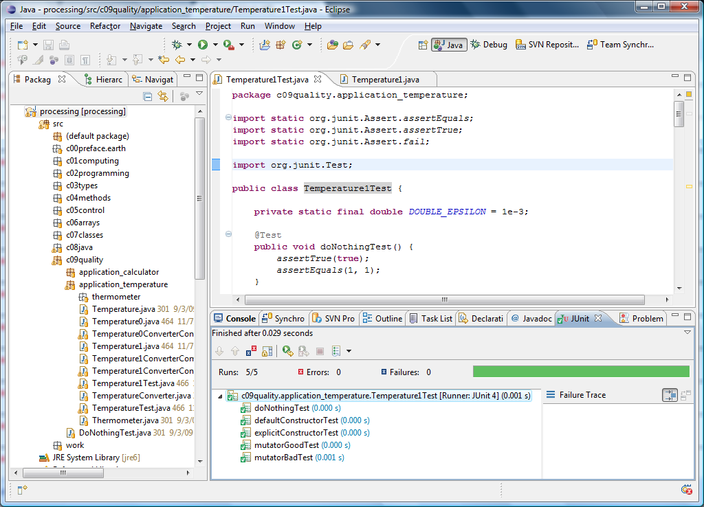
Running the Tests

Slide 32
Testing vs. Debugging
Testing is the process of finding faults.
Debugging is the process of fixing faults, commonly done using:
Execution by hand;
Normal execution with trace statements;
Step-by-step execution with a debugger.
Notes:
We’ll assume here that the program compiles.
Here’s Jeremy’s list of debugging techniques:
Exceptions use the data that they give to you. (using trace statements)
Output statements crude, but can be effective. (using trace statements)
Use a debugger to watch your program as it executes. (using the debugger)
Spaniel method explain the program to your pet. (using contemplation)
Take a shower 5% of all bugs are fixed this way. (using contemplation)

Slide 33
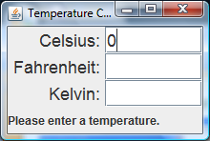
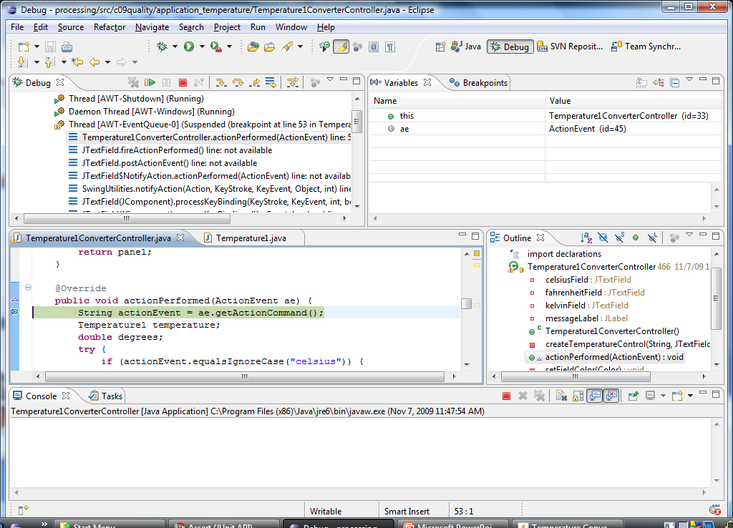
Using the Eclipse Debugger
Notes:
Do some demo of the debugger, perhaps on the if-then-else statements found in calculator lab exercise (lab8).

Slide 34
Iteration 4
Analysis
Design
Implementation
Test
Notes:
Introduce enumerated types to the Temperature class to more effectively prevent users of the Temperature API from specifying incorrect types.
See Temperature2-related classes.

Slide 35
Enumerated Types
Enumerated types specify objects that must have one of a fixed set of values.
Java specifies enumerations using enum.
Enumerated type values are accessed as constants.
Notes:
Explain why it is more efficient – it only tests the condition once and then does a single branch to the correct statementList.
As a general rule, use the most specific tool for the job; it can help the compiler to know more about what you are actually doing.
Examples:
CLI driver uses a switch (on input character)
GUI driver uses an if (on action “command”)
model uses a switch (on guess number)

Slide 36
Enumerated Types Example
public static enum ScaleName {
FAHRENHEIT, CELSIUS, KELVIN
}
private double myDegrees;
private ScaleName myScale;
public Temperature2() {
myDegrees = 0.0;
myScale = ScaleName.CELSIUS;
}
Notes:
Enumerated types can be:
Easier to read and write;
Safer to use than unrestricted strings or integers.

Slide 37
package c09quality.application_temperature;
public class Temperature2 {
// absolute value constants copied here...
public static enum ScaleName {
FAHRENHEIT, CELSIUS, KELVIN
}
private double myDegrees;
private ScaleName myScale;
public Temperature2() {
myDegrees = 0.0;
myScale = ScaleName.CELSIUS;
}
public Temperature2(double degrees, ScaleName scale) throws Exception{
if (isValid(degrees, scale)) {
myDegrees = degrees;
myScale = scale;
} else {
throw new Exception("Invalid temperature: " +
degrees + " " + scale);
}
}
private static boolean isValid(double degrees, ScaleName scale) {
if (scale == ScaleName.CELSIUS) {
return degrees >= ABSOLUTE_ZERO_CELSIUS;
} else if (scale == ScaleName.FAHRENHEIT) {
return degrees >= ABSOLUTE_ZERO_FAHRENHEIT;
} else if (scale == ScaleName.KELVIN) {
return degrees >= ABSOLUTE_ZERO_KELVIN;
} else {
return false; // will never happen...
}
}
public void setScale(ScaleName scale) throws Exception {
if (scale == ScaleName.CELSIUS) {
convertToCelsius();
} else if (scale == ScaleName.FAHRENHEIT) {
convertToFahrenheit();
} else if (scale == ScaleName.KELVIN) {
convertToKelvin();
}
}
// mode code copied here...
}

Slide 38
package c09quality.application_temperature;
import static c09quality.application_temperature.Temperature2.ScaleName.CELSIUS;
import static c09quality.application_temperature.Temperature2.ScaleName.FAHRENHEIT;
import static c09quality.application_temperature.Temperature2.ScaleName.KELVIN;
// other imports included here...
public class Temperature2ConverterController extends JFrame
implements ActionListener {
// other methods included here...
@Override
public void actionPerformed(ActionEvent ae) {
String actionCommand = ae.getActionCommand();
double degrees;
messageField.setText("");
try {
if (actionCommand.equalsIgnoreCase("celsius")) {
degrees = Double.parseDouble(celsiusField.getText());
temperature = new Temperature2(degrees, CELSIUS);
} else if (actionCommand.equalsIgnoreCase("fahrenheit")) {
degrees = Double.parseDouble(fahrenheitField.getText());
temperature = new Temperature2(degrees, FAHRENHEIT);
} else if (actionCommand.equalsIgnoreCase("kelvin")) {
degrees = Double.parseDouble(kelvinField.getText());
temperature = new Temperature2(degrees, KELVIN);
}
} catch (Exception e) {
messageField.setText("Illegal input: " + e.getMessage());
}
if (temperature != null) {
temperature.setScale(CELSIUS);
thermometer.setTemperature(temperature.getDegrees());
celsiusField.setText(new
Double(temperature.getDegrees()).toString());
temperature.setScale(FAHRENHEIT);
fahrenheitField.setText(new
Double(temperature.getDegrees()).toString());
temperature.setScale(KELVIN);
kelvinField.setText(new
Double(temperature.getDegrees()).toString());
}
}
}
// other methods included here...
}
Notes:
Note here how it is syntactically illegal to specify the wrong temperature scale.

Slide 39
Quality Goals
Correctness
Efficiency
Usability
Understandability
Notes:
Your goal is not to get the program running, it’s to get it RIGHT.

Slide 40
Eric Gamma & Kent Beck
What’s the
Big Idea
JUnit is a regression testing framework that automates the construction/execution of test cases for Java applications.
"Never in the field of software development was so much owed by so many to so few lines of code" – Martin Fowler
images from www.junit.org, June., 2006
Notes:
This tool revolutionized my approach to programming.
This is an example of the power of intelligent abstractions.

