Slide 1
A common mistake people make when trying to design something completely foolproof is to underestimate the ingenuity of complete fools.
- Douglas Adams, Mostly Harmless, 1992
Notes:
Science finds, Industry applies, Man Conforms. – 1933 World’s Fair Motto (quoted by Donald A. Norman)

Slide 2
Transition to Java
Java Programming
JavaDoc
Java GUI Programming
Interactive Computing
Notes:
Week 1 – the Java programming and JavaDoc sections; iterations 0 and 1.
Week 2 – the Java GUI programming sections
Monday – iteration 2
Wednesday – iteration 3 (cover iteration 4 if there is time)
Friday – review

Slide 3
Java Programming
Java is the general-purpose programming language on which Processing is based.
Java provides some advantages:
Notes:
Will have to add slides here about Java’s more object-oriented aspects that Processing downplays.
Advantages:
Java is more general-purpose than Processing;
Java provides a more complete GUI API;
Java uses more pre-built libraries;
Java is more scalable (e.g., Processing’s use of inner classes);
Java currently has a larger variety of better IDEs (and this will likely always be the case).

Slide 4
Iteration 0
Analysis
Design
Implementation
Test
Notes:
Build a console-based program that reads a temperature value in Celcius and prints out its Farenheit equivalent.
See TemperatureConverter.java.
Design:
Prompt user
Get input from user
Compute conversion using f = 9/5*C + 32
Print converted value with description

Slide 5
Java Console Applications
Java applications can be built as text-based, command-line interfaces.
Java uses the following pre-defined classes for text-based input and output:
Scanner
System.out
Notes:
The Scanner is a class that supports flexible input of words, lines, numbers, etc.
System.out supports output using print() and println() (just like the Processing methods of the same name).

Slide 6
package edu.calvin.cs108;
import java.util.Scanner;
/**
* TemperatureConverter converts Celsius temperatures to Fahrenheit.
* This routine assumes that the user enters a valid temperature.
*
* @author kvlinden
* @version Summer, 2006
*/
public class TemperatureConverter {
public static final String PROMPT = "Please enter the temperature in Celsius:";
public static void main(String[] args) {
System.out.print(PROMPT);
Scanner keyboard = new Scanner(System.in);
double celsius = keyboard.nextDouble();
double fahrenheit = ((9.0 / 5.0) * celsius) + 32;
System.out.print(celsius + " degrees Celsius is " + fahrenheit
+ " degrees Fahrenheit.\n");
}
}
Notes:
Go through this simple, console-based example in detail, pointing out:
Eclipse IDE
Package declaration
Documentation
Libraries
The main class (everything is in the class)
The main method (Note that the name of the class matches the name of the file. Java requires this.)
The 4 steps of the algorithm
The Scanner class parses whole words/numbers rather than doing in one character at a time.
Java programs more often use double rather than float.
Run the program on some standard test cases (e.g., 0->32, 100->212, -17.7777->0).

Slide 7
Java and Objects
Java is a more purely object-oriented language, e.g.:
Java programs are objects;
The keyboard and screen are objects;
Objects are manipulated with references.
The Processing environment hid some of these details.
Notes:
Review the features of the console-based program with respect to these features:
The program is implemented as a class.
System and Scanner are classes and contain data items (e.g., System.in) and methods (Scanner#print()).
Processing hid these facts from us.
Java is not purely object-oriented because it still retains the primitive types (int, double, boolean, char).

Slide 8
Instance versus Class Members
Java allows data and methods to be associated with either:
A particular object, or
The class as a whole.
Instance members are defined for each object of a class.
Class members are marked as static and are shared by all objects of a class.
Static methods only reference static data.
Notes:
Processing didn’t allow us to declare static members in classes because it implements its classes as inner classes. The students don’t need to know this, but this why we must wait until now to explain static members.

Slide 9
Referencing Members
Instance members are referenced using the object identifier.
objectIdentifier.memberIdentifier
Class members are referenced using the class identifier.
ClassIdentifier.memberIdentifier
Notes:
Examples:
instance member references: keyboard.readDouble()
class member references: TemperatureConverter.PROMPT, TemperatureConverter.main(), Math.PI

Slide 10
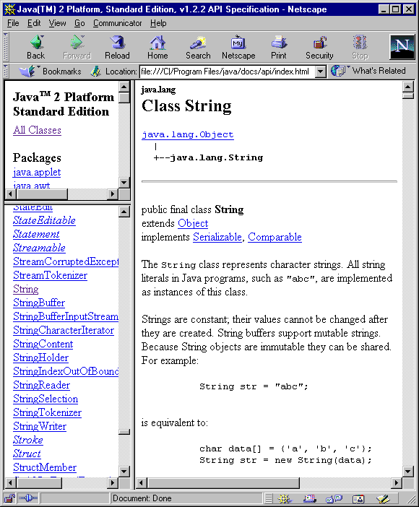
JavaDoc
What’s the
Big Idea
Application Programmers Interface (API) documentation is one critical aid in using a common abstraction.
JavaDoc is a Java tool designed to automate the construction of API documentation.
Notes:
Java has over 1600 classes for you to use - you’ll never remember them all. E.g., many languages have a string library, and they are all similar but not identical. Here’s the javadoc string manual: http://java.sun.com/j2se/1.5.0/docs/api/index.html
This is a key part of the quest to build ever more useful/powerful abstractions. The Java String API is anything but vague – refer back to the Dijkstra this week.

Slide 11
JavaDoc: Comments
JavaDoc supports comments for classes, methods, instance variables.
JavaDoc comments include:
A general description of the component written in HTML;
Additional tagged information for:
@author
@version
@param
@return
Notes:
Go through these, noting the following about tagged values:
They are all optional
They can take most any HTML-formatted text
They can be repeated, e.g., there is a separate @param for every parameter, each of which includes the name and a short description.

Slide 12
JavaDoc: Example
package c08java.text_examples;
import java.util.Scanner;
/**
* TemperatureConverter converts Celsius temperatures to Fahrenheit. This
* routine assumes that the user enters a valid temperature.
*
* @author kvlinden
* @version 23august2009
*/
public class TemperatureConverter {
/**
* This string prompt illustrates a static data member.
*/
public static final String PROMPT = "Please enter the temperature in Celsius:";
/**
* The main method implements the temperature conversion using console-base input and output.
*
* @param args these command line arguments are ignored
*/
public static void main(String[] args) {
System.out.print(PROMPT);
Scanner keyboard = new Scanner(System.in);
double celsius = keyboard.nextDouble();
double fahrenheit = ((9.0 / 5.0) * celsius) + 32;
System.out.print(celsius + " degrees Celsius is " + fahrenheit + " degrees Fahrenheit.\n");
}
}
Notes:
To demo, From Project – Generate JavaDoc.

Slide 13
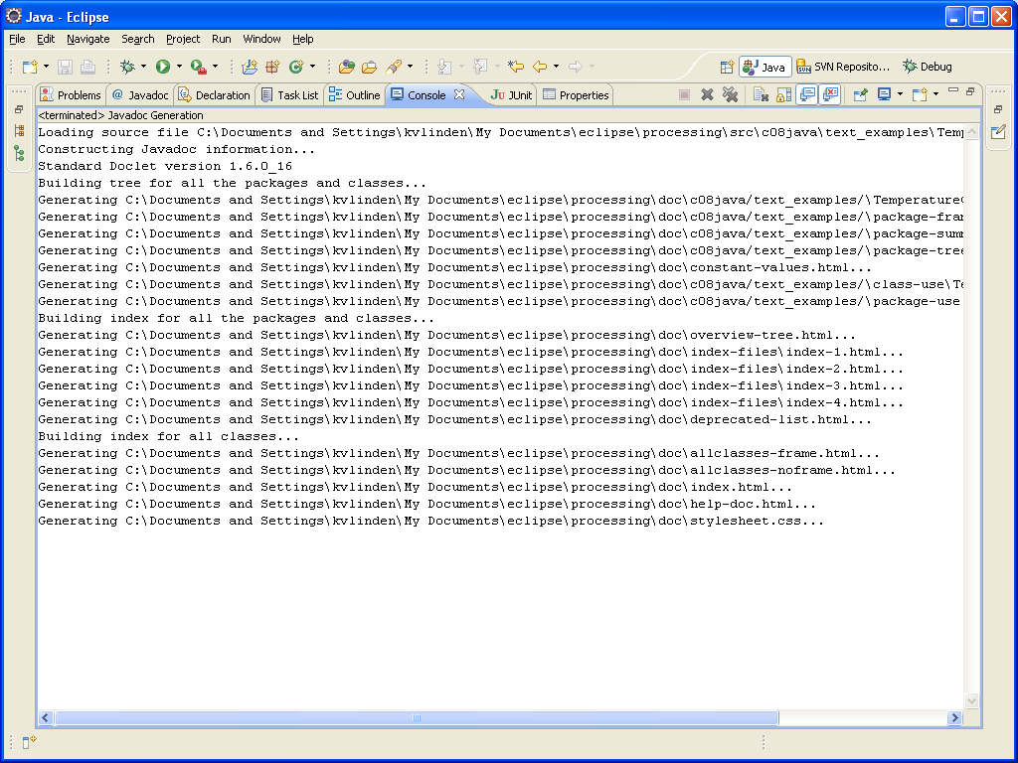
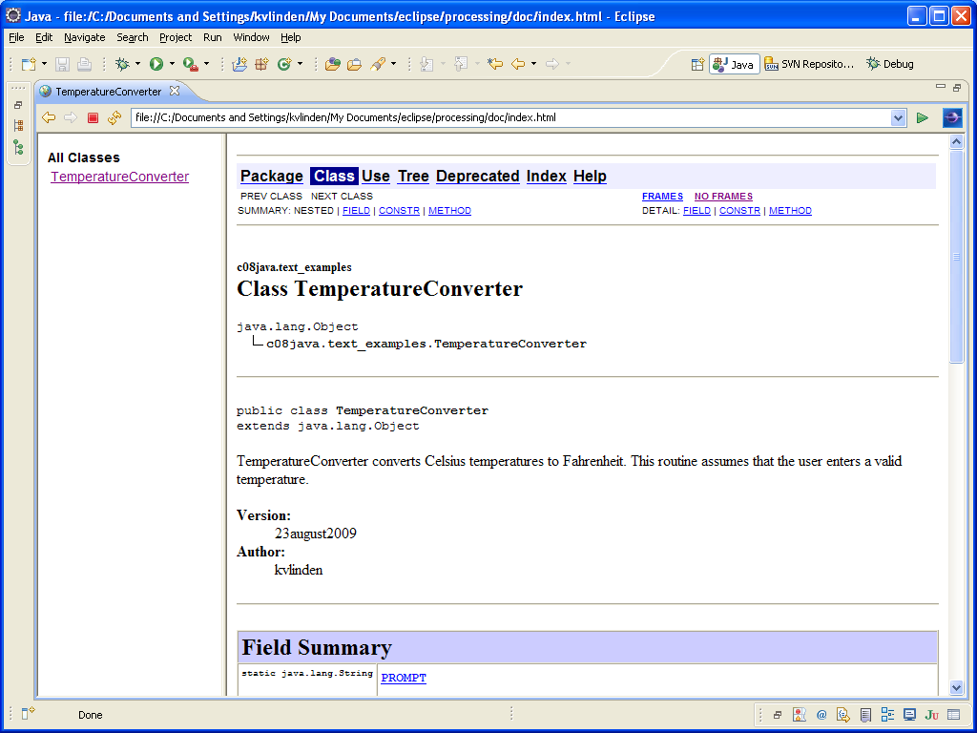
JavaDoc: Generation
Notes:
Choose “Project”-”Generate JavaDoc”.

Slide 14
Java GUI Programming
Graphical user interfaces (GUIs) are a standard application for object-oriented programming.
Outline:
Example
GUI Design
Java GUI Implementation
Notes:
GUI design is a “classic” application for OOP

Slide 15
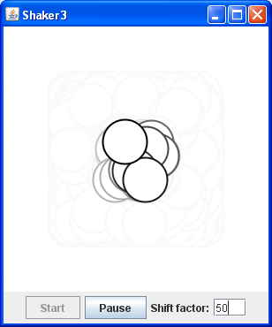
Example: Analysis (1)
We’d like to build a controller for a shaking circle animation application.
A sample image of this goal is shown here.

Slide 16
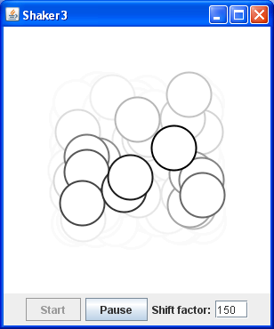
Example: Design (1)
Elements:
Present the shaking circle animation in the same way that the Processing application did;
Provide a control panel that specifies:
the maximum shake factor;
start/pause buttons.

Slide 17
GUI Design
If the user can’t figure the interface out, it doesn’t matter how good the program is.
An interface must be usable:
Include the information users need; leave out the information they don’t need.
Be consistent from one window to another.
Use commonly known interface patterns.
Give feedback.
Put the user in control.
Notes:
Scheiderman’s 8 golden rules of interface design:
1. Strive for Consistency.
2. Enable Frequent Users to Use Shortcuts.
3. Offer Informative Feedback.
4. Design Dialogs to Yield Closure.
5. Offer Error Prevention and Simple Error Handling.
6. Permit Easy Reversal of Actions.
7. Support Internal Locus of Control.
8. Reduce Short-Term Memory Load.

Slide 18
Designing User Interaction
Raindrop animation @ given frame rate
Pause the
animation.
Raindrop animation
– paused –
##
##
Exit.
Reset animation
to new frame rate.
Reset animation
to first image.
Restart the
animation.

Slide 19
Java GUI Implementation
Java GUIs are built using Java Foundation Classes (JFC) and, in particular, the Java Swing GUI classes.
GUI programs make use of inheritance.
Notes:
Inheritance relieves us of the responsibility of programming many of the standard GUI features and behaviors.
GUI classes are often called “widgets”.

Slide 20
Building a GUI Controller
All Java GUIs are built within frames.
To build a frame, implement a class that:
inherits from the JFrame class;
includes a main() method.
The main method implements the following algorithm:
Construct the frame object;
Assembles the frame’s GUI components;
Set the frame as visible.
Notes:
This is a rather simple extension of the interation 0 console-based application.

Slide 21
Inheritance
Inheritance allows us to build “child” classes as extensions of “parent” classes.
Child classes inherit their parent’s data and methods.
Inheritance is specified using the extends clause.
Notes:
Inheritance, one of the three key features of OO programming, relieves us of the responsibility of programming many of the standard GUI features and behaviors.
We often draw inheritance relationships using the UML diagram shown here.

Slide 22
Iteration 1a
Analysis
Design
Implementation
Test
Notes:
Build an empty GUI controller – a JFrame application with just the main method containing a call to the default ShakerController constructor and the setVisible(). You can either write an empty default constructor or use the one that Java automatically creates for you; I prefer the former.
Show how it runs – expand the window to full screen to show that it’s there but (currently) empty.
Take this opportunity to show how to run things in the IDE (e.g., the run and stop buttons).
Remind students where we’re headed: getting processing program wrapped up as Java.

Slide 23
Integrating Processing & Java
You can integrate a Processing sketch into a Java GUI as follows:
Encapsulate the Processing sketch as an object that inherits from PApplet;
Construct that object and add it to the GUI controller frame build in iteration 1a.
Notes:
We implement the GUIController and SketchPanel, and inherit all the members of Jframe and PApplet (which, by the way, is a child of Applet and grandchild or JPanel). It’s the PApplet features that support the Processing animation and the JPanel features that allow us to include the sketch in the Java frame.
We deal with “supporting” classes in Processing later in these slides (it’s harder).

Slide 24
Encapsulating a Sketch
Processing sketches are implemented as classes that inherit from PApplet.
You can encapsulate sketches as follows:
Create a new class that extends PApplet and contains the Processing sketch code;
Mark the pre-defined Processing methods (e.g., setup() and draw() ) as public;
Treat the sketch variables as instance data and add constructors, accessors and mutators as needed.
Notes:
Demo this one step at a time. Add a default constructor and an explicit-value constructor that receives the frame rate.
Change the variable names to private my* instance variables to match our convention from chapter 7.

Slide 25
Iteration 1b
Analysis
Design
Implementation
Test
Notes:
Build a Java-fied version of the shaker app. (see ShakerController1.java).
This illustrates the work that the Processing IDE automatically does behind the scenes to implement our sketches in the Java environment.
Be careful to note the use the Controller class and the Panel class. They must be used consistently and properly.
Note that the controller must init() the panel object. The panel inherits the init() method from Applet.
We’ll discuss the add() method in the next iteration. It is inherited from JFrame.
pack() and setVisible() are also inherited from JFrame

Slide 26
package c08java.shaker;
import javax.swing.JFrame;
/**
* ShakerController1 is a simple version of a Java controller for the Processing shaking circle
* application. It provides a simple Jframe in which to run the original application as it runs
* in Processing.
*
* @author kvlinden
* @version Fall, 2009
*/
public class ShakerController1 extends JFrame {
private ShakerPanel1 shakerPanel;
public ShakerController1() {
setTitle("Shaker1");
setDefaultCloseOperation(EXIT_ON_CLOSE);
shakerPanel = new ShakerPanel1(5);
shakerPanel.init();
add(shakerPanel);
}
public static void main(String[] args) {
ShakerController1 controller = new ShakerController1();
controller.pack();
controller.setVisible(true);
}
}
Notes:
Be careful to note the use the Controller class and the Panel class. They must be used consistently and properly.
Note that the controller must init() the panel object. The panel inherits the init() method from Applet.
We’ll discuss the add() method in the next iteration. It is inherited from JFrame.
pack() and setVisible() are also inherited from JFrame.

Slide 27
package c08java.shaker;
import processing.core.PApplet;
/**
* ShakerPanel1 is a simple Java encapsulation of the original shaker animation from Processing.
* It draws a shaking circle and allows the user to reposition the circle using a mouse click.
*
* @author kvlinden
* @version Fall, 2009
*/
public class ShakerPanel1 extends PApplet {
private static final int SIZE = 300;
private int myShift;
public ShakerPanel1(int shift) {
myX = myY = SIZE / 2;
myShift = shift;
}
public void setup() {
size(SIZE, SIZE);
smooth();
}
public void draw() {
background(255);
strokeWeight(2);
ellipse(myX + random(-myShift / 2, myShift / 2), myY + random(-myShift / 2, myShift / 2),
50, 50);
}
public void mousePressed() {
myX = mouseX;
myY = mouseY;
}
}
Notes:
Build this code by hand using the process specified above.

Slide 28
Java Foundation Classes
The Java Foundation Classes (JFC) Swing library provides a library of classes for GUI implementation.
The most useful for us will be those for:
JButton
JLabel
JTextField
JFrame
JPanel
Notes:
Again, motivate with wanted to control the shaker application.
http://java.sun.com/products/jfc/

Slide 29
Java’s Event Model
Java GUIs commonly implement user interaction using action listeners.
To use an action listener, a frame must:
Include a constructor method that:
creates GUI objects that generate events;
registers a listener for each event generator.
Defines listener objects that listen for and respond to GUI events.
Notes:
Processing hides much of the power/complexity of Java’s event model.
For the frame constructor, we will do the following:
implement GUI objects as JFC/Swing widgets;
define an actionPerformed() method for the GUI controller class itself.
register listeners using addActionListener().
See the code for examples of all this.

Slide 30
Action Listeners
GUI objects that generate events must register an action listener.
guiObject.addActionListener(actListObject)
Listener objects are defined as classes that:
Implement the ActionListener interface;
Override the actionPerformed() method.
We use the controller object itself (denoted this) as the action listener object.
Notes:
A Java interface is a class that declares a set of methods that an implementing class must define.

Slide 31
Classes versus Interfaces
Our GUI controller class does the following:
Extends the JFrame class;
Implements the ActionPerformed interface.
An interface specifies a set of methods that an implementing class must implement.
Notes:
An interface is a protocol or promissory note.
Example, the ActionPerformed interface requires that the class implement actionPerformed(). This allows Java to use it as a action listener.

Slide 32
Iteration 2
Analysis
Design
Implementation
Test
Notes:
Add a simple textfield-based controller to control the shift limit (see ShakerController2.java).
Controller changes:
Add one JFC text field widget (using the default layout manager and add()).
Add an action listener that sets the panel’s frame rate (using implements, addListener(), actionPerformed()).
Panel changes:
Add a setFrameRate() mutator method in the Panel class.
Processing did these things for us, but its GUI features were limited.

Slide 33
Layout Managers
Java provides a variety of layout managers that pack components in a GUI frame.
BorderLayout() – components added at compass positions (north, south, east, west, center);
FlowLayout() – components are added left-to-right, top-to-bottom;
BoxLayout() – components added in horizontal or vertical box;
GridLayout(m,n) – components are added on a grid of m×n equal sized cells;
GridBagLayout – The most flexible (and complicated) layout manager.
Notes:
Motivate: Text is nice, sometimes buttons are nicer. How do we indicate where to put them?
BorderLayout is the default (as we saw above).

Slide 34
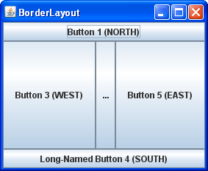
package c08java.lecture_examples;
import java.awt.BorderLayout;
import javax.swing.*;
public class BorderWindow extends JFrame {
public BorderWindow() {
setTitle("BorderLayout");
setDefaultCloseOperation(EXIT_ON_CLOSE);
// setLayout(new BorderLayout()); This is actually the default.
add(new JButton("Button 1 (NORTH)"), BorderLayout.NORTH);
add(new JButton("2 (CENTER)"), BorderLayout.CENTER);
add(new JButton("Button 3 (WEST)"), BorderLayout.WEST);
add(new JButton("Long-Named Button 4 (SOUTH)"), BorderLayout.SOUTH);
add(new JButton("Button 5 (EAST)"), BorderLayout.EAST);
}
public static void main(String args[]) {
BorderWindow controller = new BorderWindow();
controller.pack();
controller.setVisible(true);
}
}
Notes:
BorderLayout gives you vertical and horizontal control.
Talk through the code noting:
The GUI is layed out in the BorderWindow contructor function, not the main driver.
The driver just creates the GUI object, starts it, and gets out of the way.
The method calls in the constructor all have an implicit this.

Slide 35
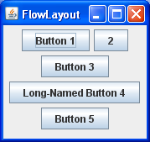
package c08java.lecture_examples;
import java.awt.FlowLayout;
import javax.swing.JButton;
import javax.swing.JFrame;
public class FlowWindow extends JFrame {
public FlowWindow() {
setTitle("FlowLayout");
setDefaultCloseOperation(EXIT_ON_CLOSE);
setLayout(new FlowLayout());
add(new JButton("Button 1"));
add(new JButton("2"));
add(new JButton("Button 3"));
add(new JButton("Long-Named Button 4"));
add(new JButton("Button 5"));
}
public static void main(String args[]) {
FlowWindow controller = new FlowWindow();
controller.pack();
controller.setVisible(true);
}
}
Notes:
FlowLayout provides rather simple adjacency formatting.

Slide 36
Iteration 3
Analysis
Design
Implementation
Test
Notes:
Add start/pause buttons and a label for the frame rate text field (see ShakerController3.java).
This requires the use of an hierarchical GUI frame structure built using nested GUI components.

Slide 37
Containment
application
(a JFrame)
shakerPanel
(a JPanel)
controlPanel
(a JPanel)
startButton
(a JButton)
pauseButton
(a JButton)
shiftLabel
(a JLabel)
shiftField
(a JTextField)

Slide 38
Distinguishing User Events
actionPerformed() can be called to handle events generated by multiple objects.
To distinguish which object event to handle:
It receives an event object from the JRE.
The event object’s getActionCommand() method returns the name of the event, called an action command.
Each GUI class has its own way to specifying the action command.
Notes:
JButton text strings decorate the button and serve as the button object’s action command.
In general, GUI widget classes allow you to specify their action command string.

Slide 39
ShakerController3()
JPanel controlPanel = new JPanel(new FlowLayout());
startButton = new JButton("Start");
startButton.setEnabled(false);
startButton.addActionListener(this);
controlPanel.add(startButton);
pauseButton = new JButton("Pause");
pauseButton.setEnabled(true);
pauseButton.addActionListener(this);
controlPanel.add(pauseButton);
controlPanel.add(new JLabel("Shift factor:"));
add(controlPanel, BorderLayout.SOUTH);
...
actionPerformed()
public void actionPerformed(ActionEvent e) {
if (e.getActionCommand().equalsIgnoreCase("start")) {
startButton.setEnabled(false);
pauseButton.setEnabled(true);
}
...
}
Notes:
Explain how the Start button action command is handled.
Give handout, have them try to fill in the blanks for the pause button.
Then show the full code in the final example code, which includes all the action commands.

Slide 40
public class ShakerController3 extends JFrame
implements ActionListener {
private ShakerPanel3 shakerPanel;
private JTextField shiftField;
private JButton startButton, pauseButton;
public ShakerController3() {
setTitle("Shaker3");
setDefaultCloseOperation(EXIT_ON_CLOSE);
shakerPanel = new ShakerPanel3(5);
shakerPanel.init();
add(shakerPanel);
JPanel controlPanel = new JPanel(new FlowLayout());
startButton = new JButton("Start");
startButton.setEnabled(false);
startButton.addActionListener(this);
controlPanel.add(startButton);
pauseButton = new JButton("Pause");
pauseButton.setEnabled(true);
pauseButton.addActionListener(this);
controlPanel.add(pauseButton);
controlPanel.add(new JLabel("Shift factor:"));
shiftField = new JTextField(3);
shiftField.setText("5");
controlPanel.add(shiftField);
shiftField.addActionListener(this);
add(controlPanel, BorderLayout.SOUTH);
}
public void actionPerformed(ActionEvent e) {
if (e.getActionCommand().equalsIgnoreCase("start")) {
shakerPanel.setRunning(true);
startButton.setEnabled(false);
pauseButton.setEnabled(true);
} else if (e.getActionCommand().equalsIgnoreCase("pause")) {
shakerPanel.setRunning(false);
startButton.setEnabled(true);
pauseButton.setEnabled(false);
} else {
int newShift = Integer.parseInt(shiftField.getText());
shakerPanel.setShift(newShift);
}
}
public static void main(String[] args) {
ShakerController3 controller = new ShakerController3();
controller.pack();
controller.setVisible(true);
}
}
Notes:
The controller is the same as above.

Slide 41
public class ShakerPanel3 extends PApplet {
private static final int SIZE = 300;
private int myX, myY, myShift;
private boolean myRunningStatus;
public ShakerPanel3(int shift) {
myX = myY = SIZE / 2;
myShift = shift;
myRunningStatus = true;
}
public void setShift(int shift) {
if (shift < 0) {
System.out.println("invalid shift value: "
+ shift);
exit();
}
myShift = shift;
}
public void setRunning(boolean status) {
myRunningStatus = status;
}
public void setup() {
size(SIZE, SIZE);
smooth();
}
public void draw() {
if (myRunningStatus) {
background(255);
strokeWeight(2);
ellipse(myX + random(-myShift / 2, myShift / 2),
myY + random(-myShift / 2, myShift / 2), 50, 50);
}
}
public void mousePressed() {
myX = mouseX;
myY = mouseY;
}
}

Slide 42
More JFC
The Swing GUI classes provide a variety of other GUI components.
The GUI slider component, for example is implemented using ChangeListener and the stateChanged() method.
Java provides good reference and tutorial materials for JFC and Swing, e.g.:
http://java.sun.com/docs/books/tutorial/ui/features/components.html
Notes:
http://java.sun.com/products/jfc/

Slide 43
Iteration 4
Analysis
Design
Implementation
Test
Notes:
Replace the controller with a slider if there is time (see ShakerController4.java).

Slide 44
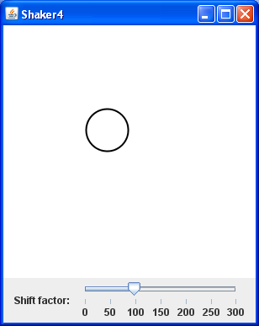
ShakerController4()
JSlider slider = new JSlider(JSlider.HORIZONTAL, 0,DEFAULT_SIZE, INITIAL_SHIFT);
slider.setMajorTickSpacing(50);
slider.setPaintTicks(true);
slider.setPaintLabels(true);
slider.addChangeListener(this);
...
stateChanged()
@Override
public void stateChanged(ChangeEvent e) {
JSlider slider = (JSlider) e.getSource();
int value = slider.getValue();
shakerPanel.setShift(value);
}
Notes:
Be careful to note the use the Controller class and the Panel class. They must be used consistently and properly.
Note the implements class for action listeners. This is an interface, not class inheritance. We won’t address this distinction in this course.

Slide 45
Classes in Java vs. Processing
Processing implements “auxiliary” classes as inner classes.
This approach:
grants the supporting class an intimate, highly coupled relationship with the main sketch;
doesn’t scale well to larger applications;
is uncommon in Java programming.
We integrate them as separate classes.

Slide 46
Integrating Processing Classes
Integrate Processing classes into a Java as you did with the main sketch, except:
Encapsulate the support class as a class that extends Object (only);
Pass a reference to the PApplet object to the display() method.
Notes:
Note that you could view Processing classes as being drawn inside the sketchPanel class – for scalability, Java moves them out.
In addition, you may have to modify the code in the following ways:
Use Math and System library methods/variables rather than protected PApplet methods/variables;
Java defaults to double rather than float.
Treat color as an integer and move all use of the color() method to display() (or render()).
Show code for variation 5.

Slide 47
public class ShakerPanel5 extends PApplet {
private int mySize, myX, myY, myShift;
private boolean myRunningStatus;
private Figure myFigure;
public ShakerPanel5(int size, int shift) {
mySize = size;
myShift = shift;
myRunningStatus = true;
}
// ... repeated code removed for space ...
public void setup() {
size(mySize, mySize);
smooth();
myFigure = new Figure(mySize / 2, mySize / 2, 50, 5);
}
public void draw() {
if (myRunningStatus) {
background(255);
myFigure.render(this);
}
}
}
Notes:
The controller is the same as above.

Slide 48
public class Figure {
private int myX, myY, myDiameter, myShift;
public Figure(int x, int y, int diameter, int shift) {
myX = x;
myY = y;
myDiameter = diameter;
myShift = shift;
}
public void render(PApplet p) {
p.strokeWeight(2);
p.ellipse(myX + p.random(-myShift / 2, myShift / 2),
myY + p.random(-myShift / 2, myShift / 2),
myDiameter, myDiameter);
}
}
Notes:
Basic changes:
Sequestered all the color and drawing calls to display();
Passed a reference to the PApplet object to display();
Replaced references to Math methods/data with Math library calls (re-implementing computeDistance())

Slide 49
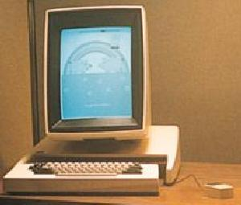
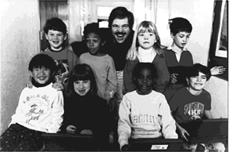
Alan Kay the Alto
What’s the
Big Idea
The Alto incorporated the first GUI interface.
It was developed at Xerox PARC in the early 1980’s.
Steve Jobs took the idea to Apple for its Macintosh computers.
"Only people born before a technology is invented think of it as a technology"
images from www.parc.xerox.com
Notes:
Remind them that OO really took hold in GUIs (smalltalk) (review encaps/inherit/polym). It was very natural there to think of objects that were like other objects, but with a few extensions.

