Slide 1
All our knowledge brings us nearer to our ignorance,
All our ignorance brings us nearer to death,
But nearness to death, no nearer to God.
Where is the Life we have lost in living?
Where is the wisdom we have lost in knowledge?
Where is the knowledge we have lost in information?
The cycles of Heaven in twenty centuries
Bring us farther from God and nearer to the Dust.
- T. S. Eliot, Choruses From ‘The Rock’, Selected Poems
(New York: Harcourt, Brace & World, 1964), p. 107.
Notes:
One might add, “where is the information we have lost in data?”.

Slide 2
Arrays and Files
Example
One-Dimensional Arrays
Loading Arrays from Files
Multi-dimensional Arrays

Slide 3
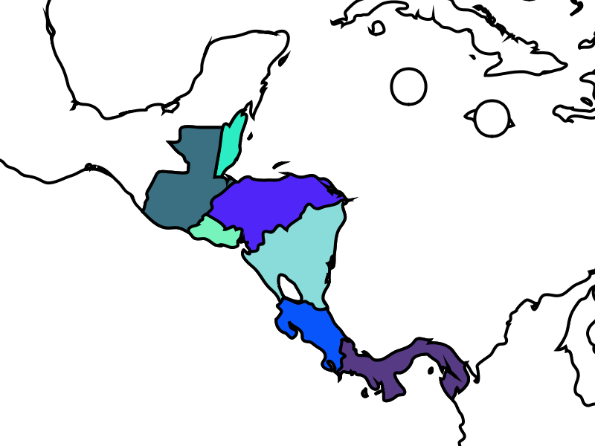
Example: Analysis (1)
We’d like to present relative national population data for Central America.
We should see the data elements geographically.
A sample image is shown here.
map from commons.wikimedia.org
Notes:
We’ll focus on Central America. Can you name these countries?
Guatemala(GT) Belize(BZ)
El Salvador(SV) Honduras(HN)
Nicaragua(NI)
Costa Rica(CR)
Panama(PA)

Slide 4
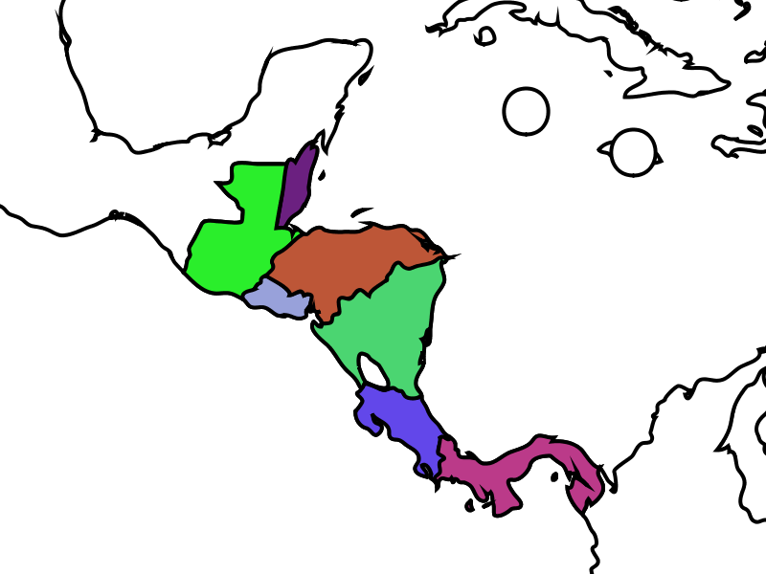
Example: Analysis (1)
The program should:
Represent the lists of data;
Process the elements of those data;
Store the data permanently;
Present the data geographically.
map from commons.wikimedia.org

Slide 5
Representing Lists of Objects
Frequently, applications must store lists of objects of the same type.
Variables represent one object at a time so a list would require separate variables:
String country1, country2, country3;
Processing represents lists of objects using arrays.
Notes:
Analysis item 1 – represent lists of data

Slide 6
Array Definition Pattern
ElementType[] arrayName;
or
ElementType[] arrayName = new ElementType[length];
or
ElementType[] arrayName = arrayLiteral;
ElementType is any type (including an array type);
arrayName is the handle for the array object being defined – if there is no assignment clause in the statement, the handle value is set to null;
length is an expression specifying the number of elements in the array;
arrayLiteral is the list of literal of type ElementType, enclosed in curly braces ({ }).
Notes:
Note that ElementType[] is also a type and can thus be used as a type anywhere (parameters, return values, variable declarations, etc).

Slide 7
Array Definitions
double[] array1;
final int SIZE = 4;
int[] array2 = new int[SIZE];
String[] array3 = { "Bashful", "Doc" };
array1
array2
[0] [1] [2] [3]
? ? ? ?
array3
[0] [1]
“Bashful” “Doc”
Notes:
Here are 3 of the declaration forms for the Processing/Java standard array. There are some issues here:
Java arrays are objects, so they are accessed via handles.
Predefined sizes (the default is 0, a null pointer)
Predefined values can be assigned with array literals (the default should not be assumed)
Indexes start with 0 (not 1).
“new” allocates new memory at run time
Java arrays of primitive types are stored as values, objects in an array are stored via handles.
Why do they do this? Why not just put the strings “in-line” like the primitive objects? – to make indexing more efficient

Slide 8
Array Subscripts
String[] anArray = new String[2];
anArray[0] = "Grumpy";
anArray[1] = "Happy";
println(anArray[1]);
anArray
[0] [1]
“Grumpy” “Happy”
Notes:
This prints Happy on the text output screen.
The pattern here is:
identifier[index]
Question: Create new (empty) array called array1. What will array1[0] return?
Answer: The dreaded null-pointer error!
Moral: Declare AND initialize before accessing array elements.

Slide 9
Working with Arrays
String[] anArray = new String[2];
anArray[0] = "Grumpy";
anArray[1] = "Happy";
for (int i = 0; i < anArray.length; i++) {
println(anArray[i]);
}
anArray
[0] [1]
“Grumpy” “Happy”
Notes:
This prints:
Grumpy
Happy
(and then quits!)
Note the use of length (not length()!). This is an irritating inconsistency in Processing/Java, but it can’t be helped at this point.

Slide 10
Iteration 1 (cont.)
Analysis
Design
Implementation
Test
Notes:
See centralAmericaPopulationData.pde.
Analysis – We’ll represent the country names/population data and print them out.
Design –
Define arrays for country names and population data (need to orthogonal)
For each country :
a. Print name and population data (on the same line)
Implementation – do this without setup() or draw().
Test – Should see the data from the program printed out properly.

Slide 11
String[] countries =
{ "Belize", "Costa Rica", "El Salvador",
"Guatemala", "Honduras", "Nicaragua",
"Panama" };
int[] populations =
{ 294385, 4133884, 6948073, 12728111,
7483763, 5675356, 3242173 };
for (int i = 0; i < countries.length; i++) {
println(countries[i] + ": " + populations[i]);
}
Notes:
Demonstrate this: Do just the populations first, then add the country names.
The indexes must correspond between the two arrays (i.e., the population for countries[0] better be populations[0]).
Output:
Belize: 294385
Costa Rica: 4133884
El Slavador: 6948073
Guatemala: 12728111
Honduras: 7483763
Nicaragua: 5675356
Panama: 3242173

Slide 12
Iteration 2
Analysis
Design
Implementation
Test
Notes:
See centralAmericaPopulationData.pde.
Analysis – Compute the total population of CA.
Design – Add a new method using the “accumulator pattern”
Receive values, an array of integer values, from the calling program
Set result = 0
For each value:
Set result = result + value[i]
Return result
Implementation – will need to add setup() and new method for this.
Test – Should get the same answer as in Wikipedia (actually, wikipedia is wrong about this one).

Slide 13
Arrays as Parameters
int computeTotal(int[] values) {
int result = 0;
for (int i = 0; i < values.length; i++) {
result += values[i];
}
return result;
}
Notes:
Demonstrate this:
Start with simple sum, then try removing/changing the array elements and try 0 elements
Upgrade to compute the average, then try 0 elements (add if statement to protect against division by 0).

Slide 14
Reference Values as Parameters
void draw() {
String[] sa = {"Grumpy", "Happy"};
changeStringArray(sa);
println(sa);
}
void changeStringArray(String[] sa) {
sa[0] = "Dopey";
sa[1] = "Sleepy";
println(sa);
}
Notes:
Demonstrate this and draw a picture of the reference type array to show how the original array actually gets changed even though the array reference is passed by value.

Slide 15
Exercises
Notes:
Have them do some sample exercises here:
Search through an array of the dwarves ages and find the oldest (or youngest) dwarf.
Compute the average of the dwarves ages.

Slide 16
Persistent Storage
Problems with our current approach to data processing:
Data must be hard-coded into the program;
Data stored during the execution of a program is lost when the program exits.
Processing supports persistent storage using files.
Notes:
Problems:
- it’s a big pain to enter data into a program, and redo the program every time the data changes.
- Data is also lost when the power goes out, or the operating system crashes, or your roommate kicks the plug out of the wall, or when your battery goes dead, or when the program crashes, …

Slide 17
Saving Text Data
Program: dwarfOutput.pde
String[] dwarves = new String[2];
dwarves[0] = "Grumpy";
dwarves[1] = "Happy";
saveStrings("data/dwarves.txt", dwarves);
Output: dwarves.txt
Grumpy
Happy
Notes:
saveStrings() is a simple utility method that saves an array of strings to a text file one element per line.

Slide 18
Loading Text Data
Input: dwarves.txt
Bashful
Doc
Program: dwarfInput.pde
String[] dwarves;
dwarves = loadStrings("data/dwarves.txt");
Notes:
loadStrings() is a simple utility method that loads an array of strings from a text file one element per line.

Slide 19
Loading Numeric Data
Input: ages.txt
127
324
Program: agesInput.pde
String[] ageLines;
ageLines = loadStrings("data/ages.txt");
int[] ages = new int[ageLines.length];
for (int i = 0; i < ageLines.length; i++) {
ages[i] = int(ageLines[i]);
}
Notes:
This data file contains numeric data on each line. Processing’s load and store methods only work with strings (because these are text files).
If there is time, add the computation of the minimum and/or maximum age value.

Slide 20
Loading Mixed Data
Input: dwarfData.txt
Bashful 127
Doc 324
Program: dwarfDataInput.pde
String[] dwarfLines, tokens;
dwarfLines = loadStrings("data/dwarfData.txt");
int[] dwarfAges = new int[dwarfLines.length];
String[] dwarfNames = new String[dwarfLines.length];
for (int i = 0; i < dwarfLines.length; i++) {
tokens = split(dwarfLines[i], " ");
dwarfNames[i] = tokens[0];
dwarfAges[i] = int(tokens[1]);
}
Notes:
This data file contains both text and numeric data on each line. Processing’s load and store methods only work with strings (because these are text files).
Walk through this processing on the board, drawing out the text file, all of the arrays (with indexes), and labelling arrows with method calls (e.g., loadStrings(), split(), etc.).

Slide 21
Iteration 3
Analysis
Design
Implementation
Test
Notes:
See centralAmericaPopulationData.pde
Analysis – Load all the population and country name data from a file.
Design – Add a new method:
Receive data filename
Load the lines of the data file.
Initialize country names and population values arrays to the numberof lines in the file.
For each line from the file:
Split the line based on a space character.
Set countryname[i] = line token #1
Set data value to integer version of line token #2
Return result
Implementation – Will need to create a data file for this (see populationData.txt)
Test – Should get all the same output as before (it’s just the input that has changed).

Slide 22
void loadPopulationData(String dataFilename) {
String[] dataLines = loadStrings(dataFilename);
populationCountries =
new String[dataLines.length];
populationValues = new int[dataLines.length];
String[] tokens;
for (int i = 0; i < dataLines.length; i++) {
tokens = split(dataLines[i], " ");
populationCountries[i] = tokens[0];
populationValues[i] = int(tokens[1]);
}
}
Notes:
Demonstrate this.

Slide 23
Iteration 4
Analysis
Design
Implementation
Test
Notes:
See centralAmericaPopulationMap.pde
Analysis – Show the data on the map.
Design – Add new setup() logic:
Load a world SVG map.
Load the CA population data.
Add a new draw() logic:
Display the world map (scaled to show Central America).
For each country in CA:
Get the SVG child for that country (indexed by country name).
Set the color of that country proportional to its population.
Implementation – Will need to create a data file for this (see populationCAISO.txt) and work with SVG images.
Test – Should get a pretty map with Belize the whitest and Guatemala the darkest shades of blue.

Slide 24
/* centralAmericaPopulationMap displays the
* population of the seven Central American
* countries using data from Wikipedia.
*
* data:
* http://en.wikipedia.org/wiki/Central_america
* world image:
* http://commons.wikimedia.org/wiki/File:BlankMap-World6.svg
* country codes:
* see http://www.iso.org/iso/iso_3166_code_lists
*
* @author: kvlinden
* @version 24july2009
*/
PShape world;
String[] populationLines, populationCountries;
float[] populationValues;
float maximumPopulation, minimumPopulation ;
void setup() {
size(800, 600);
world = loadShape("BlankMap-World6.svg");
// world.disableStyle();
loadPopulationData("populationCAISO.txt");
smooth();
noLoop();
}
Continued

Slide 25
void draw() {
background(255);
translate(-2100, -2250);
scale(4.0);
shape(world);
float intensityValue;
PShape country;
for (int i = 0; i < populationCountries.length; i++) {
country = world.getChild(populationCountries[i].toLowerCase());
if (country != null) {
country.disableStyle();
intensityValue = map(populationValues[i], minimumPopulation ,
maximumPopulation , 0, 255);
fill(255 - intensityValue, 255 - intensityValue, 255);
//fill(random(255), random(255), random(255));
shape(country);
}
}
}
void loadPopulationData(String filename) {
String[] aLine;
populationLines = loadStrings(filename);
populationCountries = new String[populationLines.length];
populationValues = new float[populationLines.length];
maximumPopulation = Integer.MIN_VALUE;
minimumPopulation = Integer.MAX_VALUE;
for (int i = 0; i < populationLines.length; i++) {
aLine = split(populationLines[i], " ");
populationCountries[i] = aLine[0];
populationValues[i] = float(aLine[1]);
if (populationValues[i] > maximumPopulation ) {
maximumPopulation = populationValues[i];
}
if (populationValues[i] < minimumPopulation ) {
minimumPopulation = populationValues[i];
}
}
}

Slide 26
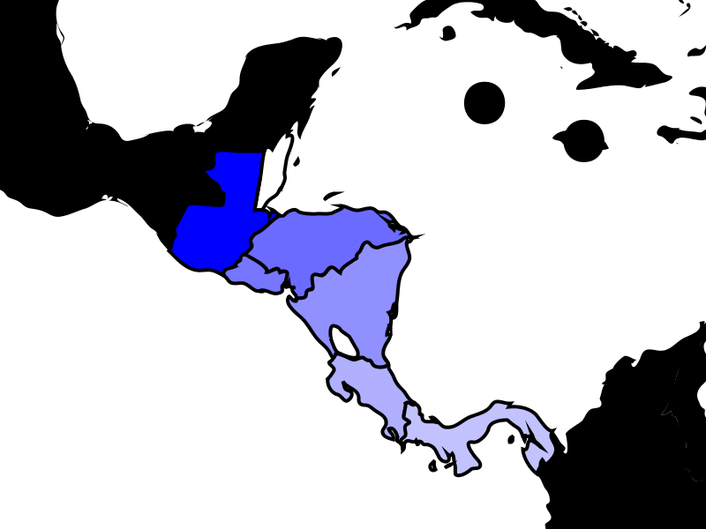
Notes:
So how does this code change if instead of population, we want to show life expectancy?
This is the average life expectancy data for 2007 taken from GapMinder’s spreadsheet of the original UN data.

Slide 27
Iteration 5
Analysis
Design
Implementation
Test
Notes:
Have students explain differences from population data code. How does data file change? what about the rest of the code?
Show them the full life-expectancy data map of the world.
See expectancyMap.pde.
This example combines elements from the lecture and the text.

Slide 28
Notes:
This is the average life expectancy data for 2007 taken from GapMinder’s spreadsheet of the original UN data.

Slide 29
/* expectancyMap displays the world with color based on average
* life-expectancy data from GapMinder.
*
* data:
* http://www.gapminder.org/gapminder-world/documentation/
* world image:
* http://commons.wikimedia.org/wiki/File:BlankMap-World6.svg
* country codes:
* see http://www.iso.org/iso/iso_3166_code_lists
*
* @author: kvlinden
* @version 19july2009
*/
PShape world, country;
String[] expectancyLines, expectancyCountries;
float[] expectancyValues;
float maximumExpectancy, minimumExpectancy;
void setup() {
size(1125, 590);
world = loadShape("BlankMap-World6-small.svg");
// world.disableStyle();
loadExpectancyData("expectancyISO.txt");
smooth();
noLoop();
}
void draw() {
background(255);
shape(world);
float intensityValue;
for (int i = 0; i < expectancyCountries.length; i++) {
country = world.getChild(expectancyCountries[i].toLowerCase());
if (country != null) {
country.disableStyle();
intensityValue = map(expectancyValues[i], minimumExpectancy,
maximumExpectancy, 0, 255);
fill(255 - intensityValue, 255 - intensityValue, 255);
shape(country);
}
}
}
Continued

Slide 30
Continued
void loadExpectancyData(String filename) {
String[] aLine;
expectancyLines = loadStrings(filename);
expectancyCountries = new String[expectancyLines.length];
expectancyValues = new float[expectancyLines.length];
maximumExpectancy = Integer.MIN_VALUE;
minimumExpectancy = Integer.MAX_VALUE;
for (int i = 0; i < expectancyLines.length; i++) {
aLine = split(expectancyLines[i], " ");
expectancyCountries[i] = aLine[0];
expectancyValues[i] = float(aLine[1]);
if (expectancyValues[i] > maximumExpectancy) {
maximumExpectancy = expectancyValues[i];
}
if (expectancyValues[i] < minimumExpectancy) {
minimumExpectancy = expectancyValues[i];
}
}
println("max: " + maximumExpectancy + " min: " + minimumExpectancy);
}

Slide 31
Multi-Dimensional Data
Some data sets cannot be represented with single-dimensional arrays.
Examples:
Notes:
Matrixes, sudoku puzzles, tictactoe games, chess, checkers, etc.
Spreadsheets are generally two dimensional.
Databases are generally X dimensional where X > 2.

Slide 32
Multi-Dimensional Arrays
Some data collections, like the Sudoku grid can be viewed as multi-dimensional data.
Declaring 2-D arrays:
type[][] identifier = arrayExpression;
Constructing 2-D arrays:
new type[totalRows][totalColumns]
Accessing 2-D array elements:
identifier[someRow][someColumn]
This can be generalized to more dimensions.

Slide 33
Iteration 6
Analysis
Design
Implementation
Test
Notes:
Show the 2d data from the text life-expectancy example.
There may not be time for this example.

Slide 34
Notes:
Demonstrate this.
This is the average life expectancy data for 2007 taken from GapMinder’s spreadsheet of the original UN data.

Slide 35
/* expectancyChartAnimation displays an animated bar graph of part of
* GapMinder's life-expectancy data for 2007 (see
* http://www.gapminder.org/gapminder-world/documentation/).
*
* @author kvlinden
* @version 20july2009
*/
String[] expectancyLines, expectancyCountries, expectancyYears;
float[][] expectancyValues;
String source = "GapMinder.com, 2009";
int barHeight = 25, barWidthUnit = 3, labelWidth = 50, maximumAge = 90, headerSize = 25, footerSize = 100;
int width, height, frameCount;
PFont headerFont, font;
void setup() {
loadExpectancyData("expectancyValues.txt", "expectancyCountries.txt", "expectancyYears.txt");
width = barWidthUnit * maximumAge + labelWidth + 1;
height = barHeight * expectancyCountries.length + footerSize;
size(width, height);
headerFont = loadFont("Calibri-Bold-14.vlw");
font = loadFont("Calibri-12.vlw");
frameRate(1);
frameCount = 0;
}
void draw() {
background(255);
drawHeader("Average Life Expectancy in Years (" + expectancyYears[frameCount] + ")");
//drawHeader("Average Life Expectancy in Years");
drawBarGraph(expectancyValues[frameCount], expectancyCountries);
drawSummaryStatistics(expectancyValues[frameCount]);
frameCount++;
if (frameCount >= expectancyYears.length) {
noLoop();
}
}
void drawHeader(String headerText) {
textFont(headerFont);
fill(0);
textAlign(LEFT, TOP);
text(headerText, 10, 5);
}
Continued

Slide 36
void drawBarGraph(float[] values, String[] labels) {
textFont(font);
textAlign(RIGHT, TOP);
for (int i = 0; i < values.length; i++) {
// Draw the bar
fill(234, 189, 90);
rect(labelWidth, i * barHeight + headerSize, values[i] * barWidthUnit, barHeight);
// Write the label and numeric value.
fill(0);
text(labels[i], labelWidth - 5, i * barHeight + 5 + headerSize);
text(values[i], labelWidth + values[i] * barWidthUnit - 5, i * barHeight + 5 + headerSize);
}
}
void drawSummaryStatistics(float[] values) {
textFont(font);
fill(0);
textAlign(LEFT, TOP);
text("Average: " + computeAverage(values), labelWidth, height - footerSize + headerSize + 12);
text("Maximum Value: " + computeMaximum(values), labelWidth, height - footerSize + headerSize + 24);
text("Minimum Value: " + computeMinimum(values), labelWidth, height - footerSize + headerSize + 36);
text("Data Source: " + source, labelWidth, height - footerSize + headerSize + 55);
}
float computeAverage(float[] values) {
if ((values == null) || (values.length <= 0)) {
return 0.0;
}
float sum = 0.0;
for (int i = 0; i < values.length; i++) {
sum += values[i];
}
return sum / values.length;
}
Continued

Slide 37
float computeMaximum(float[] values) {
if ((values == null) || (values.length <= 0)) {
return 0.0;
}
float maximum = Integer.MIN_VALUE;
for (int i = 0; i < values.length; i++) {
if (values[i] > maximum) {
maximum = values[i];
}
}
return maximum;
}
float computeMinimum(float[] values) {
if ((values == null) || (values.length <= 0)) {
return 0.0;
}
float minimum = Integer.MAX_VALUE;
for (int i = 0; i < values.length; i++) {
if (values[i] < minimum) {
minimum = values[i];
}
}
return minimum;
}
void loadExpectancyData(String valuesFilename, String countriesFilename, String yearsFilename) {
expectancyCountries = loadStrings(countriesFilename);
expectancyYears = loadStrings(yearsFilename);
expectancyLines = loadStrings(valuesFilename);
expectancyValues = new float[expectancyLines.length][expectancyCountries.length];
String[] tokens;
for (int i = 0; i < expectancyLines.length; i++) {
tokens = split(expectancyLines[i], " ");
for (int j = 0; j < tokens.length; j++) {
expectancyValues[i][j] = float(tokens[j]);
}
}
}

Slide 38
Data Management
Storing, retrieving and manipulating data sets are very common problems.
Database Management Systems are designed to address these problems.
Database
Files
Records
Fields
Characters/Strings/Integers
Bits
Notes:
Note that databases (data sets) are just higher in the data hierarchy than files. We’ve worked in this class with everything below databases.

Slide 39
The Relational Data Model
Most current DBMSs use the relational data model.
Relational models separate the structure of the data from the data itself.
Schema: Data:
Field | Field Type
ID | int
First Name | String
Last Name | String
Nickname | String
ID | FirstName | LastName | Nickname
111223333 | Steve | Schultze | Zee
666554444 | Jeff | Plantinga | Plant
777889999 | Ryan | Tuuk | Tuuk
333221111 | Shelley | Nagel | mom
444556666 | Adam | Bultman | theMan
Notes:
This way, you wouldn’t have to recompile the program to reorder the fields or change one of their types.
Yes, I’m ignoring the variable-length URL field – that creates problems that we’ll deal with in other classes.

Slide 40
Structured Query Language
SQL is the standard query language for relational databases.
Example:
SQL> SELECT firstName, lastName
FROM StudentTable
WHERE ID > 600000000;
FIRSTNAME LASTNAME
--------- --------
Jeff Plantinga
Ryan Tuuk
Notes:
This way, you wouldn’t have to recompile the program to reorder the fields or change one of their types.

Slide 41
Edgar F. Codd (1923-2003) Relational Data Model
Codd developed the relational model in the early 1970s.
Included features for:
Data definition
Data queries
Most current database systems use the relational model.
image from wikipedia, June, 2006
Notes:
Edgar F. (Ted) Codd - won the ACM Turing award in 1981 for his work on the Relational Data model.

Slide 42
Privacy
What’s the
Big Idea
Database systems allow us to build and maintain large data sets:
This can be useful for many applications.
It can also be dangerous.
Guidelines:
Collect only what you need to collect.
Have a clear policy on what information is collected and on how it is used.
Keep the data accurate and secure.
Notes:
Large databases that contain “personal” information can be dangerous. The Europeans are particularly sensitive to this given that it is well-known that the Nazis used telephone records to track down Jews. Consider the PagePanopticon database – What data does it need to maintain? What should and shouldn’t it do with that data? Are there any potential misuses to which that data could be put? How could you secure the data?

