Slide 1
recursion n. See recursion. See also tail recursion.
- The Jargon Dictionary, v. 4.2.2
Notes:
Do a Google search on the term “recursion”.

Slide 2
Additional Control Structures
Advanced control statements:
Selection: Switch statement;
Repetition: Non-counting loops.
Recursion
Notes:
Monday – Selection/repetition statements
Wednesday – Recursion
Friday – Final project pointer (depending on semester schedule) and retrospective

Slide 3
The switch Statement
Multi-alternative selection can be implemented using:
The multi-branch if statement
The switch statement
The multi-branch if statement can always be used.
The switch statement is a specialized form that operates more efficiently under certain circumstances.
Notes:
They’ve used multi-branch ifs before (e.g., Temperature#setScale(), Calculator#calculate()).
Show them the day ordinal converter program as an example (c05 – textExamples - SwitchConsole#convertIf()) – Use the debugger to show the execution.

Slide 4
switch: Syntax and Behavior
switch (expression) {
case value₁:
statementList₁
case value₂:
statementList₂
…
default:
statementList_{n}
}
Requirements:
expression must be integer compatible;
values must be constants or literals;
Cases check for equality.
expression
StatementList₁
value₁
StatementList₂
value₂
otherwise
StatementList_{n}
Notes:
Illustrate the restrictions in the example:
Strings are not integer compatible types (e.g., int, char, boolean, NOT string, real).
The switch statement can be:
easier to read and write;
more efficient to execute.
Example: show SwitchConsole#convertSwitch()

Slide 5
switch & if: Examples
if (dayCode == 1) {
System.out.println("Sunday");
} else if (dayCode == 2) {
System.out.println("Monday");
} else if (dayCode == 3) {
System.out.println("Tuesday");
} else if (dayCode == 4) {
System.out.println("Wednesday");
} else if (dayCode == 5) {
System.out.println("Thursday");
} else if (dayCode == 6) {
System.out.println("Friday");
} else if (dayCode == 7) {
System.out.println("Saturday");
} else {
System.out.println("invalid code);
}
switch (dayCode) {
case 1:
System.out.println("Sunday");
break;
case 2:
System.out.println("Monday");
break;
case 3:
System.out.println("Tuesday");
break;
case 4:
System.out.println("Wednesday");
break;
case 5:
System.out.println("Thursday");
break;
case 6:
System.out.println("Friday");
break;
case 7:
System.out.println("Saturday");
break;
default:
System.out.println("invalid code");
}
Notes:
These statements have the same behavior. The text includes a pattern for this example that could be helpful.
Draw lines connecting the common code and control.

Slide 6
switch: Fall-Through Behavior
The switch statement implemented fall-through behavior.
More than one case can be associated with one statement list.
If only one list is to be executed, then that list must explicitly exit the switch using:
break
return
throw
exit
Notes:
Note the break statements in the example switch statement.
Example: show SwitchConsole#convertSwitchCombine() (to illustrate the combination of cases, a natural result of drop-through behavior)
Example 2: show SwitchConsole#convertSwitchCombineReturn() (to illustrate the use of return rather than break)

Slide 7
switch: Examples
switch (dayCode) {
case 1:
System.out.println("Sunday");
break;
case 2:
System.out.println("Monday");
break;
case 3:
System.out.println("Tuesday");
break;
case 4:
System.out.println("Wednesday");
break;
case 5:
System.out.println("Thursday");
break;
case 6:
System.out.println("Friday");
break;
case 7:
System.out.println("Saturday");
break;
default:
System.out.println("invalid code");
}
switch (dayCode) {
case 1:
case 7:
System.out.println("weekend");
break;
case 2:
case 3:
case 4:
case 5:
case 6:
System.out.println("weekday");
break;
default:
System.out.println("invalid code");
}
Notes:
This switch statement is copied from before.

Slide 8
package c09quality.application_temperature;
public class Temperature2 {
// absolute value constants copied here...
public static enum ScaleName {
FAHRENHEIT, CELSIUS, KELVIN
}
private double myDegrees;
private ScaleName myScale;
public Temperature2() {
myDegrees = 0.0;
myScale = ScaleName.CELSIUS;
}
public Temperature2(double degrees, ScaleName scale) throws Exception{
if (isValid(degrees, scale)) {
myDegrees = degrees;
myScale = scale;
} else {
throw new Exception("Invalid temperature: " +
degrees + " " + scale);
}
}
private static boolean isValid(double degrees, ScaleName scale) {
switch (scale) {
case CELSIUS:
return degrees >= ABSOLUTE_ZERO_CELSIUS;
case FAHRENHEIT:
return degrees >= ABSOLUTE_ZERO_FAHRENHEIT;
case KELVIN:
return degrees >= ABSOLUTE_ZERO_KELVIN;
default:
return false;
}
}
Continued
Notes:
This example presumes that we covered enum last week (as a way to improved the robustness of the Temperature implementation).

Slide 9
public void setScale(ScaleName scale) {
switch (scale) {
case CELSIUS:
convertToCelsius();
break;
case FAHRENHEIT:
convertToFahrenheit();
break;
case KELVIN:
convertToKelvin();
break;
}
}
private void convertToCelsius() {
switch (myScale) {
case FAHRENHEIT:
myDegrees = 5.0 / 9.0 * (myDegrees - 32.0);
break;
case KELVIN:
myDegrees = myDegrees - 273.15;
break;
}
myScale = ScaleName.CELSIUS;
}
// two conversion methods copied here...
}

Slide 10
package c09quality.application_temperature;
import static c09quality.application_temperature.Temperature2.ScaleName.CELSIUS;
import static c09quality.application_temperature.Temperature2.ScaleName.FAHRENHEIT;
import static c09quality.application_temperature.Temperature2.ScaleName.KELVIN;
// other imports included here...
public class Temperature2ConverterController extends JFrame
implements ActionListener {
// other methods included here...
@Override
public void actionPerformed(ActionEvent ae) {
String actionCommand = ae.getActionCommand();
double degrees;
messageField.setText("");
try {
if (actionCommand.equalsIgnoreCase("celsius")) {
degrees = Double.parseDouble(celsiusField.getText());
temperature = new Temperature2(degrees, CELSIUS);
} else if (actionCommand.equalsIgnoreCase("fahrenheit")) {
degrees = Double.parseDouble(fahrenheitField.getText());
temperature = new Temperature2(degrees, FAHRENHEIT);
} else if (actionCommand.equalsIgnoreCase("kelvin")) {
degrees = Double.parseDouble(kelvinField.getText());
temperature = new Temperature2(degrees, KELVIN);
}
} catch (Exception e) {
messageField.setText("Illegal input: " + e.getMessage());
}
if (temperature != null) {
temperature.setScale(CELSIUS);
thermometer.setTemperature(temperature.getDegrees());
celsiusField.setText(new
Double(temperature.getDegrees()).toString());
temperature.setScale(FAHRENHEIT);
fahrenheitField.setText(new
Double(temperature.getDegrees()).toString());
temperature.setScale(KELVIN);
kelvinField.setText(new
Double(temperature.getDegrees()).toString());
}
}
}
// other methods included here...
}
Notes:
Note here how it is syntactically illegal to specify the wrong temperature scale.

Slide 11
Non-Counting Loops
So far, we’ve used counting for loops.
There are other repetition statements:
while statement
do-while statement
Forever loop
Notes:
Build some simple examples such as those shown in WhileConsole.

Slide 12
The while Loop
A while loop executes a statement based on a boolean condition.
False
while (condition)
statement
condition
True
Statement

Slide 13
while: Example
System.out.print("Guess a number from 1-10: ");
int number = -1;
while (number != 7) {
number = keyboard.nextInt();
}
System.out.println("You guessed it!");
Notes:
See WhileConsole#guessWhile().

Slide 14
The do-while Loop
A do-while loop is a post-test version of the while statement.
do
statement
while (condition);
statement
condition
True
False
Notes:
We might have done the example using this sort of loop, given that we always want to execute that loop once.

Slide 15
do-while: Example
System.out.print("Guess a number from 1-10: ");
do {
number = keyboard.nextInt();
} while (number != 7);
System.out.println("You guessed it!");
Notes:
This one is a little cleaner because we don’t need to initialize number.
See WhileConsole#guessDoWhile().

Slide 16
The Forever Loop
A for loop without the sub-expressions is a non-counting, non-conditional loop.
while (true) {
StatementList₁
if (ExitCondition)
break;
StatementList₂
}
StatementList₁
True
ExitCondition
False
StatementList₂
Notes:
We are guaranteed that StmtList1 will execute at least once, but StmtList2 may not execute.
Without the break statement, the loop will run forever.
You can also use for(;;) { } for this purpose, though this is more commonly used in C/C++.

Slide 17
Forever Example
System.out.print("Guess a number from 1-10 (0 to give up): ");
while (true) {
number = keyboard.nextInt();
if (number == 7) {
System.out.println("You guessed it!");
break;
} else if (number == 0) {
System.out.println("Quitter!");
break;
}
System.out.print("try again: ");
}
Notes:
This one is nicer because gives more feedback and allows the user to quit. In this example, the 0 value is often called a sentinel.
See WhileConsole#guessForever().

Slide 18
while: Example
public static int computeGCD(int a, int b)
throws Exception {
if ((a <= 0) || (b <= 0)) {
throw new Exception("illegal values");
}
int remainder = 1;
while (remainder != 0) {
remainder = a % b;
if (remainder == 0) {
return b;
} else {
a = b;
b = remainder;
}
}
return 0;
}
Notes:
This is an implementation of the GCD algorithm we discussed in week 1. We assume that a and b are positive.
See MathLibrary.computeGCD(a, b).

Slide 19
package c09quality.application_temperature;
public class Temperature2 {
// absolute value constants copied here...
public static enum ScaleName {
FAHRENHEIT, CELSIUS, KELVIN
}
private double myDegrees;
private ScaleName myScale;
public Temperature2() {
myDegrees = 0.0;
myScale = ScaleName.CELSIUS;
}
public Temperature2(double degrees, ScaleName scale) throws Exception{
if (isValid(degrees, scale)) {
myDegrees = degrees;
myScale = scale;
} else {
throw new Exception("Invalid temperature: " +
degrees + " " + scale);
}
}
private static boolean isValid(double degrees, ScaleName scale) {
switch (scale) {
case CELSIUS:
return degrees >= ABSOLUTE_ZERO_CELSIUS;
case FAHRENHEIT:
return degrees >= ABSOLUTE_ZERO_FAHRENHEIT;
case KELVIN:
return degrees >= ABSOLUTE_ZERO_KELVIN;
default:
return false;
}
}

Slide 20
Recursion
Introduction
Examples:
Factorial;
Towers of Hanoi;
Graphical examples.
Lisp
Notes:
Some of the examples have extensive behavioral slide demonstrations that I can skip by going directly to the analysis show.
Examples:
Factorial – the flagship recursion example
Exponentiation – here the recursive implementation is much more efficient (though the iterative version is a strawman).
Towers – Here the iterative version is too hard to contemplate (show emacs towers?)
iSudoku – Here, we actually care about the application.

Slide 21
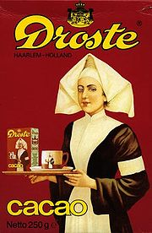
Introduction
Recursion is a way of defining functions self-referentially.
Examples:
Droste effect;
(Parenthetical comments (especially comments within comments), etc.);
A chain of phone callers on hold;
Inductive Proofs.
Image from google.com
Notes:
All of these involve self-similarity or self-reference.
Other examples:
Recursive Acronyms: GNU, CCA

Slide 22
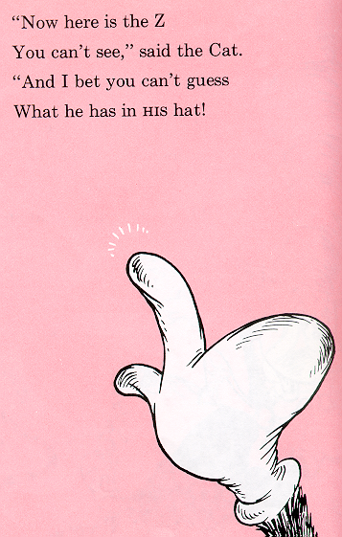
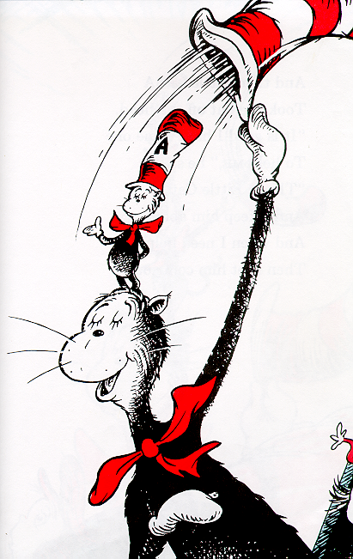
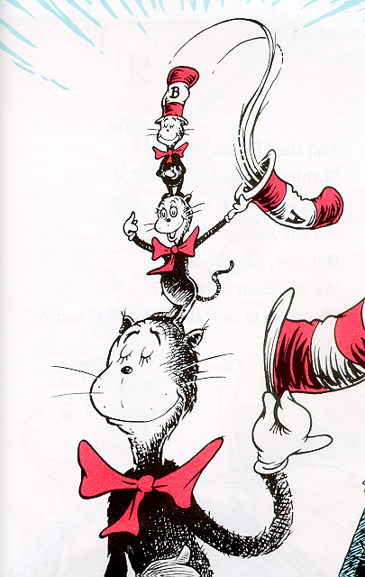
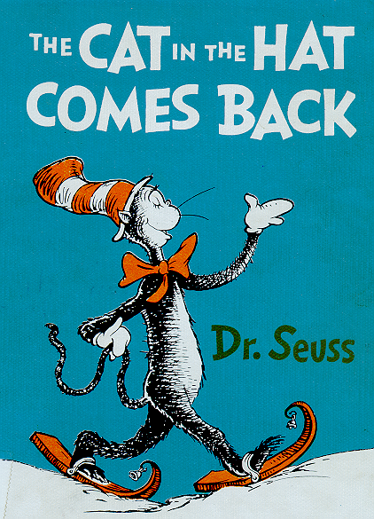
from The Cat in the Hat Comes Back, Dr. Seuss

Slide 23
Example: Factorial
Write a function that, given n, computes n!
n! == 1 * 2 * ... * (n-1) * n
Example:
5! == 1 * 2 * 3 * 4 * 5 == 120
Assumptions:
Receive n, a non-negative integer.
Return n!, a double (to avoid integer overflow).

Slide 24
Preliminary Analysis
This can be viewed as a counting problem, so we could solve it iteratively:
public static int factorial1(int n){
int result = 1;
for (int i = 2; i <= n; i++)
result *= i;
return result;
}

Slide 25
An Alternate Analysis
Consider the following alternate analysis:
n! == 1 * 2 * ... * (n-1) * n
(n-1)! == 1 * 2 * ... * (n-1)
n! == (n-1)! * n
Historically, this is how the factorial function was defined.

Slide 26
The Mechanics of Recursion
Design recursive functions using a three-step process:
1. Identify a base case - an instance of the problem whose solution is trivial. E.g., The factorial function has two base cases:
if n == 0: n! == 1
if n == 1: n! == 1
from The Cat in the Hat Comes Back, Dr. Seuss

Slide 27
Mechanics (cont.)
2. Identify an induction step - a means of solving the non-trivial instances of the problem using one or more “smaller” instances of the problem. E.g.,
n! == (n-1)! ∗ n
from The Cat in the Hat Comes Back, Dr. Seuss

Slide 28
Mechanics (cont.)
3. Form an algorithm that includes the base case and induction step, and ensures that each inductive step moves toward the base case.
factorial:
Receive n.
If n > 1 then
Return factorial(n-1) * n.
Else
Return 1.
from The Cat in the Hat Comes Back, Dr. Seuss

Slide 29
Implementation
public static int factorial(int n) { if (n > 1) return factorial(n-1) * n; else return 1; }
Notes:
Walk through this example, drawing the call stack.
The lab asks them to do summation recursively, so this factorial algorithm/implementation is a good model.

Slide 30
Example: Towers of Hanoi
Move disks from a source pin to a target pin, using the third pin as an auxiliary.
Rules:
move only one disk at a time;
never put a larger disk onto a smaller one.
Notes:
Legend has it that there were three diamond needles set into the floor of the temple of Brahma in Hanoi, with 64 golden disks, each a different size, stacked in concentric order on the left-most needle.
The priests were to transfer the disks from the first needle to the second needle, using the third as necessary. But they could only move one disk at a time, and could never put a larger disk on top of a smaller one.
When they completed this task, the world would end!

Slide 31
Design
Today’s problem is to write a program that generates the instructions for the priests to follow in moving the disks.
While quite difficult to solve iteratively, this problem has a simple and elegant recursive solution.

Slide 32
Driver Program
public static void main (String [] args) {
Scanner keyboard = new Scanner(System.in);
System.out.println("The Hanoi Towers\n");
System.out.print("number of disks: ");
int n = keyboard.nextInt();
move(n, 'A', 'B', 'C');
}
Notes:
For flexibility, let’s allow the user to enter the number of disks for which they wish a set of instructions:

Slide 33
Design (cont.)
Base case:
Inductive case:
Notes:
Demonstrate this with a physical towers of hanoi game.
Show how easy the problem is to solve in you can move n-1 disks together (taking advantage of recursion).

Slide 34
Algorithm
We can combine these steps into the following algorithm:
0. Receive n, src, dest, aux.
1. If n > 1:
a. move(n-1, src, aux, dest);
b. move(1, src, dest, aux);
c. move(n-1, aux, dest, src);
Else
Display “Move the top disk from ” + src + “ to ” + dest.

Slide 35
Implementation
public static void move(int n, char src, char dest, char aux) {
if (n > 1) {
move(n-1, src, aux, dest);
move(1, src, dest, aux);
move(n-1, aux, dest, src);
} else
System.out.println("Move the top disk from " +
src + " to " + dest);
}
}
Notes:
Note that this recursive structure defines a set of rather complex behaviors. We’d get lost thinking about all the moves for a 5 disc problem, but the computer does them all easily, mechanically, as defined by a recursive algorithm. Expect to see more and more applications of algorithmic specification (like this one) to natural world problems (in Biology, chemistry, physics, etc).
Run the algorithm for n==1, n==3, n==8 and n==64.

Slide 36
Algorithm Analysis
How many “moves” does it take to solve this problem as a function of n, the number of disks to be moved.
n # of moves required______
1 1
2 3
3 7
4 15
5 31
...
i 2^{i}-1
64 2⁶⁴-1
Notes:
2^64 is “a really big number”.

Slide 37
Analysis (cont.)
Given a “super-printer” that can generate and print 1,048,576 (2²⁰) instructions/second, how long would it take to print 2⁶⁴-1 instructions?
2⁶⁴/2²⁰ = 2⁴⁴ seconds
≅ 2⁴⁴ / 2⁶ = 2³⁸ minutes
≅ 2³⁸ / 2⁶ = 2³² hours
≅ 2³² / 2⁵ = 2²⁷ days
≅ 2²⁷ / 2⁹ = 2¹⁸ years
≅ 2¹⁸ / 2⁷ = 2¹¹ centuries
≅ 2¹¹ / 2⁴ = 2⁷ = 128 millennia
Notes:
64 = 2⁶ is an approximation of 60 (for the minutes and hours calculations)
32 = 2⁵ is an approximation of 24 (for the days calculation)
512 = 2⁹ is an approximation of 365 (for the years calculation)
128 = 2⁷ is an approximation of 100 (for the centuries calculation)
16 = 2⁴ is an approximation of 10 (for the centuries calculation)
And this just prints the priest’s instructions (assuming our computer doesn’t crash, in which case we have to start all over again). How fast can the priests actually move the disks? Calculating the date of the apocalypse is left as an exercise...

Slide 38
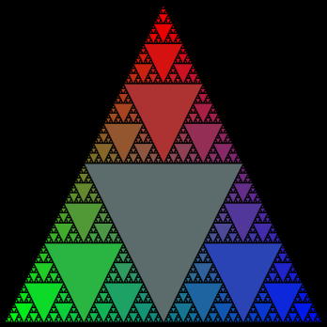
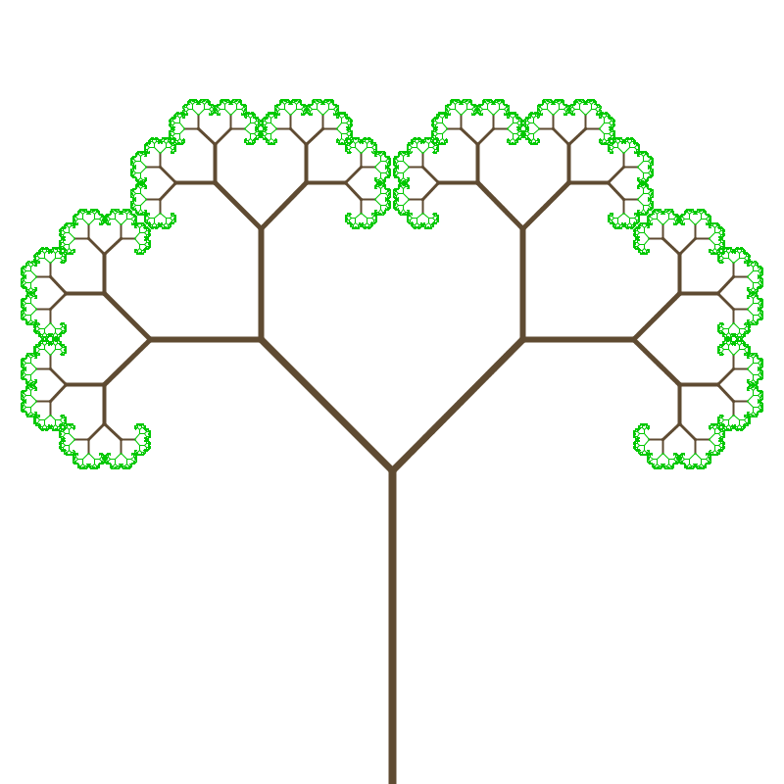
Graphical Examples
Sierpinski triangles
Tree fractals
Koch’s snowflake
Notes:
See Pyramid, Tree and Koch.
The tree is probably the simplest example of self-similarity (because each branch clearly looks like a little tree).
Fibonacci as in class example (routinely defined recursively, but more efficient to use a loop.

Slide 39
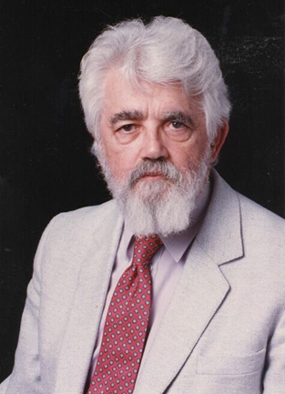
John McCarthy Artificial Intelligence
What’s the
Big Idea
McCarthy received the Turing award in 1971 for his seminal contributions to AI (including the name of the field).
He developed Lisp, one of the oldest programming languages.
(defun reverse (l acc)
“reverses the order of the element of L”
(if (null l)
acc
(reverse (cdr l) (cons (car l) acc))))
from http://www-formal.stanford.edu/
Notes:
“Lots of Insidious/Idiodic and Stupid Parentheses”

