Slide 1
Being abstract is something profoundly different from being vague... The purpose of abstraction is not to be vague, but to create a new semantic level in which one can be absolutely precise.
- attributed to Edsger W. Dijkstra
Notes:
Great computer scientists can boil problems down to their essence, with nice layers of abstraction that remove redundancy. This eliminates redundant code and encourages reuse.

Slide 2
Methods
Example
Working with Methods
Defining animation methods
Defining interaction methods
User-defined methods
The Art of Computing
Notes:
Monday: Cover the example and animation methods.
Wednesday: Cover scope and finish the animation examples.
Monday: Cover interaction and user-defined methods. Be sure to get through scope, they need that for lab 4.
Wednesday: Start into control statements.

Slide 3
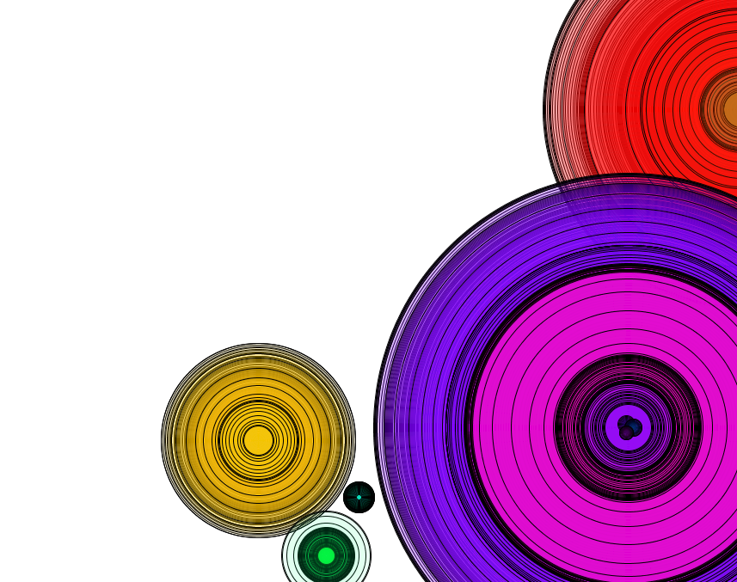
Example: Analysis (1)
We’d like to build an interactive tool for drawing animated figures.
The figures should include circles that grow/shrink.
Some sample images are shown here.
Notes:
The text focuses on the animation of moving figures.
The lecture focuses on the animation of changing figures.

Slide 4
Example: Analysis (1 cont.)
Features:
The environment should use animation to show figures changing;
The environment should support interactive drawing.
The geometric elements are ellipses.
We’ll start with the restricted goal of animating a growing ellipse.
Notes:
This is a much more open-ended goal. We’ll be exploring/experimenting here more than problem solving.

Slide 5
Defining Animation Methods
Animation is an illusion created by presenting carefully designed image frames at a sufficient frame rate.
For our first iteration, we’d like to draw an expanding circle. For this, we need to:
Set up for the animation;
Draw each frame of the animation.
Notes:
We’ve done animations before:
Raindrops – This one didn’t simulate motion and thus required no memory of previous locations.
Shaker – This one did simulate motion (i.e., shaking), but always in the same, hard-coded, location.

Slide 6
Example: Design (1)
Data Structures and Algorithm:
Data: diameter (float)
Setup:
Set up a 510x510 background
Set diameter = 0
Draw:
Clear the background.
Draw an ellipse in the center with diameter.
Increment diameter
We expect to see the illusion of a growing ellipse.
Notes:
Animation always breaks down to these two phases – initial set up and frame rendering.

Slide 7
Example: Implementation (1)
Relevant implementation tools:
animation methods: setup(), draw()
Notes:
Start with the non-method-based, non-animated approximation of the program:
int width = 510, height = width, diameter;
size(width, height);
smooth();
diameter = 0;
background(255);
ellipse(width/2, height/2, diameter, diameter);
setup() is used for the initial set up task – Processing calls it only once at the beginning of the animation.
draw() draws each individual animation frame – Processing calls it repeatedly throughout the animation.

Slide 8
Methods
In Processing, programmers add new operations by defining methods.
Using methods helps us to:
Modularize the program;
Create helpful procedural abstractions;
Improve readability;
Encourage reuse.
To build new methods, we’ll use the same IID approach we’ve used before.
Notes:
Most of the “interesting” operations we would like to perform are not pre-defined.

Slide 9
Iteration 1.1: Set Up
Analysis
Design
Implementation
Test
Notes:
Discuss methods as ways to block code up.
Analysis – We want a 510x510 background with the width/height variables set to 0. We should be able to do this in one iteration!
Design – We’ve done default backgrounds and initialized variables before, so that part is easy. But we’ve never “blocked” statements together before. That requires methods. Start by adding simple braces around the setup code, then add the return type, method name, and empty parameter list. You can just comment out the draw() code block for the moment.
Implementation – This requires defining the setup() method.
Test – Should see a blank output window.

Slide 10
Method Definition Pattern
returnType methodName(parameterDeclarations){
statements
}
returnType is the type of value returned by the method or void if the method does not return a value;
methodName is the identifier that names the method;
parameterDeclarations is a comma-separated list of parameter declarations of the form type identifier that is omitted if there are no parameters;
statements is a set of statements that define the behavior of the method.

Slide 11
final int WIDTH = 510, HEIGHT = WIDTH;
float diameter;
void setup() {
size(WIDTH, HEIGHT);
diameter = 0;
}
Notes:
Explain how Processing automatically calls this method once at the beginning of the animation cycle.
If you misspell the name, then Processing will not call your code (e.g., by calling the method setUp()).
Always declare variables before using them. And I usually declare variables at the beginning, initialize them in setup() and use them in draw() (except for the width & height variables, which are special because they get used right away and otherwise would be set automatically by Processing).

Slide 12
Iteration 1.2: Drawing Frames
Analysis
Design
Implementation
Test
Notes:
Analysis – We want to repeatedly draw successively larger ellipses.
Design –We’ve drawn ellipses before, and we’ve used variables to “remember” values from one statement to the next.
Implementation – This requires defining the draw() method.
Test – Should see (the illusion of) an expanding ellipse.

Slide 13
void draw() {
background(255);
float x = WIDTH/2, y = HEIGHT/2;
ellipse(x, y, diameter, diameter);
diameter += 2;
}
Notes:
Better demo this to see the animation.
Mess with the code some:
Add noFill() and smooth() to create the color gradient.
Try running it without incrementing the diameter (or setting the diameter to a fixed value).
Try misspelling either setup() or draw().
Explain how Processing calls this method at a given frame rate.
If there is time, show them the moving ball from the text.

Slide 14
Example: Testing (1)
The resulting output should give the illusion of a growing ellipse.
Notes:
Try the following quizzes:
Move the background() from draw() to setup() – what happens?
Add stroke(diameter) to draw() and noFill() to setup() – what happens?
Move background() back to draw() – what happens?

Slide 15
Scope
All identifiers have a scope.
An identifier can be reused to identify two different variables so long as the variable scopes don’t overlap.
Scoping rules:
Variables are in scope from where they are declared to end of that block.
Parameters are in scope throughout the method in which they are declared.
Notes:
Scope is the range of places where a particular variable is valid/known.
We’ll talk about the parameter scoping rule later.

Slide 16
final int WIDTH = 510, HEIGHT = WIDTH;
float diameter;
void setup() {
size(WIDTH, HEIGHT);
diameter = 0;
}
void draw() {
background(255);
float x = WIDTH/2, y = HEIGHT/2;
ellipse(x, y, diameter, diameter);
diameter += 2;
}
Notes:
Talk about identifiers and scope. It’s sort of like rooms with mirrored glass – you can see out but not in. Note the following things:
We make the global variables global so that they can be used in both setup() and draw(). Declaring them local to either (or both) of the methods won’t work because the value can’t then be shared. In this situation, we must separate the declaration of the variable from its initialization and use;
We could have another variable named x in setup() if we wanted to, but it would be a different variable.
We’ll talk about parameters and scope below.

Slide 17
Defining Interaction Methods
Processing supports user interaction using a set of pre-declared methods that respond to user-initiated events.
User events include mouse and keyboard actions.
For our second iteration, we’d like to allow the user to restart the ellipse animation in a spot specified using the mouse.

Slide 18
Iteration 2
Analysis
Design
Implementation
Test
Notes:
Analysis – We’ll start with the existing expanding ellipse code and add mouse event handling.
Design – Here, we’ll add declarations and definitions of x & y variables, and then use them in the ellipse() call. Then we define a mousePressed() method as follows:
Set ellipse x,y to mouseX and mouseY.
Reset diameter to 0.
Implementation – add x & y and the mousePressed() method definition.
Test – Should be able to restart the animation.

Slide 19
void mousePressed() {
figureX = mouseX;
figureY = mouseY;
diameter = 0;
}
Notes:
Better demo this to see the animation.
Mess with the code some:
Add noFill() and smooth() to create the color gradient.
Try running it without incrementing the diameter (or setting the diameter to a fixed value).
Try misspelling either setup() or draw().
Mention mouseClicked(), mouseMoved(), mouseDragged(), mouseReleased() as well (see Processing reference).
Mention mouseX, mouseY, pmouseX, and pmouseY as Processing-maintained variables.
If there is time, show them the dragging ball from the text.

Slide 20
Iteration 3
Analysis
Design
Implementation
Test
Notes:
Analysis – We’d like to clear the screen when the user presses any key on the keyboard.
Design – Here, we’ll define the keyPressed() method as follows:
Reset the background to white.
Implementation – add the keyPressed() method definition.
Test – Should be able to clear the screen.

Slide 21
void keyPressed() {
background(255);
}
Notes:
Mention also keyReleased() and keyTyped().
This one can be cute with 0 instead of 255.

Slide 22
/**
* expandingFigure displays an expanding/fading figure
* with mouse-directed restarts and variable starting
* points, and a keyboard-directed erase feature.
*
* @author kvlinden
* @version Fall, 2009
*/
int width = 510, height = width;
float figureX, figureY, diameter;
void setup() {
size(width, height);
background(255);
smooth();
noFill();
figureX = width / 2;
figureY = height / 2;
diameter = 0;
}
void draw() {
stroke(constrain(diameter/2, 0, 255));
ellipse(figureX, figureY, diameter, diameter);
diameter += 2;
}
/**
* Press the mouse anywhere to restart the expanding
* figure centered at that point.
*/
void mousePressed() {
figureX = mouseX;
figureY = mouseY;
diameter = 0;
}
/**
* Press any key to erase the board.
*/
void keyPressed() {
background(255);
}

Slide 23
User-Defined Methods
Processing already knows about the animation and interaction methods. It declared them, it provides default definitions for them, it calls them.
Processing also supports user-defined methods.
For our next iteration, we’d like to allow the user to interactively create a resizable ellipse by pressing and dragging the mouse.
Notes:
For this example, start with the figure drawing program and remove the color capabilities for simplicity’s sake.

Slide 24
Iteration 4
Analysis
Design
Implementation
Test
Notes:
Analysis – We’d like to build an ellipse by pressing and dragging the mouse as is common in drawing packages.
Design – Here, we’ll define the mousePressed() and mouseDragged() methods as follows:
mousePressed()
Reset the figure coordinates to the current mouse position.
Reset the figure width/height to 0.
mouseDragged()
Set figure width and height to 2 * distance from the center to the mouse position.
(Re)Draw the ellipse.
Implementation – See the code below.
Test – Should be able to do some neat stuff.

Slide 25
Parameters
Parameters are variables provided by the calling context and used in the method.
Parameter List Pattern:
type identifier, type identifier, …
Notes:
The () goes there even if the parameter list is empty.
When specifying a method like this, we say that the method “receives from its calling program values for …”.

Slide 26
void mouseDragged() {
float diameter = 2 * computeDistance(figureX, figureY,
mouseX, mouseY);
fill(255);
drawCircle(figureX, figureY, diameter);
}
void drawCircle(float x, float y, float diameter) {
ellipse(x, y, diameter, diameter);
}
Notes:
It is important to get to this slide to set them up for lab 4, which requires that they build a composite figure method.
Draw the data/control flow for this method call with parameters.
See the similar figure in the text.
Note that drawCircle() “receives from its calling program” one set of coordinates and a diameter, and “returns” nothing.
Reiterate how this method achieves all of the purposes we identified for writing methods:
Modularize the program;
Create helpful procedural abstractions;
Improve readability;
Encourage reuse.

Slide 27
Returning Values
The return type indicates the type of result the method produces.
Methods that don’t return values specify void as the return type.
Return pattern:
return expression;
expression is a valid expression whose type is the same as (or is compatible with) the specified return type of the containing method
Notes:
If the method doesn’t return any value, you can either:
say return; with no expression;
leave the return out altogether, which we have been doing with the animation/interaction methods.

Slide 28
void mouseDragged() {
float diameter = 2 * computeDistance(figureX, figureY,
mouseX, mouseY);
fill(255);
drawCircle(figureX, figureY, diameter);
}
float computeDistance(float x1, float y1, float x2, float y2) {
float dx = x1-x2;
float dy = y1-y2;
return sqrt(dx*dx + dy*dy);
}
Notes:
Draw the data/control flow for this method call with parameters and return value.
See the similar figure in the text.
Note that computeDistance() “receives from its calling program” two sets of coordinates and “returns” the Euclidian distance between them.
Note also that Processing already has a dist() method that we could use here. This is just a simple illustration.
Reiterate how this method achieves all of the purposes we identified for writing methods:
Modularize the program;
Create helpful procedural abstractions;
Improve readability;
Encourage reuse.

Slide 29
Documenting Methods
If we expect other programmers to use our methods, we need to document them clearly.
Document the purpose and assumptions of each method.
Notes:
In general, don’t state the obvious.

Slide 30
/**
* Compute the Euclidean distance from (x1, y1) to (x2, y2).
* (This partially re-implements Processing's dist() method).
*
* @param x1 the x coordinate of position 1
* @param y1 the y coordinate of position 1
* @param x2 the x coordinate of position 2
* @param y2 the y coordinate of position 2
* @return the distance from (x1, y1) to (x2, y2)
*/
float computeDistance(float x1, float y1, float x2, float y2) {
float dx = x1-x2;
float dy = y1-y2;
return sqrt(dx*dx + dy*dy);
}
Notes:
The sketch documentation contains the purpose of the sketch code, the author and the date.
This documentation documents the method, using the JavaDoc format we’ve used in previous examples.
The API spec for this method can be generated from this documentation.

Slide 31
Scope (cont.)
All identifiers have a scope.
An identifier can be reused to identify two different variables so long as the variable scopes don’t overlap.
Scoping rules:
Variables are in scope from where they are declared to end of that block.
Parameters are in scope throughout the method in which they are declared.
Notes:
This extends the scope discussion from above.

Slide 32
float figureX, figureY, diameter;
// code skipped here...
void mouseDragged() {
diameter = 2 * computeDistance(figureX, figureY, mouseX, mouseY);
fill(255);
drawCircle(figureX, figureY, diameter);
}
void drawCircle(float x, float y, float diameter) {
ellipse(x, y, diameter, diameter);
}
float computeDistance(float x, float y, float x2, float y2) {
float dx = x - x2;
float dy = y - y2;
return sqrt(dx*dx + dy*dy);
}
Notes:
Revisit identifiers and scope with respect to parameters. Note the following things:
Parameters can have different names from their arguments (e.g., x & y in drawCircle());
The same identifier can refer to different variable values in different scopes (e.g., x and y in drawCircle() and computeDistance());
If a local name is the same as a global one, the local definition overrides the global one (e.g., diameter – changing the value of the red diameter in drawCircle() will not change the value of the green diameter in mouseDragged()). Use the “main street” analogy. This means that we are able to reuse identifiers in the code, so long as the compiler can’t confuse which one we’re working with. This also means that if we redefine a variable in a method, then the global definition is lost.
Demo these concepts by modifying/running the given program.

Slide 33
Methods Review
Notes:
Have them write some methods:
- myDouble() receives from its calling program an integer and returns the two times that integer;
myFavoriteNumber() receives nothing from its calling program, prints your favorite number (using println()) and returns nothing.

Slide 34
Iteration 5
Analysis
Design
Implementation
Test
Notes:
Analysis – Here, we’ll add color and an magna-doodle-like erase method.
Design – Change the fill in mouse dragged to call computeColor():
Create and return a new color whose transparency is 10 and whose RGB values are computed based on distances from (figureX, figureY) to the corners of the screen. I just experimented a while here until I got something that I liked.
Implementation – See the final code below.
Test – Should be able to do some neat stuff.

Slide 35
/* figureDrawer allows the user to interactively
* draw an ellipse by pressing the mouse on the
* center point and dragging the mouse to specify
* the radius. It sets transparent colors based on
* x and y.
*
* @author kvlinden
* @version Fall, 2009
*/
float figureX, figureY, diameter;
int eraseLine; // position of erase line
void setup() {
size(375, 625);
background(255);
smooth();
colorMode(HSB, 2 * PI, 100, 100);
eraseLine = -2;
}
// There must be a draw method.
void draw() {
}
Continued

Slide 36
/**
* Allow the user to draw an ellipse of arbitrary size
* by pressing the mouse at the center point and dragging
* the mouse to specify the radius.
*/
void mousePressed() {
figureX = mouseX;
figureY = mouseY;
figureWidth = 0;
figureHeight = 0;
stroke(0);
strokeWeight(1);
}
void mouseDragged() {
float diameter = 2 * computeDistance(figureX, figureY,
mouseX, mouseY);
fill(computeColor(figureX, figureY, mouseX, mouseY));
drawCircle(figureX, figureY, diameter);
}
/**
* Draw circle is a simple abstraction that draws circles
* as ellipses with equal width and height.
* @param x x coordinate of the circle’s center point
* @param y y coordinate of the circle’s center point
* @param diamter the diameter of the circle
*/
void drawCircle(float x, float y, float diameter) {
ellipse(x, y, diameter, diameter);
}
Continued

Slide 37
/**
* Compute the Euclidean distance from (x1, y1) to (x2, y2).
* (This partially reimplements Processing's dist() method).
*
* @param x1
* @param y1
* @param x2
* @param y2
* @return the distance from (x1, y1) to (x2, y2)
*/
float computeDistance(float x1, float y1, float x2, float y2) {
float dx = x1-x2;
float dy = y1-y2;
return sqrt(dx*dx + dy*dy);
}
/**
* computeColor returns a color object based on the
* figure's specifications.
*
* @param sourceX the source's x coordinate
* @param sourceY the source's y coordinate
* @param targetX the target's x coordinate
* @param targetY the target's y coordinate
* @return a semi-transparent color based on the parameters
*/
color computeColor(float sourceX, float sourceY,
float targetX, float targetY) {
return color(PI + computeFacingAngle(sourceX, sourceY,
targetX, targetY),
100, 100, 10);
}
// computeFacingAngle() from the text...
Continued

Slide 38
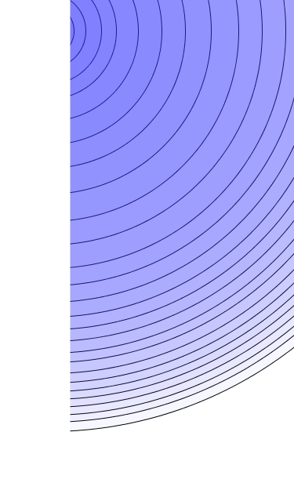
Notes:
Christian discovered that this tool will draw pastel-like circles (without lines) if the space bar is continuously being pressed.

Slide 39
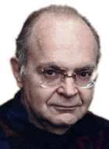
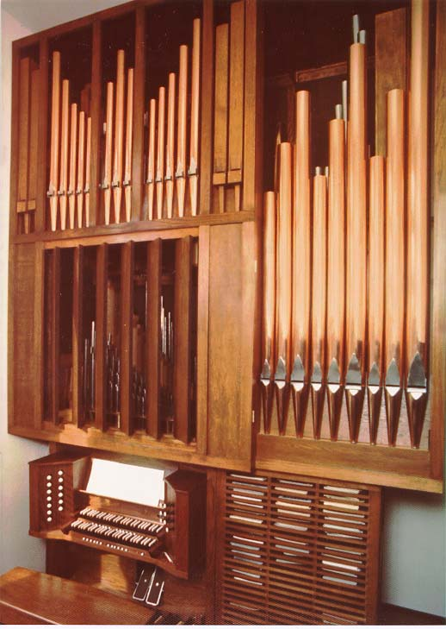
Donald Knuth (1938 - )
What’s the
Big Idea
Publications:
The Art of Computer Programming
The TeXbook
3:16 Bible Texts Illuminated
“Programmers who subconsciously view themselves as artists will enjoy what they do and will do it better.” - Programming as an Art, 1974
images from stanford.edu
Notes:
TAOCP, 1968-73
3:16, 1990
texbook, 1984
He also wrote a novel, Surreal Numbers, about some college dropouts that invented a mathematical system.

