Slide 1
It is a profoundly erroneous truism, repeated by all copy-books and by eminent people when they are making speeches, that we should cultivate the habit of thinking of what we are doing. The precise opposite is the case, civilization advances by extending the number of important operations which we can perform without thinking about them. Operations of thought are like cavalry charges in a battle - they are strictly limited in number, they require fresh horses, and must only be made at decisive moments.
- Alfred North Whitehead, Introduction to Mathematics
Notes:
We expand our human capabilities by abstracting away from the low-level details, e.g., by dealing with strings or real numbers rather than their low-level implementation details. This abstraction is the key to computing. This week we’ll see another important step in abstraction – data types.

Slide 2
Types and Expressions
Example
Programming Types and Expressions
Types
Expressions
Computing Machines
Binary Representations
Boolean Logic
The first programmable machine
Notes:
Monday: objects/types/expressions – through iteration 2
Wednesday: expressions/types continued, binary/boolean – through iteration 4
Friday: lab recap, quiz
Plug problets.org!!!

Slide 3
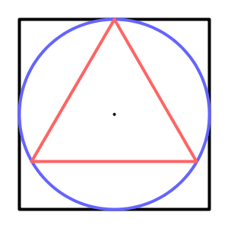
Example: Analysis (0)
We’d like to draw a scalable geometric logo.
The diagram should illustrate basic concepts in geometry and trigonometry.
A sample image of this vision is shown here.
Notes:
This initial iteration, which the slides will generally call iteration 0, uses only concepts presented in previous weeks. It serves as a review.
There is an Adobe video explaining how build a golden section using a circle radius as shown in this Wikipedia example.
Show a Google image search for “golden ratio” to see examples of its (alleged) use.

Slide 4
Example: Design (0)
There are several parts to this design; we’ll focus on the square first.
Algorithm:
Create a 300x300 canvas.
Draw a 250x250 square in the middle of the canvas.
Draw a 250 diameter circle in the middle of the canvas.
Notes:
You can choose to leave the square out if you want extra time.

Slide 5
Example: Implementation (0)
Relevant implementation tools:
size(), background(), smooth(), rect(), ellipse();
Literal values.
Notes:
This iteration only uses tools from last week. Build it one figure at a time, reviewing the things they’ve learned before.
For the code, see CircumscribedTriangle0.

Slide 6
Example: Testing (0)
We should be able draw the square and circle in the center of the canvas.
Issues with this prototype:
Notes:
So, we have a prototype and looks ok for starters, but there are some issues:
The figures don’t scale relative to the size of the background – yuck! It would be nice if they grew as the size of the background grows.
This requires variables.

Slide 7
Types
In object-oriented programming:
All program data are stored as objects.
All objects have specified data types.
The data type determines:
How an object is represented
How an object is manipulated
Notes:
The use of the term “object” is commonly restricted to reference types only, but this slide uses it somewhat more broadly.

Slide 8
Kinds of Objects
In programs, objects can appear as:
Literals
Variables
Constants
Variables and constants are named using identifiers.
Notes:
We’ll give more details on each of this in the following slides.
A literal is an object specified literally and exactly.
Named objects:
- A variable is a named object whose value varies.
- A constant is a named objects whose value remains the same throughout the program (enforced by compiler).

Slide 9
Literals
Literals are object values specified explicitly in the code.
Examples:
42
"you silly English k-nih-git"
'A'
true
Notes:
Do examples of these using println() in a processing window.

Slide 10
Variable Declarations
Variables are used to store values that may change during program execution.
They can be either initialized or uninitialized.
Pattern:
Type Name [ = Expression ];
Notes:
Explain the use the square brackets in the BNF.
Variables require types.

Slide 11
Primitive Types: Integers
Integers are whole numbers.
Processing provides several integer types:
byte −128 through 127
short −32768 through 32767
int −2147483648 through 2147483647
long −2⁶³ through 2⁶³ − 1
Literal integer expressions:
42
-22
0
Notes:
Run the examples using println().
Show example where compiler gives error for invalid value (e.g. println(9999999999+1); )

Slide 12
Primitive Types: Real Numbers
Reals are numbers with decimal points.
Processing provides two real data types:
float
double
Literal real expressions:
xEn represents x * 10^{n} where:
x is a fixed-point real-number, + or -
n is an integer, negative or positive.
Example: Avagadro’s number is near 6.0221415e23
Notes:
float – 32 bits, 6-7 decimal places
double – 64 bits, 15 decimal places
Run the examples using println().
Float is used in Processing for efficiency’s sake, and double is generally used in Java;
Our java compiler allows you to use either ‘e’ or ‘E’ for the literals
Avagadro’s number is formally defined to be the number of carbon-12 atoms in 12 grams of unbound carbon-12 in its rest-energy electronic state. Based on x-ray diffraction, the number is: (6.0221415 +/- 0.0000010) e 23
http://www.americanscientist.org/issues/pub/an-exact-value-for-avogadros-number/1

Slide 13
Primitive Types: Characters
Processing provides one character type:
char
Literal character expressions:
'A'
' '
'.'
Escape characters:
'\n' '\t' '\'' '\"' '\\'
Processing represents individual characters using Unicode.
Notes:
Run the examples using println().

Slide 14
Primitive Types: Booleans
Booleans are true/false values.
Processing provides one boolean type:
boolean
Literal boolean expressions:
true
false
Notes:
Run the examples using println().

Slide 15
Variable Declarations
Variables are used to store values that may change during program execution.
They can be either initialized or uninitialized.
Pattern:
Type Name [ = Expression ] ;
Examples:
int age = 18;
double gpa = 3.25;
char letterGrade = 'A';
Notes:
Now that we know about a few types, consider some examples of variable declarations.
Be sure to demonstrate something like: double temp =12; println(temp); will actually print 12.0

Slide 16
Constant Declarations
Constants are used to store values that do not change during execution.
They must be initialized.
Pattern:
final Type Name = Expression;
Examples:
final int MAX_SCORE = 100;
final double PI = 3.14159;
final String PROMPT = "Value: ";
Notes:
Do examples of these using println().
Compiler will tell you that you can’t change the value.
Actually, PI is already in the Math library (with as many decimal points at the precision of the double data type allows).
(e.g., printing PConstants.PI, a float, and Math.PI, a double, is interesting)

Slide 17
Multiple Declarations
Values of the same type can be declared and/or initialized in a list
Type is given only once
Examples:
double gpa = 3.25,credits;
final int MAX = 100, MIN = 0;

Slide 18
Identifiers
A variable or constant is named by an identifier.
Processing identifiers must begin with a letter followed by zero or more letters, digits or underscores.
Valid: age, r2d2, myGPA, MAX_SCORE, ...
Invalid: 123go, coffee-time, sam’s, $name, …
Identifiers cannot be Processing reserved words.
Notes:
Do examples of these using println().
An identifier is used to name:
variables,
constants,
classes,
methods, and
keywords.
Reserved words are things like int, final, double.

Slide 19
Naming Conventions
Choose “good” identifier names.
Follow identifier naming conventions:
Down-case variable identifiers.
Camel-case multi-word variables.
Up-case constant identifiers.
Underscore multi-word constants.
Capitalize class identifiers.
Notes:
Conventions are not enforced by the compiler, but can improved understandability of the code.
Choose your identifier to be indicative of the variable’s function.
- E.g., don’t use “frodo” or “r2d2” (unless you’re building an animation game with those characters).
Naming conventions:
- Down-case variable identifiers. E.g., diameter, slices
- Camel-case multi-word variables. E.g., numberOfSlices
- Up-case constant identifiers. E.g., PI
- Underscore multi-word constants. E.g., SPEED_OF_LIGHT
- Capitalize class identifiers. E.g., Metric (We’ll see this later.)
Tidbit: Early programming languages (e.g. Fortran) had limits on the number of characters in the variable name, and it was often not enough!

Slide 20
Expressions
Expressions are sequences of objects (called operands) and operators that combine to produce a value.
The operands can be variables, constants, literals or method calls.
The operators depend upon the data types of the operands.
The type of the expression is the type of the value it produces.

Slide 21
Numeric Expressions
Processing provides arithmetic operators for reals and integers : + - * / %
Integer division produces an integer, real division produces a real:
3/4 → 3.0/4.0 →
3.0/4 → 3/4.0 →
Integer division:
3/4 → (the quotient)
3%4 → (the remainder)
Notes:
Run the examples using println().

Slide 22
Implicit Type Conversion
When types are mixed in an expression, the “narrower” type is promoted to the larger type, e.g.,
3.0 / 4
Possible promotions:
byte short int long float double char
Notes:
Here, the Java compiler promotes the ints to doubles, does the operations, and returns a double. Don’t under-estimate the work that the compiler is doing here.
Note that the compatibility is one way only.

Slide 23
Assignment Expressions
The value of a variable can be changed using an assignment statement:
age = 19;
letterGrade = 'B';
credits = hours * 3.0;
done = true;
Pattern:
Name = Expression;
Notes:
Run the examples using println().

Slide 24
Iteration 1
Analysis
Design
Implementation
Test
Notes:
Analysis – Make the figures scalable
Design – Given: The size of the square/circle and canvas
Create a 300x300 canvas with room for the figures and the border.
Draw the square in the middle of the canvas.
Draw the circle in the middle of the canvas.
Implementation – This will require variables and simple numeric expressions.
For the code, see the sample program (CircumscribedTriangle1).
Test – Should be able to do multiple figure logos with different sizes by simply changing the width/height. In a sense, this code encapsulates the essence of what the logo is and can thus be scaled for anything from small cards to large posters. One problem is that there is a constant value in there the we’re not representing as a constant.

Slide 25
Iteration 2
Analysis
Design
Implementation
Test
Notes:
Analysis – Add a UNIT width/height constant
Design – The algorithm is the same.
Implementation – This uses constant UNIT for the width/height value.
For the code, see CircumscribedTriangle2.

Slide 26
Primitive vs Reference Types
Primitive types store literal values.
Reference types store the address of the object representation created with new:
The constructor pattern:
new ClassName (Arguments)
int age = 42;
age
42
myAge
0x2ccb
Integer myAge =
new Integer(42);
0x2ccb
42
Notes:
A primitive data type is a simple data type, built into Java.
e.g., integers, reals, characters, booleans
A reference data type is built from other data types and is constructed from a class.
e.g., strings, user-defined classes. Java2 provides over 1600 reference types.
Many people consider this legacy of the hybrid C++ language to be a problem with Java. Smalltalk doesn’t support primitive types, everything is an reference object.
Mostly, we’ll use int, but Integer can come in handy at times.
And we’ll definitely use other reference types (Screen, Keyboard, new classes of our own construction).

Slide 27
Strings
Strings are text sequences of characters.
Processing provides one text data type:
String
Literal String expressions:
"Hello"
"you silly English k-nih-git"
Strings reference types allow quoted literals and a concatenation operator (+).
Notes:
Run the examples using println().
“I said “hello”!”
“I said\n\tSTOP!”
The String class is a reference type that has literals and operators like a primitive type.
String s1 = new String(“test”);
OR
String s2 = “test”;
“123” == 123 ???
“123” == “123” ???
“123”.equals(“123”) ???

Slide 28
Wrapper Classes
Wrapper classes add capabilities to the primitive types.
Their names are capitalized, e.g.
Integer, Double, Boolean, Character
Integer i =
new Integer(42);
i
0x2ccb
0x2ccb
42
Notes:
This is the sort of non-OO hack that many people dislike about Java/C++.
It’s an example of the more general distinction between primitive and reference types.
Examples of why this would be useful:
Constants:
Integer.MAX_VALUE
Integer.MIN_VALUE
Methods:
String digits = Integer.toString(intVal)

Slide 29
Type Conversion
Implicit:
Using explicit type casting:
Using wrapper classes for the same thing:
3.0 / 4
(double)3 / 4
Integer intValue = new Integer(3);
println(intValue.doubleValue() / 4);

Slide 30
Mathematical Resources
Static constants, e.g.:
PI: 3.1415927
TWO_PI: 6.2831855
Useful methods, e.g.:
abs(x) sqrt(x) max(x,y)
exp(x) log(x) pow(x,y)
Examples:
final float C = 2.99792458e8;
double e = m * pow(C,2);
Notes:
Run the examples using println().
Double versions of all these constants and methods are available in the Math library (which we’ll start using when we move to Java).
The speed of light is 299,792,458 metres per second (m/s). Note that Processing doesn’t record the M/S part; you have to remember this!
See http://java.sun.com/j2se/1.5.0/docs/api/ for a complete list.

Slide 31
Iteration 3
Analysis
Design
Implementation
Test
Notes:
Analysis – Compute and print the area of the square and circle.
Design – The algorithm is the same but add two print statements after each figure is drawn.
Implementation – This uses numerical expressions.
For the code, see the CircumscribedTriangle3.
Test – Make sure that the areas in square pixels are correct.
NOTE: Do not use string expressions yet! Add after covering in 3 slides or so!

Slide 32
Boolean Expressions
Processing provides 6 boolean operators:
x == y x != y
x < y x >= y
x > y x <= y
Build more complex expressions using the logical operators:
x && y
x || y
!x
Notes:
Run the examples using println().
Do not interchange the following:
= (assignment)
== (equality)
Logical and, or and not operators:
a && b true iff a,b are both true
a || b true iff a or b is true
!a true iff a is false
Example:
(0 <= score) && (score <= 100)
Note that 0 <= score <= 100 doesn’t work!

Slide 33
Character Expressions
char objects can be used in comparisons:
The Character wrapper class provides additional methods, including:
isLetter(ch) toUpperCase(ch)
isUpperCase(ch) getNumericValue(ch)
Notes:
Run the examples using println(). Examples:
'a' < 'b' ('A' <= letter) && (letter <= 'Z')
isLetter(ch) returns true if ch is a letter, false otherwise.
isUpperCase(ch) returns true if ch is in uppercase, false otherwise.
toUpperCase(ch) returns the upper-case version of ch.
getNumericValue(ch) returns the Unicode numeric value of the character.
Note that these wrapper class methods are available for Character, but not for char. This is part of benefit of using wrapper classes.
Example: Character ch = ‘a’; println(Character.isLetter(ch); or println(Character.isLetter(‘a’);

Slide 34
String Expressions
Concatenation:
"Joe " + "Ku" → "Joe Ku"
Strings are made up of individual characters:
String name = "Joe Ku";
name.charAt(3) →
name
J
o
e
K
u
\0
0
1
2
3
4
5
6
Notes:
Run the examples using println().
name.charAt(3) ⇒ ' '

Slide 35
Precedence
Question: What is the value of the following expression:
2 + 3 * 4
Operator precedence governs evaluation order of operations in an expression.
Parentheses can be used to override default precedence:
(2 + 3) * 4
Notes:
Run the examples using println().
(2 + 3) * 4 == 20 OR 2 + (3 * 4) == 14?
* has higher precedence than +, so it is applied first, making the answer 14.

Slide 36
Operator Precedence
( ) HIGHER
+ (positive), - (negative), ! (NOT)
*, /, %
+, -
<, <=, >, >=
==, !=
&&
|| LOWER

Slide 37
Associativity
Question: What is the value of the following expression:
8 - 4 - 2
Associativity governs the order of execution of operators that have equal precedence.
Again, parentheses can be used to override the default.
Notes:
Do examples in Processing using println()
Note that precedence doesn’t help us here.
(8 - 4) - 2 == 2 OR 8 - (4 - 2) == 6
Since - is left-associative, the left - is evaluated first, giving us 2.
Most (but not all) Processing/Java operators associate left.

Slide 38
Assignment Chaining
The assignment operator supports expressions like this:
int w, x, y, z;
w = x = y = z = 0;
Notes:
Do examples of these in Processing.
Assignment operator is right-associative.
The rightmost = is applied first, assigning z zero, then y is assigned the value of z (0), then x is assigned the value of y (0), and finally w is assigned the value of x (0).

Slide 39
Assignment Shortcuts
Some assignments are so common:
var = var + x; // add x to var
var = var - y; // sub y from var
Processing provides shortcuts for them:
var += x; // add x to var
var -= y; // sub y from var
Notes:
Do examples of these in Processing.

Slide 40
In General
Most arithmetic expressions of the form:
var = var Δ value;
can be written in the “shortcut” form:
var Δ= value;
Examples:
x *= 2.0; // double x’s value
y /= 2.0; // decrease y by half
Notes:
Run the examples using println().

Slide 41
Increment and Decrement
Other common assignments include:
var = var + 1; // add 1 to var
var = var - 1; // sub 1 from var
Processing provides shortcuts for them:
in postfix form:
var++; // add 1 to var
var--; // sub 1 from var
and in prefix form: ++var --var
Notes:
Run the examples using println().

Slide 42
Prefix/Postfix Increment
The difference between the forms:
The prefix form produces the final (incremented) value as its result.
The postfix form produces the original (un-incremented) value as its result.
Example:
Notes:
Run the examples using println().
The prefix decrement behaves similarly...
int x = 1;
int y = x++;
println(x + “ “ + y);
2 1
x=10;
y=++x;
println(x + “ “ + y);
11 11

Slide 43
Iteration 4
Analysis
Design
Implementation
Test
Notes:
This is an optional step. Computing the correct points requires trigonometry and a conversion from degrees to radians.
Analysis – Add the triangle.
Design –
Implementation – This uses numerical expressions with trigonometry.
For the code, see the CircumscribedTriangle.
Test –

Slide 44
/**
* CircumscribedTriangle creates a geometric logo with
* a triangle and enclosing circle and square.
* It also computes and prints the areas of the three figures.
*
* @author kvlinden
* @version Spring, 2010
*/
final int UNIT = 300;
int width = UNIT, height = width;
int squareX, squareY, squareWidth = width - 50;
int circleX, circleY, circleDiameter;
size(width, height);
smooth();
background(255);
strokeWeight(4);
strokeJoin(ROUND);
// Draw the square.
stroke(0);
squareX = (width - squareWidth) / 2;
squareY = (height - squareWidth) / 2;
rect(squareX, squareY, squareWidth, squareWidth);
println("Square area: " + pow(squareWidth, 2) + " pixels^2");
// Draw a circle inside the square.
stroke(100, 100, 255);
circleX = width/2;
circleY = height/2;
circleDiameter = squareWidth;
ellipse(circleX, circleY, circleDiameter, circleDiameter);
println("Circle area: " + (PI * pow(circleDiameter, 2) + " pixels^2"));
// Draw an equilateral triangle in the circle, pointing up.
stroke(255, 100, 100);
triangle(circleX, squareY,
circleX-(cos(radians(30))*circleDiameter/2),
circleY+(sin(radians(30))*circleDiameter/2),
circleX+(cos(radians(30))*circleDiameter/2),
circleY+(sin(radians(30))*circleDiameter/2)
);
println("Triangle area: " + (0.5 * pow(squareWidth, 2)) + " pixels^2");
// Draw a dot in the center.
stroke(0);
point(circleX, circleY);
Notes:
This is an alternate example based on the Wikipedia entry for the “golden ratio” (see http://en.wikipedia.org/wiki/File:Golden_Rectangle_Construction.svg). There is an Adobe video explaining how build a golden section using a circle radius as shown in the image. Show a Google image search for “golden ratio” to see examples of the golden ratio’s (alleged) use.
Iteration 0 – just draw the square in the middle of the canvas.
Analysis: Try to copy the Wikipedia image
Design: Focus just on the square first
Create a 400x400 canvas.
Draw a 200x200 square in the middle of the canvas.
Implementation – Use only features they’ve seen before.
Test – It doesn’t scale relative to the size of the background – yuck! It would be nice if it grows as the size of the background grows.
Iteration 1 –
Analysis – Make the square scalable
Design – Given: The size of the square and the border
Create a canvas with room for the square and the border.
Draw the square in the middle of the canvas.
Implementation – This will require variables and simple numeric expressions.
For the code, see the sample program.
Test – Should be able to do multiple squares with different sizes.
Iteration 2 –
Analysis – Add the PHI-sized rectangle – We’ll draw from the top left rather than the bottom right.
Design – Given: The size of the square and the border
Create a canvas with room for the square and the border.
Draw the additional rectangle (on the bottom).
Draw the main square (on the top).
Implementation – This uses constants, floor(), and more complicated expressions.
For the code, see the sample program.
Test –
Iteration 3 –
Analysis – Add the construction lines
Design – Given: The size of the square and the border
Create a canvas with room for the square and the border.
Draw the additional rectangle (on the bottom).
Draw the main square (on the top).
Draw the construction lines (on the very top).
Implementation –
For the code, see the sample program.
Test –

Slide 45
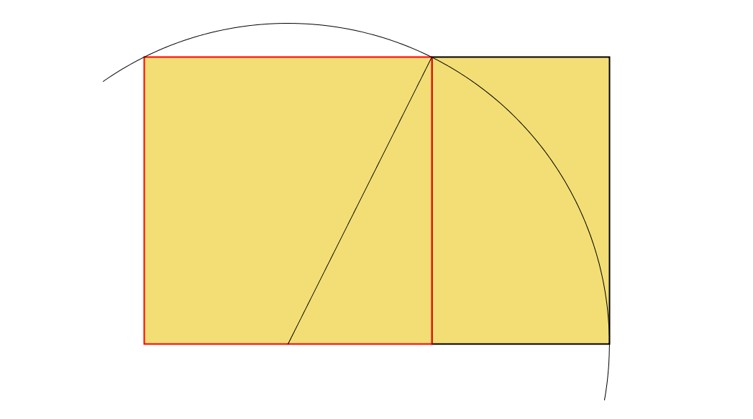
/**
* Construction draws a scalable construction set for
* the golden ratio
* (see http://en.wikipedia.org/wiki/Golden_ratio)
*
* @author kvlinden
* @version Fall, 2009
*/
final float PHI = 1.6180339887;
int a = 200, border = a/2;
float radius = sqrt(pow(a,2) + pow(a/2,2));
size(a + 2 * border, (int)(a * PHI) + 2 * border);
background(255);
smooth();
fill(242, 222, 117);
strokeWeight(2);
stroke(0);
rect(a/2, a/2 + a, a, a * PHI - a); // added square
stroke(255, 0, 0);
rect(a/2, a/2, a, a); // original square
strokeWeight(1);
noFill();
stroke(255, 0, 0);
rect(a/2, a/2, a, a);
stroke(0);
line(a/2, a, border + a, border + a);
arc(a/2, a, 2 * radius, 2 * radius,
radians(325),
radians(460));
Notes:
This is an alternate example based on the Wikipedia entry for the “golden ratio” (see http://en.wikipedia.org/wiki/File:Golden_Rectangle_Construction.svg). There is an Adobe video explaining how build a golden section using a circle radius as shown in the image. Show a Google image search for “golden ratio” to see examples of the golden ratio’s (alleged) use.
Iteration 0 – just draw the square in the middle of the canvas.
Analysis: Try to copy the Wikipedia image
Design: Focus just on the square first
Create a 400x400 canvas.
Draw a 200x200 square in the middle of the canvas.
Implementation – Use only features they’ve seen before.
Test – It doesn’t scale relative to the size of the background – yuck! It would be nice if it grows as the size of the background grows.
Iteration 1 –
Analysis – Make the square scalable
Design – Given: The size of the square and the border
Create a canvas with room for the square and the border.
Draw the square in the middle of the canvas.
Implementation – This will require variables and simple numeric expressions.
For the code, see the sample program.
Test – Should be able to do multiple squares with different sizes.
Iteration 2 –
Analysis – Add the PHI-sized rectangle – We’ll draw from the top left rather than the bottom right.
Design – Given: The size of the square and the border
Create a canvas with room for the square and the border.
Draw the additional rectangle (on the bottom).
Draw the main square (on the top).
Implementation – This uses constants, floor(), and more complicated expressions.
For the code, see the sample program.
Test –
Iteration 3 –
Analysis – Add the construction lines
Design – Given: The size of the square and the border
Create a canvas with room for the square and the border.
Draw the additional rectangle (on the bottom).
Draw the main square (on the top).
Draw the construction lines (on the very top).
Implementation –
For the code, see the sample program.
Test –

Slide 46
Binary Representations
Binary representations use a base-2 positional numbering system.
This system has only two “binary digits” (aka bits):
0 (or “off”)
1 (or “on”)

Slide 47
Decimal Numbers
Decimal numbers are base-10 (using digits 0-9)
123
1*10² + 2*10¹ + 3*10⁰
1*100 + 2*10 + 3*1
100 + 20 + 3

Slide 48
Binary Numbers
Binary numbers are base-2 (using digits 0 & 1)
110₂
1*2² + 1*2¹ + 0*2⁰
1*4 + 1*2 + 0*1
4 + 2 + 0 = 6₁₀

Slide 49
Binary Encoding Systems
“Groups” of bits can represent ranges of distinct values:
1 bit 2 (2¹) values (0 & 1)
2 bits 4 (2²) values (00, 01, 10, & 11)
3 bits 8 (2³) values
…
Binary representations can be used to encode anything (e.g., characters, integers and real numbers).
Notes:
How many bits do you need to
represent the numbers:
7 - 3
8 - 4
100 - 7
255 - 8
represent the alphabet - 5 bits
Binary representations can be somewhat arbitrary, but so long as everyone agrees to them, they will work.
Why use binary? It’s easier to build.

Slide 50
Representing Integers
50
Integers are represented in twos-complement notation
Here, the high-order bit indicates the sign:
2₁₀ = 0000000000000010₂
1₁₀ = 0000000000000001₂
0₁₀ = 0000000000000000₂
-1₁₀ = 1111111111111111₂
-2₁₀ = 1111111111111110₂
This example is shown in 16 bits, but 32 are 64 are common.
Notes:
This is experimented with in lab.

Slide 51
Representing Real Numbers
51
Real values are often represented in 64 bits using the IEEE floating point standard:
exponent
(11 bits)
sign
(1 bit)
mantissa
(52 bits)
Notes:
This scheme is like scientific notation: sign * mantissa * base^exponent (write this up there for them). The scheme shown here is not exactly what is really done, but it is close enough for our purposes.
These can give you round-off errors (e.g., PI)
ex. 5.1 % 2.0 -> 1.0999999

Slide 52
Representing Characters
52
Characters are represented using one of two common schemes:
ASCII
Uses 7 bits, allowing for 2⁷ = 128 distinct characters.
Unicode
Uses 16 bits, allowing for 2¹⁶ = 65,536 distinct characters.
See www.unicode.org.
Notes:
It’s all binary underneath!

Slide 53
Binary Arithmetic
Add binary numbers in a manner similar to adding decimal numbers.
The other arithmetic operations work too.
They are easier to implement in binary.
110₂
+ 11₂
1001₂

Slide 54
Boolean Logic
Based on two logical values: true (1) & false (0)
Boolean expressions are constructed using these operators:
AND (∧) OR (∨) NOT (¬)

Slide 55
Gates
Transistors can implement Boolean operators:
AND
OR
NOT
Notes:
How would you build these three types of gates using transistors?
AND two transistors in series
OR two transistors in parallel
NOT
power
|
.--- resistor--- Output
|
Input -----------Transistor
|
Ground
Here, if the input is on, the transistor is connected which draws the power to the ground (and therefore not through the resistor) such that the output signal is off. If the input is off, the transistor is not connected, so the power goes through the resistor to the output. resulting in the output signal being on.

Slide 56
Circuit Design
A circuit is a set of gates that transform binary inputs into binary outputs.
Inputs
Outputs
Circuit
An Interconnected set of gates

Slide 57
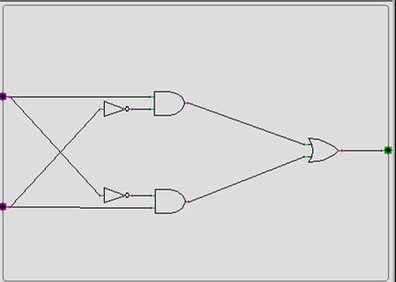
Circuit Design (2)
The Exclusive OR (XOR)
a XOR b ≡ (a ∧ ¬b) ∨ (¬a ∧ b)
input_{a}
output
input_{b}
Notes:
Note that the circuit matches the tree structure of the XOR definition, where the highest-level boolean operators are on the right. It’s not hard to imagine an algorithm that would convert a boolean expression that uses AND/OR/NOT into a circuit.

Slide 58
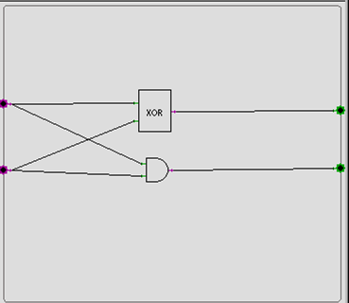
Circuit Design (3)
A Binary Half-Adder
input₁
sum
input₂
carry
Notes:
Here, we notice that SUM is equal to the output of the exclusive OR we just built, and carry is equal to the output of the standard AND. We could just put them together like this. The problem is that this takes more gates that are really necessary, 6 (5 for the XOR, and one more AND).

Slide 59
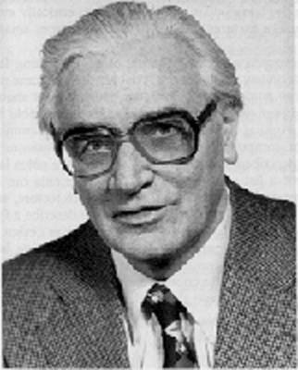
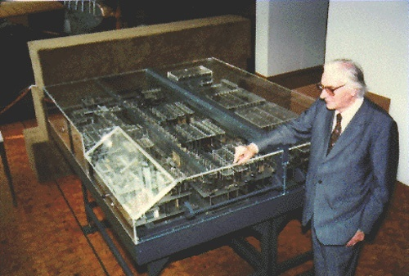
Konrad Zuse (1910-1995) The “Z computers”
1935-1938
“Modern” design:
binary (base-2)
switching circuits
programmable (using punched movie film)
He never built his full design.
Notes:
3 key innovations of modern computers:
1. the use of vacuum tubes to implement binary numbers as we saw earlier
123₁₀ = 3*10⁰ + 2*10¹ + 1*10² = 3 + 20 + 100
each digit of the number must represent 10 values (0-9)
this is hard to implement in hardware (cf. Difference engine)
110₂ = 0*2⁰ + 1*2¹ + 1*2² = 0 + 2 + 4 = 6₁₀
2. The use of electronic rather than mechanical switching (vacuum tubes rather than mechanical switches) to implement boolean logic. Eventually, transitors and then VLSI were employed.
3. Instructions were fed into the machine by reading holes punched in discarded movie film. It was, thus, programmable
He built the Z1 in his parents’ living room! He never completed his full designs. The Nazi government never supported him because they expected to win the war long before his work was completed. Thus, his work went largely unnoticed and the real computers were built elsewhere.

