Slide 1
Processing & Java An Introduction to Computing
Notes:
Monday: course intro (with exercise if appropriate)
Wednesday: algorithms & Processing example
Friday: lab recap, software engineering
If there are only 2 days in the first week and hold off on course logistics and shift day 3 to the next Monday.
Send email survey before the first session:
Welcome to CS 108, Introduction to Computing. I'm happy to have you in this course this semester. As we get started, it would be helpful for me to know a little bit about you, so could you please respond to this email (to me only!) with answers to these questions: 0. What is your class level? (fr/so/jr/sr) 1. What is your major? 2. Why are you taking this course? 3. What would you most like to get out of this course? Be sure to reply only to me (kvlinden@calvin.edu), not to the whole class. If you are using Webmail, you click "Reply" rather than "Reply to All". Looking forward to meeting you all today. many thanks, keith

Slide 2
Computer Science is no more about computers than astronomy is about telescopes.
- attributed to E.W. Dijkstra
Notes:
I can’t determine if Dijkstra actually ever said this, but here are some similar quotes:
“Computer science is no more about computers than astronomy is about telescopes, biology is about microscopes or chemistry is about beakers and test tubes. Science is not about tools. It is about how we use them and what we find out when we do.” – Fellows/Parberry, Computing Research News, 1993
“Computer Science is no more about computers than the music industry is about microphones” – CS4FN website
Point out right from the start that computing involves more than just programming computers. Programming may be “at its core” in some sense and it will certainly be hard to miss in this course, but computing also involves other stuff that we’ll talk about (people and communication skills, creativity).

Slide 3
Exercise
Write a set of instructions for distributing a brownie from a pan to each student in the class who wants one. Note the following:
Be detailed enough for an unimaginative, forgetful, myopic, clueless instructor to execute correctly.
Be clear about your assumptions.
Be general with respect to different class sizes and different pan dimensions.
Work in teams and write your instructions out on paper.
Notes:
Do an algorithmic exercise if there is time for it and the algorithms lecture before the first lab.
Bring a closed tray of uncut brownies/bars/cake, a knife and napkins. Ask them to write instructions for distributing the goodies to those who want them. We’ll do two passes; they will get something to eat if they succeed. Rules:
The instructions must be written.
Be detailed; assume that I am unimaginative, forgetful, myopic, and clueless.
I understand basic physical objects, people, spatial relations, and the table in front of me.
Basic tasks I expect to see in the result:
Open the pan
Cut the goodies in the appropriate number of pieces - cut x rows/columns where x = ceil(sqrt(n))
Distribute the goodies (with napkins) to those who want them.
Clean up.
Eating the goodies will be left to the students themselves (an OO approach!).
Morals of the story: be precise, expose all unstated assumptions, test on a non-critical infrastructure, clean up after yourself, scaling is important (e.g., Being this careful may not matter with a dozen people, but for food service operations with >1000 people it definitely would!)

Slide 4
Introduction
The course home page
Computing
Algorithms
Data Structures
Examples
Processing
Software Engineering
A Broader Perspective
Notes:
Highlight final projects (show some examples)

Slide 5
Computing
Computing is not:
The study of computers
The study of how to write programs
The study of computer applications
Computing is the study of algorithms, where an algorithm is a procedure that solves a problem using an ordered, unambiguous, finite set of operations.
Notes:
aka “Computer Science”
The “computing is not” points are partially true, but incomplete:
We study computers like astronomers study telescopes, they are important tools but nothing more. Science does not study tools.
We write programs like engineers build bridges, they are important products but nothing more. We’ll focus here in this class.
We use computer applications like drivers use cars, we care about drivers but we’re more like automotive engineers. Computer applications have changed every discipline in fundamentals ways.
These 3 things are aspects of computing, not the whole.
We’ll work with an example algorithm in lab #1.

Slide 6
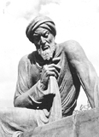
Muhammad ibn Musa al'Khwarizmi (780-850) Algorithms
Persian mathematician famous for:
Introducing base-10 numbering to the west
Writing Kitab al jabr w’al muqabala (The Rules of Restoration and Reduction)
Specifying finite, ordered, and unambiguous operations for solving problems, i.e., algorithms.
image from www.computer.org
Notes:
He didn’t invent base-10, he just described it in a book that was widely read in Europe (when it was finally translated into Latin 2 or 3 hundred years later).
Kitab al jabr w’al muqabala was about manipulating equations so that you’d “treat both sides alike”. The title gives us the word “algebra”.
We now call procedures/recipes by the name “Algorithm”, which is derived from his name. This concept precedes computing machines by a millennium.

Slide 7
Algorithms
Algorithms are powerful constructs used in problem solving.
To be computed, they must have the following properties:
Finite
Ordered
Unambiguous
Notes:
Algorithmic thinking – it’s more common than you think it is! Implemented algorithms are to the information revolution what machines were to the industrial revolution.
Recall that an algorithm is procedure that solves a problem using a finite, ordered & unambiguous set of operations (see earlier slide).
Make the algorithm finite so that it can be implemented on a computer.
Order the algorithm using the 3 basic control structures (using indentation to indicate scoping). These are discussed on the next slide.
Make the algorithm unambiguous by using the appropriate level of detail for both operations and data.
- Non-programmers shouldn't use "just kinda" steps that rely on their subconscious (because it's hard to program the sub-conscious).
Programmers shouldn't write code (because it takes too much time and obscures the real algorithm that they should be thinking about).
Don’t forget to be clear about the data structures.

Slide 8
Operations
The operations used in algorithms are primitive tasks that can be executed.
Primitive operations are the “basic” operations in the application domain, e.g., basic arithmetic, drawing graphical shapes.
Notes:
Any basic operation is fine, so long as it is finite and unambiguous. No “miracle” functions are allowed.
Your job as a programmer is to take the operations (i.e., the “tools”) provided by your programming language and use them to write programs that perform useful or interesting tasks.

Slide 9
Control Structures
Control structures specify the ordering of the operations in the algorithm.
There are three basic control structures:
Sequence
Selection
Repetition
Notes:
Exactly 3, no more, no less.
Do examples on the next few pages based on the class exercise if possible.

Slide 10
Sequence
A sequence of multiple operations is executed in order. Pattern:
operation₁
operation₂
…
operation_{n}
Example:
Notes:
Example:
Find out how many students want brownies. (details to be worked out)
Cut the brownies.
Distribute the brownies.
Clean up.
Example:
Get Up.
Wash.
Go to bed.
Paraphrased from Innocents Abroad, Mark Twain, chapter 59 (see http://www.mtwain.com/Innocents_Abroad/60.html) .
This algorithm specifies that Mark Twain does three things in order from top to bottom.
Draw the flow chart.

Slide 11
Selection
Selective operations are executed conditionally. Pattern:
if condition then
set of operations₁
else
set of operations₂
Example:
Notes:
condition is a simple true/false condition. If condition is true, then the set of operations₁ is performed. Otherwise set of operations₁ is not performed.
The else and accompanying set of operations₂ is optional. If the else is included and condition is false, then the set of operations₂ is performed.
This algorithm specifies that Twain doesn’t do any of the actions on weekends. Note that the selectively executed operations are indented in the pseudocode to make it clear what the condition is and what the selected operations are.
Draw the flow chart.
Example:
if student wants a brownie then
increment the count of students wanting brownies
go on to the next student
Example:
if it’s not the weekend then
Get Up.
Wash.
Go to bed.
go on to the next day

Slide 12
Repetition (list version)
Repetitive operations are executed iteratively. Some repetitive operations process lists of items. Pattern:
Repeat for each list element
set of operations on current element
Go on to next list element
Example:
Notes:
This one handles lists of things. Use it for the brownies example (i.e., for each student).
list is some list of similar elements (e.g., CDs, days, files).
Work with the current list element is the place in the algorithm where you do whatever work you need to do on the list elements. Note that inside the loop you only work with one element at a time (i.e., the “current” element); more complicated operations like “just look over the whole list” are too ambiguous to implement directly.
Go on to the next list element is the statement at the end of the loop body that sends control back to the beginning of the loop to work on the next element in the list.
This algorithm specifies that Twain does the actions each day.
Draw the flow chart.
Example:
repeat for each student in the class
serve the current student a brownie
Example:
Repeat for each day of the week
Get Up.
Wash.
Go to bed.
Go on to the next day

Slide 13
Repetition (conditional version)
Some repetitive operations are conditional. Pattern:
Repeat while condition
set of operations
Go on to next iteration
Example:
Notes:
This one handles looping when you don’t know how long you should repeat.
condition is some boolean condition
Work with the current list element is the place in the algorithm where you do whatever work you need to do on the list elements. Note that inside the loop you only work with one element at a time (i.e., the “current” element); more complicated operations like “just look over the whole list” are too ambiguous to implement directly.
Go on to the next list element is the statement at the end of the loop body that sends control back to the beginning of the loop to work on the next element in the list.
Draw the flow chart.
Example:
This sort of loop didn’t come up in the brownie example.
Example:
Use Euclid’s algorithm here.

Slide 14
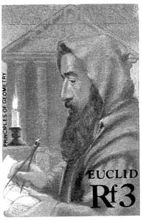
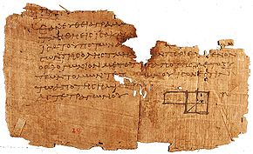
Euclid of Alexandria (325-265BC) The Elements
Euclid’s Algorithm finds the greatest common divisor of two positive natural numbers, a & b (where a ≥ b).
Images from www-groups.dcs.st-andrews.ac.uk & wikipedia.org
Notes:
See http://en.wikipedia.org/wiki/Greatest_common_divisor
This is a procedure with a finite, ordered, unambiguous set of operations, i.e., an algorithm. We’ll work through an example of this later in the lecture. For now, just note that:
Algorithms really are important for computing, so when we’re helping you in this class, we’ll likely irritate you by first focusing on your algorithm (or lack thereof) before even looking at your code.
Algorithmic thinking is very important, regardless of whether you go into CS/IS or not. All organizations have “procedures” that must be formulated and followed. E.g., Calvin College admissions/scholarships – we have to have a good answer to the question “why did person A get accepted and not person B?”. E.g., A business has to have a standardized procedure for hiring new employees. Etc. etc. etc.

Slide 15
Example: Euclid’s Algorithm
Test Cases:
GCD(36,16)→4; GCD(1,1)→1; GCD(1260,198)→18
Given:
Two positive natural numbers a & b
Set remainder = some non-zero value
Repeat these steps until remainder = 0
Set remainder = the remainder of a divided by b
If remainder = 0 Then
Print GCD is b
Else
Set a = b and b = remainder
Go on to the next repetition
Notes:
Do an example, explicitly writing out the variables a, b, and remainder:
GCD(36,16): 36 = 16*2 + 4 -> GCD(16,4): 16 = 4 * 4 with 0 remainder -> “GCD is 4”
GCD(1260,198): 1260 = 198*6 + 72 -> GCD(198,72): 198 = 72*2 + 54 -> GCD(72,54): 72 = 54*1 + 18 -> GCD(54,18): 54 = 18*3 + 0 with 0 remainder -> GCD(1260,198) = 18
Note the following things:
The algorithm is finite, ordered (using the 3 control structures) and unambiguous (using the appropriate level of abstraction).
The algorithm is not “obviously” correct, but if you follow it faithfully, you’ll get the right answer. Euclid proved that this would be case, no matter what the input. It’s actually boring to “execute” the algorithm, that’s why we program computers to do it for us; we get the more interesting task of writing the algorithm - computers are fast but dumb.
We assume that a & b are positive, natural numbers. Be careful about your assumptions – violated assumptions sink ships.
Always think about test cases – you can’t test everything, but come up with some test cases that will expose potential problems with the algorithm. Use pathological test cases (e.g., GCD(1,1), GCD(240,1), GCD(1260,198) )
Missing test cases crash airplanes.
The variables store values. Write them out (a, b and remainder) – computers are forgetful. Variables can only have 1 value at a time.
Indentation makes the structure clear – computers are pedantic.
We’ll do more with algorithms in labs #1 & 2.
http://en.wikipedia.org/wiki/Euclidean_algorithm

Slide 16
Designing Algorithms
Algorithms addressing myriad problems can be designed by recursively using a reasonable set of computable operations and the three control structures.
Notes:
It turns out that these three operation types and a reasonable set of computable operations give us the power to write algorithms for any number of problems, from the very small (e.g., multiplying m-digit numbers) to the very large (e.g., managing a modern operating system or an enterprise banking application). There are theoretical computability limits, as shown by Kurt Gödel, and some other practical limits on computing time and space, but the potential power of these algorithms is, nevertheless, immense.
Example:
print raise your hand if you want a brownie.
set counter = 0
for each student
if the current student has their hand raised then
set count = count + 1
ask student to lower their hand
go on to the next student
stop
The people who write these algorithms must be non-computer-like (imaginative, non-myopic, rememberful, clued-in).
Example:
repeat for each day of the week
if it’s not the weekend then
Get Up.
Wash.
Go to bed.
go on to the next day
stop
This algorithm is a more concise (though admittedly less engaging) way of phrasing some journal entries from Innocents Abroad, Mark Twain, chapter 59:
It reminds me of the journal I opened with the New Year, once, when I was a boy … Please accept of an extract: "Monday--Got up, washed, went to bed. "Tuesday--Got up, washed, went to bed. "Wednesday--Got up, washed, went to bed. "Thursday--Got up, washed, went to bed. "Friday--Got up, washed, went to bed. "Next Friday--Got up, washed, went to bed. "Friday fortnight--Got up, washed, went to bed. "Following month--Got up, washed, went to bed." I stopped, then, discouraged. Startling events appeared to be too rare, in my career, to render a diary necessary. I still reflect with pride, however, that even at that early age I washed when I got up.
(see http://www.mtwain.com/Innocents_Abroad/60.html)

Slide 17
Data Structures
Algorithms operate on data.
An algorithm must be precise about the abstract data structures that it manipulates.
Notes:
Unambiguous algorithms require unambiguous abstract data structure specifications (note that “abstract” is not the same as “vague” – “positive integer” is precise and abstract, “number” is probably too vague because it could be integer, real, etc.).

Slide 18
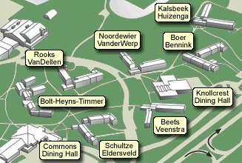
Shortest Path Problems
SP problems find a path between two points with minimum total weight.
Given graph G, starting point KH & destination CDH, the shortest path is 595 yards.
G
220
80
260
90
330
120
100
310
190
175
200
145
150
100
Notes:
Note two things:
The graph data structure is really important to this problem; it specifies what paths are possible.
The test case is a four-tuple (graph, start vertex, end vertex, correct distance).

Slide 19
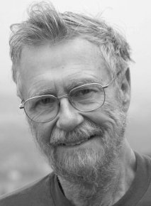
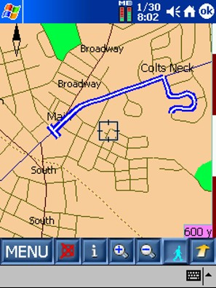
Edsger Dijkstra (1930-2002) Shortest Path Algorithm
Dijkstra’s algorithm solves the single-source shortest path problem for a graph with nonnegative edge weights.
Numerische Mathematik (1959), p. 269–271
images from www.tugurium.com, www-b2.is.tokushima-u.ac.jp & www.pocketpcthoughts.com
Notes:
See the pseudocode for this algorithm at http://en.wikipedia.org/wiki/Dijkstra's_algorithm
They don’t need to understand the algorithm, but they should understand why one would care about it.
Open Shortest Path First (OSPF) protocol is used for network routing.

Slide 20
Example: Dijkstra’s Algorithm
Test Cases: <G, KH, CDH, 595>, <G, BHT, CDH, 80>
Given: A weighted graph – G(vertexes, edges)
A current starting vertex – v
set D[v]=0
repeat for each vertex u≠v of G
set D[u] = +∞
set Q = priority queue of G’s edges based on weights
repeat while Q is not empty
set u = minimum distance vertex in Q
repeat for each vertex v in Q adjacent to u
if D[u]+weight(u,z)<D[z] then
set D[z] = D[u]+weight(u,z)
set Q(z).key = D[z]
Notes:
Note:
The test cases for this problem are four-tuples <graph, start vertex, end vertex, correct distance>. The first 3 are given, the last is the correct answer.
The use of advanced data structures (e.g., graph & priority queue).
Ignore:
The details of the algorithm encoding (you’ll see it in an algorithms course) – Just note that you do understand all the operation notation (just not the data structure notation).
How the algorithm works (frankly, this doesn’t matter, just implement it faithfully and it will work) - Dijkstra’s algorithm actually finds the shortest path from the starting point to all nodes, so it’s doing more work than it needs to and not receiving
http://en.wikipedia.org/wiki/Dijkstra’s_algorithm

Slide 21
Example: Brownies
Notes:
Talk about the brownies algorithm/data structures. Here’s a reasonable solution:
Given:
n - the number of students in the class
panWidth - the width of the pan
panLength - the length of the pan
Algorithm:
Set numberOfRows = ceiling(squareRoot(n))
Cut width into rows of width numberOfRows/panWidth
Cut length into rows of width numberOfRows/panLength
Repeat for each student in the class
Ask student if they want a brownie
If they want a brownie then
Place one napkin on the table
Use the spatula to remove one brownie
Place the brownie on the napkin
Give the brownie to the current student
Go on to the next student
Put the knife, spatula and napkins into the brownie pan.
Put the lid back on the brownie pan.
Stop
Note that this algorithm works for all pan and class sizes, but it sometimes creates very small/large brownies and can cut more brownies than are needed.

Slide 22
Example: Card Sorting
Notes:
Here’s a card-sorting activity that illustrates sort algorithms in a simple, physical way. I can’t remember the website from which I grabbed this specification:
Have them write instructions for sorting playing cards:
1. The cards start face down on the table
2. The instructions must be for only one person.
3. The person moving the cards can only have one card in each hand at any point (i.e. s/he can only look at the values of two cards)
4. The instructions can't require that the person remember the value of a card once they put it down. You can however use the space on the table however you like.
Then we share.
This works really well for me for a number of reasons:
1. If there are enough groups you'll usually see all of the n^2 sorting algorithms come out...on the first day! At least one group does selection-sort, another insertion-sort, another bubble-sort, and you even get crazy mixes, it's quite fascinating. This pays huge dividends down the line when you actually have to teach the sorts. Just harken back to day 1.
2. The students don't feel patronized. Sorting is a deep, but accessible problem. They haven't touched a computer in the class yet, but they can understand that a computer needs to process things as a series of steps and this exercise immediately gets to the depth of that, showing that sorting things is not just something a computer can "do." There are choices that have to be made, trade-offs to be considered. Students also immediately, innately, start asking good questions - "what if the list is already in order?" - "What's the 'worst' order it could be in?"
3. I usually have one group read their instructions to me (I'm the computer) and follow *EXACTLY* what they say to make the point about ambiguity in instructions.
4. Once the kids have struggled with this, you can demonstrate mergesort on a set of cards (I sometimes wait until later in the year) and it's like magic to them. They love it, and see immediately why/how it works. I'm sure many of them use it as a party trick.

Slide 23
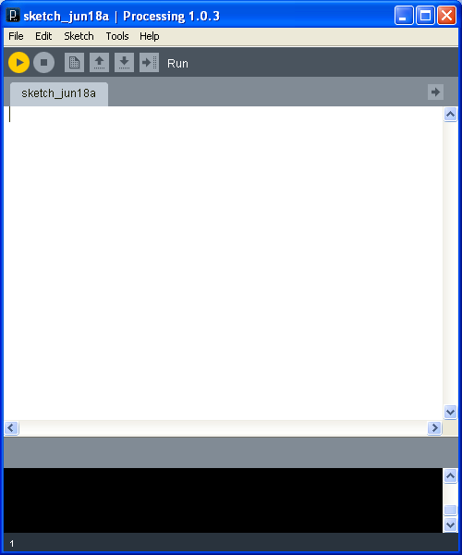
Processing IDE
Notes:
We’ll use Processing, a good language to use for graphical animations, in the next example
Go through a “nothing” example in the Processing IDE.
Notes:
Describe the elements of the IDE (control panel/run button and the program editor/text output/visual output panes).
Run a “nothing” program/sketch.
Demonstrate the basic graphical tools (optional):
the text’s “hello, earth” example;
the basic 2D shapes (point, line, rect, ellipse).
Show how to run a traditional, printed “hello, world!” example (optional).
The key point here is the use of code to produce/characterize output. Programming is not WYSIWYG. You might ask the students why anyone would bother with this code-sketch cycle when WYSIWYG is so much simpler to understand.

Slide 24
Example: Random Dots
Notes:
Do the PointDraw program example in Processing. Show the processing environment and then build this program up statement by statement, illustrating the use of the three control structures and data structures.
/*
* PointDraw draws random points in random colors.
*
* @author jnyhoff (adapted by kvlinden)
* @version 19june2009
*/
size(150, 100);
for (int counter = 0; counter < 10000; counter++) {
if (random(2) >= 1) {
stroke(255, 0, 0);
} else {
stroke(0, 0, 255);
}
point(random(150), random(100));
}
What are some of the basic operations that Processing provides? (e.g., rect(), ellipse()).

Slide 25
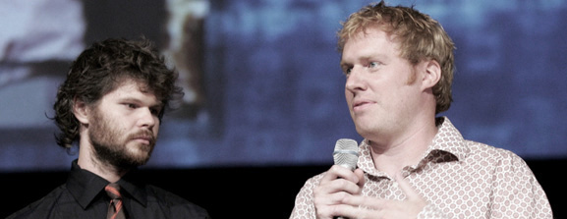
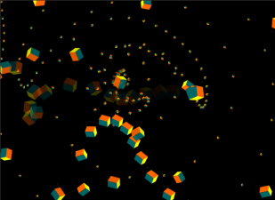
Casey Reas (1972 - ) & Ben Fry (1975 - )
What’s the
Big Idea
Processing, 2001
Developed by Reas & Fry when they were PhD students at the Aesthetics and Computation Group at the MIT Media Lab
Designed for electronic arts and visual design
“Dancing Spirals” by Ira Greenberg
images from albagcorral.com and iragreenberg.com/
Notes:
Note: hyperlinks on “MIT Media Lab,” “Aesthetics + Computation,”
“Seed Media Group” and “Design | Media Arts, UCLA,” “Dancing Spirals” (image),
“Ben Fry,” and “Casey Reas.”
Casey Reas, on creating Processing:
“Ben and I are both teachers doing all our work in software and we are really frustrated
with the current software environments that exist for doing this kind of work. Nobody
has really designed a software environment for working in the way that we like to work,
so that's why we started building it. We always worked in software environments like C,
C++, Java, and OpenGL. These environments are too complex. They're trying to do everything
so they're just massively difficult to use. And what we need is just something that is specifically
tailored for the work that we want to do. So in our language for example, we have a simpler
and better control over color than any other programming language that I have ever seen before.
So it's specifically designed for the things we find important.…it's specifically made for what
we call electronic arts.”
Ira Greenberg - http://www.iragreenberg.com -Ira is also one of those contributing to the ongoing development of Processing.
Few Computer Science professors at large have even heard of processing…yet.
We in the CS department at Calvin [Jeff Nyhoff, really] discovered Processing during
explorations into opportunities for integrating more digital art and media into
the study of computing, in addition to the strong tradition of approaching
computing in a mathematical and scientific way.
We see this as consistent with our mission within a Christian Liberal Arts college.
We truly believe almost any Calvin student would benefit from learning programming in order to be best prepared for Kingdom work in this information age. We want to make
it easier and more interesting for students from a wider range of fields to do so.
Thus, while Processing was originally developed by artists and for artists, we see the way
it brings together math and science with artistic creation as offering a wonderful way
for anyone to learn to program – certainly for students and professors at a Christian
Liberal Arts college such as ours.

Slide 26
Software Engineering
The goal of software engineering is to produce systems that have the following characteristics:
The algorithm and data structures solve the problem correctly and efficiently.
The encoded algorithm is understandable.
The resulting system is usable.
Achieving this for large problems requires creativity and ingenuity.
Notes:
We’ve got to design and implement algorithms that have these properties.
Give examples of programs that don’t (and do) these things:
Correctness (it actually solves the problem):
bad: radiation gone bad (linear accelerators programs functioning incorrectly -- http://well.blogs.nytimes.com/2010/01/23/when-radiation-treatment-turns-deadly/)
bad: the patriot missile system (>100 hours had cumulative timing fault)
good: What we hope most any program actually is
Efficiency (without wasting time or space) :
bad: A full-search chess program;
bad: Chad VP’s GR library search program (using grep)
good: the new Oracle-based GR library program
Readability (understandable by another person):
bad: “Watch this Steve”
good: code with whitespace, informative variable names
usability (in a way that is easy for its user to learn and use):
bad: dragging the disk to the trash can on the mac?!
good: the rest of the mac interface - it’s worth the extra money.

Slide 27
The Development Life-Cycle
Realistic problems tend to be large enough to require the disciplined effort of multiple people, coordinated into phases:
Analysis;
Design;
Implementation;
Testing;
Maintenance.
Notes:
I’ll say a bit about each of these tasks, sometimes called “phases”:
Analysis – Understand the goals of the problem; ask “what” questions.
Design – Layout the solution; draw sketches; specify data structures & algorithms; ask “how” questions.
Implementation – Faithfully translate the design into a running prototype; “do” it.
Testing – Verify that the prototype actually satisfies the goals of given in analysis; “evaluate” it.
Maintenance – deploy and maintain it.
In this course, we’ll focus heavily on design, implementation and testing.

Slide 28
Sequential Development
The software development life-cycle is traditionally viewed sequentially.
Analysis
Design
Implementation
Testing
Maintenance
Notes:
The so-called waterfall model. Much maligned, much used nevertheless.

Slide 29
Iterative/Incremental Development
Agile development tends to use a more iterative and incremental model.
Analysis
Design
Testing
Implementation
Notes:
We’ll call this IID (Iterative/Incremental Development). Note that the “D” is not design here, it’s the whole development process.
However you orchestrate the phases, you should always follow one critical rule: “Think first, program later”.

Slide 30
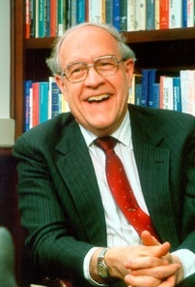
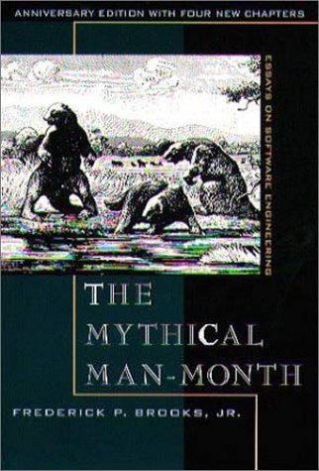
Fredrick P. Brooks (1931- ) The Mythical Man-Month
What’s the
Big Idea
Joys of programming
We enjoy designing things because we are created in the image of God.
The computer is a powerful and rewarding tool to use.
Woes of programming
The “mindless” details can be excessively tedious.
Products become obsolete too quickly.
As the child delights in his mud pie, so the adult enjoys building things, especially things of his own design. I think this delight must be an image of God's delight in making things, a delight shown in the distinctness and newness of each leaf and each snowflake.
- F. P. Brooks, Jr. The Mythical Man-Month, 1975
images from: http://www.amazon.com/
Notes:
The Mythical Man Month chronicles IBM’s OS/360 project, the largest software project up til 1964. Brooks was the project leader. Note that he explicitly talked about how the waterfall model on the previous page is wrong (he advocated iterative design or the “growing” or software).
Joys of the craft (I.e., programming):
1. The joy of building things. “I think this delight must be an image of God’s delight in making things, a delight shown in the distinctness and newness of each leaf and each snowflake.
2. The pleasure of making useful things.
3. The fascination of making complex artifacts.
4. The joy of always learning.
5. The joy of using the computer (flexible, scalable)
Woes of the craft:
1. The smallest errors mess things up.
2. Other people set your agenda
3. Picky details are a pain.
4. Debugging/testing drags on and on.
5. The product becomes obsolete so quickly.

