Slide 1
The Modal Aspects: Laws and Norms
Notes:
Each aspect cannot simply be reduced to a lower aspect (anti-reductionism)
Most human living, being and acting is multi-aspectual
Aspects include laws and norms
commitment, trust, faith, certainty, aspiration, vision
self-giving love, generosity, care, and attitude
what is due, justice, legality, rights, responsibilities
beauty, harmony, surprise, delight, and playfulness
Norms
frugality, skilled use of resources, limits, carefulness
social interaction, relationships, roles, institutions
symbolic meaning, signification
formative power, shaping: in history, culture
logical distinction, conceptualizing, and inferring
sense, perception, feeling, and emotion
life functions, integrity of organism, flourishing
Most engineering programs focus only on these “lower” aspects
energy and matter, forces
Laws
flowing movement
continuous extension
discrete quantity, number, amount

Slide 2
Design Norm | Description | Sample Questions
Cultural Appropriateness | Technology products should consider the culture into which they are embedded, cultivating improvement without disrespectful or unnecessary disruption. | Does the technology relieve burdens while preserving what is good in a cultural context? Is the design appropriate to its context, including questions of centralization vs. decentralization, large scale vs. small scale, and continuity vs. discontinuity.
Transparency | Documentation and user interface ought to be clearly understandable by the user without being overwhelming. Users should be informed about potential dangers and guided to diagnose failures. For example, software and dashboards that clearly communicate status and errors. | Is the documentation clear and unambiguous? Is the layout, color scheme, and icons of the interface helpful? Does the product perform as advertised or does it bear false witness or exaggerate its claims? Are potential dangers clearly indicated to users?
Social | The technology should foster good relationships and conviviality among all people involved. | Does the technology encourage community, hospitality, conviviality, and cooperation? Does the design process foster good teamwork? Does the product contribute to enmity, isolation, or polarization?
Stewardship | Use of creational resources should be respectful, frugal, and caring, Design should reflect concern for sustainability and the environment. This norm also includes economic considerations. | Does the design consider the entire life cycle of the product? Is it repairable and recyclable? Is it efficient, using energy and other resources wisely? Are there waste products result from its use? Is respect paid to all of God’s creatures?
Aesthetics | This norm deals with delightful harmony: the form of the technological device should suggest its function and be pleasing and satisfying to use. For example, a hammer’s form implies its function (of pounding). | Can new users easily intuit the function of this design? Is the user interface clear and pleasing to use? Is it delightful and beautiful?
Justice | Technology should correct (not cause) injustice and should encourage justice, i.e., equity and fairness. The design should help give each person their due and facilitate the opportunity for all creatures to be the creature that God intends them to be. | Does this device promote fairness? Are copyrights and intellectual property respected? Could this design be easily used for unjust purposes? Does it respect intellectual property and privacy?
Caring | Our tools should help us serve one another, promote wellness, contribute to healing, show love to our neighbor, and enable fellow creatures to flourish. Design should show loving concern for the welfare of all involved. | In what ways does this design show care for others? How does it show love for neighbor? Who might be harmed if this device is used?
Trust | Technological devices ought to be reliable, especially in situations where safety is a crucial factor. Design should be a response to God and promote faith in him rather than faith in technology of any created thing. | Can the user depend on the design for its intended purpose. Is the design safe and secure? What habits and practices are associated with the device and how might that shape the user?

Slide 3
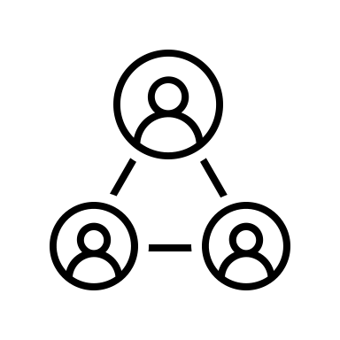
Design Norms
Does the technology relieve burdens while preserving what is good in a cultural context? Is the design appropriate to its context?
Cultural appropriateness
Transparency
Social
Stewardship
Delightful Harmony
Justice
Caring
Trust
Is the documentation clear and unambiguous? Is the layout, color scheme, and icons of the interface helpful? Does the product exaggerate its claims?
Does the technology encourage community, hospitality, conviviality, teamwork, and cooperation?
Does the design consider the entire life cycle of the product? Is it repairable and recyclable? Is it efficient, using energy and other resources wisely?
Can new users easily intuit the function of this design? Is the user interface clear and pleasing to use? Is it delightful and beautiful?
Does this device promote fairness? Could this design be easily used for unjust purposes?
In what ways does this design show care for others? How does it show love for neighbor? Who might be harmed if this device is used?
Can the user depend on the design for its intended purpose. Is the design safe & secure?
“If you go against the grain of the universe, you get splinters.” --H.H. Farmer

