Slide 1
Open up the box of a computer, and you won't find any numbers in there. You'll find electromagnetic fields. Just as if you open up a person's brain case, you won't find symbols; you'll find neurons. You can use those things, either neurons or electromagnetic fields, to represent any patterns you like. A computer could care less whether those patterns denote words, numbers, or pictures. Sure, in one sense, there are bits inside a computer, but what's important is not that they can do fast arithmetic but that they can manipulate symbols. That's how humans can think, and that's the basic hypothesis I operate from.
- Herbert Simon, OMNI Magazine (June 1994)
Notes:
It’s a mind-set, not a skill-set. Brilliance helps, but is not required. Instead, adopt these mantras: be stubborn, bossy, lazy, retentive, cynical, plodding, and importunate. Why? So you can use IT as a tool to do cool stuff…

Slide 2
Digital Modeling
Digital computers perform operations on represented data.
All data is represented by numbers.
  What kinds of data (or information) are there?
Mixed success:
  A wide range of things can be modeled.
  Some things are very difficult to model.
Notes:
It’s surprising (sometimes) what can and can’t be modeled.

Slide 3
Binary
Binary is a base-2 numbering system.
A bit is a “binary digit”:
  0 (or “off”)
  1 (or “on”)
Binary is just as powerful as decimal -- no more or less.

Slide 4
Digitizing Numbers
Numbers are represented in memory using a binary encoding scheme.
  Storing positive numbers is pretty obvious.
  What about negative numbers?
  What about “decimals”?
  What about really really really big numbers?
That’s why there are standard “encoding schemes”.
Notes:
It’s all binary underneath!
2’s compliment for integers
Floating point for real numbers

Slide 5
Decimal Numbers
Decimal numbers are base-10 (using digits 0-9)
123
1*10² + 2*10¹ + 3*10⁰
1*100 + 2*10 + 3*1
100 + 20 + 3

Slide 6
Binary Numbers
Binary numbers are base-2 (using digits 0 & 1)
110₂
1*2² + 1*2¹ + 0*2⁰
1*4 + 1*2 + 0*1
4 + 2 + 0 = 6₁₀

Slide 7
Digitizing Characters
Each character is assigned an integer value.
  Programs keep track of which memory locations store character data.
  Programs display the right glyph on the screen.
Two common schemes:
  ASCII
  Unicode
Notes:
It’s all binary underneath!

Slide 8
ASCII
American Standard Code for Information Interchange.
Uses 7 bit integers
  2⁷ = 128 different characters
Extended ASCII uses 8 bit integers
  2⁸ = 256 characters
ASCII is the most common code currently used.
Notes:
Note the “numerals” have their own ASCII code which means that “1” is different from 1. Confusing!

Slide 9
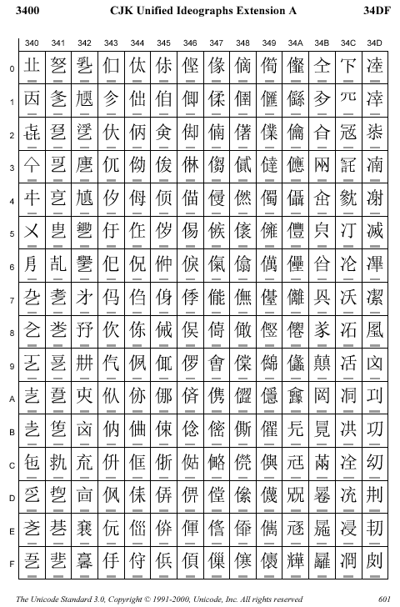
Unicode
Uses 8 - 32 bit integers
  over a million characters defined.
Unicode supports a number of different character types.
  Cyrillic
  Ancient Coptic
  All charts
Notes:
This is just a small part of the full unicode support for chinese characters.
Unicode is becoming more and more common.
I may have to explain hexadecimal to explain what the row and column numbers mean.

Slide 10

Social justice and computing
What’s the
Big Idea
The accessibility of computers and readable character sets can be seen as an issue of social justice.
Notes:
Related to the digital divide material included in the computer anatomy lectures.
Given the English-centric nature of the web, one might more accurately call it the Western-wide web.
Digital divide – the WWW is hard to access in:
the developing world
the non-western world
underpriviledged social classes
the disabled community
What could we do to help bridge this divide?
Unicode
internationalized domain name resolution
better translation tools
better international/disabled design and testing

Slide 11
Digitizing Big Data
Using numbers and characters, we can digitize and model bigger things:
  Documents
  Accountant’s ledger
  City maps
  Human behaviors
  Calendars
  Images, audio, video
Programs make sense of the data.
Notes:
Check out this article on digitally edited photos:
Can Photos Be Trusted? - Popular Science
http://www.popsci.com/popsci/technology/generaltechnology/d6002684e4646010vgnvcm1000004eecbccdrcrd.html

Slide 12
Digitizing Multimedia Data
Multimedia data is usually
  HUGE
  And highly patterned
Compress the data by taking advantage of the patterns to take up less space.
  Lossless compression doesn’t lose any information.
  Lossy compression loses some information for better compression.
Notes:
Check out this article on digitally edited photos:
Can Photos Be Trusted? - Popular Science
http://www.popsci.com/popsci/technology/generaltechnology/d6002684e4646010vgnvcm1000004eecbccdrcrd.html

Slide 13
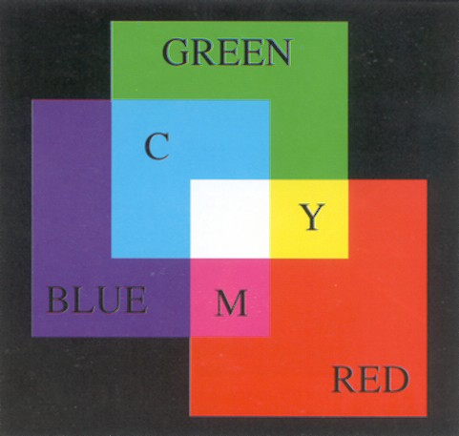
Digitizing Images
An image is an array of pixels.
Each pixel has:
  intensity values for Red, Green & Blue
  an optional alpha value for transparency
Common image file formats include:
  PNG: Lossless, often seen on the web
  GIF: Lossless, 256 colors max, but patented
  JPEG: Lossy, compression 3:1 to 60:1
  TIFF: Lossless
  BMP: Uncompressed Windows format
image from Harry Plantinga
Notes:
Check out this article on digitally edited photos:
Can Photos Be Trusted? - Popular Science
http://www.popsci.com/popsci/technology/generaltechnology/d6002684e4646010vgnvcm1000004eecbccdrcrd.html

Slide 14
Use of Image Formats
PNG: web, logos and text
GIF: web, logos and text, animation
JPEG: photos
TIFF: imaging software
BMP: never
Notes:
Check out this article on digitally edited photos:
Can Photos Be Trusted? - Popular Science
http://www.popsci.com/popsci/technology/generaltechnology/d6002684e4646010vgnvcm1000004eecbccdrcrd.html

Slide 15
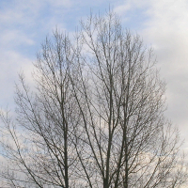
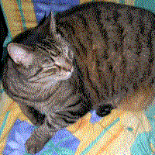
Steganography
Cryptography encrypts messages using encryption keys.
Steganography hides messages in other digital media.
Images from www.wikipedia.org
Notes:
The bottom picture was hidden in the last 2 bits of the pixel codes of the top picture and recovered. People looking at the original would never have known that the cat was there, except, perhaps, by noticing that the relatively large size of the image file is not congruent with the relatively poor resolution of image.
http://en.wikipedia.org/wiki/Steganography
http://www.calvin.edu/~lave/s-tools/
This works for GIF but not for JPG (because of the way JPG codes the colors for compression).
http://www.stegoarchive.com/

Slide 16
Digitizing Audio
Sound can also be digitized.
Common sound file formats:
  mp3 – open, patented, no DRM, older/less effective
  wma – Windows Media Audio, patented/proprietary, DRM
  AAC – Apple’s iTunes, patented, proprietary, DRM
  RealAudio – patented, proprietary, DRM
  Ogg Vorbis – unpatented, open, no DRM
Notes:
DRM – digital rights management (see wikipedia)
Lossy vs. lossless
Fights over “standards”
DRM is an ever-more-important issue

Slide 17
Digitizing Video
Common movie file formats:
  mpeg – Open (but patented) standard
  avi – Windows Media Player
  DV – As used in digital camcorders
  divx – very high compression ratios

Slide 18
How does a computer know what it is looking at?
Windows tells what kind of thing is being modeled by looking at a file’s suffix (or extension) :
  .txt: text file (in ASCII or Unicode)
  .jpg, .png, .bmp: image
  .xls, .xlsx: Excel spreadsheet
  .zip: a compressed folder of files/folders.
  .doc, .docx, .rtf: Word documents
Linux stores file type in the file itself.
Notes:
If you change the suffix of a file name, Windows thinks it is a different kind of file and will try to open it with a different program.

Slide 19
The Difficulty of Modeling
What’s the
Big Idea
Not everything can be easily modeled.
“I praise you because I am fearfully and wonderfully made.” - Acts 10:34-35
Notes:
The weather (just too much stuff) (although this is getting much better every year)
The human genome (just too much stuff we don’t understand)
Human intelligence (AI – to the sussman anomaly example here) - Easy things are hard, hard things are easy. E.g., Being human is harder than it looks. “One year in AI is enough to make one believe in God” – Alan Perlis.

