Slide 1
1. Preliminaries
Rocky K. C. Chang
February 15, 2023

Slide 2
Outlines
What is a computer network?
How to classify a computer network?
What are your expectations for a computer network?
What is the Internet?
The Internet structure
Network edge
Network core
Network performance
Layered model and protocols

Slide 3
What is Internet/computer network?
A network of computers
Computers
Hosts (autonomous)
Routers/switches
Others: middleboxes, firewalls, NAT box, etc
Often modeled as a graph
Nodes (interface or (a group of) host/routers)
Links (physical or logical)

Slide 4
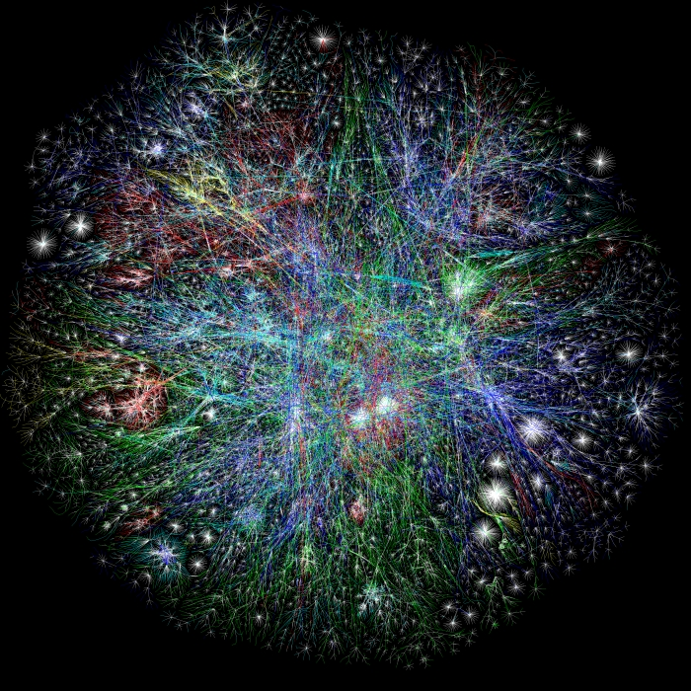
Lumeta (Global Network Visibility)

Slide 5
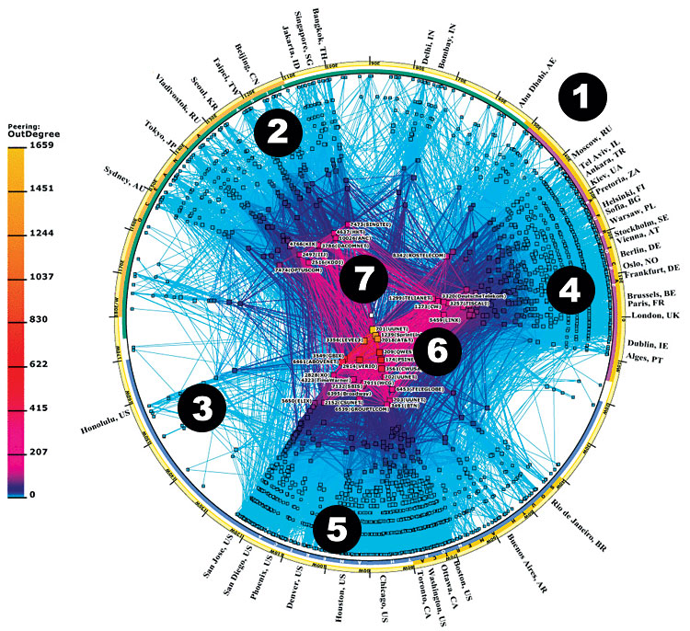
http://www.treehugger.com/files/2009/05/what-is-the-environmental-impact-of-the-internet.php

Slide 6
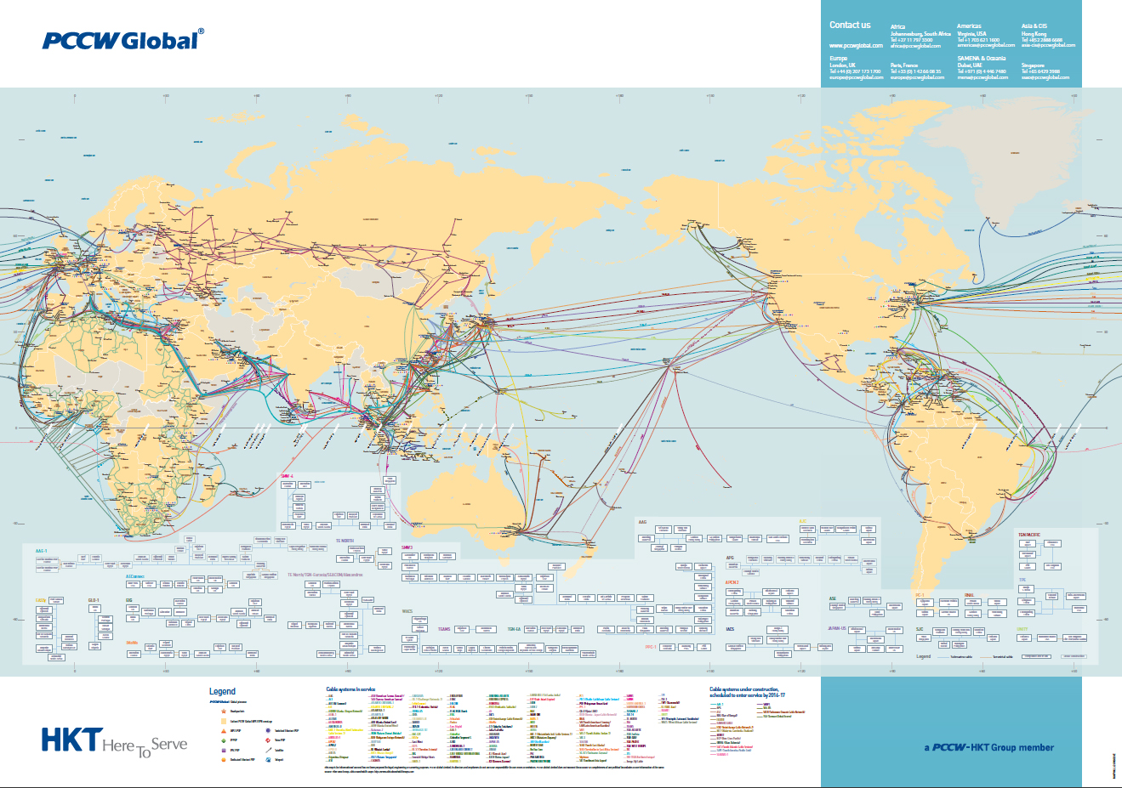
https://www.pccwglobal.com/en/global-coverage

Slide 7
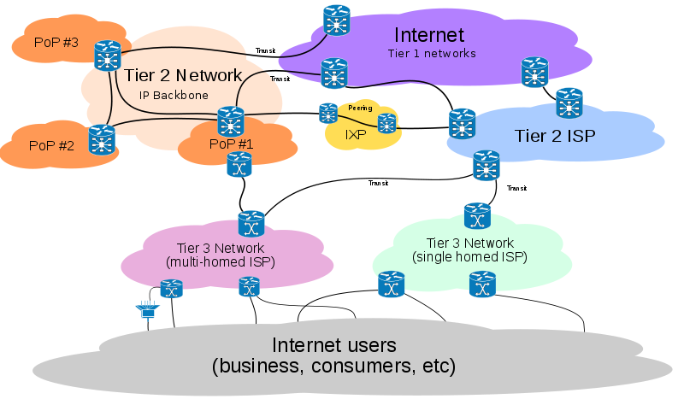
http://en.wikipedia.org/wiki/File:Internet_Connectivity_Distribution_%26_Core.svg

Slide 8
Exercise
Search for a list of Internet exchanges in the world.
What is the “ranking” of the TPIX (Taipei Internet Exchange)?

Slide 9
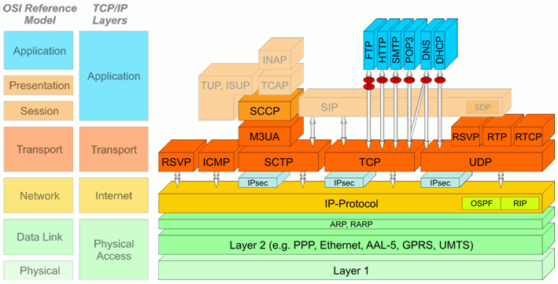
https://www.inacon.de/ph/data/IPv4/IP-Protocol-Stack_OS_RFC-791.htm

Slide 10
Exercise
Find out the full names of FTP, HTTP, SMTP, SNMP, POP3, DNS, and DHCP.

Slide 11
Outline
What is a computer network?
How to classify a computer network?
What are your expectations for a computer network?
What is the Internet?
The Internet structure
Network edge
Network core
Network performance
Layered model and protocols

Slide 12
Classifications of computer networks
According to the network size:
Interconnection networks: connecting multiple processors
Body area networks (BAN)
System/Storage area networks (SAN): connecting processors to storage servers
Sensor networks
Local area networks (LAN): connecting a limited number of hosts in a close proximity
Metropolitan area networks (MAN): connecting a limited number of LANs in a close proximity
Wide area networks (WAN): connecting hosts situated anywhere

Slide 13
Classifications of computer networks
According to mobility:
Fixed networks
Wireless networks
Mobile networks
According to the network speed:
Dial-up networks (kbps)
High-speed networks (Mbps)
Gigabit networks (Gbps)

Slide 14
Classifications of computer networks
According to the “system software”:
Novell NetWare (IPX) (obsoleted)
IBM’s SNA (?)
Xerox’s XNS (obsoleted)
DEC’s DECnet (obsoleted)
Apple’s AppleTalk (obsoleted)
Microsoft’s NetBIOS and NetBEUI
TCP/IP

Slide 15
Outline
What is a computer network?
How to classify a computer network?
What are your expectations for a computer network?
What is the Internet?
The Internet structure
Network edge
Network core
Network performance
Layered model and protocols

Slide 16
What are your expectations for a computer network?

Slide 17
Outline
What is a computer network?
How to classify a computer network?
What are your expectations for a computer network?
What is the Internet?
The Internet structure
Network edge
Network core
Network performance
Layered model and protocols

Slide 18
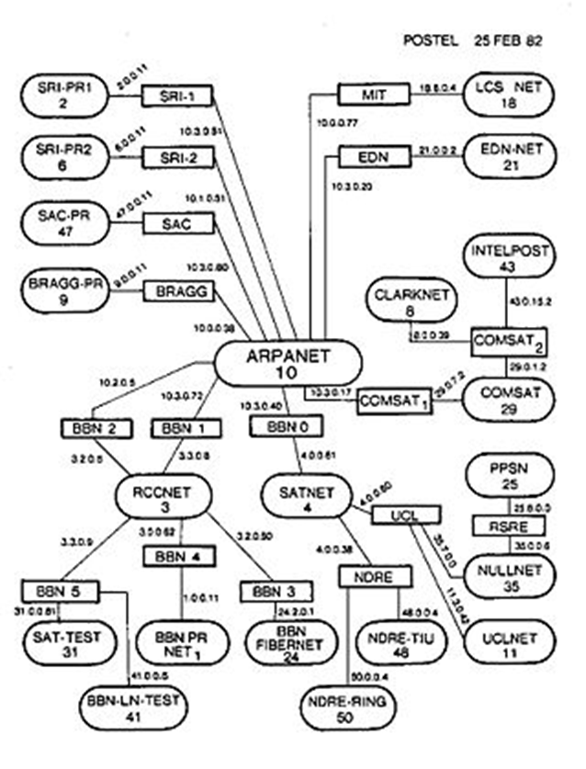
What is the Internet?
Why built an Internet?
How to build it?
Who built it?
Who owns and governs it?
Who continues to develop the technologies?
Who manages the domain names and IP addresses?
Source: https://en.wikipedia.org/wiki/History_of_the_Internet#ARPANET

Slide 19
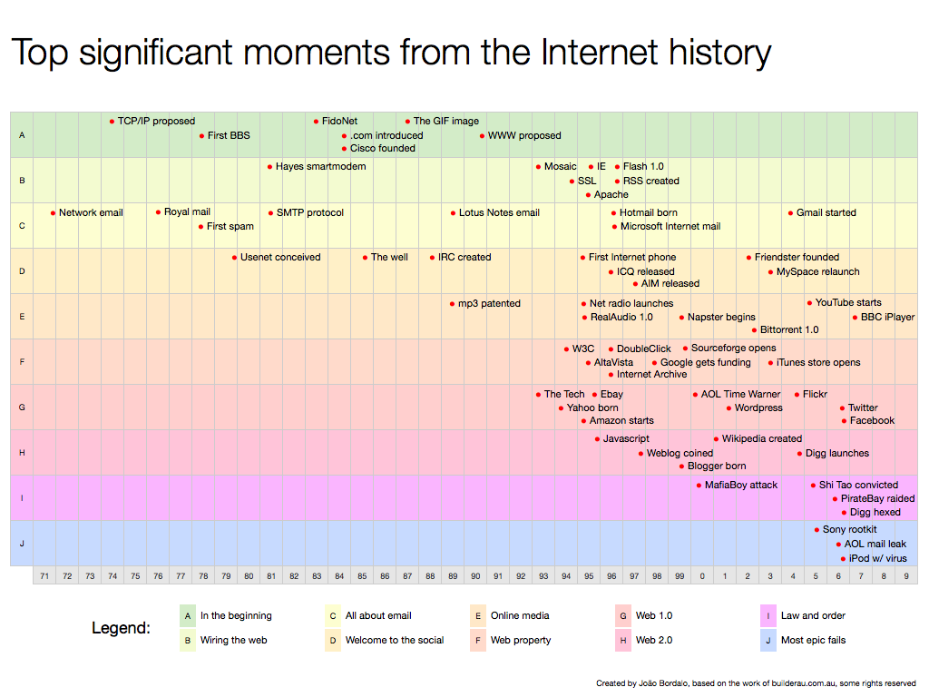
Source: http://joaobordalo.com/files/topInternetHistory.png

Slide 20
Content
What is a computer network?
How to classify a computer network?
What are your expectations for a computer network?
What is the Internet?
The Internet structure
Network edge
Network core
Network performance
Layered model and protocols

Slide 21

A “nuts and bolts” view
PC
millions of connected computing devices: hosts = end systems
running network apps
Mobile network
server
Global ISP
wireless
laptop
cellular
handheld
Home network
communication links
fiber, copper, radio, satellite
transmission rate = bandwidth
Regional ISP
access
points
wired
links
Institutional network
routers: forward packets (chunks of data)
router

Slide 22
A “nuts and bolts” view
protocols control sending, receiving of msgs
e.g., TCP, IP, HTTP, SIP, CSMA/CD
Internet: “network of networks”
loosely hierarchical
public Internet versus private intranet
Internet standards
RFC: Request for comments
IETF: Internet Engineering Task Force
Mobile network
Global ISP
Home network
Regional ISP
Institutional network

Slide 23
What’s the Internet: a service view
communication infrastructure enables distributed applications:
Web, VoIP, email, games, e-commerce, file sharing
communication services provided to apps:
reliable data delivery from source to destination
“best effort” (unreliable) data delivery

Slide 24
What’s a protocol (πρωτόκολλον)?
human protocols:
“what’s the time?”
“I have a question”
introductions
… specific msgs sent
… specific actions taken when msgs received, or other events
network protocols:
machines rather than humans
all communication activity in Internet governed by protocols
protocols define format, order of msgs sent and received among network entities, and actions taken on msg transmission, receipt

Slide 25


What’s a protocol?
A human protocol and a computer network protocol:
Hi
TCP connection
request
Hi
TCP connection
response
Got the
time?
Get http://www.awl.com/kurose-ross
2:00
<file>
time

Slide 26
Outline
What is a computer network?
How to classify a computer network?
What are your expectations for a computer network?
What is the Internet?
The Internet structure
Network edge
Network core
Network performance
Layered model and protocols

Slide 27
A closer look at network structure:
Network edge: applications and hosts
access networks, physical media: wired, wireless communication links
Network core:
interconnected routers
network of networks

Slide 28
The network edge:
End systems (hosts):
run application programs
e.g. Web, email
at “edge of network”
peer-peer
client/server model
client host requests, receives service from always-on server
e.g. Web browser/server; email client/server
client/server
peer-peer model:
minimal (or no) use of dedicated servers
e.g. Skype, BitTorrent

Slide 29
Access networks and physical media
Q: How to connect end systems to edge router?
residential access nets
institutional access networks (school, company)
mobile access networks
Keep in mind:
bandwidth (bits per second) of access network?
shared or dedicated?

Slide 30
Digital Subscriber Line (DSL)
Existing phone line: 0-4KHz phone; 4-50KHz upstream data; 50KHz-1MHz downstream data
Internet
home
phone
DSLAM
telephone
network
splitter
DSL
modem
central
office
home
PC
Also uses existing telephone infrastructure
XDSL, X = A, RA, H, V, S, …
dedicated physical line to telephone central office

Slide 31

Cable Network Architecture: Overview
Typically 500 to 5,000 homes
cable headend
cable distribution
network (simplified)
home

Slide 32
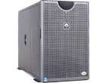
Cable Network Architecture: Overview
server(s)
cable headend
cable distribution
network
home

Slide 33
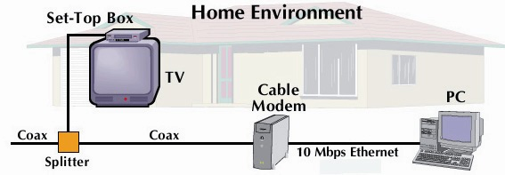
Cable Network Architecture: Overview
cable headend
cable distribution
network (simplified)
home

Slide 34
Fiber to the Home
ONT
Internet
optical fibers
optical fiber
ONT
OLT
optical
splitter
central office
ONT
Optical links from central office to the home
Two competing optical technologies:
Passive Optical network (PON)
Active Optical Network (PAN)

Slide 35
Ethernet Internet access
100 Mbps
Institutional
router
Ethernet
switch
To Institution’s ISP
100 Mbps
1 Gbps
100 Mbps
server
Typically used in companies, universities, etc
10 Mbs, 100Mbps, 1Gbps, 10Gbps Ethernet
Today, end systems typically connect into Ethernet switch

Slide 36
Wireless access networks
shared wireless access network connects end system to router
via base station aka “access point”
wireless LANs:
802.11b/g/n/ac (WiFi): 11/54/600/1000Mbps
wider-area wireless access
provided by telco operator
~1Mbps over cellular system (EVDO, HSDPA)
WiMAX (10’s Mbps) over wide area
LTE
router
base
station
mobile
hosts

Slide 37
Exercise
Find out the physical (or MAC) addresses of your notebook’s WiFi adaptor and Ethernet adaptor using ipconfig –all.

Slide 38
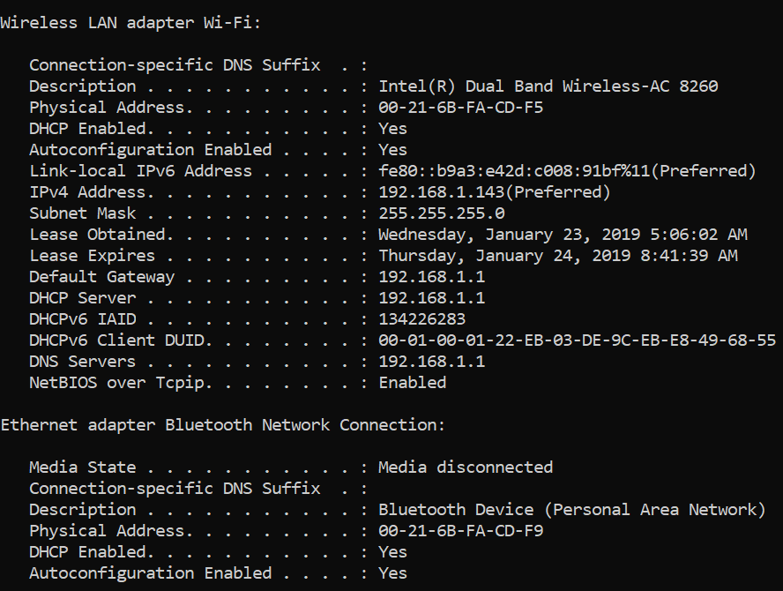

Slide 39
Exercise
Do a traceroute (tracert on WIN) to a local host, such as www.sinica.edu.tw, www.post.gov.tw, google.com.tw, etc.
Which “hops” belong to the edge and which belongs to the core?
Repeat the above for hosts outside Taiwan, such as my alma mater RPI (www.rpi.edu), or your favorite university.

Slide 40
Outline
What is a computer network?
How to classify a computer network?
What are your expectations for a computer network?
What is the Internet?
The Internet structure
Network edge
Network core
Network performance
Layered model and protocols

Slide 41
The Network Core
Mesh of interconnected routers
The fundamental question: how is data transferred through the net?
circuit switching: dedicated circuit per call: telephone net
packet-switching: data sent thru net in discrete “chunks”

Slide 42
Network Core: Circuit Switching
End-end resources reserved for “call”
link bandwidth, switch capacity
dedicated resources: no sharing
circuit-like (guaranteed) performance
call setup required

Slide 43
Network Core: Circuit Switching
Network resources (e.g., bandwidth) divided into “pieces”
pieces allocated to calls
resource piece idle if not used by owning call (no sharing)
dividing link bandwidth into “pieces”
frequency division
time division

Slide 44
Circuit Switching: FDM and TDM
Example:
FDM
4 users
frequency
time
TDM
frequency
time
Notes:
Two simple multiple access control techniques.
Each mobile’s share of the bandwidth is divided into portions for the uplink and the downlink. Also, possibly, out of band signaling.
As we will see, used in AMPS, GSM, IS-54/136

Slide 45
Network Core: Packet Switching
Each end-end data stream divided into packets
user A, B packets share network resources
each packet uses full link bandwidth
resources used as needed
Resource contention:
aggregate resource demand can exceed amount available
congestion: packets queue, wait for link use
store and forward: packets move one hop at a time
Node receives complete packet before forwarding
Bandwidth division into “pieces”
Dedicated allocation
Resource reservation

Slide 46
Packet Switching: Statistical Multiplexing
100 Mb/s
Ethernet
A
C
statistical multiplexing
1.5 Mb/s
B
queue of packets
waiting for output
link
D
E
Sequence of A & B packets does not have fixed pattern, bandwidth shared on demand: statistical multiplexing.

Slide 47
Packet-switching: store-and-forward
L
R
R
R
takes L/R seconds to transmit (push out) packet of L bits on to link at R bps
store and forward: entire packet must arrive at router before it can be transmitted on next link
delay = 3L/R (assuming zero propagation delay)
Example:
L = 7.5 Mbits
R = 1.5 Mbps
transmission delay = 15 sec
more on delay shortly …

Slide 48
Packet switching versus circuit switching
Packet switching allows more users to use network!
1 Mb/s link
each user:
100 kb/s when “active”
active 10% of time
circuit-switching:
10 users
packet switching:
with 35 users, probability > 10 active at the same time is around .0004
N users
1 Mbps link
Q: how did we get value 0.0004?

Slide 49
Packet switching versus circuit switching
Great for bursty data
resource sharing
simpler, no call setup
Excessive congestion: packet delay and loss
protocols needed for reliable data transfer, congestion control
Q: How to provide circuit-like behavior?
bandwidth guarantees needed for audio/video apps
still an unsolved problem

Slide 50
Internet structure: network of networks
roughly hierarchical
at center: “tier-1” ISPs (e.g., Verizon, Sprint, AT&T, Cable and Wireless), national/international coverage
treat each other as equals
Tier-1 providers interconnect (peer) privately
Tier 1 ISP
Tier 1 ISP
Tier 1 ISP

Slide 51
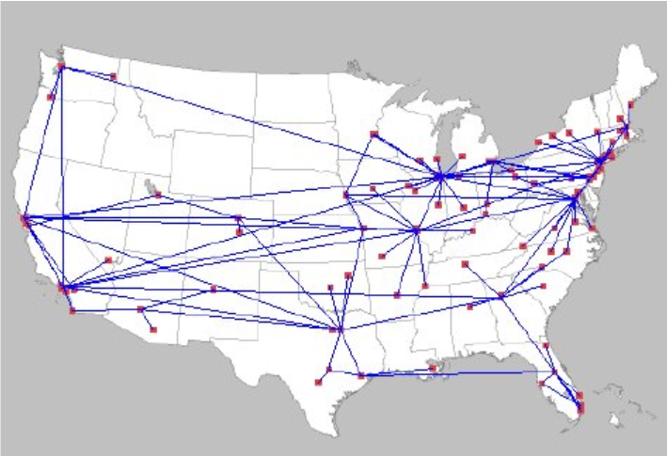
AT&T POP Level Network in the US (2013)
Source: https://www.researchgate.net/publication/259673301_A_Novel_Approach_to_Interior_Gateway_Routing/figures?lo=1

Slide 52
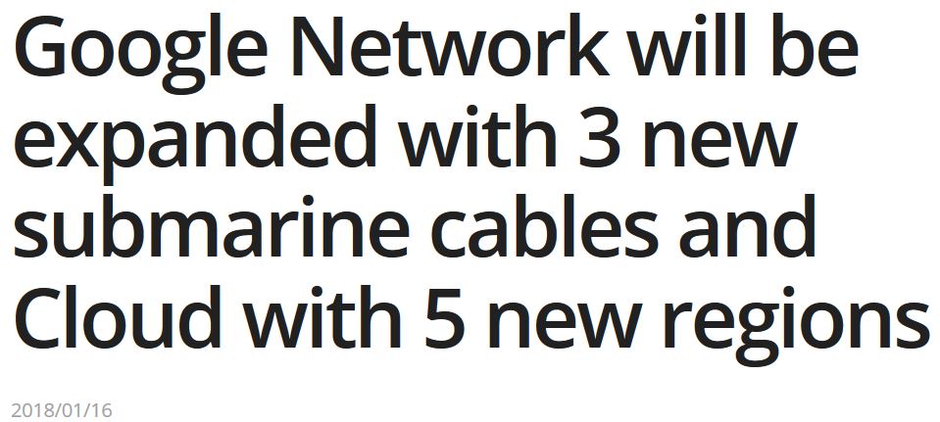
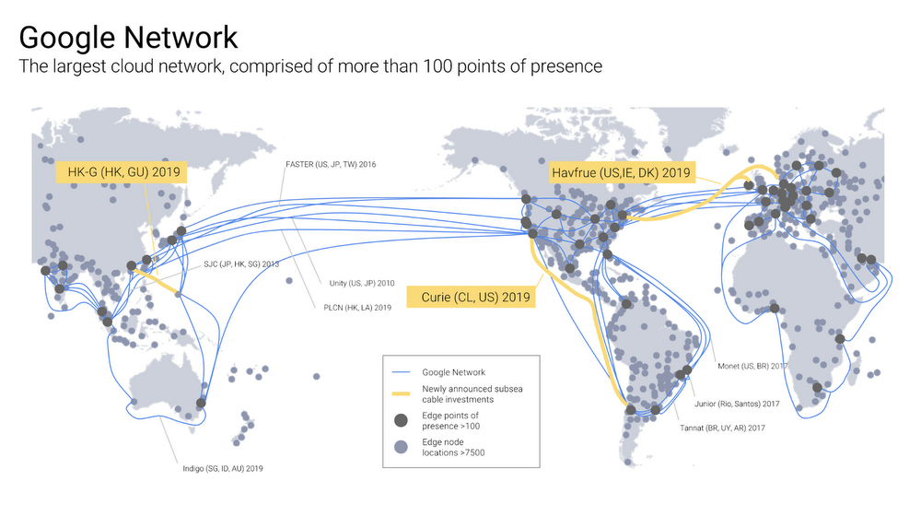
Google’s network
Source: https://ppc.land/google-network-will-be-expanded-with-3-new-submarine-cables-and-cloud-with-5-new-regions/

Slide 53
Internet structure: network of networks
“Tier-2” ISPs: smaller (often regional) ISPs
Connect to one or more tier-1 ISPs, possibly other tier-2 ISPs
Tier-2 ISPs also peer privately with each other.
Tier-2 ISP pays tier-1 ISP for connectivity to rest of Internet
tier-2 ISP is customer of
tier-1 provider
Tier-2 ISP
Tier-2 ISP
Tier 1 ISP
Tier 1 ISP
Tier 1 ISP
Tier-2 ISP
Tier-2 ISP
Tier-2 ISP

Slide 54
Internet structure: network of networks
“Tier-3” ISPs and local ISPs
last hop (“access”) network (closest to end systems)
local
ISP
Tier 3
ISP
local
ISP
local
ISP
local
ISP
Local and tier- 3 ISPs are customers of
higher tier ISPs
connecting them to rest of Internet
Tier-2 ISP
Tier-2 ISP
Tier 1 ISP
Tier 1 ISP
Tier 1 ISP
Tier-2 ISP
Tier-2 ISP
Tier-2 ISP
local
ISP
local
ISP
local
ISP
local
ISP

Slide 55
Internet structure: network of networks
a packet passes through many networks!
local
ISP
Tier 3
ISP
local
ISP
local
ISP
local
ISP
Tier-2 ISP
Tier-2 ISP
Tier 1 ISP
Tier 1 ISP
Tier 1 ISP
Tier-2 ISP
Tier-2 ISP
Tier-2 ISP
local
ISP
local
ISP
local
ISP
local
ISP

Slide 56
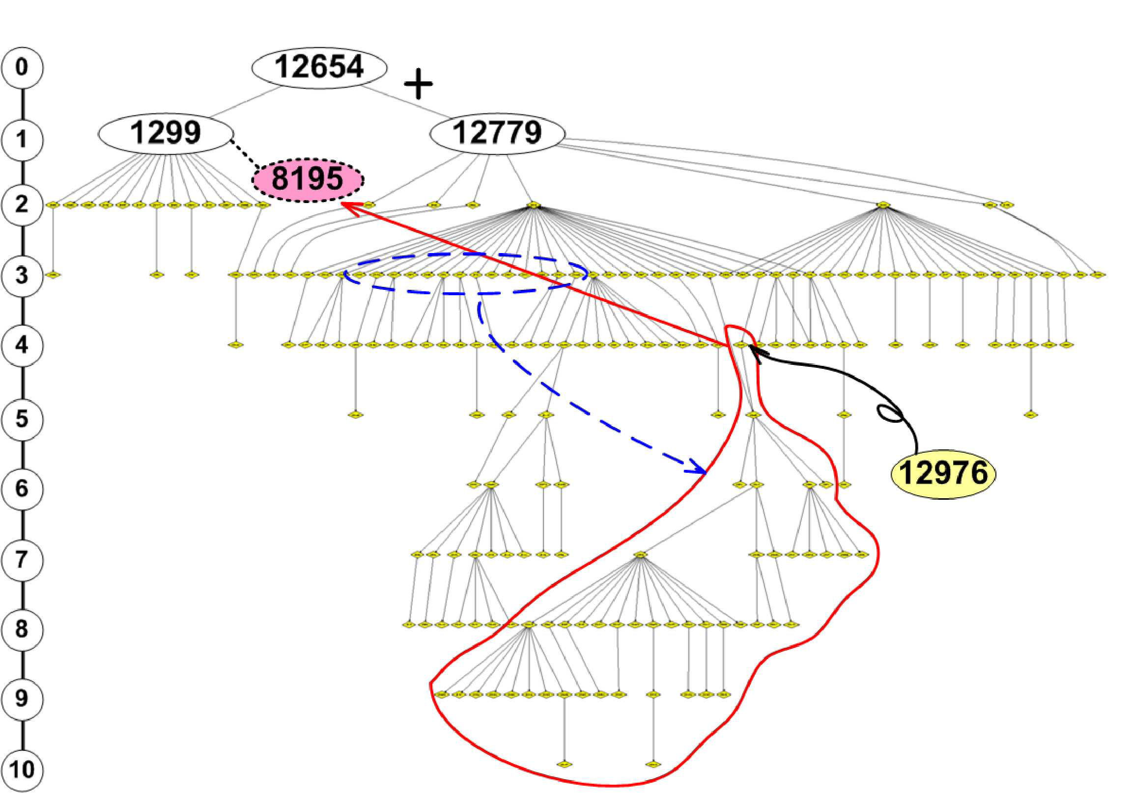
A real example

Slide 57
Outline
What is a computer network?
How to classify a computer network?
What are your expectations for a computer network?
What is the Internet?
The Internet structure
Network edge
Network core
Network performance
Layered model and protocols

Slide 58
How do loss and delay occur?
packets queue in router buffers
packet arrival rate to link exceeds output link capacity
packets queue, wait for turn
packet being transmitted (delay)
A
B
packets queueing (delay)
free (available) buffers: arriving packets
dropped (loss) if no free buffers

Slide 59
Four sources of packet delay
1. nodal processing:
check bit errors
determine output link
2. queueing
time waiting at output link for transmission
depends on congestion level of router
transmission
A
propagation
B
nodal
processing
queueing

Slide 60
Delay in packet-switched networks
3. Transmission delay:
R=link bandwidth (bps)
L=packet length (bits)
time to send bits into link = L/R
4. Propagation delay:
d = length of physical link
s = propagation speed in medium (~2x10⁸ m/sec)
propagation delay = d/s
Note: s and R are very different quantities!
transmission
A
propagation
B
nodal
processing
queueing

Slide 61
Nodal delay
d_{proc} = processing delay
typically a few microsecs or less
d_{queue} = queuing delay
depends on congestion
d_{trans} = transmission delay
= L/R, significant for low-speed links
d_{prop} = propagation delay
a few microsecs to hundreds of msecs

Slide 62
“Real” Internet delays and routes
What do “real” Internet delay & loss look like?
Traceroute program: provides delay measurement from source to router along end-end Internet path towards destination. For all i:
sends three packets that will reach router i on path towards destination
router i will return packets to sender
sender times interval between transmission and reply.
3 probes
3 probes
3 probes

Slide 63
Packet loss
queue (aka buffer) preceding link in buffer has finite capacity
packet arriving to full queue dropped (aka lost)
lost packet may be retransmitted by previous node, by source end system, or not at all
buffer
(waiting area)
packet being transmitted
A
B
packet arriving to
full buffer is lost

Slide 64
Exercise
Ping google.com.tw and find out the performance of the network path from your machine to the destination.
Find out the locations of the hops on the path.

Slide 65
Throughput
throughput: rate (bits/time unit) at which bits transferred between sender/receiver
instantaneous: rate at given point in time
average: rate over longer period of time
link capacity
R_{s} bits/sec
link capacity
R_{c} bits/sec
server, with
file of F bits
to send to client
pipe that can carry
fluid at rate
R_{s} bits/sec)
pipe that can carry
fluid at rate
R_{c} bits/sec)
server sends bits
(fluid) into pipe

Slide 66
Throughput (more)
R_{s} < R_{c} What is average end-end throughput?
R_{s} bits/sec
R_{c} bits/sec
R_{s} > R_{c} What is average end-end throughput?
R_{s} bits/sec
R_{c} bits/sec
bottleneck link
link on end-end path that constrains end-end throughput

Slide 67
Throughput: Internet scenario
R_{s}
per-connection end-end throughput: min(R_{c},R_{s},R/10)
in practice: R_{c} or R_{s} is often bottleneck
R_{s}
R_{s}
R
R_{c}
R_{c}
R_{c}
10 connections (fairly) share backbone bottleneck link R bits/sec

Slide 68
Exercise
Try out a number of speedtest services:
http://www.myspeedmeter.net
https://www.speedtest.net
https://www.speedcheck.org

Slide 69
Outline
What is a computer network?
How to classify a computer network?
What are your expectations for a computer network?
What is the Internet?
The Internet structure
Network edge
Network core
Network performance
Layered model and protocols

Slide 70
Protocol “Layers”
Networks are complex!
many “pieces”:
hosts
routers
links of various media
applications
protocols
hardware, software
Question:
Is there any hope of organizing structure of network?
Or at least our discussion of networks?

Slide 71


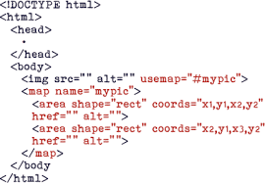

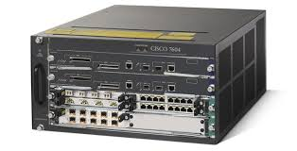

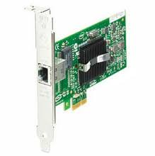
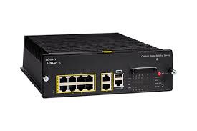
https://www.google.com.hk/
HTTP
https://www.google.com.hk/
TLS/SSL
TCP port
TCP port
TCP
IP address
IP address
158.132.1.1
IP
IP
IP
IP
172.217.163.227
MAC address
MAC address
802.11
Ethernet

Slide 72
exercise
Take any packet captured by your Wireshark. How many protocol layers are included in that packet?

Slide 73

Encapsulation
source
message
M
application
transport
network
link
physical
segment
H_{t}
M
H_{t}
datagram
H_{n}
H_{n}
H_{t}
M
frame
H_{l}
H_{n}
H_{t}
M
link
physical
DEcapsulation
switch
destination
H_{n}
H_{t}
M
network
link
physical
M
application
transport
network
link
physical
H_{l}
H_{n}
H_{t}
M
H_{n}
H_{t}
M
H_{t}
M
H_{n}
H_{t}
M
H_{l}
H_{n}
H_{t}
M
router

Slide 74
Encapsulation
source
message
M
application
transport
network
link
physical
segment
H_{t}
M
H_{t}
datagram
H_{n}
H_{n}
H_{t}
M
frame
H_{l}
H_{n}
H_{t}
M
link
physical
DEcapsulation
switch
destination
H_{n}
H_{t}
M
network
link
physical
M
application
transport
network
link
physical
H_{l}
H_{n}
H_{t}
M
H_{n}
H_{t}
M
H_{t}
M
H_{n}
H_{t}
M
H_{l}
H_{n}
H_{t}
M
router

Slide 75
Generic layering and protocols
Each protocol defines two interfaces:
Service interface: the operations that local objects can perform on the protocol.
Peer interface: the form and meaning of messages exchanged between protocol peers to implement the communication service.
Services
Services
Message format and interpretation
Protocol entity
Protocol entity
Services
Services
Message format and interpretation
Protocol entity
Protocol entity

Slide 76
Why layering?
Dealing with complex systems:
explicit structure allows identification, relationship of complex system’s pieces
layered reference model for discussion
modularization eases maintenance, updating of system
change of implementation of layer’s service transparent to rest of system
e.g., change in gate procedure doesn’t affect rest of system
layering considered harmful?

Slide 77
Internet protocol stack
application: supporting network applications
FTP, SMTP, HTTP
transport: process-process data transfer
TCP, UDP
network: routing of datagrams from source to destination
IP, routing protocols
link: data transfer between neighboring network elements
PPP, Ethernet
physical: bits “on the wire”
application
transport
network
link
physical

Slide 78
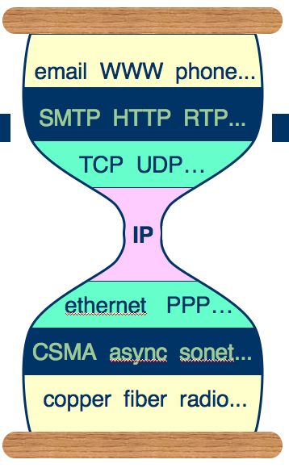
The Internet's hour-glass model
Application
FTP
HTTP
NV
TFTP
Transport
TCP
UDP
Network
IP
Data-link
…
NET
1
NET
2
NET
n
http://www.artofteachingscience.org/?p=291

Slide 79
Conclusions
We looked at general issues, such as the definition of a computer network, classifications of computer networks, and expectations from them.
For the Internet, we looked at the current Internet structure, network performance, and layered model and protocols.
In the coming lectures, we will examine the internetworking (layer 3), transport layer (layer 4) very briefly and datalink issues (layers 1-2).

Slide 80
Acknowledgments
Most of the slides are obtained from the slides provided by Computer Networking: A Top Down Approach, 5th edition by Jim Kurose, Keith Ross.

Slide 81
“I think the press has a tendency to pick a person and paint them 10 feet tall. In fact, each of us does a little piece and I’ve done one thing, people add on that and then another. So you get credit for doing the whole damn thing, and that’s not so.” — Paul Baran, after receiving the National Medal of Technology and Innovation

Slide 82
"Let love and faithfulness never leave you; bind them around your neck, write them on the tablet of your heart. Then you will win favor and a good name in the sight of God and man." (Proverbs 3:3-4)
"不可讓慈愛誠實離開你，要繫在你的頸項上，刻在你的心版上。 這樣，你在 神和世人眼前，必蒙恩寵，得著美名。" (箴言 3:3-4)

Slide 83
end

