Slide 1
L1.2. An Introduction to
Block Ciphers
Rocky K. C. Chang, February 2013

Slide 2
Outline
Product and iterated ciphers
  A simple substitution-permutation network
DES and AES
Modes of operations
  Cipher block chaining
  How to ensure message integrity?
  How to increase the security of DES?

Slide 3
Affine cipher as a product cipher
Multiplicative Cipher:
  Let M = C = Z₂₆ = {0, 1, 2, …, 25}.
  K = {a ∈ Z₂₆: gcd(a, 26} = 1}.
  E_{K}(m) = am mod 26.
  D_{K}(c) = a⁻¹c mod 26.
Affine Cipher:
  A key in the Shift Cipher is an element b in K = {0, 1, 2, …, 25}.
  A key in the Multiplication Cipher is an element a in Z₂₆ such that gcd(a, 26} = 1.
  Hence, a key in the product of an Multiplicative Cipher and an Affine Cipher is in the form of (a, b), where
  E_{(a,b)}(m) = (am + b) mod 26.

Slide 4
Iterated ciphers
Block ciphers today are product ciphers.
  Involves a sequence of permutation (diffusion) and substitution (confusion) operations.
A common design is an iterated cipher consisting of a round function and a key schedule.
  Encryption of a plaintext proceeds through N similar rounds.
  The key K is used to construct the N round keys or subkeys: K¹, K², …, and K^{N}.
  Denote the round function as g() that take in the current state and a subkey as inputs.

Slide 5
Encryption in an iterated cipher
K¹, K², …, K^{N} are the subkeys derived from K.
The encryption operation:
  w⁰ ← m
  w¹ ← g(w⁰, K¹)
  w² ← g(w¹, K²)
  …
  w^{N-1} ← g(w^{N-2}, K^{N-1})
  w^{N} ← g(w^{N-1}, K^{N})
  c ← w^{N}

Slide 6
Decryption in an iterated cipher
To decrypt c, we need a function g⁻¹() which performs the followings:
  w^{N} ← c
  w^{N-1} ← g⁻¹(w^{N}, K^{N})
  w^{N-2} ← g⁻¹(w^{N-1}, K^{N-1})
  …
  w¹ ← g⁻¹(w², K²)
  w⁰ ← g⁻¹(w¹, K¹)
  m ← w⁰
By comparing the decryption and encryption operations, g⁻¹() has to satisfy
  g⁻¹(g(w, y), y) = w for all w and y.

Slide 7
A simple substitution-permutation network

Slide 8
A simple substitution-permutation network
There are 4 “identical” rounds for encryption:
  Each round uses a round key.
  An initial key K generates the round keys according to a key schedule.
Functions of the components:
  In each of the long rectangular box, the 16-input bits are XOR-ed with the subkey (for mixing the round key with data)
  The S-boxes perform 4-bit substitutions (for providing nonlinearity).
    Remove the linear algebraic structure.
    The operation of an S-box cannot be encoded in a linear equation.
  The output bits of the S-boxes are permutated (for providing diffusion).
    One bit change in the input affect more than one bit in the output.
How is decryption performed?

Slide 9
Threats
In a known-plaintext attack, one can launch a brute-force attack.
  Should not regard a brute-force attack as a real attack.
  Cipher designers have anticipated it, and hope that this is the only way to attack it.
Linear and differential cryptanalysis
  Known-plaintext attacks
  Linear: finding a probabilistic linear relationship between some bits in the plaintext and a subset of state bits.

Slide 10
The Data Encryption Standard (DES)

Slide 11
DES’s overall
DES is a special type of iterated cipher called a Feistel cipher.
Inputs to DES: 64-bit blocks of a plaintext
DES uses a 56-bit key (8 parity bits)
Output from DES: 64-bit blocks of a ciphertext
Encryption algorithm:
  Apply an initial permutation (IP) to the input block.
  Iterate 16 rounds of operations with subkeys (k₁, k₂, …, k₁₆).
  The subkeys are generated according to a key schedule and a key K.
  The result from round 16 is input to the inverse of IP (IP⁻¹).

Slide 12
DES encryption
Initial permutation
Round 1
Round 2
56-bit
key
…
Round 16
Final permutation

Slide 13
The permutations
The initial permutation:
  (L₀, R₀) ← IP(input block), where
  L₀, and R₀ are the left and right blocks (32 bits each)
  IP is a fixed function.
The final permutation:
  Output block ← IP⁻¹(R₁₆, L₁₆)
  IP⁻¹ cancels the effect of IP.

Slide 14
Why permute?
The permutations do not enhance the security.
Why?
  Take a modified DES that does not have the permutations (called EDS).
  If we can break EDS (discover the key), we can also break DES.
    Given a DES <m, c>, m’ ← IP(m); and c’ ←IP(c) and reverse the left and right blocks.
    Feed (m’, c’) to our EDS-breaking codes.

Slide 15
In each round
Perform for round i = 1, 2, …, 16 (Feistel cipher).
  L_{i} ← R_{i-1}
  R_{i} ← L_{i-1} ⊕ f(R_{i-1}, k_{i}), where
    k_{i} is the 48-bit per-round key for the round i
    L_{i-1} and R_{i-1} are the left and right blocks as a result of the (i-1)th round.
    f is called the S-box function (or Mangler function).
    The swapping operation is a simple permutation cipher.
Generate the per-round keys.

Slide 16
Feistel cipher encryption for round i

Slide 17
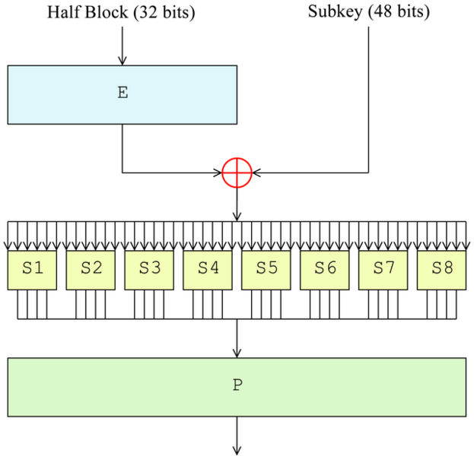
Mangler function

Slide 18
Feistel cipher decryption for round i

Slide 19
DES decryption
Decryption algorithm:
  Apply IP to a ciphertext block.
  Swap the left and right 32-bit blocks
  Iterate the same 16 rounds of operations with keys (k₁₆, k₁₅, …, k₁).
  Swap the left and right 32-bit blocks for the result from the last round.
  The output goes through IP⁻¹ to obtain the plaintext block.
Decryption requires exactly the same set of operations as encryption!

Slide 20
The security of DES
16 weak keys to avoid
A single critique about DES: a relatively short key length
Have been “cracked” many times:
  Linear cryptanalysis: 2⁴³ plaintext-ciphertext pairs and 40 days in 1994
  Brute-force: e.g., a special machine in 56 hours in 1998.

Slide 21
The Advanced Encryption Standard (AES)

Slide 22
The AES initiative
Unlike DES, an open call for the AES algorithms was made in Sept. 1997.
The requirements:
  Unclassified, publicly disclosed secret key encryption algorithm.
  It must support (at a minimum) block sizes of 128-bits, key sizes of 128-, 192-, and 256-bits.
  It should have a strength at the level of 3DES, but should be more efficient than 3DES.
  The algorithm, if selected, must be available royalty-free, worldwide.

Slide 23
The AES candidates
CAST-256 by Entrust Technologies, Inc.
CRYPTON by Future Systems, Inc.
DEAL by Ecole Normale Superieure
E2 by NTT
FROG by TecApro Internacional S.A.
HPC by Rich Schroeppel
LOKI97 by L. Brown, J. Pieprzyk, and J. Seberry
MAGENTA by Deutsche Telekom AG
MARS by IBM
RC6 by the RSA Laboratories
Rijndael by J. Daemen and V. Rijmen
Serpent by R. Anderson, E. Biham, and L. Knudsen
Twofish by B. Schneier, et al.

Slide 24
The finalists
MARS by IBM
RC6 by the RSA Laboratories
RIJNDAEL (Rhine Dahl) by J. Daemen and V. Rijmen
  Support different combinations of block sizes (128, 160, 192, 224, 256) and key sizes (128, 192, 256)
  http://csrc.nist.gov/archive/aes/rijndael/Rijndael-ammended.pdf
SERPENT by R. Anderson, E. Biham, and L. Knudsen
TWOFISH by B. Schneier, et al.

Slide 25
The AES algorithm
DES is based on an Feistel network; AES is a substitution-permutation network.
The AES algorithm is an iterated cipher, similar to the simple substitution-permutation network in structure.
  The number of round depends on the key length, e.g., N = 10 for 128-bit key and N = 14 for 256-bit key.
Each round provides
  Subkey mixing (XOR)
  Substitutions (SubBytes)
  Permutations (ShiftRows and MixColumns)
AES is broken! http://www.theregister.co.uk/2011/08/19/aes_crypto_attack/)

Slide 26
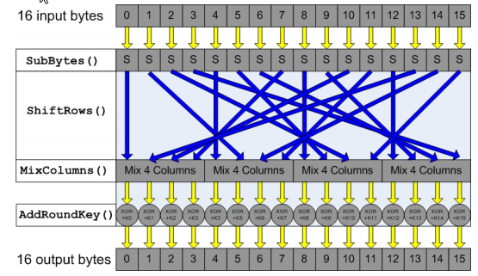
AES with 128 bits

Slide 27
The modes of operations

Slide 28
A simple electronic code book (ECB)
Break the message into 64-bit blocks and pad the last one, if necessary.
  How does the receiver know about the padding?
Encrypt/decrypt each block with the secret key.
Disadvantages:
  Identical 64-bit blocks give identical ciphertexts for them.
  May rearrange or even modify blocks without having the receiver know about it.

Slide 29
A simple electronic code book (ECB)

Slide 30
An improved approach
Generate a 64-bit random number r_{i} for each plaintext block m_{i}.
m_{i} ⊕ r_{i} and then encrypt the result.
Send out the ciphertext and the r_{i}s.
Solve the problem of identical ciphertext blocks.
Disadvantages:
  Send out twice the amount of information.
  An attacker can still remove or swap or even modify blocks without having the receiver know about it.

Slide 31
An “improved” approach
transmit r₁, c₁, r₂, c₂, r₃, c₃, r₄, c₄

Slide 32
Cipher block chaining (CBC)
CBC uses c_{i} as r_{i+1} (the ith ciphertext block used as the (i+1)th random number.)
CBC encryption:
  c₀ ← IV
  c_{i} ← E(m_{i} ⊕ c_{i-1}) for i > 0
CBC decryption:
  c₀ ← IV
  m_{i} ← D(c_{i}) ⊕ c_{i-1} for i > 0

Slide 33
Benefits of CBC
Remove the need for sending all random numbers except for the first block.
  The first random number is known as an initialization vector (IV).
CBC solves the identical ciphertext block problem.
  Each ciphertext block is dependent on the corresponding plaintext block and the previous blocks.
  Without IV, two identical messages will encrypt in the same way up to the first difference.
A randomly chosen IV also prevents chosen-plaintext attacks.

Slide 34
CBC encryption

Slide 35
CBC decryption

Slide 36
Security problems of CBC
An attacker can add blocks to the end of an encrypted message without being detected.
  Need to know where the message ends.
If a bit is added or lost from the ciphertext stream, all subsequent blocks are shifted 1 bit out of position.
  Need to ensure that the block structure remains intact.

Slide 37
Security problems of CBC
An attacker can alter a ciphertext block to introduce controlled changes.
E.g., if bit 3 of c_{i} is modified,
  Since m_{i+1} = c_{i} ⊕ decrypted c_{i+1}, bit 3 of m_{i+1} is also modified (deterministic).
  Since m_{i} = c_{i-1} ⊕ decrypted c_{i}, m_{i} would also be modified (nondeterministic).
Can this modification be detected by the receiver?

Slide 38
How to ensure message integrity?

Slide 39
Generating MACs for unencrypted messages
As usual, compute the CBC for a message.
Send out the plaintext with the last ciphertext block (CBC residue, MAC).
The receiver verifies whether the plaintext + CBC residue has been modified by
  Computing the CBC for the message and comparing the last ciphertext block with the MAC.

Slide 40
Generating MACs for unencrypted messages

Slide 41
Both secrecy and message integrity
Proposal 1?

Slide 42
Both secrecy and message integrity
Proposal 2?

Slide 43
Both secrecy and message integrity
Proposal 3?

Slide 44
How to increase the security of DES?

Slide 45
Multiple encryption DES
Triple DES (3DES or EDE) using 2 keys
  Encrypt (or Decrypt )a plaintext and then decrypt (or encrypt) it.
Encryption:
Decryption:
k₁
k₂
k₁
m
E
D
E
c
k₁
k₂
k₁
c
D
E
D
m

Slide 46
EDE with CBC on the outside

Slide 47
Design issues
How many encryption?
How many keys?
Order of encryption and decryption?
  EEE, DDD, EDE, DED
CBC outside vs inside?

Slide 48
Summary
The modern block ciphers are iterated ciphers.
  Based on multiple rounds of substitutions and permutations.
  Subject to linear and differential cryptanalysis, and brute-force attacks
Examined DES, including the operations and special properties.
Examined the operational issues for block ciphers, e.g.,
  Variable-length message
  Attacks on CBC
  Message integrity
  Increase DES security

Slide 49
Acknowledgments
The notes are prepared mostly based on
  D. Stinson, Cryptography: Theory and Practice, Chapman & Hall/CRC, Second Edition, 2002.
  C. Kaufman, R. Perlman and M. Speciner, Network Security: Private Communication in a Public World, Second Edition, Prentice Hall PTR, 2002.
  W. Mao, Modern Cryptography: Theory and Practice, Prentice Hall, 2004.
  B. Schneier, Applied Cryptography, Second Edition, Wiley, 1996.
  The Mangler function is taken from http://en.wikipedia.org/wiki/File:Data_Encryption_Standard_InfoBox_Diagram.png.
  The AES block diagram is taken from http://www.giac.org/cissp-papers/42.pdf.
Other references:
  AES homepage: http://csrc.nist.gov/archive/aes/index.html
  Wiki: http://en.wikipedia.org/wiki/Advanced_Encryption_Standard

