Slide 1
Workshop 5: IPSec Security
Ricky Mok
4 Apr 2014

Slide 2
Preparation
Group yourself into groups of 2 people.
You will take turn to be “client” and “server”.
Boot both computers into Windows XP.
Download/ Copy a VM image.
Import the image into the Virtualbox
File-> Import Appliance
Prepare the Wireshark (from Y:) at the client

Slide 3
Objectives
Get hand-on experience in
setting up a simple L2TP/IPSec VPN server in Linux.
connecting the VPN server with Windows client.
Use Wireshark to look into
AH (only) vs ESP
IPSec

Slide 4
L2TP/IPSec
L2TP (Layer 2 Tunneling Protocol)
For setting up virtual tunnels between two parties
Provide sessions control
Provide no encryption or confidentiality
L2TP headers are placed inside UDP packets
➔IPSec often works with L2TP to provide authentication and encryption for each IP packets.
IP
UDP
L2TP
Payload

Slide 5
Steps overview
Step 0 – Prepare the VM and Wireshark
Step 1 – Setup the server
Step 2 – Setup the client in AH mode
Use Wireshark to capture the packets
Step 3 – Setup the client in ESP mode
Use Wireshark to capture the packets
Step 4 – Cleanup

Slide 6
VM Setup
After importing the VM, “Start” the VM in the virtualbox
Username is “ubuntu”
Password is “comp444vpn”
Copy your VM’s IP address.
Terminate ->ifconfig eth0

Slide 7
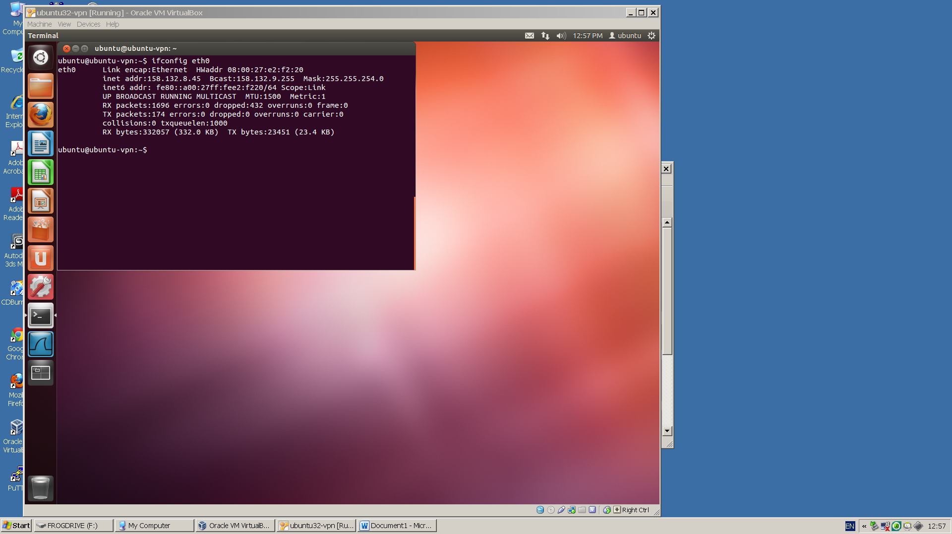
Get your VM’s IP address
2
1

Slide 8
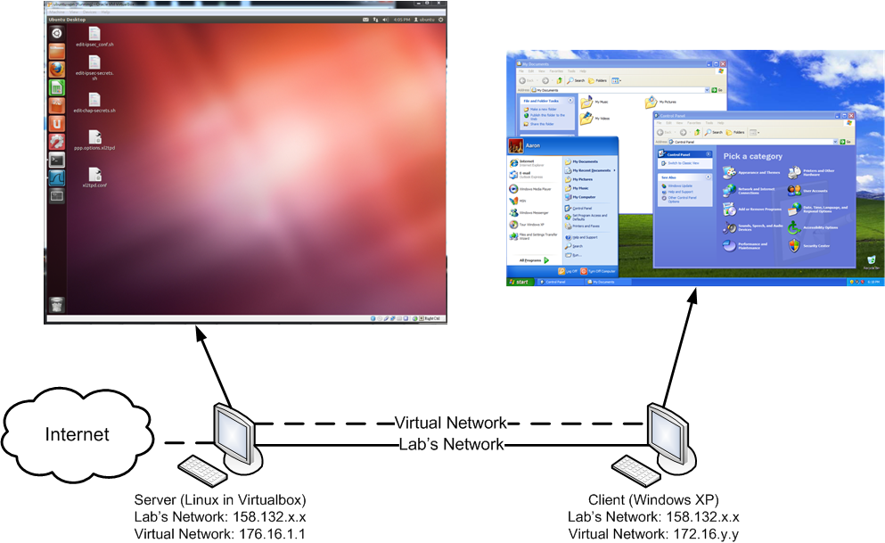
Setup overview
Client establishes a VPN connection with the server.

Slide 9

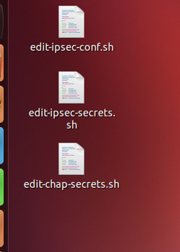
Setting up the server
Openswan - IPSec
xl2tpd – L2TP
A few configuration files control the settings
You can find the links on the VM’s desktop

Slide 10
Editing the configuration files
The following scripts are prepared for you to manage the config files.
edit-ipsec-conf.sh
Main IPSec settings
edit-ipsec-secrets.sh
Setting the pre-shared key (PSK)
edit-chap-secrets.sh
Setting the VPN user/password

Slide 11
IPSec setting
Double click edit-ipsec-conf.sh to edit “/etc/ipsec.conf”
Under “conn L2TP-PSK-noNAT”
This is our main IPSec setting for our VPN server.
“auth=ah” allows the server accepting AH-only clients.
“type=transport” sets to transport mode.
Replace “158.132.255.60” with your VM’s IP address at the line “left=158.132.255.60”

Slide 12
PSK settings
Double click edit-ipsec-conf.sh to edit “/etc/ipsec.secrets”
This file sets the pre-shared key
Replace the IP address with yours and
158.132.255.60 %any: PSK "comp444vpnpsk"

Slide 13
User access
Double click edit-chap-secrets.sh to edit /etc/ppp/chap-secrets
“compvpn” is the VPN user name; “vpnpwd” is the VPN password
compvpn l2tpd vpnpwd *
You can replace with yours.

Slide 14
Your VPN server is ready!
There are two files we did not edit. But you can take a look.
/etc/xl2tpd/xl2tpd.conf
/etc/ppp/options.xl2tpd

Slide 15
Client
IP of the VPN server
Pre-shared key
VPN Username/password

Slide 16
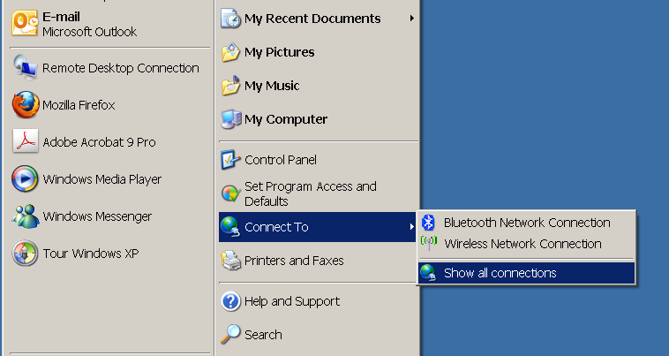
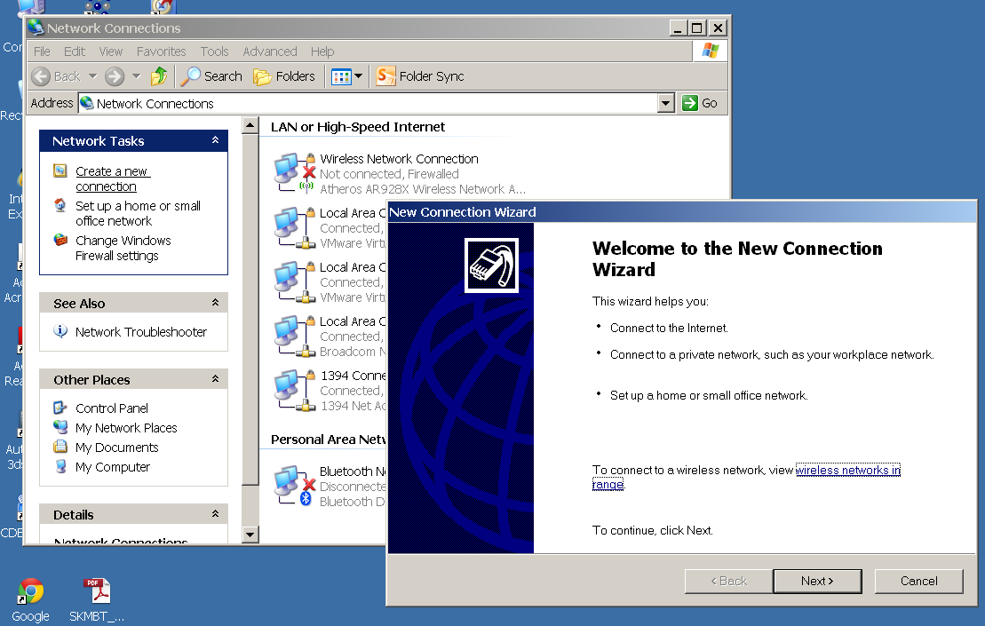
Setting up a new VPN connection
Connect To -> Show all connections
Create a new connection

Slide 17
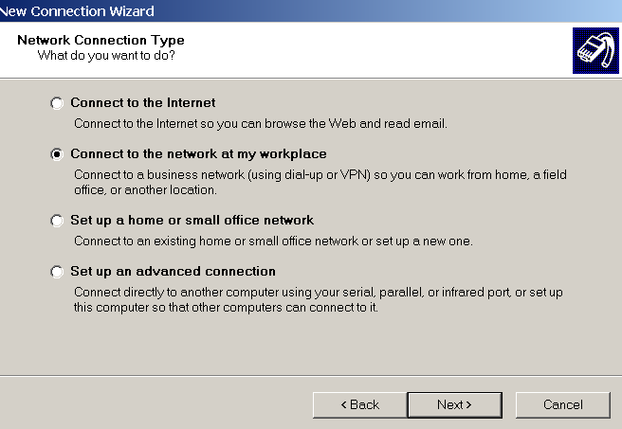
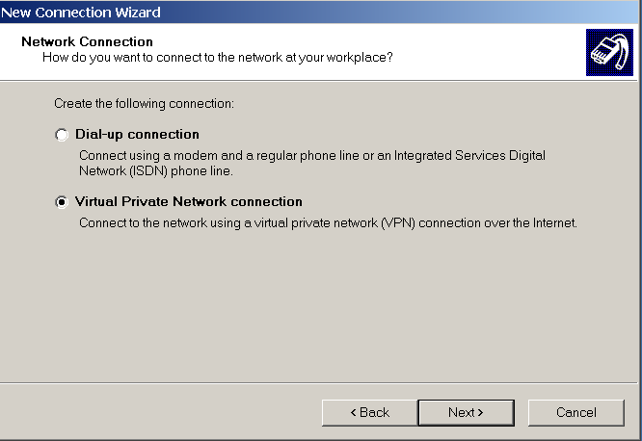
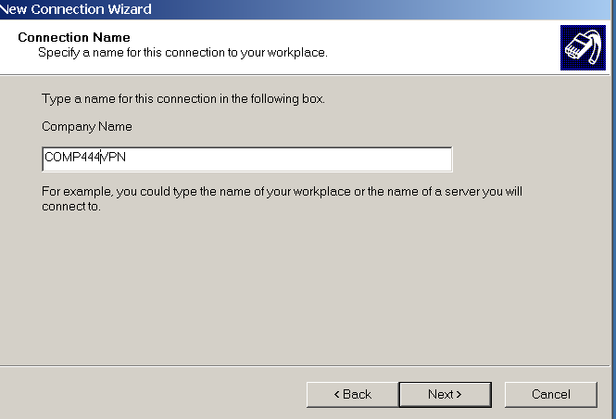
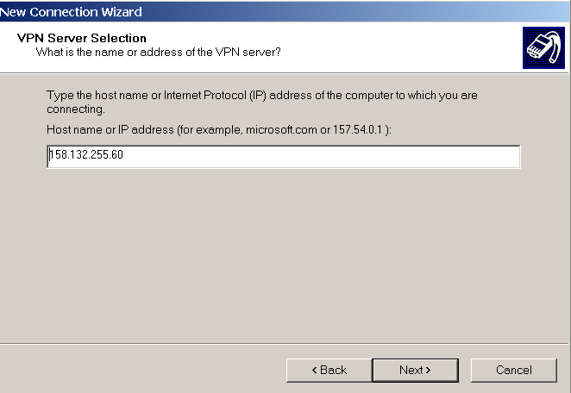
Setting up VPN in Windows
Type a arbitrary name here
Put the VPN server’s IP here

Slide 18
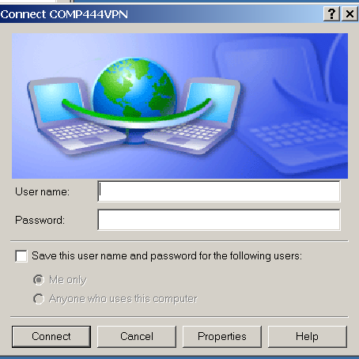
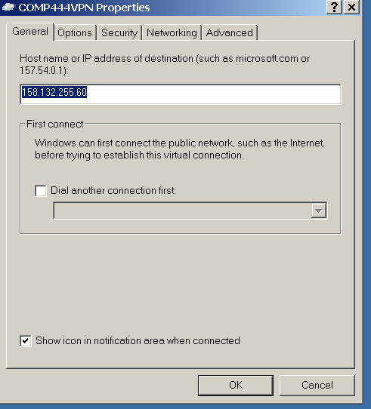
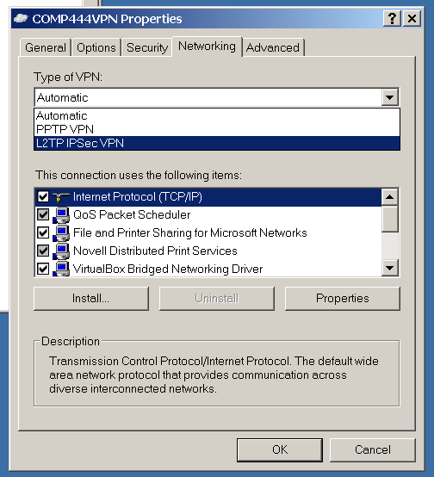
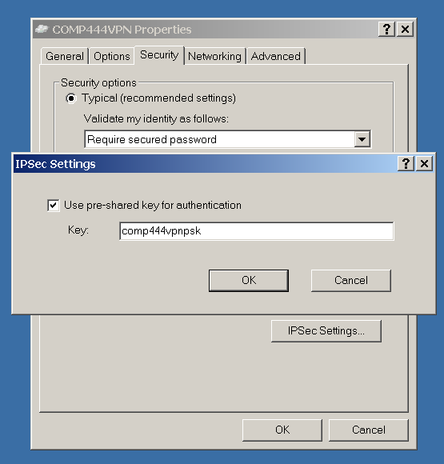
Setting up VPN in Windows
Enter the PSK here
Select L2TP here

Slide 19
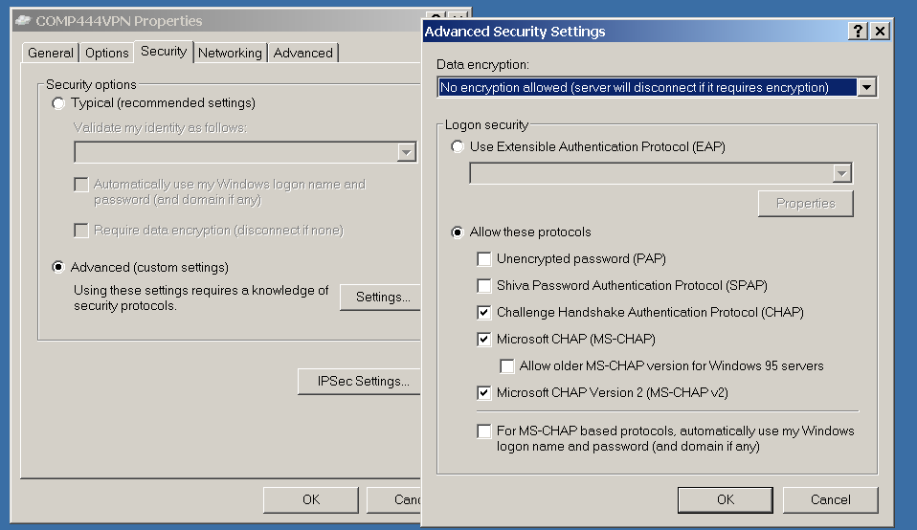
AH-only
Choose “No encryption allowed” to force the client to use HA-only mode

Slide 20
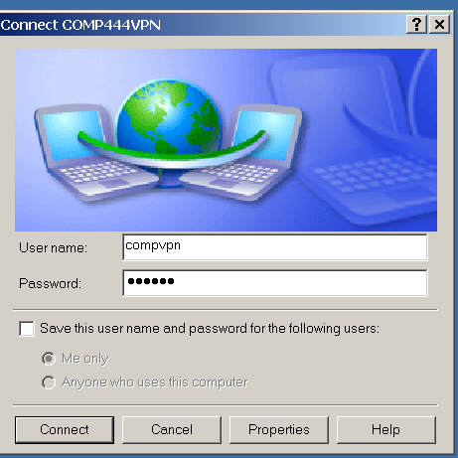
Connect to the VPN
Key in the username and password you set in the chap-secrets.
But WAIT!

Slide 21
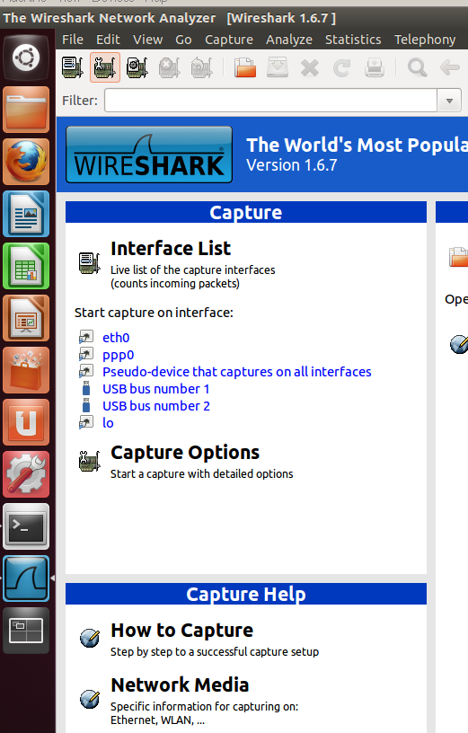
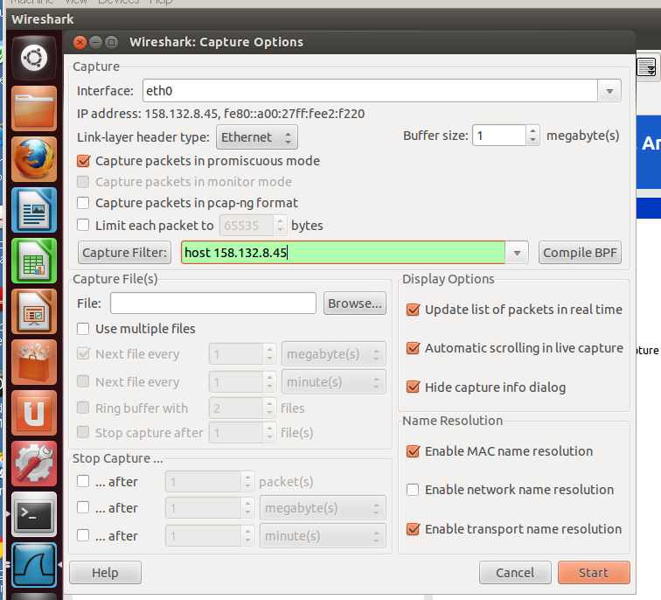
Ready to connect!
Start the Wireshark capture in the Linux and Windows client first.
Type a capture filter
“host <vpn server’s IP>”
Then, press “start”

Slide 22
Connect!
Now, ask your partner to press the connect button.
If success, all traffic from the client will now send to the VPN server.
The VPN server will redirect them to the Internet.
Open a browser, access http://frog.im/tv/b.jpg (server IP 192.254.235.192)

Slide 23
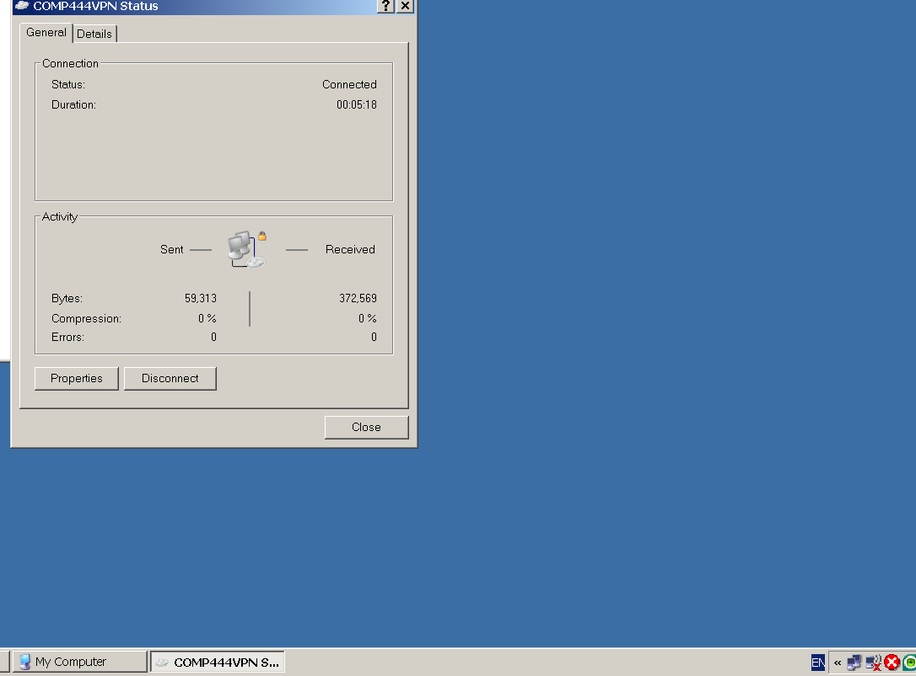
Prepare for ESP Mode
Disconnect the VPN connection
Clear your browser’s cache.
Stop and save the Wireshark captures

Slide 24
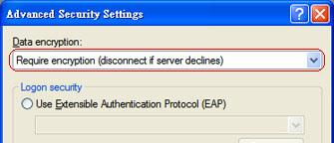
Change to use ESP mode

Slide 25
ESP mode
Again, start the wireshark capture at both server and client first.
Connect and access the same web page.
Disconnect the VPN
Save packet traces

Slide 26
Cleanup
Delete the VPN connection in Windows.
Copy your packet traces
Shutdown and delete the VM.
Now, you can switch the role with your partner.

Slide 27
Q1 (AH-only mode)
Consider the trace you captured at the server.
How many HTTP GET request(s) (sending to 192.254.235.192) can you observe?
What is/are the source IP address(es)?
Select the first HTTP GET and expand the first IP header.
What is the protocol number?
How is it related to the next header?
What is the usage of that header?

Slide 28
Q1
Can you find another IP header and a TCP header inside the payload? If yes, how are they related to your second HTTP GET packet? (e.g., IP addresses, TCP ports, sequence number and acknowledgement number)
Open the trace captured at the client, and locate the same HTTP GET. You may find that the packet is identical to the first HTTP GET packet you located in the server packet trace. If there is an MITM attack between the client and the VPN server, how can the VPN server detect whether the packet is modified?

Slide 29
Q2 (AH-only mode)
In our lab, we are using transport mode (as set in the Openswan). But you may observe an outer-inner IP headers in packets sending between the client and server. Explain why it is still called the “transport” mode.

Slide 30
Q3 (ESP mode)
Consider the trace you captured at the server.
How many HTTP GET request(s) (sending to 192.254.235.192) can you observe?
What is/are the source IP address(es)?
Why that packet is not encrypted?
Consider the trace you captured at the client.
Can you find any HTTP GET to the same server in plaintext?

Slide 31
Q4 (ESP mode)
Look the trace you captured at the server again, and locate the first packet with protocol ISAKMP.
What are the usages of the first two ISAKMP packets?
How many transform proposal(s) supplied by the client?
How many transform proposal(s) supplied by the server?
Which encryption algorithm should be used after the SA process?

Slide 32
END

