Slide 1
COMP444 Workshop 4: Android Security
Daoyuan
Mar 28, 2014

Slide 2
Objectives
Learn to use basic Android analysis tools;
Understand several flaws in Android apps;
Practice to identify vulnerabilities in real-world Android apps.

Slide 3
PART I: Learn Android TOOLS
Learn Android Tools

Slide 4
Before we start …
Enter into XP using your lab machines.
Android SDK tools are installed at:
Y:\Win32\android-sdk-windows
Later I will use android-sdk-windows for short
Know how to use Windows command line:
Start → Run → Cmd

Slide 5
Overview of Basic Android Tools
Android SDK includes a variety of tools.
http://developer.android.com/tools/help/index.html
http://developer.android.com/sdk/index.html
Android SDK Manager (android sdk)
Manage the installed components of the SDK.
AVD Manager (android avd)
Manage your created emulator configurations.
Emulator (emulator)
A QEMU-based device-emulation tool.
Android Debug Bridge (adb)
Communicate with an emulator instance.
Dalvik Debug Monitor Server (ddms) or (monitor)
Contain a set of useful tools to monitor Android apps.

Slide 6
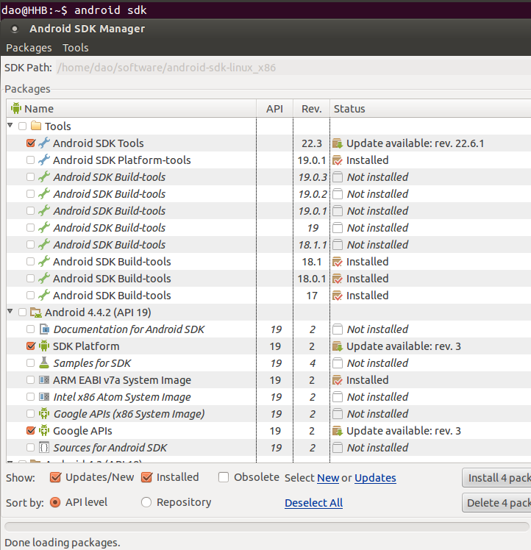
Android SDK Manager (android sdk)
Windows:
SDK Manager.exe
Quite slow …
So avoid to open it.
Major Android SDKs have been installed in the lab.

Slide 7
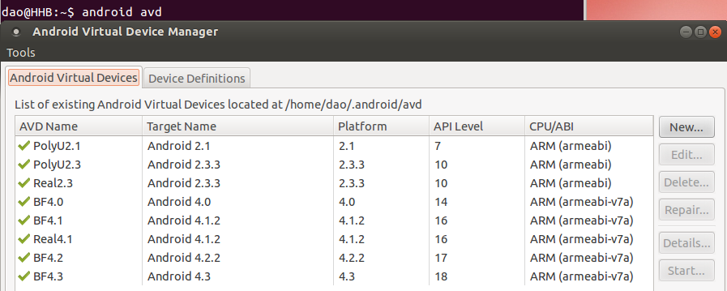
AVD Manager (android avd)
Create an AVD (Android Virtual Devices).
4.0’’ Nexus S, Android 4.0, 300MB RAM, 50MB SD Card
Windows: AVD Manager.exe

Slide 8
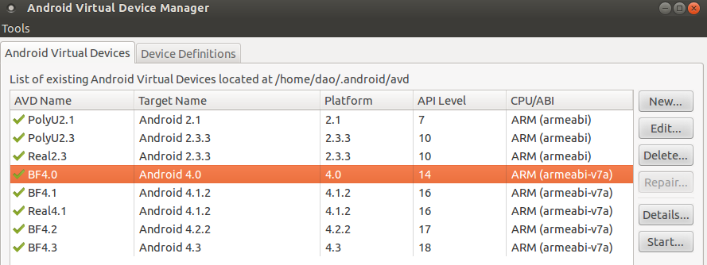
Emulator (emulator)
How to start a emulator?
In AVD Manager, select an avd, then click the “start” button.
Maybe a little bit long, have to wait …

Slide 9
(Optional) Using Hardware Devices for Analysis
http://developer.android.com/tools/device.html#setting-up
Enable USB debugging on your device;
Set up your system to detect your device.
http://developer.android.com/tools/extras/oem-usb.html#WinXp
Allow installation of apps from unknown sources
In your phone: Setting → Security → Select it.

Slide 10
Android Debug Bridge (adb)
android-sdk-windows\platform-tools\adb.exe
Use command line to run it, just type adb under this directory.
List the current devices.
Install an Android app (in PC) to emulator.
Y:\Win32\android-sdk-windows\platform-tools>adb devices
List of devices attached
emulator-5554 device (other possible statuses are offline or bootloader)
Y:\Win32\android-sdk-windows\platform-tools>adb install C:\andTest\yourapp.apk
59 KB/s (1862419 bytes in 30.531s)
pkg: /data/local/tmp/yourapp.apk
Success
Download app from: http://goo.gl/zzcGt1

Slide 11
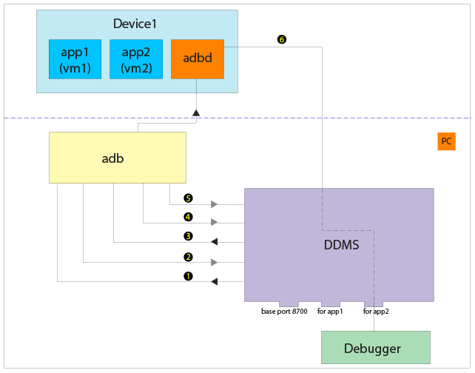
ADB architecture
Other useful commands: (such as adb shell)
Type adb help to query.
http://rxwen.files.wordpress.com/2009/10/android_debugging_arch1.png

Slide 12
Dalvik Debug Monitor Server (ddms)
Provide UI control for some adb commands.
android-sdk-windows\tools\ddms.bat
Follow the following practices:
Observe the listed processes.
Know the app package name we just installed.
Browse files in emulator using File Explorer.
Pull files from emulator to PC.
Capture the screen using Screen Capture button.
Monitor the log outputs using logcat command.
One important hint:
Always remember to select the emulator or phone in the left side panel.

Slide 13
PART II: FLAWS in ANDROID APPS
Understand Flaws in Android Apps

Slide 14
Overview of Potential Flaws
The Victim App
1
Component 1
Network requests
. . .
2
All logs in logcat
Component n
Logs from app 1
Private File Zone
5
. . .
Sensitive files
3
Logs from app n
4
Other large files
The public SD card

Slide 15
Focus on insecure storage issues
Insecure internal storage
Sometimes the assumption is that phones are rooted.
Sometime the file permissions are mis-configured.
SD Card issue
Save cleartext-sensitive info to the public SD Card.
Logcat issue
Output sensitive logs to the logcat.

Slide 16
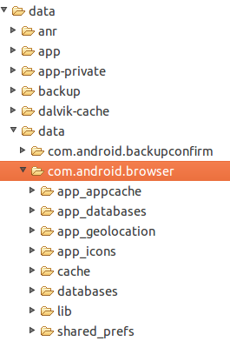
Insecure internal storage
Android saves each app’s internal files at:
/data/data/app-package

Slide 17
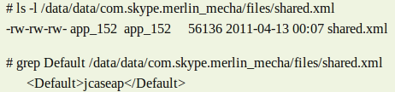
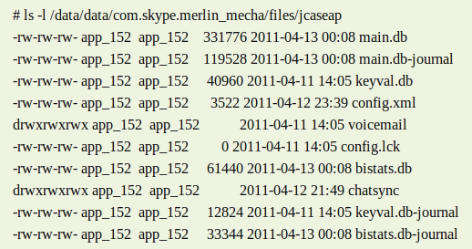
Insecure internal storage: Skype
Skype once mis-configured file permissions.
Owner + Group + Other

Slide 18
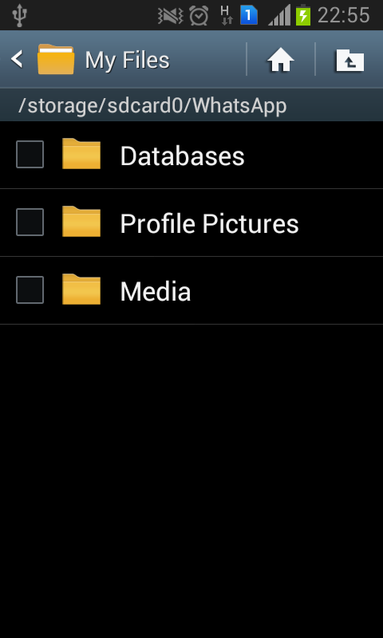
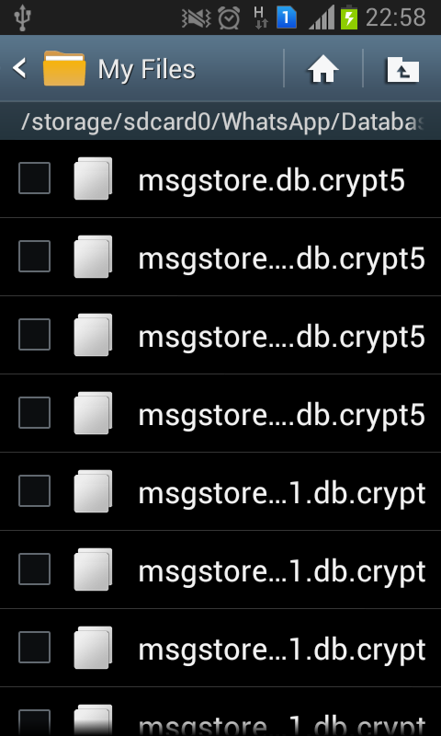
SD Card issue
Whatsapp saves some files in SD Card.
If you have a phone,
You can browse them using a file manager.
https://play.google.com/store/apps/details?id=org.openintents.filemanager

Slide 19
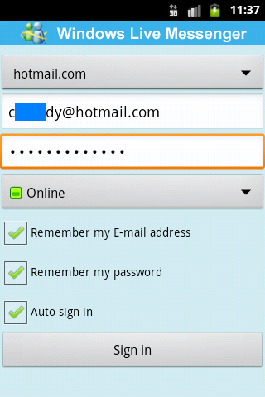
Logcat issue: MSN Password Leak
Identify and test it using my own account.

Slide 20
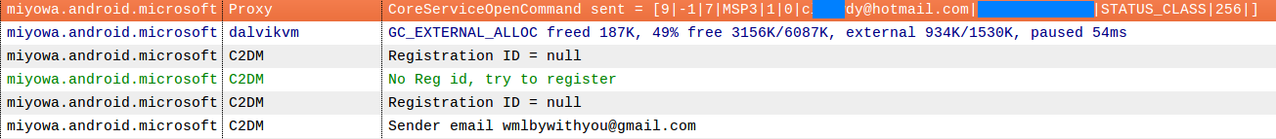
Logcat issue: MSN Password Leak
Logcat in DDMS:
email
pwd

Slide 21
PART III: Exercises
Practice your skills

Slide 22
Exercises
In general,
Your answers should be supported by your screenshots.
I also assume you will never take the same screenshot.
Questions are simple, but you need to do them by yourselves.
Please hand in a hard copy of all exercise answers!

Slide 23
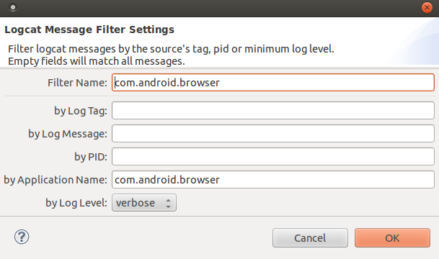
Exercise #1
Set a logcat filter and give a screenshot of logcat outputs from the default Android browser. (5 marks)
Hint: the filter is like this:

Slide 24
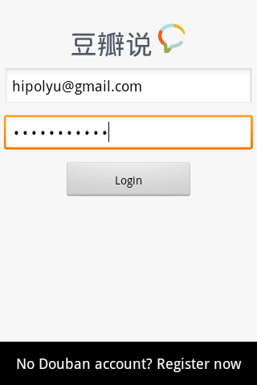
Exercise #2
In an app called Douban Shuo (http://goo.gl/zzcGt1), where does it save an user’s password to? Encrypted or not? Provide screenshots to support your answers. (10 marks)
Hint: Under its shared_prefs directory in internal storage.
http://www.douban.com/
User:hipolyu@gmail.com
Pwd: android2014

Slide 25
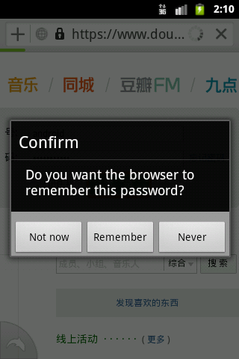
Exercise #3
In Android 4.0’s default browser, suppose that an user chooses to remember his or her password.
Does the browser save the password in an encrypted form? Provide screenshots to support your answers. (10 marks)
Hint: the file name is webview.db.
Open it with sqlite3 command in the adb shell. (then issue .dump)
http://developer.android.com/tools/help/adb.html#sqlite
http://www.douban.com/
User:hipolyu@gmail.com
Pwd: android2014

Slide 26
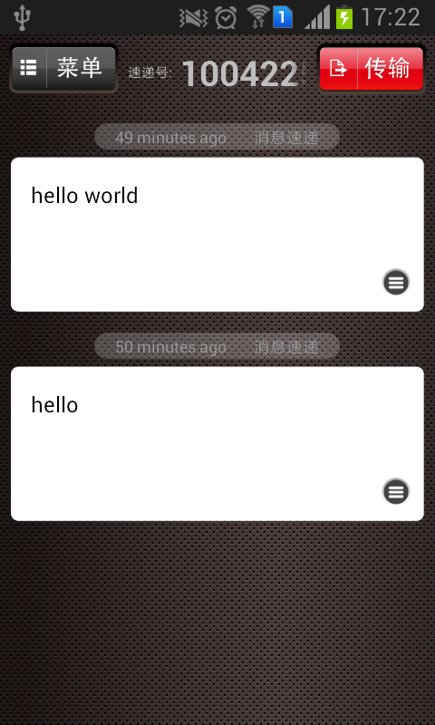
Exercise #4
An app called Xiao Xi Su Di (消息速递) saves users’ messages in SD card. Suppose you have its SD card directory (http://goo.gl/q3Zssw), please determine which file does it save messages to? Encrypted or not. (5 marks)
Hint: use SQLite Database browser (http://goo.gl/kpvPI) to browse its database files.

Slide 27
Questions?

