Slide 1
Cryptographic Hash Functions
Rocky K. C. Chang, February 5, 2015

Slide 2
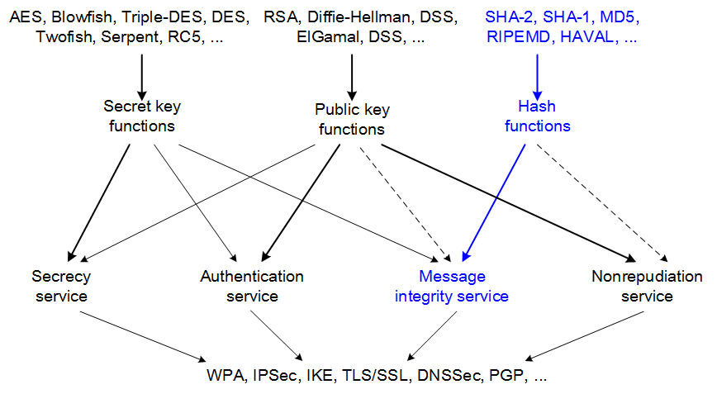
This set of slides addresses

Slide 3
Outline
Cryptographic hash functions
  Unkeyed and keyed hash functions
  Security of cryptographic hash functions
  Iterated hash functions
  Two weaknesses
Message authentication codes
  What does an MAC do?
  MAC security
  HMAC
  Using MAC properly

Slide 4
Cryptographic hash functions

Slide 5
Hash functions
A hash function (or message digest function) takes an arbitrarily long string of bits and produces a fixed-sized result.
  The hash result is also known as digest or fingerprint.
  Cryptographic hash function vs. hashing used in data structures and algorithms.
  Cryptographic hash function vs. error detection codes, such as checksum and CRC

Slide 6
For examples,
For a message m, compute x = h(m).
  Assume that x is stored in a safe place, but m is not.
  Whenever retrieving m, compute h(m).
    If h(m)= x, one should be confident that m has not been altered.
Alice and Bob share a secret key K, and use h_{K}() to protect the integrity of their messages.
  Assume that K is only known to Alice and Bob.
  Alice (or Bob) computes x = h_{K}(m) and sends (m, x) to Bob (or Alice).
  At Bob’s (or Alice) side, he computes h_{K}(m).
    If h_{K}(m) = x, (s)he should be confident that both m and x have not been altered.

Slide 7
Many uses of cryptographic hash functions
Message authentication (or message integrity) and digital signature
Map a variable-sized value to a fixed-size value.
Serve as a cryptographic pseudo-random generators to generate several keys from a single shared secret.
Their one-way property isolates different parts of a system.

Slide 8
A (keyed) hash family consists of
M: a set of possible messages
X: a finite set of possible message digests
K: the key space, a finite set of possible keys
For each K∈K, there is a hash function h_{K} ∈H. Each h_{K}: M → X.
Moreover,
  Usually assume that |M| ≥ 2|X|.
  A pair (m, x) is valid under the key K if h_{K}(m) = x.
  |K| = 1 for unkeyed hash functions.

Slide 9
Security of a cryptographic hash function
The basic requirement for a cryptographic hash function is that
  The only efficient way to produce a valid pair (m, x) is to first choose m, and then compute x = h(m).
As a counter example, consider a message: (m₁, m₂) with h(m₁, m₂) = am₁ + bm₂ mod n, where m₁, m₂, a, b ∈ Z_{n}, n>1.
  Given h(m₁, m₂) and h(m’₁, m’₂), one can determine the value of h() for other messages.
  For a message (am₁+bm’₁, am₂+bm’₂), h(am₁+bm’₁, am₂+bm’₂) = a h(m₁, m₂) + b h(m’₁, m’₂).
Security of a cryptographic hash function can be evaluated based on the difficulty of solving three problems.

Slide 10
Problem 1: The preimage problem
The preimage problem:
  Given a hash function h: M → X and an element x ∈ X,
  Find m ∈ M such that h(m) = x.
If the preimage problem can be solved, then (m, x) is a valid pair.
A hash function for which the preimage problem cannot be efficiently solved is said to be one-way or preimage resistant.

Slide 11
Problem 2: The second preimage problem
The second preimage problem:
  Given a hash function h: M → X and an element m ∈ M,
  Find an m’ ∈ M such that m’ ≠ m and h(m’) = h(m).
If the 2nd preimage problem can be solved, then (m’, h(m)) is a valid pair.
A hash function for which the 2nd preimage problem cannot be efficiently solved is said to be second preimage resistant.

Slide 12
Problem 3: The collision problem
The collision problem:
  Given a hash function h: M → X,
  Find m, m’ ∈ M such that m’ ≠ m and h(m’) = h(m).
If (m, x) is a valid pair, and m, m’ is a solution to the collision problem, then (m’, x) is also a valid pair.
A hash function for which the collision problem cannot be efficiently solved is said to be collision resistant.
Which problem is the easiest to solve?

Slide 13
Solving the preimage problem
Consider the following algorithm to solve the preimage problem.
  Choose a subset M₀ ⊆ M and |M₀| = q.
  For each m ∈ M₀, if h(m) = x, return m.
  Return “unsuccessful.”
Pr[success] = 1 – Pr[all q attempts are unsuccessful].
Assuming independent events, Pr[all q attempts are unsuccessful] = Pr[an attempt is unsuccessful]^{q}.
Let |X|=B and Pr[an attempt is unsuccessful] = 1–1/B.
Therefore, Pr[success] = 1–(1–1/B)^{q} ≈ q/B if q is small compared to B.

Slide 14
Solving the 2nd preimage problem
Consider the following algorithm to solve the 2nd preimage problem.
  Compute h(m).
  Choose a subset M₀ ⊆ M\{m} and |M₀| = q–1.
  For each m’ ∈ M₀, if h(m’) = h(m), return m’.
  Return “unsuccessful.”
Pr[success] = 1–(1–1/B)^{q–1} .

Slide 15
Solving the collision problem
Consider the following algorithm to solve the collision problem.
  Choose a subset M₀ ⊆ M and |M₀| = q.
  For each m ∈ M₀, evaluate h(m).
  If h(m) = h(m’) for some m’ ≠ m, return m’, m.
  Else, return “unsuccessful.”
To conduct step 3, one can sort the values of h().

Slide 16
Solving the collision problem
Problem: what is the success probability of the algorithm to solve the collision problem given q attempts?
Assume uniform probability and independence.
Pr[unsuccessful] = Pr[all the q values of h() are different] = (B/B)((B–1)/B)((B–2)/B) … ((B–q+1)/B).
Pr[successful] = 1–Pr[unsuccessful] = 1–(B/B)((B–1)/B)((B–2)/B) … ((B–q+1)/B).
Pr[successful] ≈ 1 – e^{-q(q-1)/2B} for a sufficiently large B.

Slide 17
The birthday attack
Q: How many attempts are needed so that Pr[successful] ≥ p? (birthday problem if B = 365)
After performing more approximation for Pr[successful] ≈ 1 – e^{-q(q-1)/2B} , we have
  q ≈ (2B ln(1/(1- Pr[successful])))^{1/2}.
For p = 0.5, q ≈ 1.17√B.
  Hashing just over √B random elements of M yields a collision probability of 0.5.
  Different values of p will give different constant factors, but q is still proportional to √B.
  For a n-bit hash function, a birthday attack (or square root attack) needs 2^{n/2} random hashes.
  Answer for the birthday problem?
Which problem is the easiest to solve?

Slide 18
Re-examining the 3 problems
If we can solve the 2nd preimage problem, we can also solve the collision problem.
  Randomly choose an m ∈ M.
  Use the solution to the 2nd preimage problem to find m’.
  Return (m, m’).
If we can solve the preimage problem, we can also solve the collision problem.
  Randomly choose an m ∈ M.
  Compute h(m).
  Use the solution to the preimage problem to find m’.
  Return (m, m’).
Collision resistant => 2nd preimage resistant and collision resistant => preimage resistant.

Slide 19
Iterated hash functions
Almost all hash functions put into practice are iterated hash functions.
  h: M → X, where X = {0, 1}^{p} (i.e., p-bit hash function).
An iterated hash function h() usually consists of three main steps:
  (1) Preprocessing
  (2) Processing
  (3) Output transformation
Require a compression function for step (2):
  Compress : {0,1}^{n+t} → {0,1}^{n}, t ≥ 1.

Slide 20
Iterated hash functions

Slide 21
(1) Preprocessing
Given an input string m, where |m| ≥ n + t + 1, construct a string y, such that |y| ≡ 0 (mod t).
  Let y = y₁ || y₂ || … || y_{r}, where |y_{i}| = t, i = 1, 2, …, r.
  t is the block size and r is the number of blocks.
This step must ensure that the mapping m→y is one-to-one.
  Else, it is possible to find m ≠ m’ so that y = y’.
  Then h(m) = h(m’), i.e., h() would not be collision-resistant.
Moreover, |y| = rt ≥ |m| because of the one-to-one requirement on the mapping m→y.
A commonly used preprocessing step is to add padding: y = m || pad(m).

Slide 22
(2) Processing and (3) output transformation
(2) Processing
  Let IV be a public initial value of length n. Compute
    z_{o} ← IV
    z₁ ← compress(z_{o} || y₁)
    z₂ ← compress(z₁ || y₂)
    …
    z_{r} ← compress(z_{r-1} || y_{r}).
(3) Optional output transformation
  Let g: {0,1}^{n} → {0,1}^{p} be a public function. Without this transformation, we have n = p.

Slide 23
Merkle–Damgård construction
The construction is based on the iterated hash function construction with
  The last block is padded with 0 and a binary string that encodes the length of the original message (Merkle–Damgård strengthening).
  The compress function is collision-resistant.
  Ralph Merkle and Ivan Damgård independently proved that the hash function is collision resistant if the compress function is collision-resistant.
This construction was used in the design of many popular hash algorithms such as MD5 and SHA-1.

Slide 24
Message Digest (MD5)
Block size and output: t = 512 bits and p = 128 bits (4 x 32-bit)
Padding
  Padding is always performed.
  The message is extended to just 64 bits short of a multiple of 512 bits long.
  The last 64 bits encodes the message length.
  For the rest: a single "1" bit is appended to the message, and then "0" bits are appended.
The compress function is made from an “encryption function” by the Davies-Meyer scheme.
  MD5 makes four passes over each block of data.
  Each passes involves 16 operations.
The hash output is a concatenation of the 4 output words.

Slide 25
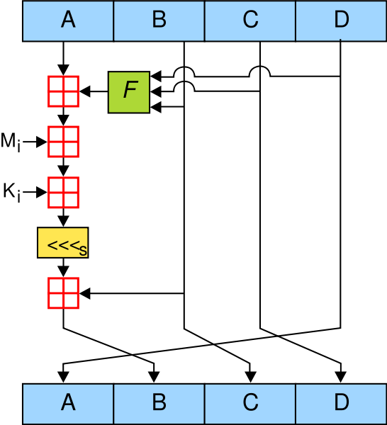
A single operation in MD5 (wikipedia)

Slide 26
Secure Hashing Algorithm (SHA-1)
Block size and output: t = 512 bits and p = 160 bits (5 x 32-bit)
Same padding as MD5
The compress function is also made from an “encryption function” by the Davies-Meyer scheme.
  SHA-1 makes five passes over each block of data.
  Each rounds involves 20 operations.
The hash output is a concatenation of the 5 output words.

Slide 27
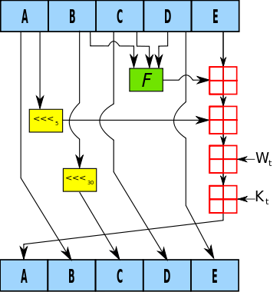
A single operation in SHA-1 (wikipedia)

Slide 28
Security of MD5 and SHA-1
If the compress function is collision resistant, then the iterated hash function is also collision resistant.
Security of MD5
  The Compress function in MD5 is known to have collisions.
  The 128-bit hash size is also insufficient.
Security of SHA-1
  SHA-1 was broken by a research team from Shandong University in 2005.
  Collisions in the full SHA-1 in 2⁶⁹ hash operations, much less than the brute-force attack of 2⁸⁰ operations.
SHA-2 (SHA-224, SHA-256, SHA-384, SHA-512)
SHA-3, originally known as Keccak which was the winner of the NIST hash function competition in 2012.

Slide 29
Weakness 1: length extensions
Consider a message m which is hashed to a value h(m).
Choose a new message that is m||pad(m)||m', where m' is an additional message.
Therefore, h(m) is the intermediate hash value in the hash of the new message.
Using h(m), m', and pad (m'), one can compute the new message's hash value.

Slide 30
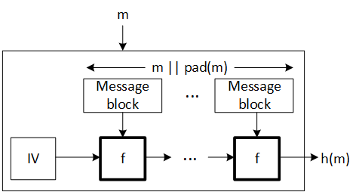
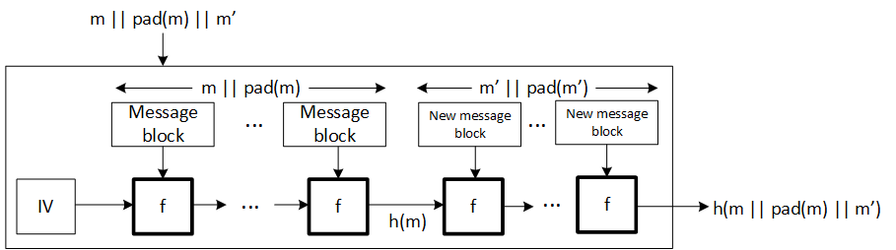
Weakness 1: length extensions (cont'd)

Slide 31
What is the problem?
The main problem is that there is no special processing at the end of the hash function computation.
Consider that Alice sends a message to Bob and wants to authenticate it by sending h(K||m), where K is a secret shared by Alice and Bob.
Now an attacker can append text to m, and update the hash value without knowing K.

Slide 32
Workshop on the extension attack
The attack
  Attacker has the knowledge of h(K||m||pad(m)) and m.
  Attacker will guess the length of the key K to compute pad(m).
  With the correct key length, attacker can append arbitrary data to K||m with its paddings and obtain the correct hash of the appended message.

Slide 33
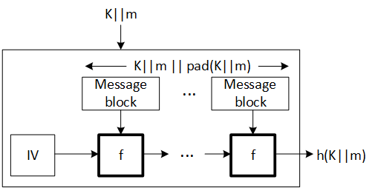
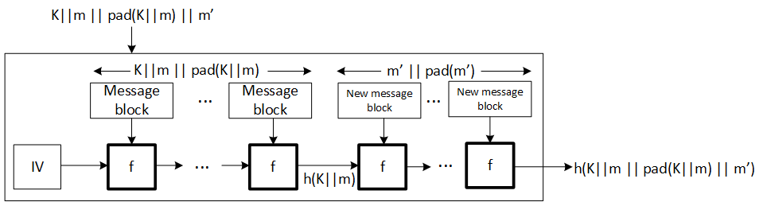
The workshop (cont'd)

Slide 34
Weakness 2: partial message collision
Assume that mutual authentication is based on h(m||K), where
  m is a random message and K is a secret key.
How does an attacker obtain a correct h(m||K) without knowing K?
First, the attacker has to find two strings m and m’ that lead to a collision when hashed by h(), i.e., the birthday attack.
After getting one side to authenticate m, i.e., receiving h(m||K), he can produce h(m’||K) for m’.
Since h() is computed iteratively,
  Once there is a collision (h(m) = h(m’)) and
  the rest of the hash inputs are the same (i.e., K),
  the hash value stays the same too (i.e., h(m||K) = h(m’||K)).

Slide 35
Message authentication codes

Slide 36
Message authentication codes
An MAC is a construction that prevents tampering (modify, replay) with messages.
  Encryption does not prevent an attacker from manipulating messages.
Like encryption, MACs use a secret key K known only to both Alice and Bob.
  Alice sends a message m to Bob with a MAC value MAC(K,m).
  Bob checks that the MAC value of the message is equal to MAC(K,m).

Slide 37
Security of MAC
Similar to hash functions, an ideal MAC(K,m) should be computationally indistinguishable from a random mapping.
An attack on MAC is successful if
  Given (m₁,MAC(K,m₁)), (m₂,MAC(K,m₂)), …, (m_{k},MAC(K,m_{k})),
  An attacker is able to find a message m (not m₁, m₂, …,m_{k}) together with its valid MAC(K,m).
The success of the attack does not necessarily require a full knowledge of K.

Slide 38
Generating the MAC
There are 2 main approaches to generating MACs.
  (CBC-MAC) Use of CBC and the MAC is the last block of the ciphertext.
  (HMAC) Use keyed hash functions.
The CBC-MAC is generally considered secure if the underlying cipher is secure.
  A number of different collision attacks that limit its security level.
  Avoid using the same key for encryption and authentication.

Slide 39
Keyed hash functions
Hash functions were not originally designed for message authentication.
Authentication of what?
  A message is sent from a certain source.
  A message has not been modified after being sent.
  A message is not an old message.
The main problem is how to encode a shared secret into a hash function.

Slide 40
A few possibilities
The secret-prefix method: MAC(K,m) = h(K||m).
  Subject to the length extension attack
The secret-suffix method: MAC(K,m) = h(m||K).
  Subject to the partial message collision attack
The secret-prefix-suffix method: MAC(K,m) = h(K||m||K).
  A 128-bit key can be recovered using 2⁶⁷ known text-MAC pairs.

Slide 41
HMAC
HMAC computes h(K ⊕ opad || h(K ⊕ ipad || m)).
  opad and ipad are specified constants, and they should have a large Hamming distance from each other.
  The message m is hashed only once and the output is hashed again with the key.
  HMAC uses hash function as a black-box.
  h() can be any of the iterative hash functions, such as MD5 and SHA-1.
The main idea is to “key” the initial states for a hash function.
HMAC was chosen as the mandatory-to-implement authentication transform for IPSec (RFC 2104).

Slide 42
Using MAC properly
What information should be authenticated?
  Or, what part of a packet should be included in MAC(K,m)?
The Horton Principle: Authenticate what is being meant, not what is being said.
  An MAC only authenticates a string of bytes (what is being said), but
  Not necessary the interpretation of the message (what is meant).

Slide 43
For example,
The authenticated message may include
  A “message ID” that prevents replay attack,
  The source and destination of the message,
  Protocol field, etc.
In another case, Alice may use MAC to authenticate m = a || b || c, where a, b, and c are some data fields.
  Additional (authenticated) information may be sent to Bob on how to interpret these data fields, in terms of their lengths, for example.

Slide 44
Summary
Examined the problems connected to the security of a cryptographic hash function.
The birthday attack is a major attack on hash functions.
All the practical hash functions, such as MD5 and SHA-1, are based on iterated hash functions which can be subject to
  Length extension attacks and
  partial message collision attacks
Message authentication is based on MAC computed on a message and a shared secret.
The MAC’s security can be compromised for some keyed hash functions.
Authenticate what is being meant, not what is being said.

Slide 45
Acknowledgments
The notes are prepared mostly based on
  D. Stinson, Cryptography: Theory and Practice, Chapman & Hall/CRC, Second Edition, 2002.
  N. Ferguson and B. Schneier, Practical Cryptography, Wiley, 2003.

