Slide 1
Java
Quality

Slide 2
Objectives
Understand how to verify the correctness of a program’s behavior.
Be able to write unit tests for program behavior
Understand how to use exceptions to deal with anomalous conditions
Be able to generate appropriate exceptions
Be able to handle exceptions generated
Be able to use the eclipse debugger

Slide 3
Testing
Testing is a much maligned, but critically important aspect of software development.
Principles:
Test all aspects of the application.
You can’t test every possible case.
Test rigorously.
Test early and test often.

Slide 4
Varieties of Testing
Functional testing
Levels of functional testing:
Unit testing
System testing
Non-functional testing
Usability testing
A common mistake people make when trying to design something completely foolproof is to underestimate the ingenuity of complete fools.
- Douglas Adams, Mostly Harmless, 1992
Notes:
Functional testing tests features of the code. Unit testing tests individual units (i.e., classes); system testing tests the system as a whole.
Nonfunctional testing tests other aspects of the application not related to features, e.g., user testing.
There are other levels/types that could be listed – we’ll focus on these in the course.

Slide 5
Unit Testing
Classes are the fundamental program unit.
Manually testing the functions in each unit can be both tedious and error-prone.

Slide 6
Example: IceCreamOrder Testing
package c10quality.icecream;
import java.util.Scanner;
public class IceCreamCommandLine {
public static void main(String[] args) {
System.out.print("Order (e.g. 3 Vanilla): ");
Scanner keyboard = new Scanner(System.in);
IceCreamOrder order =
new IceCreamOrder(keyboard.nextInt(),
keyboard.next(), false);
System.out.println("\t" + order);
System.out.print(”Add scoops (e.g. 2): ");
order.setScoops(order.getScoops() + keyboard.nextInt());
System.out.println("\t" + order + "\n" + "finis");
}
}
Notes:
This code manually tests the IceCreamOrder class/unit. It is very much like the Console built in iteration 0, except that now we program it to read the test cases from the user manually – Note that it doesn’t test the user interface (the view), only the computations (the model).
JUnit provides a mechanism to automate model tests like this.

Slide 7
JUnit
Provides an automated unit testing framework for Java applications.
Never in the field of software development was so much owed by so many to so few lines of code.
- Martin Fowler, www.junit.org
Notes:
JUnit has been criticized as a minor thing, something any reasonable programmer could produce in a weekend. This is true, but utterly misses the point. The reason JUnit is important, and deserves the Churchillian knock-off, is that the presence of this tiny tool has been essential to a fundamental shift for many programmers. A shift where testing has moved to a front and central part of programming. People have advocated it before, but JUnit made it happen more than anything else. (from http://martinfowler.com/books.html, 6nov2009)

Slide 8
Implementing JUnit Tests
JUnit test class pattern:
import org.junit.Test;
public class ClassTestName {
testMethods
}
Distinguish:
Model
View(s)
Notes:
Models and views:
The model is tool implementation. (no I/O here)
The view is the visible interface to the tool. (no computation here, but interface)
Advantages:
Better modularization.
You can create multiple views on the same model (e.g., a GUI driver and a command-line driver).
You can more easily Unit test the model (GUIs are harder to test).

Slide 9
Implementing JUnit Tests (cont.)
Test method pattern:
@Test
public void methodTestName() {
assertCommands
}
Assert commands signal unit test failures when their assertions are not satisfied.
Assert command patterns:
assertTrue(booleanExpression)
assertEquals(expr1, expr2, [delta])
fail(messageString)
Notes:
You can find a complete API reference for JUnit assert commands here: http://junit.org/apidocs/org/junit/Assert.html

Slide 10
package c09quality.icecream;
import static org.junit.Assert.assertEquals;
import static org.junit.Assert.assertTrue;
import static org.junit.Assert.fail;
import org.junit.Test;
public class IceCreamOrderTest {
@Test
public void doNothingTest(){
}
}
Notes:
Run these in eclipse. Show blank, effect of not annotating.
A test passes unless given a reason not to.

Slide 11
package c09quality.icecream;
import static org.junit.Assert.assertEquals;
import static org.junit.Assert.assertTrue;
import static org.junit.Assert.fail;
import org.junit.Test;
public class IceCreamOrderTest {
private static final double DOUBLE_EPSILON = 1e-3;
@Test
public void doNothingInterestingTest(){
assertTrue(true);
assertEquals(1, 1);
}
@Test
public void oneWaytoFailTest(){
assertEquals(7.0, 8.3, DOUBLE_EPSILON);
}
}

Slide 12
package c09quality.icecream;
import static org.junit.Assert.assertEquals;
import static org.junit.Assert.assertTrue;
import static org.junit.Assert.fail;
import org.junit.Test;
public class IceCreamOrderTest {
@Test
public void defaultConstructorTest(){
IceCreamOrder order = new IceCreamOrder();
assertEquals(1, order.getScoops());
assertTrue(order.getFlavor().equals("Vanilla"));
//equivalently...
assertEquals(order.getFlavor(), "Vanilla");
}
}

Slide 13
Practice, Practice, Practice...
Notes:
Worksheet

Slide 14
Adding Error Tolerance
We want to make our order class more robust, and indicate “unhappy scenarios” without stopping the program
What could go wrong?
Too few scoops
Null flavor
What if we added an interface where the user gets to enter the number of scoops?
“four”

Slide 15
Exception Handling
Classes may not know how to deal with certain types of problems appropriately.
Java provides exception handling to announce and to deal with such problems:
A class can throw an exception when a problem occurs.
A calling method can catch the exception and deal with the consequences appropriately.
Notes:
In the past we have simply printed an ugly message and stopped the program. This is inappropriately extreme in most cases. The division of labor should be as follows:
Because the class knows its own invariants, it should throw an exception when a problem occurs.
Because the controller (or other calling environment) knows the interface environment, it should deal with the exception appropriately.
The goal is to anticipate all potential problems and deal with them in an explicit way.

Slide 16
Implementing Exceptions
Throwing (or raising) exceptions:
throw new ExceptionType(message);
Catching exceptions:
try {
// method calls that might raise exceptions
} catch (ExceptionType identifier) {
// code to deal with the exceptions
}
Notes:
The catch clause includes an exception type/identifier pair, which is formatted like a parameter.

Slide 17
Example: Throwing Exceptions
public IceCreamOrder (int scoops, String flavor, boolean status)
throws Exception {
if(isValidScoops (scoops)){
myScoops = scoops;
}
else{
//System.err.println("Invalid number of scoops: " + scoops);
//System.exit(-1);
throw new Exception("Invalid number of scoops: " + scoops);
}
myFlavor = flavor;
myStatus = status;
}

Slide 18
Example: Throwing Exceptions
/**
* Set a new number of scoops for the order
* @param scoops non-negative scoops value
*/
public void setScoops(int scoops)
{
if (isValidScoops(scoops)){
myScoops = scoops;
}
else{
System.err.println("Could not change scoops to " + scoops);
System.exit(-1);
throw new Exception("Could not change scoops to " + scoops);
}
}
throws Exception

Slide 19
Dealing with the exceptions
public class IceCreamConsole {
public static void main(String[] args) {
try{
IceCreamOrder order1 = new
IceCreamOrder(3, "Cookie Dough", false);
System.out.println(order1);
order1.setScoops(2);
order1.setStatus(true);
System.out.println(order1);
}
catch (Exception e){
System.out.println(e.getMessage());
}
}
}

Slide 20
Exception Hierarchy
Java exceptions are arranged in a class hierarchy.
…
…
…
Notes:
Show how the containment hierarchy is useful for catching either specific or more general exceptions. Note that this is a UML diagram that uses block arrows for inheritance.
You can always catch an Exception, knowing that it will handle all its children.

Slide 21
Multiple Catch Blocks
Using multiple catch blocks:
try {
// method calls that might raise multiple
// types of exceptions...
} catch (ExceptionType1 identifier) {
// code to deal with exceptions of type 1...
} catch (ExceptionType2 identifier) {
// code to deal with exceptions of type 2...
} // and so forth...
Notes:
In this case, it is important to order the catch blocks in order of non-decreasing generality of their exception type (e.g., put IllegalArgument exception after NumberFormatException).

Slide 22
Catching Multiple Exceptions
import java.util.InputMismatchException;
...
...
Scanner keyboard = new Scanner(System.in);
try {
int scoops = keyboard.nextInt();
keyboard.nextLine(); // get rid of newline
String flavor = keyboard.next();
IceCreamOrder customerOrder = new IceCreamOrder(scoops,
flavor,
false);
System.out.println(customerOrder);
}
catch (InputMismatchException e) {
System.out.println(”Illegal number format”);
}
catch (Exception e) {
System.out.println(e.getMessage());
}
Notes:
Which lines could generate which kinds of exceptions?

Slide 23
Catch-or-Specify Requirement
Code that might throw an exception must be enclosed in either:
A try-catch block;
A method that specifies a throws clause.
Runtime exceptions are not subject to this requirement.
Notes:
Use the try-catch if your method should deal with the exception; use the throws clause if your code should “pass the buck” on out to the calling program.
Using unchecked exceptions is controversial; we’ll stick with checked exceptions (i.e., non-runtime exceptions) for illustrative purposes.

Slide 24
Testing Thrown Exceptions
Exceptions can (and should) be tested.
Pattern:
try {
someMethod(badArguments);
fail(message);
} catch (ExceptionType e) {
// We should catch an exception so
// do nothing here.
}
Notes:
Note:
The bad arguments here should lead to the raising of an exception.
If we don’t get thrown to the catch expression, we should fail() the test.
We can just leave the catch expression empty because getting there means that everything worked properly.

Slide 25
@Test
public void badOrderTest (){
try {
new IceCreamOrder(-2, “Vanilla”, false);
fail("inappropriately constructed a "
+ scoops + ” scoop(s) of " + flavor
+ " Order");
} catch (Exception e) {
// It should throw this exception!
}
}
Notes:
Discuss the alternative where an exception is thrown, and shouldn’t be. (I.e. have students write goodOrderTest.
Where does the fail expression appear in that case?
Now, show the construction utilities in eclispe to save some work.
Exercise: write good and bad setScoops tests.

Slide 26
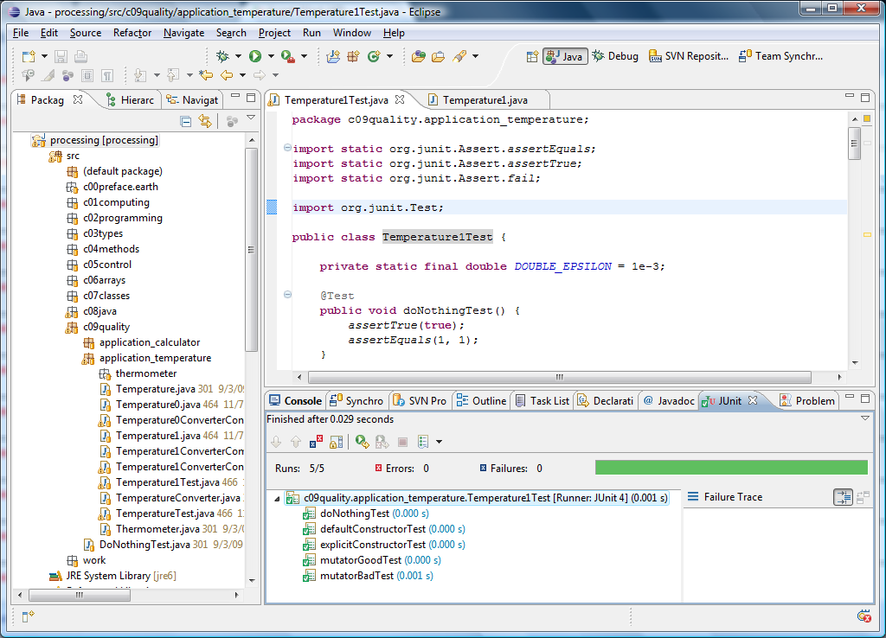
Running the Tests

Slide 27
Testing vs. Debugging
Testing is the process of finding faults.
Debugging is the process of fixing faults, commonly done using:
Execution by hand;
Normal execution with trace statements;
Step-by-step execution with a debugger.
Notes:
We’ll assume here that the program compiles.
Here’s JDFrens’ list of debugging techniques:
Exceptions use the data that they give to you. (using trace statements)
Output statements -- crude, but can be effective. (using trace statements)
Use a debugger to watch your program as it executes. (using the debugger)
Spaniel method -- explain the program to your pet. (using contemplation)
Take a shower -- 5% of all bugs are fixed this way. (using contemplation)
Demo something in eclipse

Slide 28
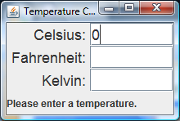
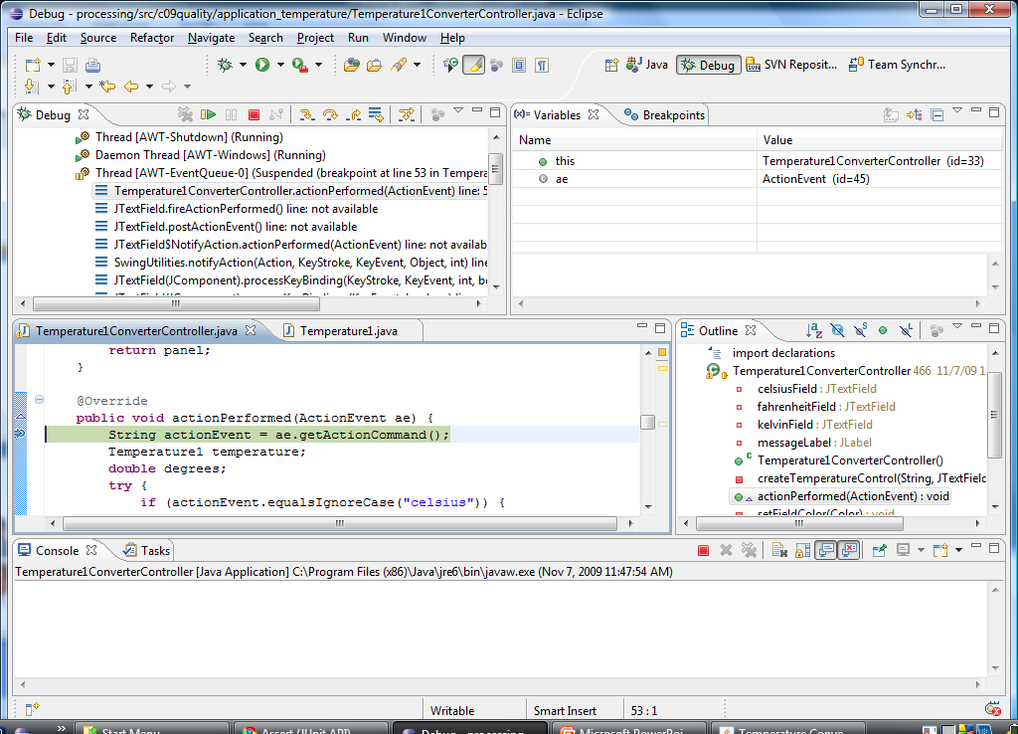
Using the Eclipse Debugger
Notes:
Do some demo of the debugger, perhaps on the if-then-else statements found in calculator lab exercise, or Fraction lab.

