Slide 1
Java
Control Structures: Repetition

Slide 2
Objectives
Be able to use a loop to implement a repetitive algorithm
Practice, Practice, Practice...
Reinforce the use of boolean expressions
Reinforce the use of Scanner for user input
Reinforce the declaration and use of methods

Slide 3
Control Structures
Control structures specify the ordering of the operations in the algorithm.
There are three basic control structures:
Sequence
Selection
Repetition

Slide 4
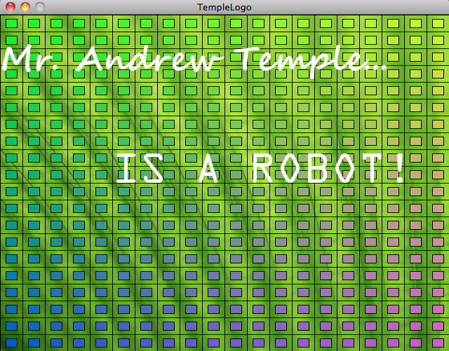
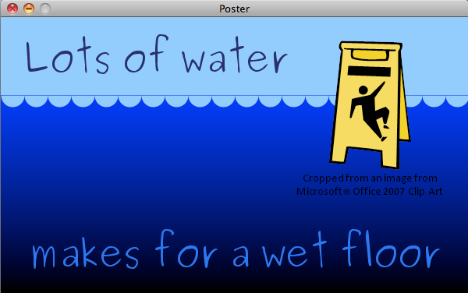
Repetition
Motivation: Do something (anything!) 10000 times!
Notes:
You certainly don’t want to manually enter the 10000 calls to the point method.
Credits: Andrew Temple, Daniel Harold

Slide 5
Repetitive Execution
Repetition statements execute their statements repeatedly, often based on a boolean condition
A while loop executes a statement based on a boolean condition.
False
condition
while (condition){
statement
}
True
Statement
Notes:
Start simple, where condition is always true.

Slide 6
Very Welcoming Program
/**
* Welcome repeatedly greets the user.
*
* @author snelesen
* @version Fall 2011
*/
import java.util.Scanner;
public class Welcome {
public static void main(String[] args) {
Scanner keyboard = new Scanner(System.in);
System.out.print(“Please enter your name: “);
String name = keyboard.next();
while( true ){
System.out.println(“Welcome “ + name + “!”);
}
}
}
Notes:
Use Ctrl-C to stop an infinite loop.
Point out scope of name variable.

Slide 7
Sentinel-based input processing
In an otherwise infinite loop, use break to exit:
return will also cause loop execution to stop
while( true ){
statements
if (condition){
break;
}
}

Slide 8
Personalized Welcome Program
/**
* Welcome greets each user until they quit
*/
import java.util.Scanner;
public class Welcome {
public static void main(String[] args) {
Scanner keyboard = new Scanner(System.in);
while( true ){
System.out.print(“Please enter your name (type “quit” to exit: “);
String name = keyboard.next();
if (name.equals(“quit”){
break;
} else {
System.out.println(“Welcome “ + name + “!”);
}
}
}
}
Notes:
Contrast scope of name variable

Slide 9
Exercise
Write a program that asks the user to input an unknown number of natural numbers, and computes their sum. Use a sentinel-based loop so that the user can enter -1 when they have entered all of their input.
Input: natural numbers or -1
Output: display the sum of the numbers entered
Algorithm:
Repeat:
Ask user for input.
Check if input is -1
If input is -1, get out of loop
If input is not -1, add input to accumulator
Output accumulator.

Slide 10
Compute Sum
...// documentation, class declaration, etc.
public static void main(String[] args) {
Scanner keyboard = new Scanner(System.in);
int sum = 0;
while( true ){
System.out.print(“Please enter a number (type “-1” to finish: “);
int currentNumber= keyboard.nextInt();
if (currentNumber == -1){
break;
} else {
sum = sum + currentNumber;
}
}
System.out.println(sum);
}
} // matches class declaration
Notes:
Contrast scope of sumvariable

Slide 11
while: Example
System.out.print("Guess a number from 1-10: ");
int number = -1;
while (number != 7) {
number = keyboard.nextInt();
}
System.out.println("You guessed it!");
Notes:
We’ve had our break statements out in the middle, but many times we can check at the top.
See WhileConsole#guessWhile().

Slide 12
Example: Guess a random number
... // documentation, import statement, class statement
public static void main(String[] args) {
Scanner keyboard = new Scanner(System.in);
// generate a random number between 0 and 100
int answer = (int)(Math.random() * 101);
// The main guess loop
int guess = -1;
while( guess != answer ){
System.out.print(“Please enter your guess: “);
guess = keyboard.nextInt();
if (guess > answer){
System.out.println(“Try lower”);
} else if (guess < answer){
System.out.println(“Try higher”);
}
}
System.out.println(“You got it!”);
}
Notes:
Note: initialized guess to something that will never match answer.

Slide 13
Example: Euclid’s Algorithm
Given: Two positive natural numbers a & b, a >= b
Return: Greatest common divisor
Set remainder = the remainder of a divided by b
Repeat these steps as long as remainder is not 0
Set a = b and b = remainder
Set remainder = the remainder of a divided by b
Go on to the next repetition
Return b

Slide 14
Greatest Common Divisor
int gcd (int a, int b){
int remainder = a % b;
while( remainder != 0 ){
a = b;
b = remainder;
remainder = a % b;
}
return b;
}

Slide 15
Common Forms
int counter = 0;
while( counter < 10 ){
System.out.print(“Welcome!“);
counter = counter + 1;
}
int sum = 0, counter = 1;
while( counter <= 10 ){
sum = sum + counter;
counter = counter + 1;
}
Notes:
Very common forms: initialization, and update. Use of accumulator.

Slide 16
Repetitive Execution
for statement:
Forever loop provides no details:
for([initExpr] ; [condition] ; [incrementExpr]){
statements
}
optional detail
optional detail
optional detail
for( ; ; ){
statements
}
Notes:
Forever loop written as while (true) {}

Slide 17
General form of for
optional detail
for( [initExpr] ; [condition] ; [incrementExpr]){
statements
}
optional detail
InitExpr
F
LoopCond
T
Statement
IncrExpr
Notes:
Not required, but many times initExpr declares and initializes a new variable, which meets the condition criteria the first time through the loop, and is updated
each time through via the increment expression.
Statement will be executed so long as LoopCondition is true.
Statement is often called the body of the loop.
Each execution of LoopCondition, Statement, IncrementExpr is called one repetition or iteration of the loop.
When LoopCondition becomes false, control proceeds to the next statement.
If the LoopCondition is initially false, then the body of the loop will not be executed.

Slide 18
for loops
int counter = 0;
while( counter < 10 ){
System.out.print(“Welcome!“);
counter = counter + 1;
}
for (int counter = 0 ; counter < 10 ; counter++){
System.out.print(“Welcome!“);
}
int sum = 0, counter = 1;
while( counter < 10 ){
sum = sum + counter;
counter = counter + 1;
}
int sum = 0;
for ( int counter = 1; counter < 10 ; counter++){
sum = sum + counter;
}
Notes:
Very common forms: initialization, and update. Use of accumulator.

Slide 19
Exercise: Conversion Table
Write a method that displays the following table:
Miles | Kilometers
1 | 1.609
2 | 3.218
...
9 | 14.481
10 | 16.090

Slide 20
Exercise
Write a program that displays all the numbers from 100 to 200, ten per line, that are divisible by 5 or 6, but not both.

Slide 21
Repetition: Nested for Loops
Loops can be nested as well.
InitExpr₁
F
for (initExpr₁; loopCond₁; incrExpr₁)
for (initExpr₂; loopCond₂; incrExpr₂)
Statement
LoopCond₁
T
InitExpr₂
F
LoopCond₂
T
Statement
IncrExpr₂
IncrExpr₁

Slide 22
Example: Triangle of stars
for( int row = 0; row < 10; row++){
for (int column = 0; column < row; column++){
System.out.print(“*”);
}
System.out.print(“\n”);
}
Notes:
Note that the condition for j is indexed off i

