Slide 1
Processing
Animation

Slide 2
Objectives
Be able to create Processing animations
Be able to create interactive Processing programs

Slide 3
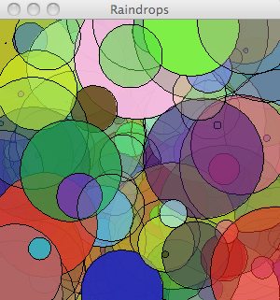
Example: Raindrops
We’d like to make an animation where differently sized and differently colored circles appear throughout the output window
Tools we already have:
Color
Ellipse

Slide 4
Defining Animation Methods
Animation is an illusion created by presenting carefully designed image frames at a sufficient frame rate.
For our first iteration, we’d like to draw circles appearing on the screen. For this, we need to:
Set up for the animation;
Draw each frame of the animation.
Notes:
Think flip book!

Slide 5
Methods
In Processing, programmers add new operations by defining methods.
Using methods helps us to:
Modularize the program;
Create helpful procedural abstractions;
Improve readability;
Encourage reuse.
To build new methods, we’ll use the same IID approach we’ve used before.
Notes:
Most of the “interesting” operations we would like to perform are not pre-defined.

Slide 6
Method Definition Pattern
returnType methodName([parameterDeclarations]){
statements
}
returnType is the type of value returned by the method or void if the method does not return a value;
methodName is the identifier that names the method;
parameterDeclarations is a comma-separated list of parameter declarations of the form type identifier that is omitted if there are no parameters;
statements is a set of statements that define the behavior of the method.
Notes:
Show a method that returns courseName (CS108)
Contrast with a void method that prints to the screen, but returns nothing.

Slide 7
Animation Methods
The programmer defines methods called setup() and draw()
void setup(){ ... }
void draw(){ ... }
Processing calls these methods automatically
setup() is run once when the program begins
draw() runs repeatedly (once each frame)

Slide 8
Start simple: One raindrop
void setup(){
size(300, 300);
background(255);
ellipse(150, 150, 30, 30);
}
But how will we make the circle change location?
Notes:
Each program we’ve written thus far could be contained within setup. All code was run once.

Slide 9
Start simple: One raindrop
void setup(){
size(300, 300);
background(255);
}
void draw(){
ellipse(150, 150, 30, 30);
}
Draws the ellipse over and over again, once each frame, exactly the same each time
Notes:
So how will we make it change??

Slide 10
Moving Raindrops
void setup(){
size(300, 300);
background(255);
}
void draw(){
float x = random(300);
float y = random(300);
ellipse(x, y, 30, 30);
}

Slide 11
How would you add color variation?
void setup(){
size(300, 300);
background(255);
}
void draw(){
float x = random(300);
float y = random(300);
ellipse(x, y, 30, 30);
}
Notes:
What happens if we move background to draw?

Slide 12
Defining Interaction Methods
Processing supports user interaction using a set of pre-declared methods that respond to user-initiated events.
User events include mouse and keyboard actions.

Slide 13
Interaction Using Mouse
Methods
mouseClicked()
mouseDragged()
mouseMoved()
mousePressed()
mouseReleased()
Variables
mouseX, mouseY, pMouseX, pMouseY
mouseButton (LEFT, RIGHT, CENTER)
mousePressed (boolean value)

Slide 14
Pause animation while mouse is pressed
void setup(){
size(300, 300);
background(255);
}
void draw(){
fill(random(255), random(255), random(255));
ellipse(random(300), random(300), 30, 30);
}
void mousePressed(){
noLoop();
}
void mouseReleased(){
loop();
}

Slide 15
Interaction Using Keyboard
Methods
keyPressed()
keyReleased()
keyTyped()
Variables
key, keycode (which key was used)
keyPressed (boolean value)

Slide 16
Clear Background
void keyPressed() {
background(255);
}

Slide 17
Exercise: Add differently sized circles
void setup(){
size(300, 300);
background(255);
}
void draw(){
fill(random(255), random(255), random(255));
ellipse(random(300), random(300), 30, 30);
}
Notes:
Start Wednesday, introduce variable for width/height.

Slide 18
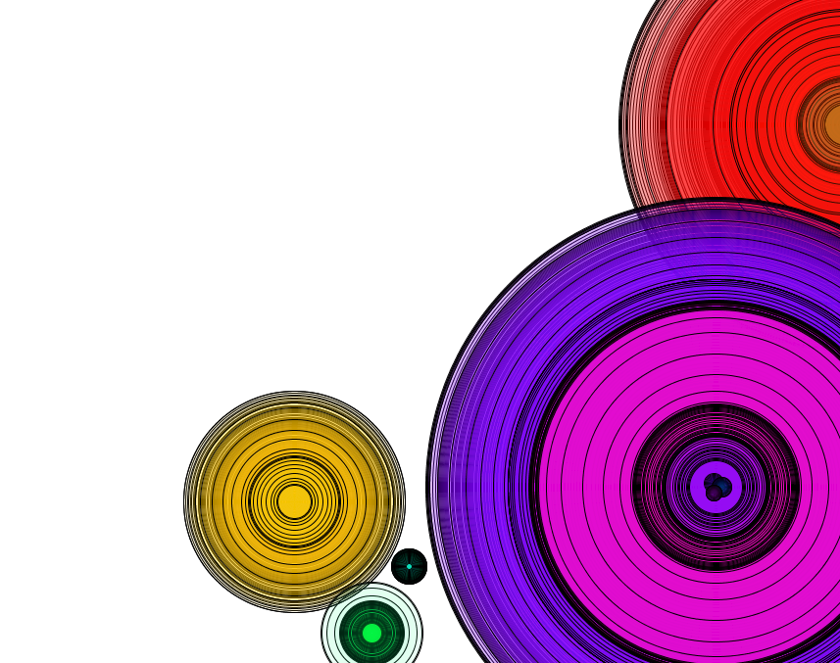
Example: Expanding Circles
We’d like to build an interactive tool for drawing animated figures.
The figures should include circles that grow/shrink.
Some sample images are shown here.
Notes:
This is our Analysis!

Slide 19
Start simple
void setup(){
size(300, 300);
background(255);
}
void draw(){
ellipse(150, 150, 30, 30);
}
But how will we make the circle change size?

Slide 20
Start simple, then add complexity
void setup(){
size(300, 300);
background(255);
}
void draw(){
int diameter = 30;
ellipse(150, 150, diameter, diameter);
diameter = diameter + 2;
}
Resets diameter each frame!!
Notes:
Will this cause the circle to get bigger each time draw is calling by Processing??

Slide 21
Start simple, then add complexity
int diameter; // global variable!
void setup(){
size(300, 300);
background(255);
diameter = 30;
}
void draw(){
ellipse(150, 150, diameter, diameter);
diameter = diameter + 2;
}

Slide 22
Variable Scope
Local Variables
Defined within another block.
Not visible throughout the program.
Global Variables
Defined at the start of the program.
Visible throughout the program since they are defined in the outermost block (they are not surrounded by any curly braces).

Slide 23
Global Variables and Animation
Declare global variables at the top of your program (before setup)
Initialize any global variables in setup()
Use global variables throughout the rest of your program as needed for animation

Slide 24
final int WIDTH = 510, HEIGHT = WIDTH;
float diameter;
void setup() {
size(WIDTH, HEIGHT);
diameter = 0;
}
void draw() {
background(255);
float x = WIDTH/2, y = HEIGHT/2;
ellipse(x, y, diameter, diameter);
diameter += 2;
}
Notes:
Talk about identifiers and scope. (Helpful analogy? It’s sort of like rooms with mirrored glass – you can see out but not in.) Note the following things:
We make the global variables global so that they can be used in both setup() and draw(). Declaring them local to either (or both) of the methods won’t work because the value can’t then be shared. In this situation, we must separate the declaration of the variable from its initialization and use;
We could have another variable named x in setup() if we wanted to, but it would be a different variable.
Creating a new variable with the same name “hides” the external variable (use println for an example)

Slide 25
Change Position of Animated Circle
void mousePressed() {
figureX = mouseX;
figureY = mouseY;
diameter = 0;
}
Notes:
Better demo this to see the animation.
Mess with the code some:
Add noFill() and smooth() to create the color gradient.
Try running it without incrementing the diameter (or setting the diameter to a fixed value).
Try misspelling either setup() or draw().
Mention mouseClicked(), mouseMoved(), mouseDragged(), mouseReleased() as well (see Processing reference).
Mention mouseX, mouseY, pmouseX, and pmouseY as Processing-maintained variables.
If there is time, show them the dragging ball from the text.

Slide 26
Animation Algorithms
Break problem into groups:
What will need to be remembered from one frame to the next
Create a global variable for each piece
What should happen before the animation begins?
Put these steps in setup()
What should happen each frame?
Put these steps in draw()
What should happen based on interaction?
Put these steps in the appropriate method (mousePressed(), keyPressed(), etc)

Slide 27
Exercise
Write an algorithm to animate a square that shakes in the middle of the screen
Global variables
setup()
draw()
Add the ability for the user to move the square to a new location based on a mouse click
mouseClicked()
Notes:
Add up/down movement as well.

