Slide 1
PROCESSING & Java
An Introduction to Computing

Slide 2
Objectives
Be able to state and apply phases of development
Be able to state and describe the goals of software engineering
Be able to write valid Processing statements and documentation
Be able to call a Processing method given an API

Slide 3
Iterative/Incremental Development
Analysis
Design
Testing
Implementation
Notes:
We’ll call this IID (Iterative/Incremental Development). Note that the “D” is not design here, it’s the whole development process.
However you orchestrate the phases, you should always follow one critical rule: “Think first, program later”.
“i*” = iterative/incremental
Analysis – Describe the elements of your current vision. (What?)
Design – Pick one (“important”) element and build an algorithm for it. (How?)
Implementation – Write code for your algorithm.
Testing – Try your code out and evaluation how well it does.

Slide 4
Preliminary Analysis
Always start by understanding and articulating the goals of the user experience you are trying to create.
This requires that you:
communicate with your stakeholders;
produce a written articulation of the goal of the project.
Notes:
Don’t jump to programming too soon!
Ask the hard questions: Is a system even possible or desirable? What would the solution look and act like? What does the customer really need/want?
Stakeholders: might be you, might be employer, etc.

Slide 5
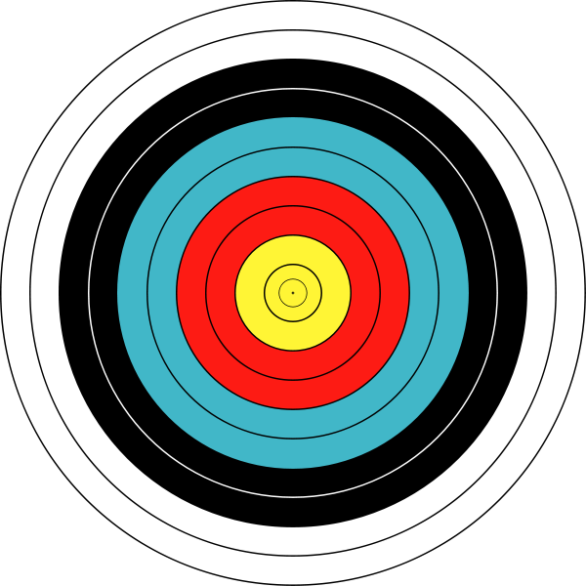
Example: Analysis
We’d like to draw an official FITA archery target for use as a graphical icon.
The icon should communicate a sense of shared purpose.
A sample image is shown here.
image from wikipedia.org
Notes:
This example is contrived, but useful. The sample image is a guess, not a specification, and we will likely have to change it during the course of development in order to achieve our goal.
This “target” image is taken from Wikipedia. It is an official FITA archery target (Fédération Internationale de Tir à l'Arc, International Archery Foundation).

Slide 6
Notes on Analysis
Analysis answers “what” questions
Good analysts know how to work with people and to think carefully about process.
Written/drawn analyses are a good way to communicate with stakeholders.
It’s often hard to anticipate everything here.
Notes:
“what” questions, not “how” questions – Don’t jump to programming too soon!
More complex problems require incremental iteration.

Slide 7
Preliminary Design
When you understand the goals of the user experience, you plan out a solution.
This requires that you:
Specify data structures and algorithms;
Identify the geometric elements of any sample images created during analysis.
Notes:
Start simple! In some ways, this speck of an example is the hardest one we’ll do all semester.
The design will be specified in terms of the relevant concepts listed here. The point is a geometrical/mathematical point, not the point() method in Processing. Geometrical points have no dimension; pixels have dimensions. Everything on the computer is discrete.
Not language specific.

Slide 8
Example: Design
The preliminary design creates an initial list of element descriptions.
Elements:
Ten evenly-spaced concentric rings with pairs colored white, black, cyan, red and yellow;
A dot in the very middle.
image from wikipedia.org
Notes:
Distinguish the key elements of the design by balancing the objects you see (and noun phrases you read) with the tools your language provides to you. At this point, you don’t know your tools very well, so I’ll walk through the example.
We’ll end up finding more graphical elements to add, but this is a reasonable vision/detailed description to start with. Get used to this state of affairs – Software engineers/arts rarely understand the whole problem when they start; they just need a compelling, unifying vision and a few detailed elements to start with.
How will we draw the target? Break up problem. Start with just a point on a well sized screen.

Slide 9
Algorithm
Specify your design using an algorithm.
Think about what you want your algorithm to do so that you can test its output.
Iteration 1 Algorithm:
Create a canvas 550x550 pixels.
Draw a single pixel at (275, 275).
Intended output: a large sketch with a dot at the very center.
Notes:
Remember, we’re starting simple!
Note that the algorithm isn’t written in Processing code; it’s written in a more general way that could be implemented using other languages (that provide graphical output capabilities).

Slide 10
Notes on Design
Design your data structures and algorithms before implementing them.
Write them in as language-independent a way as possible.
Be clear about the assumptions you make.
Prioritize the elements of your design.
Notes:
Ask students: What assumptions have we made? Ans: square canvas, unspecified colors (for now), 550x550 size (for now).
This will be more helpful advice when the systems start to get a bit more complicated and you are building your own classes.
When the algorithm is done, you can move to the coding. If you are not sure about your algorithm, do not go to the lab, do not log in, do not type anything. Get the algorithm right first, then move to implementation. You will save lots of debugging time this way!
Don Knuth once won a late-60’s SF Bay-area programming contest by turning in a solution that was the fastest and the most quickly produced. And he developed it on the worst system available with a crummy batch architecture. He attributed his success to the fact that he learned to program in the days when computer time was scarce and valuable - you got the design right before wasting your time on-line. (at least this is the way that Alan Kay tells the story).

Slide 11
Implementation
When you have a design, you can implement your first prototype as a Processing program.
You don’t need to implement everything at once; start with the highest priority element of your design.

Slide 12
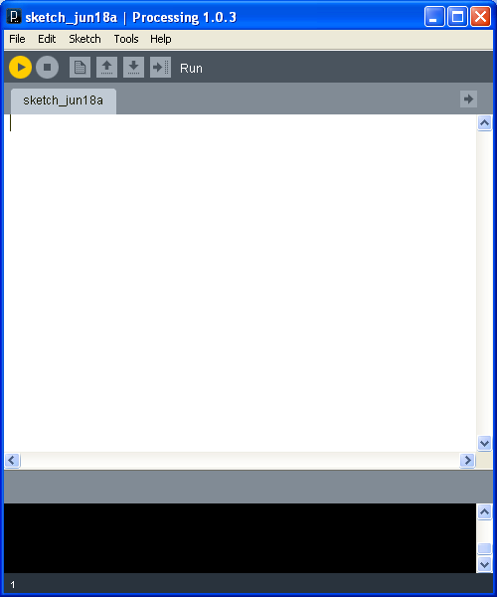
Processing IDE
Notes:
We’ll use Processing, a good language to use for graphical animations, in the next example
Go through a “nothing” example in the Processing IDE.
Notes:
Describe the elements of the IDE (control panel/run button and the program editor/text output/visual output panes).
Run a “nothing” program/sketch.
The key point here is the use of code to produce/characterize output. Programming is not WYSIWYG. You might ask the students why anyone would bother with this code-sketch cycle when WYSIWYG is so much simpler to understand.

Slide 13
Example: Implementation
The highest priority elements of the design are the background and the “dot” in the center.
Relevant implementation tools:
The canvas;
Pixels;
Documentation;
Built in processing methods (size(), point()).
Notes:
We’ve already seen the canvas in our blank program (which produced a blank canvas)

Slide 14
Geometric Coordinate Systems
Notes:
This is the mathematical coordinate plane. In this world, points are infinitely small and lines are infinitely long.
Most computer systems view the output canvas as the bounded area on the bottom right of the traditional x-y grid.

Slide 15
Pixels and Coordinates
size(150, 100);
point(100, 50);
image from text chapter 2
Notes:
Discuss the nature of the canvas, pixels and coordinates. Use the size() and point() methods to create canvases and pixels using pixel-based sizes and coordinates, but focus on design concepts, not the implemented code. We use code here only to give them some idea of the level of abstraction at which algorithms must be written and to make the concepts concrete.
Run several demo sketches with different sized canvases (default size, small, large, non-square) and pixels at different locations (e.g., (0, 0), (50, 50), (100, 100)!). Use Gimp to zoom into the bit-mapped output, if appropriate).

Slide 16
Statements
Processing programs are implemented using sets of ordered statements.
Statement Pattern:
statement;
where statement is a method call, assignment or block.
Notes:
Give examples of this pattern and explain that italic/underlined text is replaced by real program code (e.g., statement changes, but the semi-colon must always be there).
We’ll mostly use method calls now.

Slide 17
Calling Methods
Many of Processing’s tools are implemented as methods that must be invoked or called.
Method Call Pattern:
methodName (argumentList)
where:
methodName is the pre-defined identifier of
the method being called;
argumentList is an ordered, comma-
separated list of argument expressions.
Notes:
Give examples of this pattern and explain that italic/underlined text is replaced by real program code (e.g., methodName is replaced, the parens aren’t).

Slide 18
Documentation
Documentation explains the code using text ignored by the compiler
Documentation Pattern:
/*
* Multi-line comments
*/
or
// Single-line comment
Notes:
For multi-line comments, Processing ignores the text between the /* and the */.
For single-line comments, Processing ignores the rest of the text on the line after the //.

Slide 19
/**
* Target1 produces the dot at the middle of the FITA archery target.
* (cf. http://en.wikipedia.org/wiki/File:Archery_Target_80cm.svg)
* This routine assumes that 550x550 square canvas.
*
* @author kvlinden, snelesen
* @version Fall, 2012
*/
size(550, 550);
// Draw the center point of the target.
point(275, 275);
Notes:
Do NOT run program yet!
Note:
The Java/Processing compiler pretty much ignores whitespace (spaces, line feeds, and carriage returns) except for its role as a token separator.
The semi-colon ends a line (not a carriage return).
The documentation is larger than the code. It documents the things that aren’t obvious from the code itself, e.g., we say “center point” – important - rather than “point at the center of the canvas” – obvious. This example used the standard documentation format used in the text and that we expect the students to use in the course; eventually, we’ll explain that this is JavaDoc format. The author line should include all code authors (e.g., kvlinden, jnyhoff, nyhl, snelesen) and the version line should identify the assignment, semester and year.
The 2 steps of the algorithm are written as two lines of code.
Run the program AFTER discussion of testing - It produces a dot as we expected, but it’s hard to see

Slide 20
Notes on Implementation
In this phase, focus on faithfully translating the data structures & algorithm into working code.
Notes:
This is the sort of work that is often “outsourced”. If you don’t want your job to be outsourced, develop your abilities in all the other areas of programming/computing.
If there is time, I’d show how to save/submit this prototype in the manner used for the labs and homeworks.

Slide 21
Testing
When you have a working prototype, you can compare its behavior with your original user experience goals.
Run the prototype; if appropriate, show it to your stakeholders.

Slide 22
Example: Testing
Notes:
Well, we just aren’t very far yet. Could introduce strokeWeight() here to make the center point more apparent.

Slide 23
Notes on Testing
This phase may motivate us to modify our design or even our analysis.
Getting the code to compile and run is not the goal. The goal is to produce a program that is:
Useful
Correct
Efficient
Understandable
User-friendly
Notes:
Usefulness is assessed by the stakeholders in each iteration. Analysis/Design/Implementation quality is characterized by:
Useful – Test this by checking in with the stakeholders on each iteration – We’re assuming that out vision is compelling to someone (perhaps a bit of a stretch with this simple example).
Correct – Test this by running the test cases (perhaps automated tests with non-interactive/graphical experiences) – This seems ok at this point.
Efficient – Test this by timing the test cases – Take my word that it ran quickly.
Understandable – Test this by looking through the code - We’ve looked at the code already.
User-friendly – Test this with usability studies – Only the users can really do this and at this point the program is probably too simple to be very interesting to them.
Hospitable

Slide 24
Tool Box
Ellipse
Smooth
Color
Text
Images
Notes:
Alternate between slides and Processing, using each tool to iteratively improve our target.

Slide 25
Drawing Ellipses
 | ellipse(50, 50, 65, 45);
Pattern: ellipse(xCenter, yCenter, width, height) xCenter – The x coordinate of the center of the ellipse yCenter – The y coordinate of the center of the ellipse width – The width of the ellipse’s bounding rectangle in pixels height – The height of the rectangle in pixels
image from text chapter 2
Notes:
Explain how to read documentation. Order of arguments matters! Demo a few more here. Show that circles are ellipses with equal width/height.

Slide 26
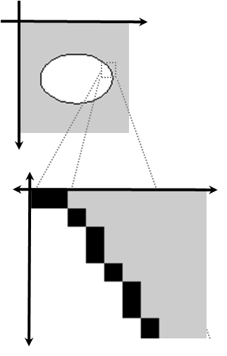
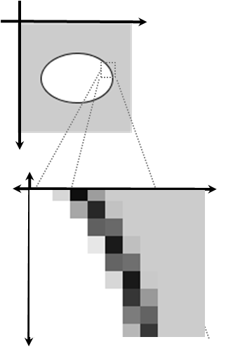
Smoothing
noSmooth(); ellipse(50, 50, 65, 45); | smooth(); ellipse(50, 50, 65, 45);
image from text chapter 2
Notes:
Here is an implementation detail related to smoothing.

Slide 27
Filling and Grayscale Color
size(200, 200);
background(255);
smooth();
fill(50);
ellipse(100, 100, 150, 150);
fill(150);
ellipse(100, 100, 100, 100);
fill(250);
ellipse(100, 100, 50, 50);
image from text chapter 2

Slide 28
RGB Color
image from text chapter 2
Notes:
Explain RGB color and use it to add the cyan, red and yellow bands.

Slide 29
Typesetting and Text
 | textFont(loadFont("CurlzMT-40.vlw")); fill(33, 33, 111); text("potus", 10, 65);
Pattern: text(textString, xCoordinate, yCoordinate) textString – The text to be typeset using the font loaded with loadFont(fontFilename) assuming that fontFilename was created using Processing’s font tool and stored in the data sub-directory xCoordinate – The x coordinate of the lower-left corner of the text yCoordinate – The y coordinate of the lower-left corner of the image
image from text chapter 2

Slide 30
Bitmap Images
 | image(loadImage("potus-100x100.gif"), 0, 0);
Pattern: image(imageObject, xCoordinate, yCoordinate) imageObject – The image object to be rendered; this can be loaded with loadImage(imageFilename) assuming that imageFilename is stored in the data sub-directory xCoordinate – The x coordinate of the upper-left corner of the image yCoordinate – The y coordinate of the upper-left corner of the image
image from wikipedia

Slide 31
/**
* Target1 produces a FITA archery target.
* (cf. http://en.wikipedia.org/wiki/File:Archery_Target_80cm.svg)
* This routine assumes that 550x550 square canvas.
* @author kvlinden, snelesen
* @version Fall, 2012
*/
size(550, 550);
smooth();
fill(255);
ellipse(275, 275, 500, 500);
ellipse(275, 275, 450, 450);
fill(0);
ellipse(275, 275, 400, 400);
stroke(255);
ellipse(275, 275, 350, 350);
fill(0, 255, 255);
stroke(0);
ellipse(275, 275, 300, 300);
ellipse(275, 275, 250, 250);
fill(255, 0, 0);
ellipse(275, 275, 200, 200);
ellipse(275, 275, 150, 150);
fill(255, 255, 0);
ellipse(275, 275, 100, 100);
image(
loadImage("anImageFilename"),
250, 250);
fill(0);
textFont(loadFont("Calibri-40.vlw"));
text("The imageName dartboard", 25, 60);
textFont(loadFont("Calibri-Bold-40.vlw"));
text(" official", 25, 60);
Notes:
This code ends up delivering more than we had originally thought it would deliver.

